Slide 1


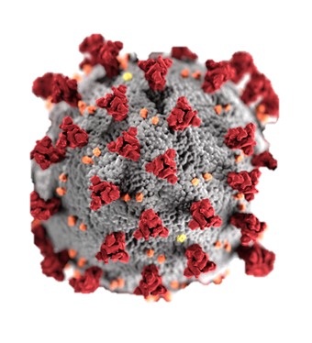
Markus Brunnermeier
Princeton University
2. Nov. 2021

Slide 2
Living in a World with Recurrent Shocks
Health: Pandemic – Covid-19
Antibiotic resistance
Financial Crises
Cyberattacks
Natural disaster … better building of infrastructure
Uncertainty with new technologies
+ Crises come typically in pairs/triplets ...
Resilience discussed everywhere
  robustness, risk avoidance, …, redundancies

Slide 3
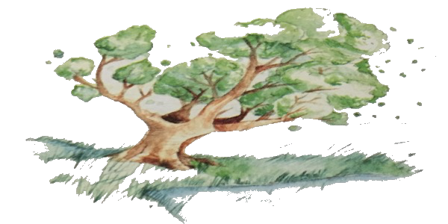
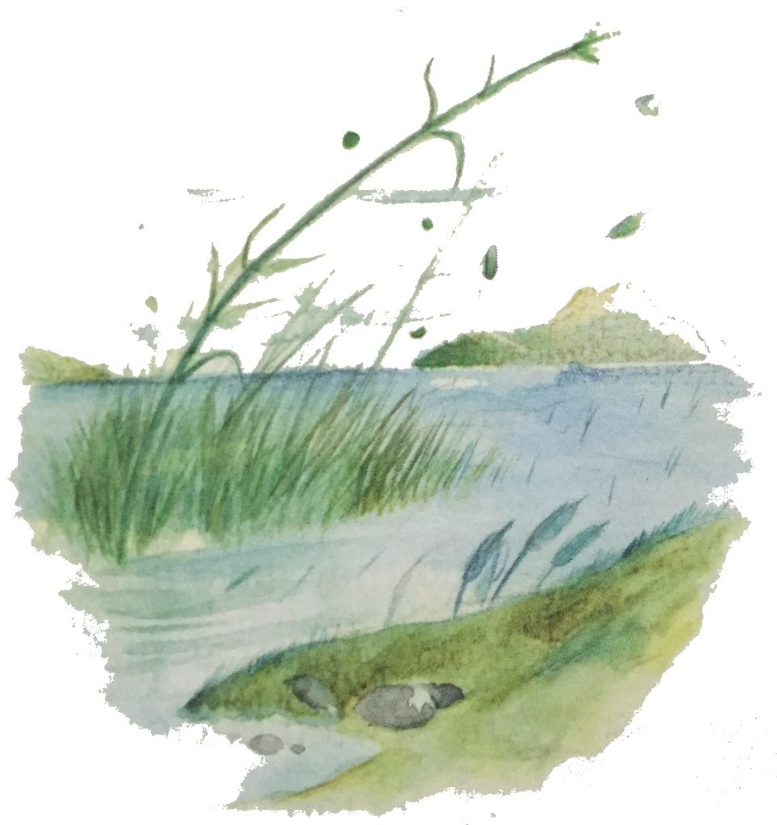
Robustness $≠$ Resilience
Robustness vs. Resilience
  withstand, fault tolerant Impact, but bounce back
    block most (known/unknow) shocks React to shocks
  the oak the reed
  Robustness barrier “I bend, a bow, but I do not break”
  La Fontaine
Volatility Paradox
  Learning to be resilient via small risk exposure (human immune system)
Redeployable
redundancies

Slide 4
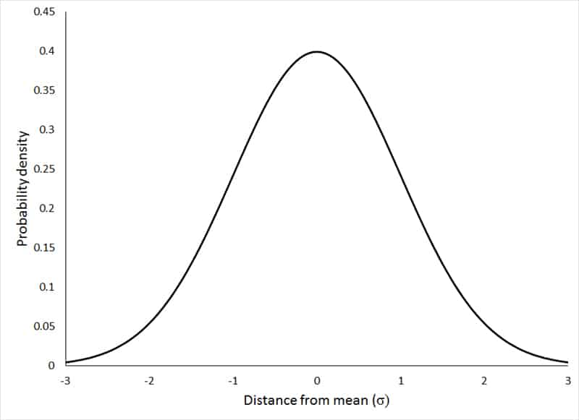

Risk avoidance $≠$ Resilience
Risk management - static
  Variance
Resilience management - dynamic
  Mean-reversion
  bounce “back” to new normal
Distributional impulse response (Fanchart)
roly-poly toy

Slide 5

Ability to Rebound Allows to take Risk $⇒$ Growth
Resilient path vs. risk avoidance path
Risky but resilient
Riskless
$$t$$

Slide 6
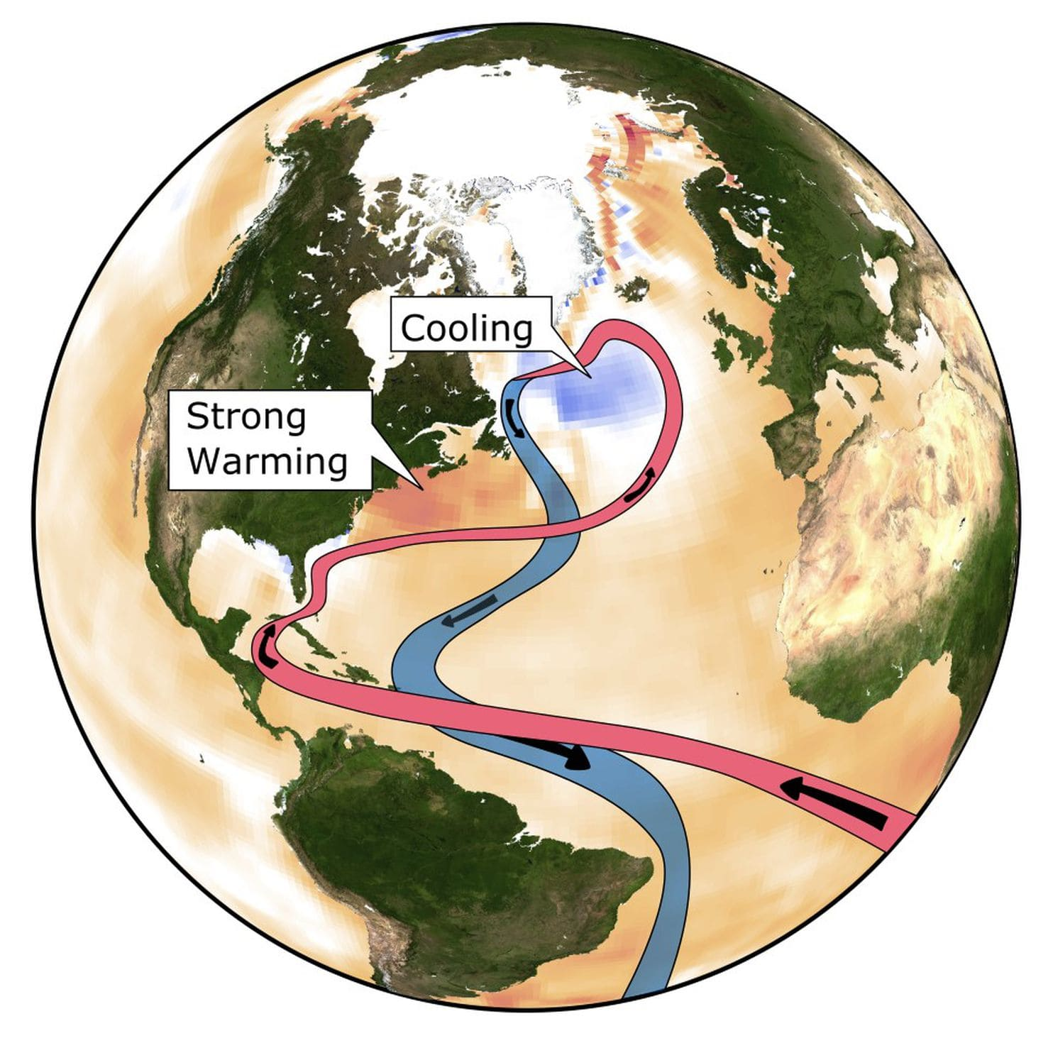

Resilience Destroyers
If externality of others’ behavior, difficult to avoid
Traps: “points of no return”
Feedbacks:
Tipping Points: path dependency
Tipping point
bifurcation
Feedback loops
Spirals
$$t$$
Climate change: Turning off the Gulf stream
6

Slide 7
Resilience, Risk, and Growth - Sustainability
Resilience +
No adverse trend
Risky but resilient
Riskless – adverse trend
$$t$$

Slide 8
Tipping Points: Resilient Sustainable Path
Seemingly riskless part with adverse trend
subject to catastrophe risk
  Resilience path is only hope
Risky but resilient
Not so riskless – adverse trend
Tipping point
Feedback loops
Spirals
$$t$$

Slide 9
The “Term Structure of Resilience”
Dynamic trade-off
  Bounce back more quickly in the short-run at the expense of
  Being more vulnerable to the next shock and to future
    Traps
    Feedback loops
    Tipping point (move closer)
Flexibility vs. better communication through commitment
  Build the right institutions

Slide 10
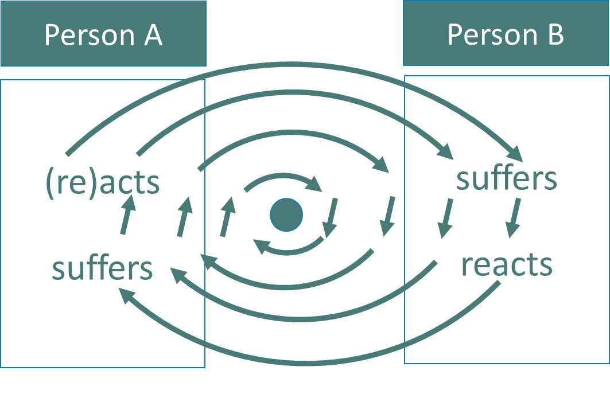
Resilience: Individual, System, Society
Individual: Training, human capital, freedom,
System: Redundancies (networks, global value chains)
Buffers (bank capital, …)
Society:
  Interaction btw individual’s externalities and responses
  Key: Endogenous reaction of others
  Social contract: social norms, laws, and market
“Feedback Externalities”

Slide 11
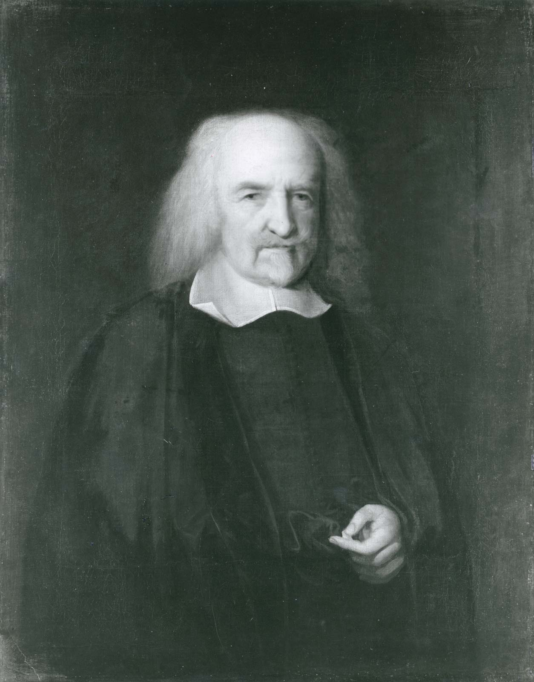
Social Contract
Thomas Hobbes, (Leviathan, 1651),
John Locke,
Jean-Jacques Rousseau
  An externality interpretation
Social contract to limit
  Externality from others
    Incl. trap, feedback externalities
    Robert Nozick
  Shocks (externalities from mother nature)
    John Rawls and the “veil of ignorance”
    Not insure, but provide resilience
    Diversity vs. homogeneity

Slide 12
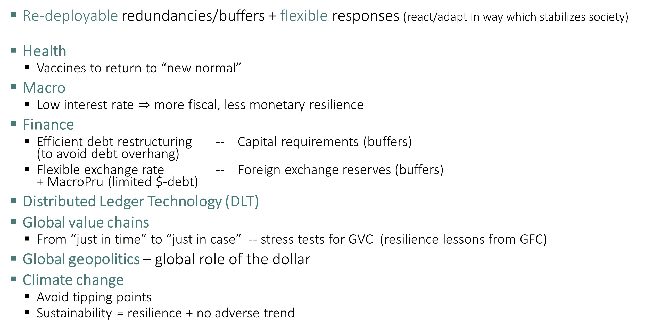
Resilience and Policy Implications
Re-deployable redundancies/buffers + flexible responses (react/adapt in way which stabilizes society)
Health
  Vaccines to return to “new normal”
Macro
  Low interest rate $⇒$ more fiscal, less monetary resilience
Finance
  Efficient debt restructuring -- Capital requirements (buffers)
  (to avoid debt overhang)
  Flexible exchange rate -- Foreign exchange reserves (buffers)
  + MacroPru (limited $-debt)
Distributed Ledger Technology (DLT)
Global value chains
  From “just in time” to “just in case” -- stress tests for GVC (resilience lessons from GFC)
Global geopolitics – global role of the dollar
Climate change
  Avoid tipping points
  Sustainability = resilience + no adverse trend

Slide 13
Outline of Book
Part I: Society and Resilience
Part II: 4 Elements of Resilience Management: COVID
Part III: Macro Resilience
  Innovation boost vs. Scarring
  Financial whipsaw
  Public Debt
  Inflation whipsaw
Part IV: Global Resilience
  EMDE
  Geopolitics, World order, Global finance, Value chains, Climate

Slide 14

Resilience and Debt
Equity
Debt
Tax revenue
“robust”/resistant until it breaks
through “Robustness barrier”
Equity

Slide 15
Japanese
Private Bank
Swiss
Private Bank
Bank of Japan
Swiss National Bank
US Federal Reserve
US Dollar
European
Central
Bank
US Dollar
Private
European Bank
Euro
Collateral
Bank of
Canada
Swap line
Network
Bank of
England
Canadian
Private Bank
British
Private Bank

Slide 16
GloSBies
A
L
Pool of Sovereign Bonds
Senior
Bond
Pooling
Tranching
Junior
Bond

Slide 18
“Financial Markets Whipsaw”
Robustness Equity capital = buffer/redundancies
Resilience: Efficient Debt Restructuring
Lender of last resort by central banks

Slide 19
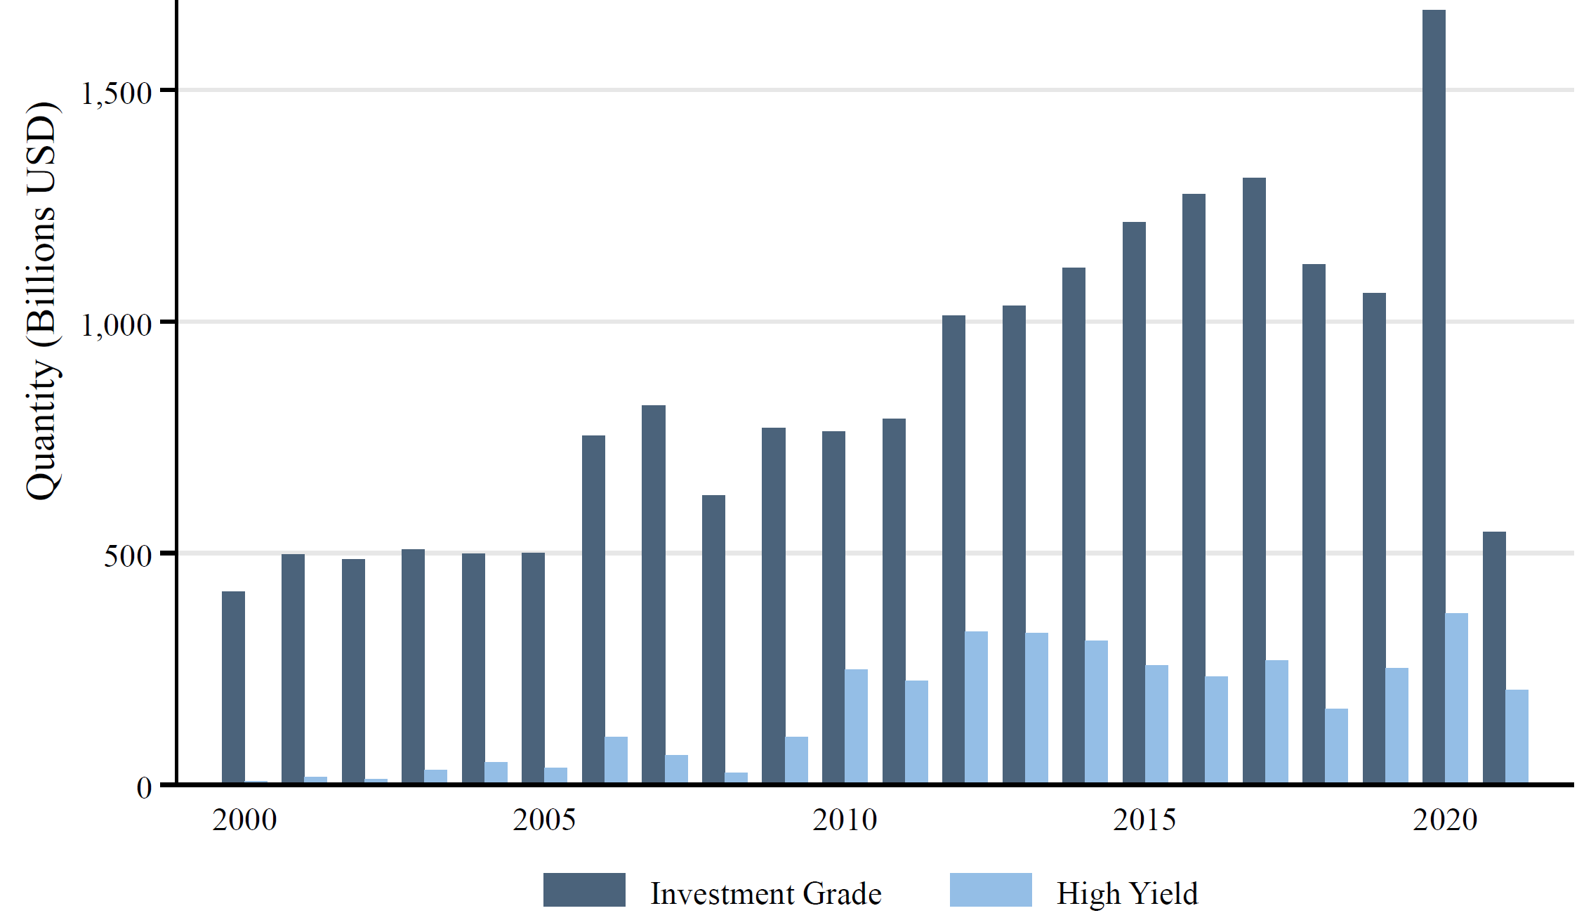
“Financial Markets Whipsaw”: Stocks and Corporate Bonds
March 2020 shivers followed by strong recovery
  Stock market record heights – IPOs like during NASDAQ bubble
  Corporate bond market CB: Tail risk removal
Record corporate
bond issuance

Slide 20
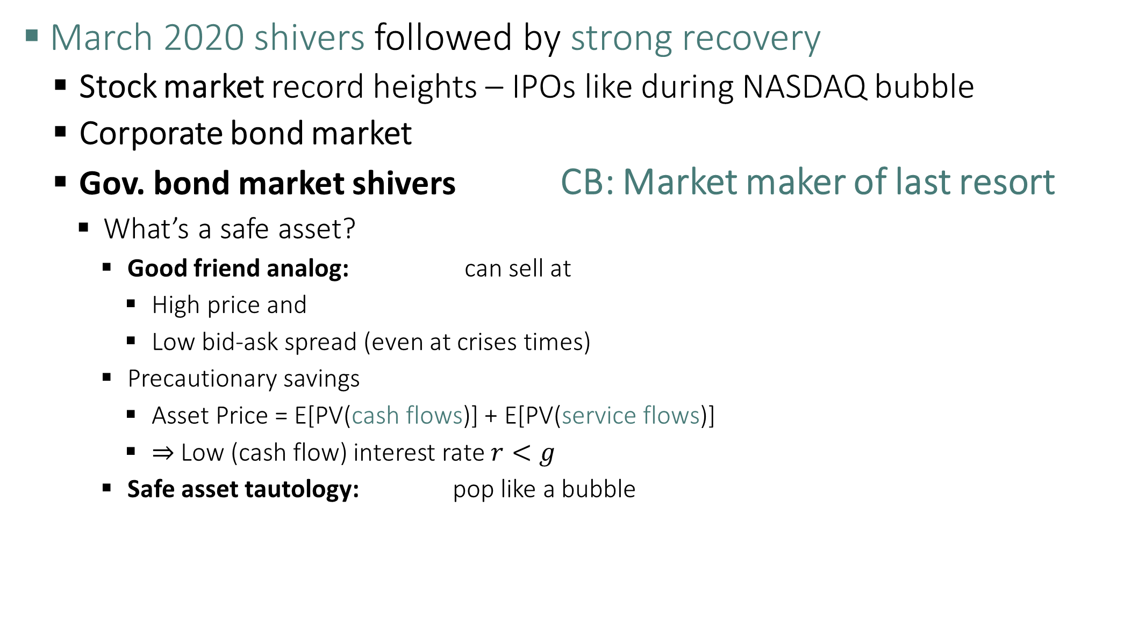
“Financial Markets Whipsaw”: US Treasury
March 2020 shivers followed by strong recovery
  Stock market record heights – IPOs like during NASDAQ bubble
  Corporate bond market
  Gov. bond market shivers CB: Market maker of last resort
    What’s a safe asset?
      Good friend analog: can sell at
        High price and
        Low bid-ask spread (even at crises times)
      Precautionary savings
        Asset Price = E[PV(cash flows)] + E[PV(service flows)]
        $⇒$ Low (cash flow) interest rate $r<g$
      Safe asset tautology: pop like a bubble
to preserve safe asset status

Slide 21
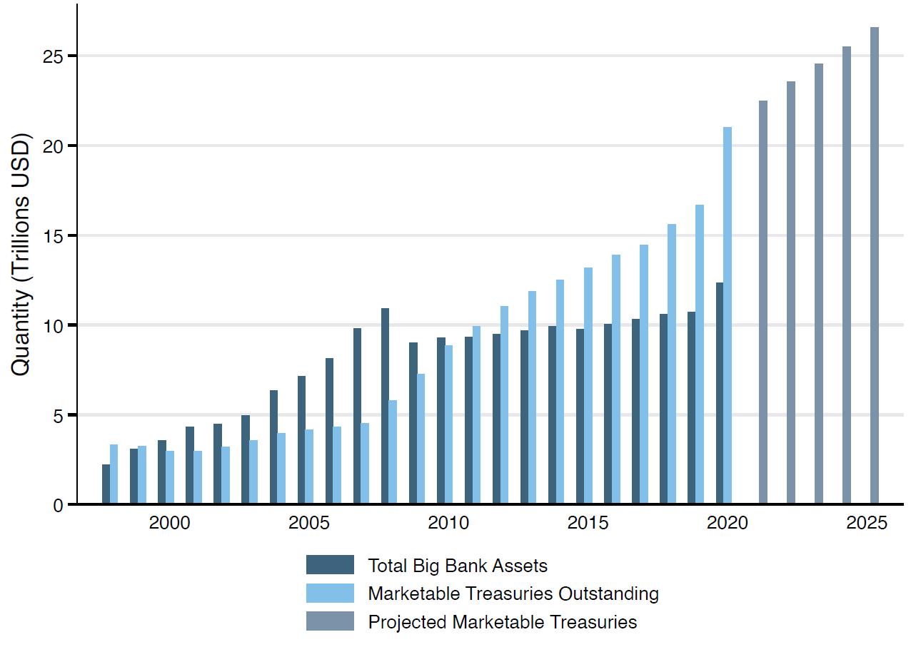
“Financial Markets Whipsaw”: US Treasury
March 2020 shivers followed by strong recovery
  Gov. bond market shivers CB: Market maker of last resort
    What’s a safe asset?
      Good friend: can sell at high price and low-bid ask spread in crisis times
to preserve safe asset status
Lacking
Market Making Capacity
Duffie (2020)

Slide 22
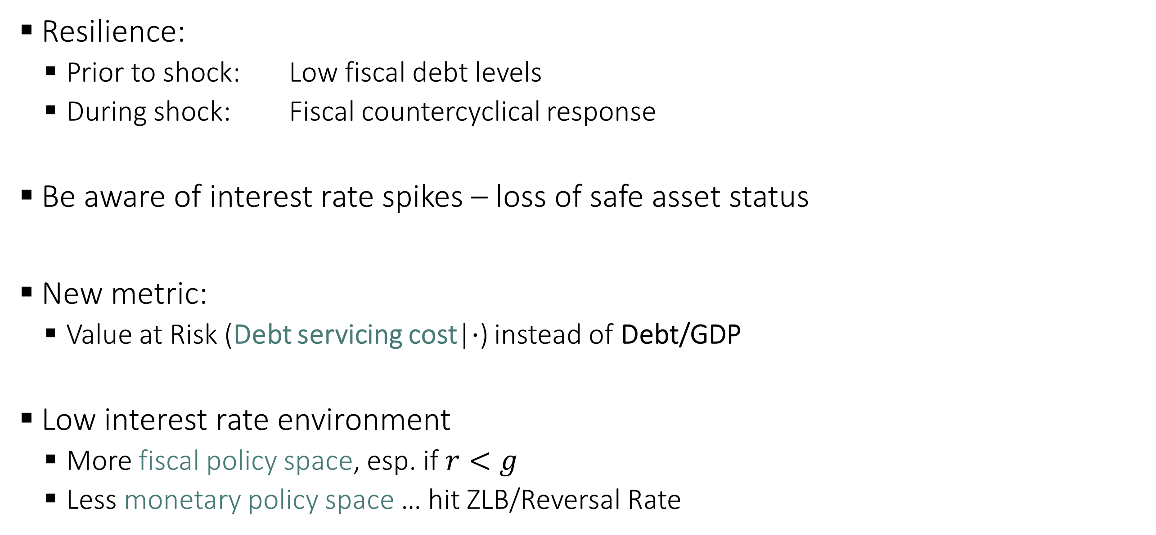
High Public Debt at Low Interest Rate
Resilience:
  Prior to shock: Low fiscal debt levels
  During shock: Fiscal countercyclical response
Be aware of interest rate spikes – loss of safe asset status
New metric:
  Value at Risk (Debt servicing cost|$⋅$) instead of Debt/GDP
Low interest rate environment
  More fiscal policy space, esp. if $r<g$
  Less monetary policy space … hit ZLB/Reversal Rate

Slide 23
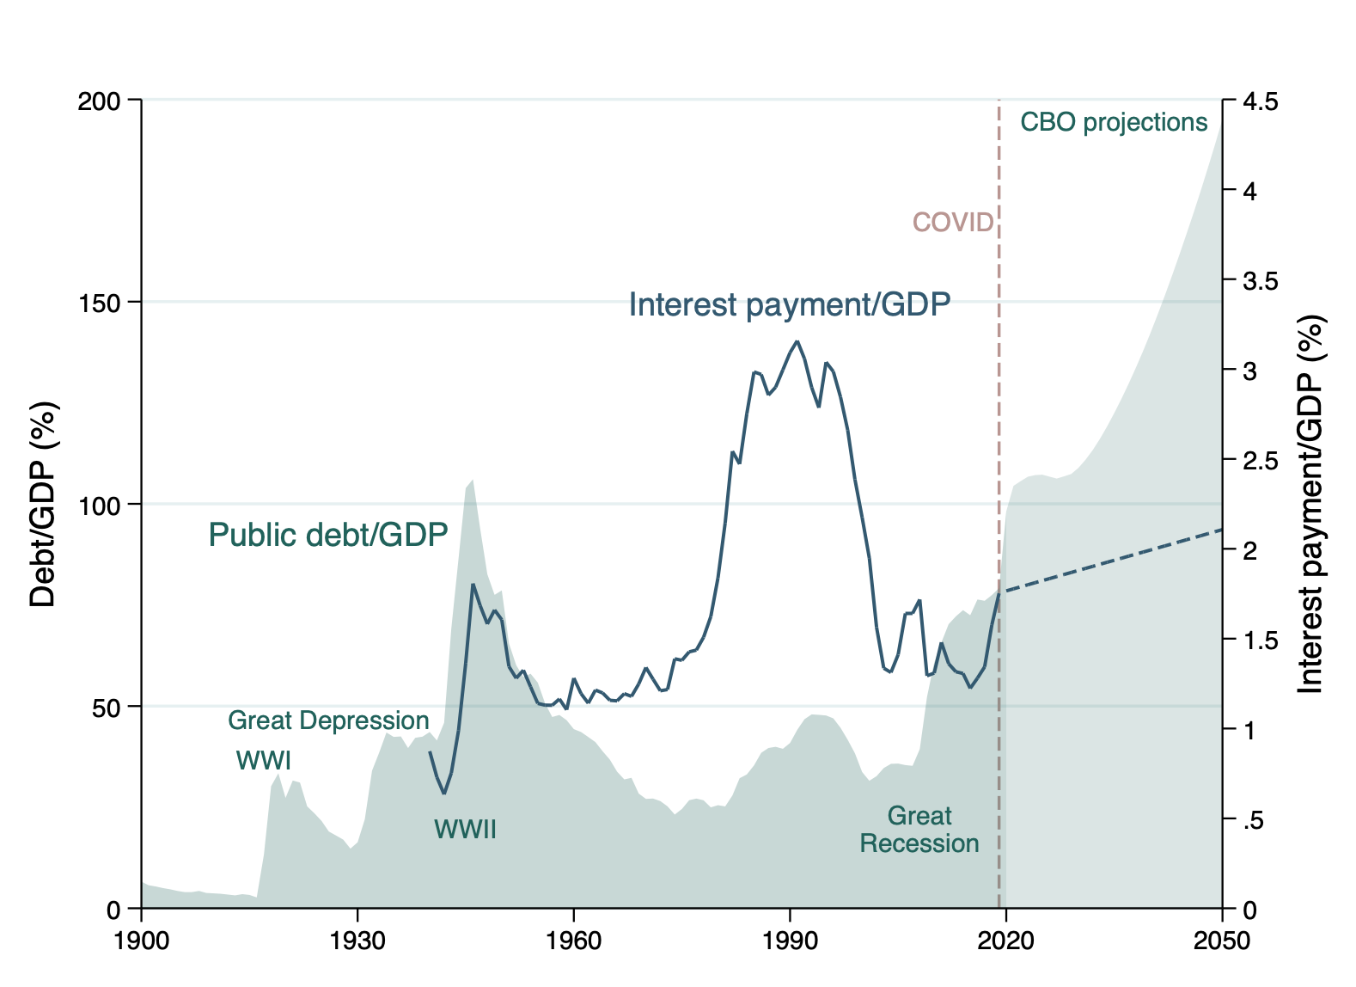

High Public Debt Levels, but low interest rates
Debt/GDP vs. Value at Risk (Debt servicing cost|$⋅$)
Why is government debt interest rate so low?
See Brunnermeier, Merkel, Sannikov (2020). “Debt as safe asset: Mining the Bubble”

Slide 24
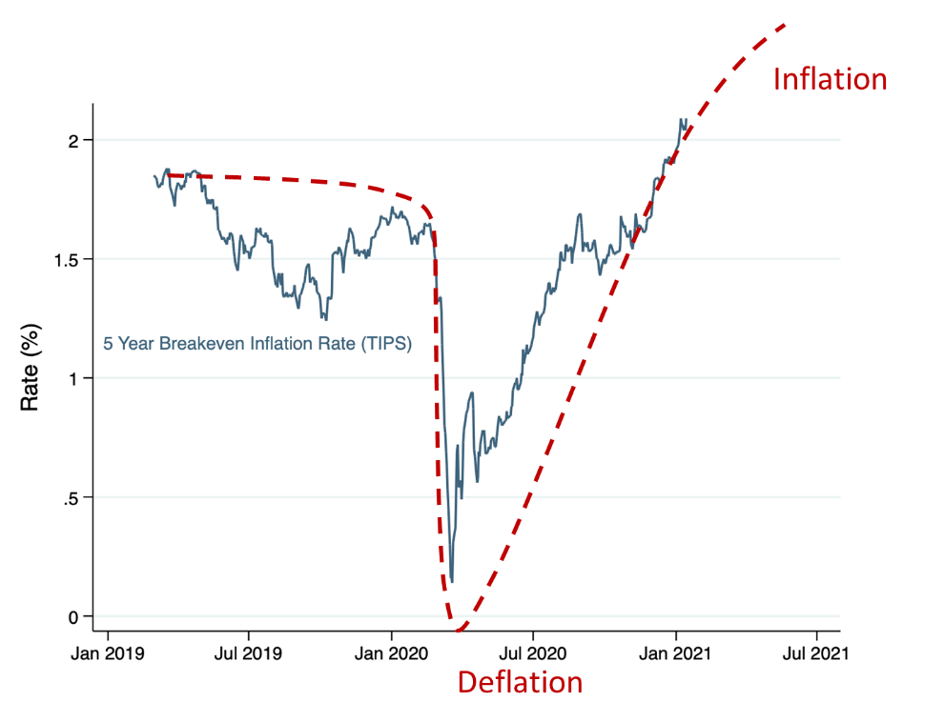
“Inflation Whipsaw”
5 Year Breakeven Inflation Rate (TIPS)
2 traps (“resilience destroyers”)
  Deflation trap
  Inflation trap (fiscal + financial dominance)
Inflation

Slide 25
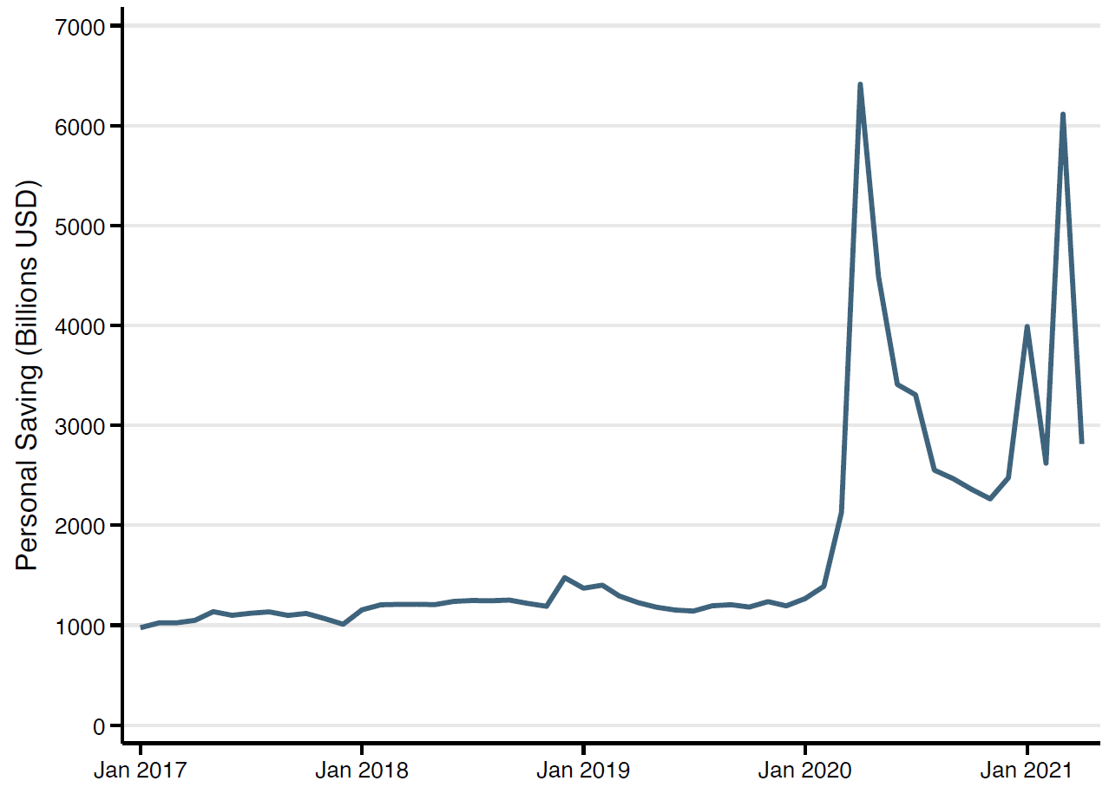
“Inflation Whipsaw”
Stimulus checks checking accounts at Banks hold reserves at Fed
Fed buys Government debt (QE) Government issues debt to finance stimulus
Personal savings due to increase uncertainty

Slide 26
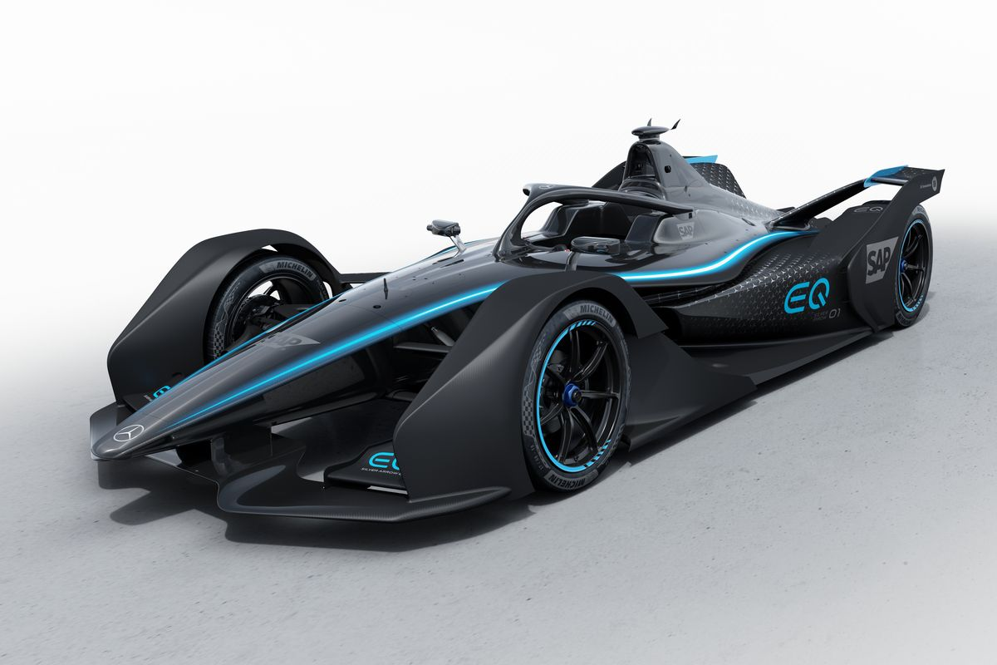
“Inflation Whipsaw”
5 Year Breakeven Inflation Rate (TIPS)
2 traps (“resilience destroyers”)
  Deflation trap
  Inflation trap (fiscal + financial dominance)
Independence central bank
+ MacroPru
  Accelerator and breaks
Inflation

Slide 27
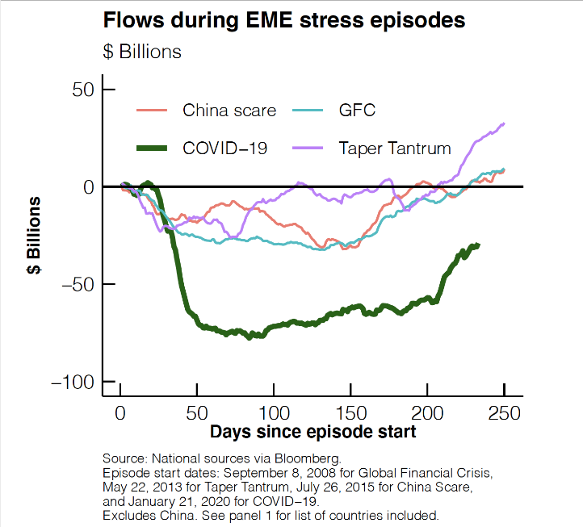
Global Financial Crisis – just avoided in March 2020
Flight to safety in the US dollar
Fed interest rate cut and repo facility
Size and speed!

Slide 28
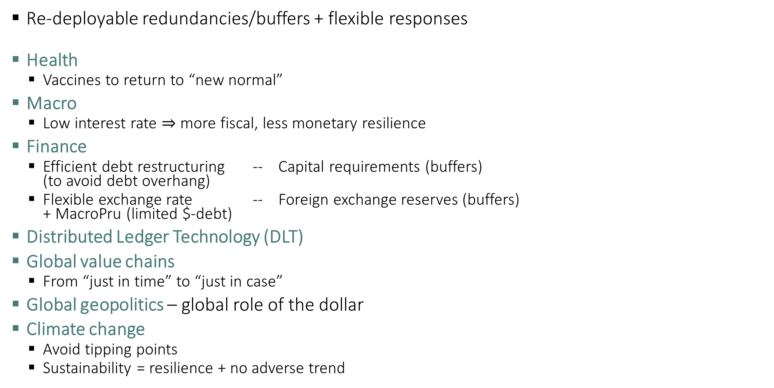
Resilience and Policy Implications
Re-deployable redundancies/buffers + flexible responses
Health
  Vaccines to return to “new normal”
Macro
  Low interest rate $⇒$ more fiscal, less monetary resilience
Finance
  Efficient debt restructuring -- Capital requirements (buffers)
  (to avoid debt overhang)
  Flexible exchange rate -- Foreign exchange reserves (buffers)
  + MacroPru (limited $-debt)
Distributed Ledger Technology (DLT)
Global value chains
  From “just in time” to “just in case”
Global geopolitics – global role of the dollar
Climate change
  Avoid tipping points
  Sustainability = resilience + no adverse trend

Slide 29
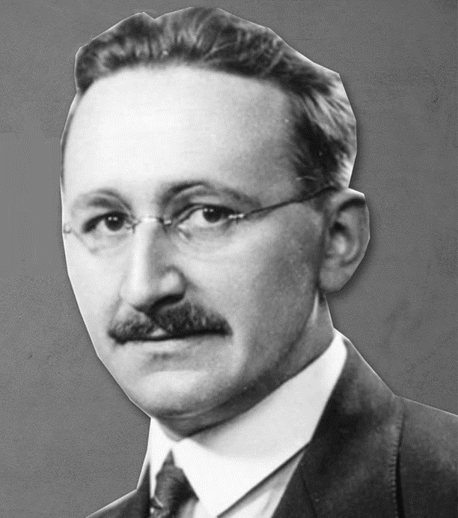
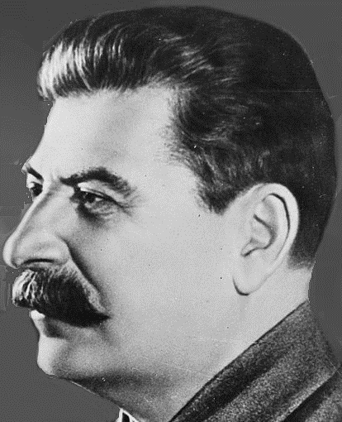
A Personal Conjecture
In an increasingly complex society
Autocratic societies
  Seek robustness – attractive feature after crises
  Suppression, minimize movements/disruptions
  Surveillance
  Tighten with each crisis … no rebound
Open/democratic society
  More resilient
  May appear wobbly when shock hits but
  internal mechanism allow for rebound
  Open to mavericks
  Transparency and more information flow/aggregation
Good in
Enforcing rules
Invented universally
accepted vaccines
Notes:
Maverick = Andersdenkende

Slide 30
Extra Slides

Slide 31
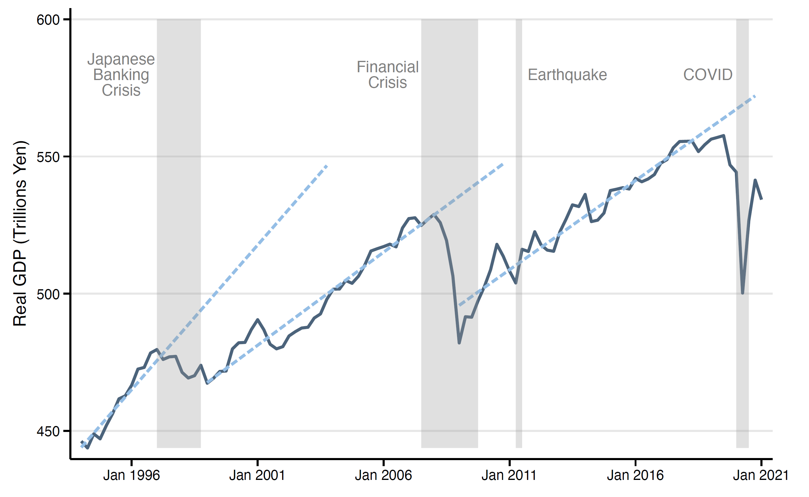

Resilience $≠$ Risk and Growth
Japanese GDP
  Lack of resilience after financial crisis, resilience after Fukoshima
$$t$$

Slide 32
Resilience $≠$ Risk avoidance
Resilience management - dynamic
  Mean-reversion
  bounce “back” to new normal
Risk management - static
  Variance
Distributional impulse response
(Fanchart)
roly-poly toy

