Slide 1
IMF and WTO in a fragmented world: Fostering mutually reinforcing reforms?
1st November 2022
www.cigionline.org

Slide 2
Globalization: Economic interdependence
HAPPY CONSUMERS (capped wages)
LESS POVERTY (more inequality)
Free K movement
(caged tax-payers)
Financial innovation (Concealed risks)
Private profits (socialized risks)
Free Trade
(carbon leakage)
RESILIENCE “Just in Case” logic
Hector R. Torres

Slide 3

From Geoeconomics to Geopolitics
"Favoring the 'friend-shoring' of supply chains to a large number of trusted countries -- so we can continue to securely extend market access -- will lower the risks to our economy, as well as to our trusted trade partners
Hector R. Torres

Slide 4
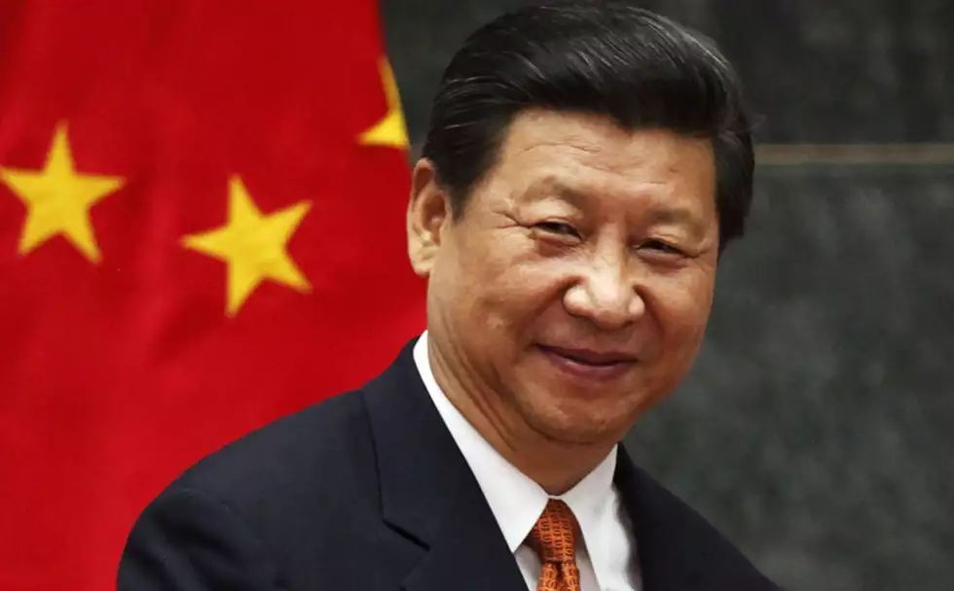
From Geoeconomics to Geopolitics
“Let us join hands and let multilateralism light our way toward a community with a shared value for humankind” Davos 2021
“It is time for China to put our national interest first”, Beijing, 2022 Communist Party Congress
Hector R. Torres

Slide 5
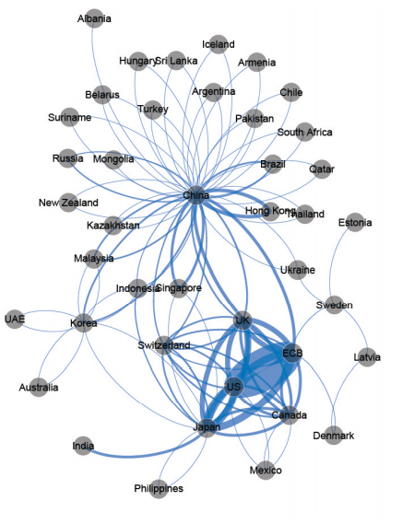
Rules based
Deals based
Chinaless
Indo-Pacific Economic Framework
Americaless
Global Security Initiative
Entrench Fragmentation
Hector R. Torres
Hector R. Torres
Notes:
People’s Bank of China since 2009 signed bilateral currency swap agreements with thirty-two counterparties.
The stated intention of these swaps is to support trade and investment and to promote the international use of renminbi

Slide 6

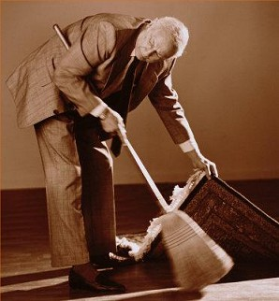

Hector R. Torres

Slide 7
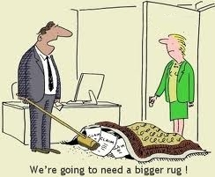
WTO:
No room left under WTO’s carpet
        Dispute Settlement: Appealing into the void
        Consensus: The right to block
        Governments & Corporate Decisions?
        “Developing” (no rush)
Dysfunctional Practices
Obsolete Rules
Hector R. Torres

Slide 8
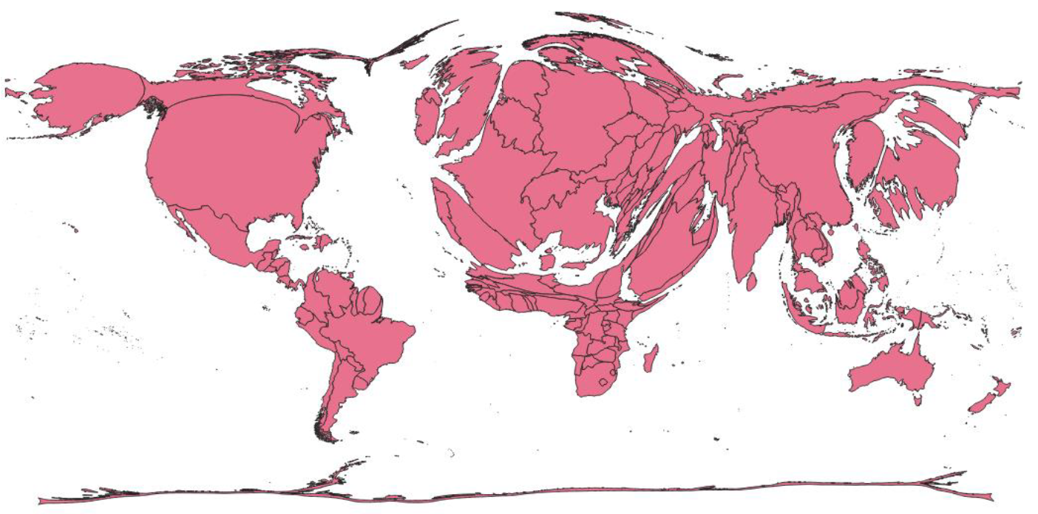
North Atlantic Driven
Source G24
Hector R. Torres
Notes:
Weighted voting leads to weighted influence?
[Quotas are calculated using a weighted average of GDP (weight of 50 per cent; measured as a blend of GDP at market exchange rates, 60 per cent, and on GDP at purchasing-power-parity exchange rates, 40 per cent), openness (30 per cent, measured as the annual average of the sum of current payments and current receipts of goods, services, income, and transfers for a five-year period), “economic variability” (15 per cent based on current receipts and net capital flows, measured as a standard deviation from the centered three-year trend over a 13-year period), and international reserves (5 per cent). The formula also includes a “compression factor” to reduce the dispersion in calculated quota shares across members.]

Slide 9
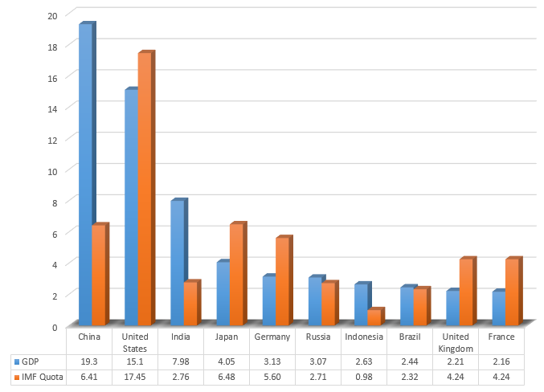
Ignoring Asia
Can it last?
Hector R. Torres

Slide 10
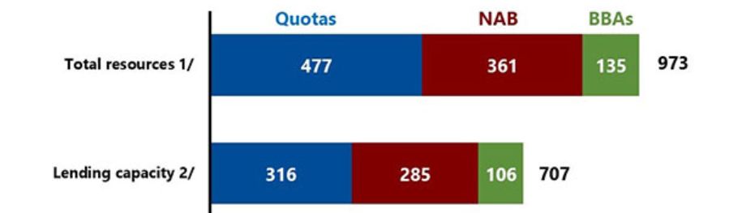
Does it matter?
Hector R. Torres

Slide 11

Can we get it straight?
Hector R. Torres

Slide 12
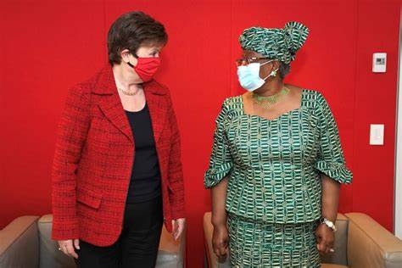

Daring to reform
Hector R. Torres

Slide 13
www.cigionline.org

