Slide 1





IMF COLLABORATION with
the world bank ON
MACRO-STRUCTURAL ISSUES
Michael
Kell
Louellen
Stedman
Alisa
Abrams
Roxana
Pedraglio
Tamar
Gutner
IEO/AU School of International Studies| 14 Jan 2021

Slide 2
What the evaluation covered
  Focused on collaboration with the World Bank as part of four IMF pilots on macro-structural issues
    Inequality, Gender, Climate/Energy (2015-19)
    Macro-structural reforms (2016-19)
  Collaboration in context of surveillance
  Also considered some longer-standing areas of Bank-Fund collaboration (eg, debt, tax)
  Focus on Bank, but also draw lessons from IMF working with other partners (OECD, ILO, WTO, UN agencies)
  Evaluation period 2014 - 2019

Slide 3
…and what it didn’t cover
  Not
    A comprehensive evaluation of all aspects of BFC
    An evaluation of the quality/impact of IMF work on macro-structural issues
    An evaluation of the Bank’s collaboration with the Fund
  First of IEO’s shorter evaluations
    12 months (rather than 18-24 months)
    Fewer Background Papers
    May or may not make recommendations

Slide 4
Why this evaluation and why now?
  Long history of efforts to improve Bank-Fund collaboration (“BFC”), but no formal review since 2010
  Several previous IEO evaluations have identified shortcomings in BFC
  Board interest:
    increased Fund attention on macro-critical structural issues in recent years, but operational budget constrained. Collaboration with Bank and others promoted as a means to square the circle
    Interest in strengthening BFC more generally
  Timed to identify lessons to inform 2020 Comprehensive Surveillance Review

Slide 5
Evaluation questions
  What role has collaboration with the World Bank played in the Fund’s work on macro-structural issues?
    What was the Fund’s vision for collaboration?
    How did it operationalize that?
    What collaboration took place?
    Was it effective, in terms of quality, influence and efficiency?
  What are the factors that support or hinder external collaboration?
  What lessons are there for the Fund to strengthen collaboration?

Slide 6
History of Bank-Fund Collaboration
  Articles of Fund and Bank explicitly require cooperation with “international organizations having specialized responsibilities in related fields”
  At least 25 agreements between Fund and Bank since 1940s, broadly four types
    Information sharing (1946 agreement)
    Demarcation of responsibilities (from 1960s, culminating in 1989 Concordat)
    Joint working and complementarity in areas of shared responsibility (from 1990s; Malan Report, 2007)
    Joint frameworks for specific issues, eg HIPC, FSAPs, Deby Vulnerabilities)

Slide 7
Identifying Bank-Fund Collaboration
  Collaboration: “To work jointly with others or together especially in an intellectual endeavor”.
  Range of activities
    drawing on publications, data, indicators;
    informal discussions and seeking comments on drafts;
    conferences and workshops with Bank, OECD and UN Women;
    Co-authoring or outsourcing reports;
    Joint missions and meetings with authorities;
    Developing joint assessment frameworks (eg for CCPA)
    Joint work/reports within formalized structures (eg DSAs, FSAPs)

Slide 8
Methods
  Document review
  Semi-structured interviews
    160 in total
    30 with Bank staff
    few with country authorities (besides EDs)
  Linked surveys of Fund and Bank staff
  (Very) simple quantitative analysis
Notes:
More on how and why it was created?

Slide 9
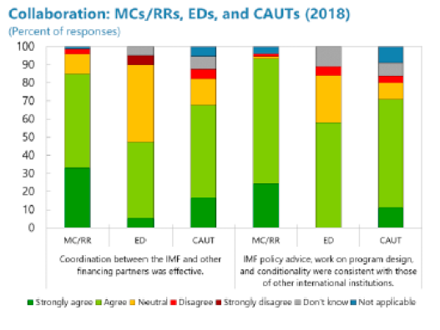
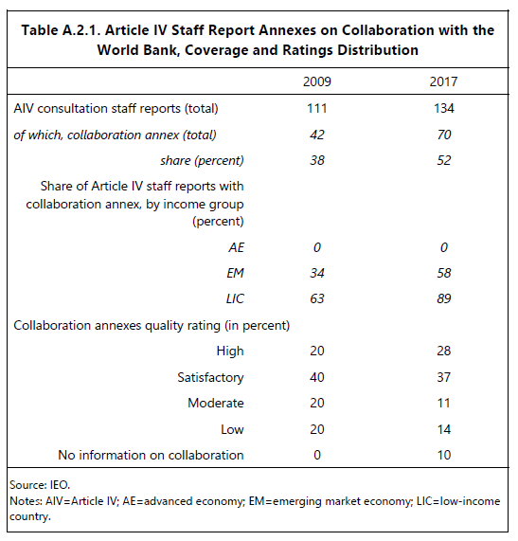
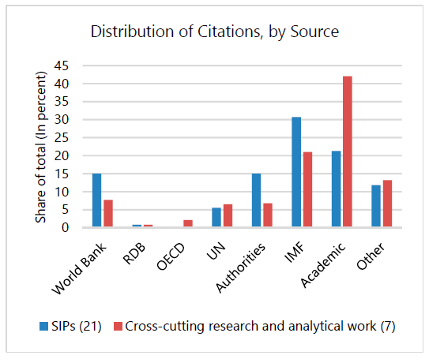
Quantifying collaboration
Notes:
More on how and why it was created?

Slide 10
Benefits of Bank-Fund Collaboration
  In interviews,
  Fund and Bank staff tended to emphasize that BFC helps credibility of both institutions with member countries, eg by promoting consistency of advice, avoiding conflicting advice
  Most IMF Board members and country authorities stressed that BFC helps operational efficiency of Fund and Bank by reducing duplication
  Some also noted that collaboration between IFIs supports the credibility and effectiveness of the multilateral system, and therefore has the attributes of a global public good

Slide 11
Key Findings (1)
  BFC on MSI has been broad, but uneven
    Informal collaboration is widespread
    but aspirations that the Fund would systematically leverage Bank expertise were not achieved
    and little “deep” collaboration (eg joint outputs)
  Fund macro-structural work generally well-regarded, but little evidence that quality and impact have been greatly enhanced, or costs reduced, by BFC
  Some cases of mixed messages on shared issues, and missed opportunities to exploit synergies
  Benefits of collaboration have been clearer in some of the Fund’s other partnerships, such as with UN Women
Notes:
More on how and why it was created?

Slide 12
Key Findings (2)
  Unevenness of BFC on MSI reflects
    Decentralized approach to MS pilots
    Fund cultural tendency towards self-reliance, but also the importance of “personality” and other idiosyncratic factors
    Challenges of working with another large organization (finding the right people, aligning goals and timetables)
    Little systematic Fund consideration of incentives/constraints on Bank staff to collaborate
  Extent of BFC beyond MSI varies widely across policy areas
  Where deep – eg debt and financial sector – it reflects
    Clear messages from shareholders
    Mutual organizational benefits from collaboration
    Well-defined roles and tailored frameworks that have been adapted over time
Notes:
More on how and why it was created?

Slide 13
Lessons (1)
  Collaboration can bring benefits, but is also difficult; not a panacea for addressing resource constraints
  Fund should identify areas where returns to collaboration likely to be highest, based on an understanding of the business needs and constraints of partners and resource implications for the Fund
  Frameworks for collaboration can be important, but should be tailored to each issue (and we don’t see a case for revising the Concordat)
  Personalities and chemistry will always matter for effective collaboration, but incentives and culture can influence behavior
Notes:
More on how and why it was created?

Slide 14
Lessons (2)
  BFC would be facilitated by easier access to basic information (eg where to find experts) and curated knowledge bases
  Fund needs adequate in-house expertise on macro-structural issues to support effective collaboration
  Management’s commitment to engage with partners is critical
  The IMF Board could do more to help BFC
Notes:
More on how and why it was created?

Slide 15
Recommendations
  Where collaboration judged to bring the greatest returns, agree tailored frameworks with partners (eg, on climate action)
  Improve internal incentives to collaborate and address cultural reluctance to look outside for help
  Work with Bank to find ways to improve access to information and knowledge
  The Fund Board should strengthen its role in facilitating collaboration, through its oversight role, its scope to influence staff behavior and its direct engagement with the Bank Board
Notes:
More on how and why it was created?

Slide 16
Reactions and Next Steps
  IMF Management
    Broadly agreed with core messages
    Support for recommendations, with qualifications
  IMF Board
    Endorsed the key findings
    Recognized success hinges on agreement with Bank, but urged “active engagement” by Fund
    Unanimously supported IEO recommendations
    Some Directors proposed a high level joint management committee
  Staff
    Present Comprehensive Surveillance Review to Board in Spring 2021
    Management Implementation Plan for Board consideration
Notes:
More on how and why it was created?

Slide 17
Thank you!
  Visit us at ieo.imf.org
  The BFC team would like to thank:
  Jeff Chelsky and Alison Evans from the World Bank Independent Evaluation Group
  Kwang Lee for research assistance,
  Esha Ray for editorial assistance,
  Annette Canizares, Arun Bhatnagar and Nicole Tumbaco for administrative assistance
  And also:
  IMF and World Bank staff who gave their time generously to answer our many questions and to respond to our surveys;
  the numerous other people we interviewed;
  and the participants in our internal workshops who read and commented on drafts.

Slide 18
Background slides

Slide 19
Definitions
  Collaboration: “To work jointly with others or together especially in an intellectual endeavor”.
  Structural issues: “impediments to [the] efficient production of goods and services and the efficient allocation of resources”
  An issue is “macrocritical if it affects, or has the potential, to affect domestic or external stability, or global stability”

Slide 20
Framework for partnership with Bank on climate
  Climate a good candidate for a tailored framework
  Framework should
      set out goals for collaboration and roles of each institution
      establish appropriate incentives for staff
      have the strong endorsement of senior Fund and Bank managements and be presented to the Boards of both institutions.
      identify the minimum quantity and type, and best deployment, of specialist Fund expertise that is needed to help facilitate collaboration and mitigate risks
      identify senior individuals as focal points for external engagement.
Notes:
More on how and why it was created?

Slide 21
Surveys of Fund and Bank staff
  Covered (i) experience in collaborating over last five years; (ii) costs and benefits of collaboration; and (iii) knowledge sharing, incentives for working together, and HR issues.
  Extensive help from IEG: identifying target groups, question design, terminology
  Sent to 1,300 IMF staff, 2,260 Bank staff
  Very low response rates:14% for Fund – typically 30-60% for other IEO surveys; 6% for Bank
  But still valuable: triangulation, quantification
Notes:
More on how and why it was created?

Slide 22
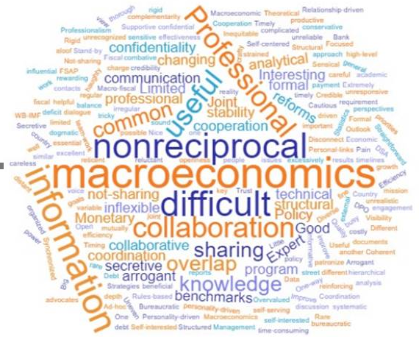
Three words Bank staff use to describe collaborating with the Fund

Slide 23
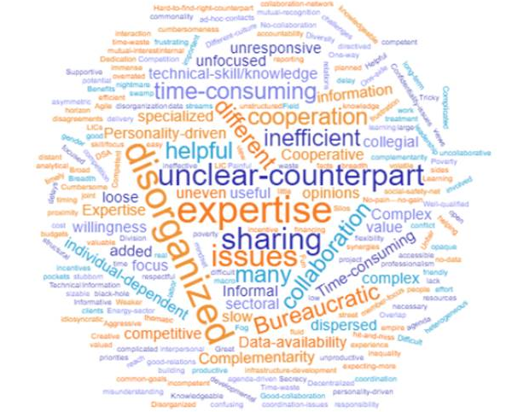
Three words Fund staff use to describe collaborating with the Bank

