Slide 1
Assessment of the Extra Capacity Required of Alternative Energy Electrical Power Systems to Completely Replace Fossil Fuels
Simon P. Michaux
18/08/2022
Associate Professor Mineral Processing & Geometallurgy

Slide 2
The industry changed in 2005
A case can be made that this blow out was a chain reaction started in the oil industry
A major economic correction (GFC 2008) did not resolve the problems
The change started something like 17 years in our past

Slide 3
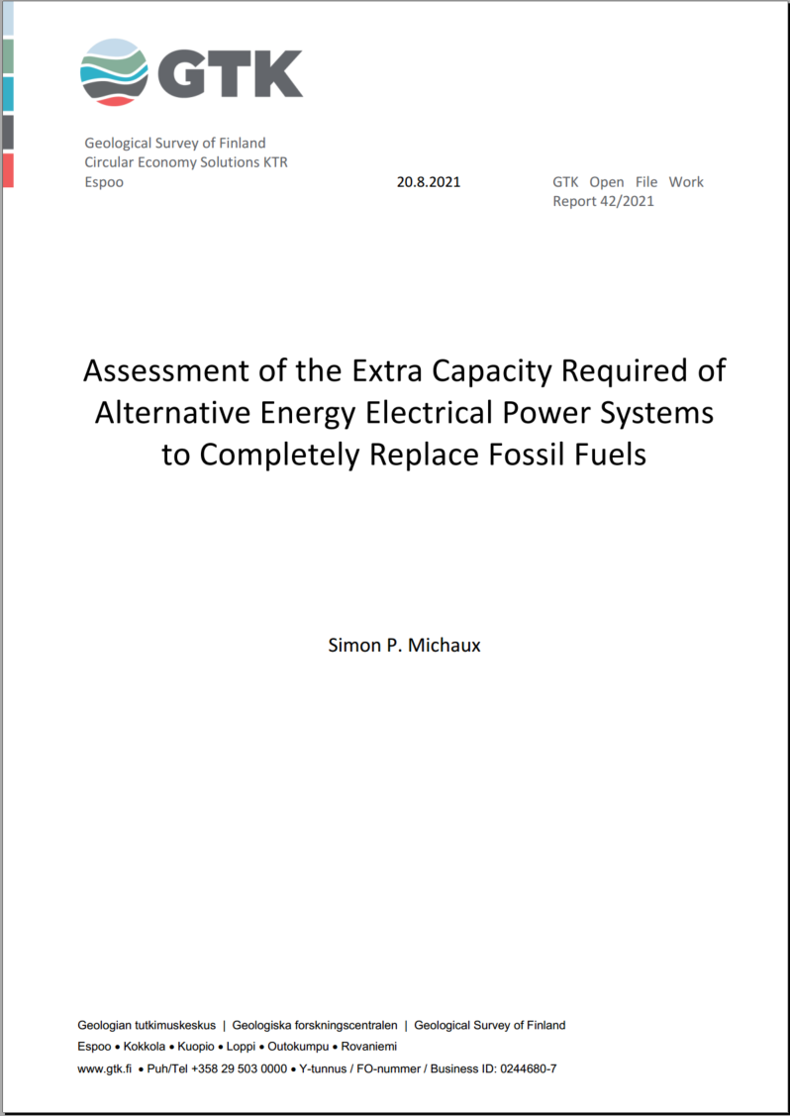
Summary
Number of vehicles, by class
Number and size of batteries
An understanding of the EV to H₂-Cell split
Estimates of EV & H₂-Cell rail transport
Estimates of an EV & H₂-Cell maritime shipping fleet
Estimates of phasing out of fossil fuel industrial applications
Examination of the feasibility of expanding the nuclear NPP fleet
Assessment of the feasibility of global scale biofuels
Plastics & fertilizer industries
Physical Tasks done industrially by fossil fuels
Determine the true scope of useful work done
Assemble non-fossil fuel systems that could do the same useful work
Calculate the quantity of electrical power needed
Using same energy mix as 2018, determine how many new non-fossil fuel power stations are needed
Link to full report below
https://tupa.gtk.fi/raportti/arkisto/42_2021.pdf
Link to 8 page summary
https://mcusercontent.com/72459de8ffe7657f347608c49/files/be87ecb0-46b0-9c31-886a-6202ba5a9b63/Assessment_to_phase_out_fossil_fuels_Summary.pdf

Slide 4




What would it take to replace the existing fossil fuel system?
What is the true scope of tasks to fully phase out fossil fuels, and the complete replacement with non-fossil fuel powered systems?
Existing ICE transport fleet size
Cars & Trucks
Rail
Maritime shipping
Aviation
What is the number and size of required batteries/hydrogen cells/solar panels/wind turbines
In 2018, 84.5% of global primary energy consumption was fossil fuel based
Required power grid expansion to charge the needed number of batteries, and make hydrogen
Number of new power stations
Required power storage to manage intermittent supply
Economic growth once new system is stable
Existing system is fully replaced
(2018 scope used)
Phase out fossil fuels & non-fossil fuel systems implemented
Current plans are not large enough in scope, the task before us is much larger than the current paradigm allows for

Slide 5
Baseline calculation
The global fleet of vehicles is estimated to be 1.416 billion, which travelled an estimated 15.87 trillion km in the year 2018
0.7% is EV in 2020
For the same energy output:
…an Electric Vehicle system requires battery storage mass 3.2 times the fuel tank (@700bar) mass of a hydrogen H-Cell system
…meanwhile a hydrogen H-Cell system will require 2.5 times more electricity compared to a Electric Vehicle system
All short-range transport could be done by Electric Vehicle systems
All passenger cars, commercial vans, delivery trucks and buses (1.39 billion vehicles), would travel 14.25 trillion km in 365 days
This would require 65.19 TWh of batteries (282.6 million tonnes of Li-Ion batteries)
All long-range distance transport could be powered with a hydrogen fuel cells
All Class 8 HCV trucks, the rail transport network (including freight), and the maritime ship fleet
In total, 200.1 million tonnes of hydrogen would be needed annually

Slide 6
GLOBAL SYSTEM I
1.39 billion Electric Vehicles
Charging Batteries
695.2 million Passenger Cars 5.4 trillion km
1 128.5 TWh
29 million Buses & Delivery Trucks 803 billion km
1 166.1 TWh
4 495.7* TWh
601 million Vans, Light Trucks 7.9 trillion km
2 181.7 TWh
62 million Motorcycles 160 billion km
19.4 billion kWh
*updates in EV energy efficiency reduced this number by 4% from (Michaux 2021)
Industry
Electrical Power Generation
17 086.1 TWh
19 958.6 TWh
Building Heating
2 816.0 TWh
Steel Manufacture
56.5 TWh

Slide 7
GLOBAL SYSTEM II
Hydrogen Economy
H₂-Cell Vehicles
Hydrogen
Manufacture of H₂
28.9 million Class 8 HCV Trucks
Travelled 1.62 trillion km
129.9
million tonnes
7 503.7 TWh
Rail Transport 9 407 billion tkm freight
1 720 billion passenger-kilometers
18.5
million tonnes
200.1 million tonnes
11 553.6 TWh
1 066.5 TWh
Maritime Shipping cargo
72 146 billion tonne-km
51.7
million tonnes
2 983.4TWh
Biomass Economy
Biomass Sustainably Sourced from the Planetary Environment
Aviation
Biofuel ??? liters
Sustainability audit
Plastics Manufacture
Biomass Feedstock ??? tonnes

Slide 8
GLOBAL SYSTEM III
Hydro Power
4 809.6 TWh
3 628 stations
Nuclear Power
2 701.4 TWh
211 stations
Additional Annual Electrical Power Requires 36 007.9 TWh
EV 4 495.7 TWh
Wind Power
13 800.4 TWh
169 867 stations
Power storage buffer 548.9 TWh
Industry 19 958.6 TWh
Solar Power
=
586 032 NEW Non-Fossil Fuel Power Stations
13 800.4 TWh
393 840 stations
H₂ 11 553.6 TWh
Other Renewables
Geothermal & Tidal
266.7 TWh
442 stations
Biowaste to Energy
624.0 TWh
18 044 stations
Power plant fleet in 2018 was 46 423 stations

Slide 9
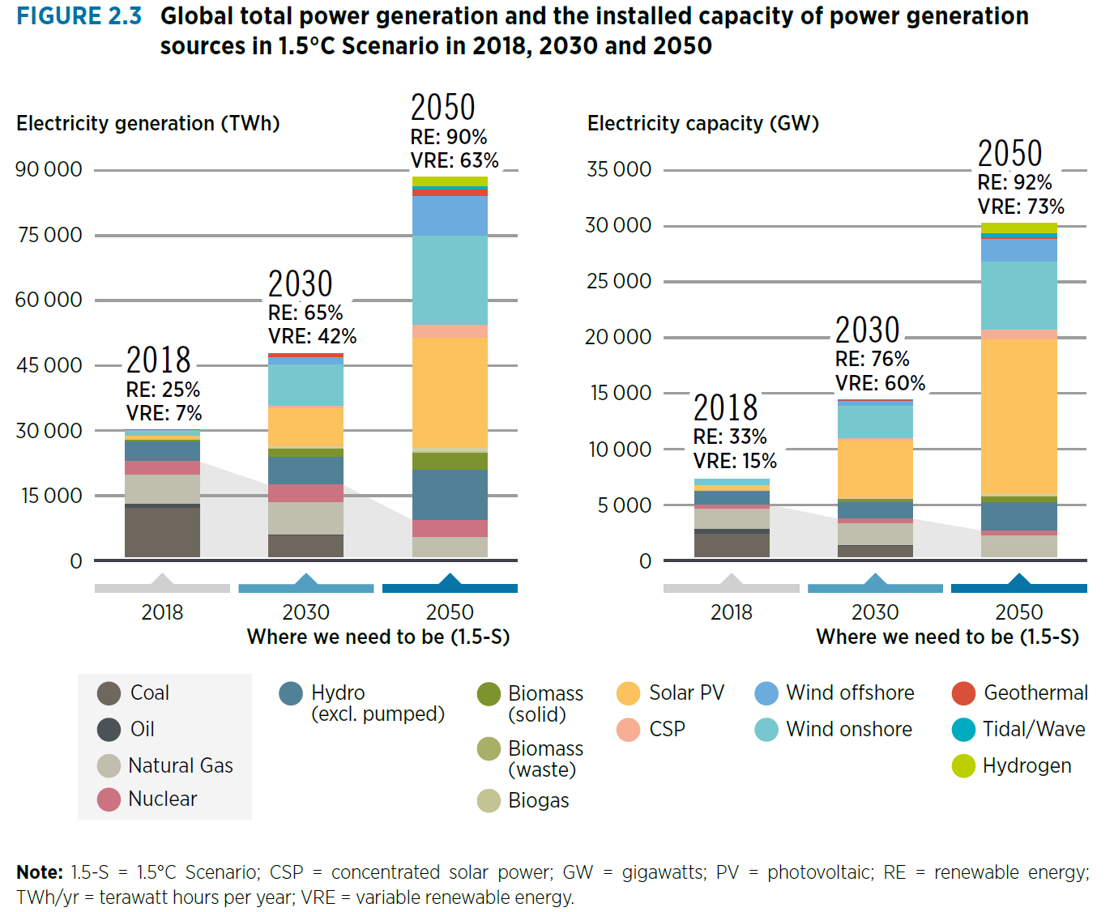
Global total power generation and the installed capacity of power generation sources in 1.5°C Scenario in 2018, 2030 and 2050 (Source: IRENA 2022)

Slide 10
To deliver 1000 TWh of power to the grid over 1 year…
(Source Data: Global Energy Observatory, Agora Energiewende and Sandbag 2019)
Renewables have a much lower ERoEI ratio than fossil fuels and may not be strong enough to power the next industrial era

Slide 11

36 007.9 TWh
Electrical power required to phase out coal fired steel manufacture
Electrical power required to phase out gas building heating
Electrical power required to phase out gas and coal power generation
Oil
Extra electrical power annual capacity required to be installed
Total electrical power production in 2018 was 26 614 TWh
Electric power required to produce hydrogen for H₂-Cell vehicles
Gas
17 086.1 TWh to be phased out
Coal
Electrical power required charge EV batteries
Existing Non-fossil Fuel Power Generation
9 528.7 TWh
2nd generation of work done

Slide 12

New energy split
28.9 million trucks (H₂-Cell)
695.2 million passenger cars (EV)
46.8 kWh battery
11 553.6 TWh
29 million buses (EV)
227.5 kWh battery
36 007.9 TWh
New annual capacity
36 007.9 TWh
New annual capacity
4 495.7 TWh
601.3 million commercial vans (EV)
42 kWh battery
62 million motorcycles (EV)
12 kWh battery
19 958.6 TWh
Electrical Power Generation, heating & steel manufacture
Developed from a combination of an IEA 2021 projection and some of my own assumptions

Slide 13
Gas and hydro are the existing buffer

Slide 14
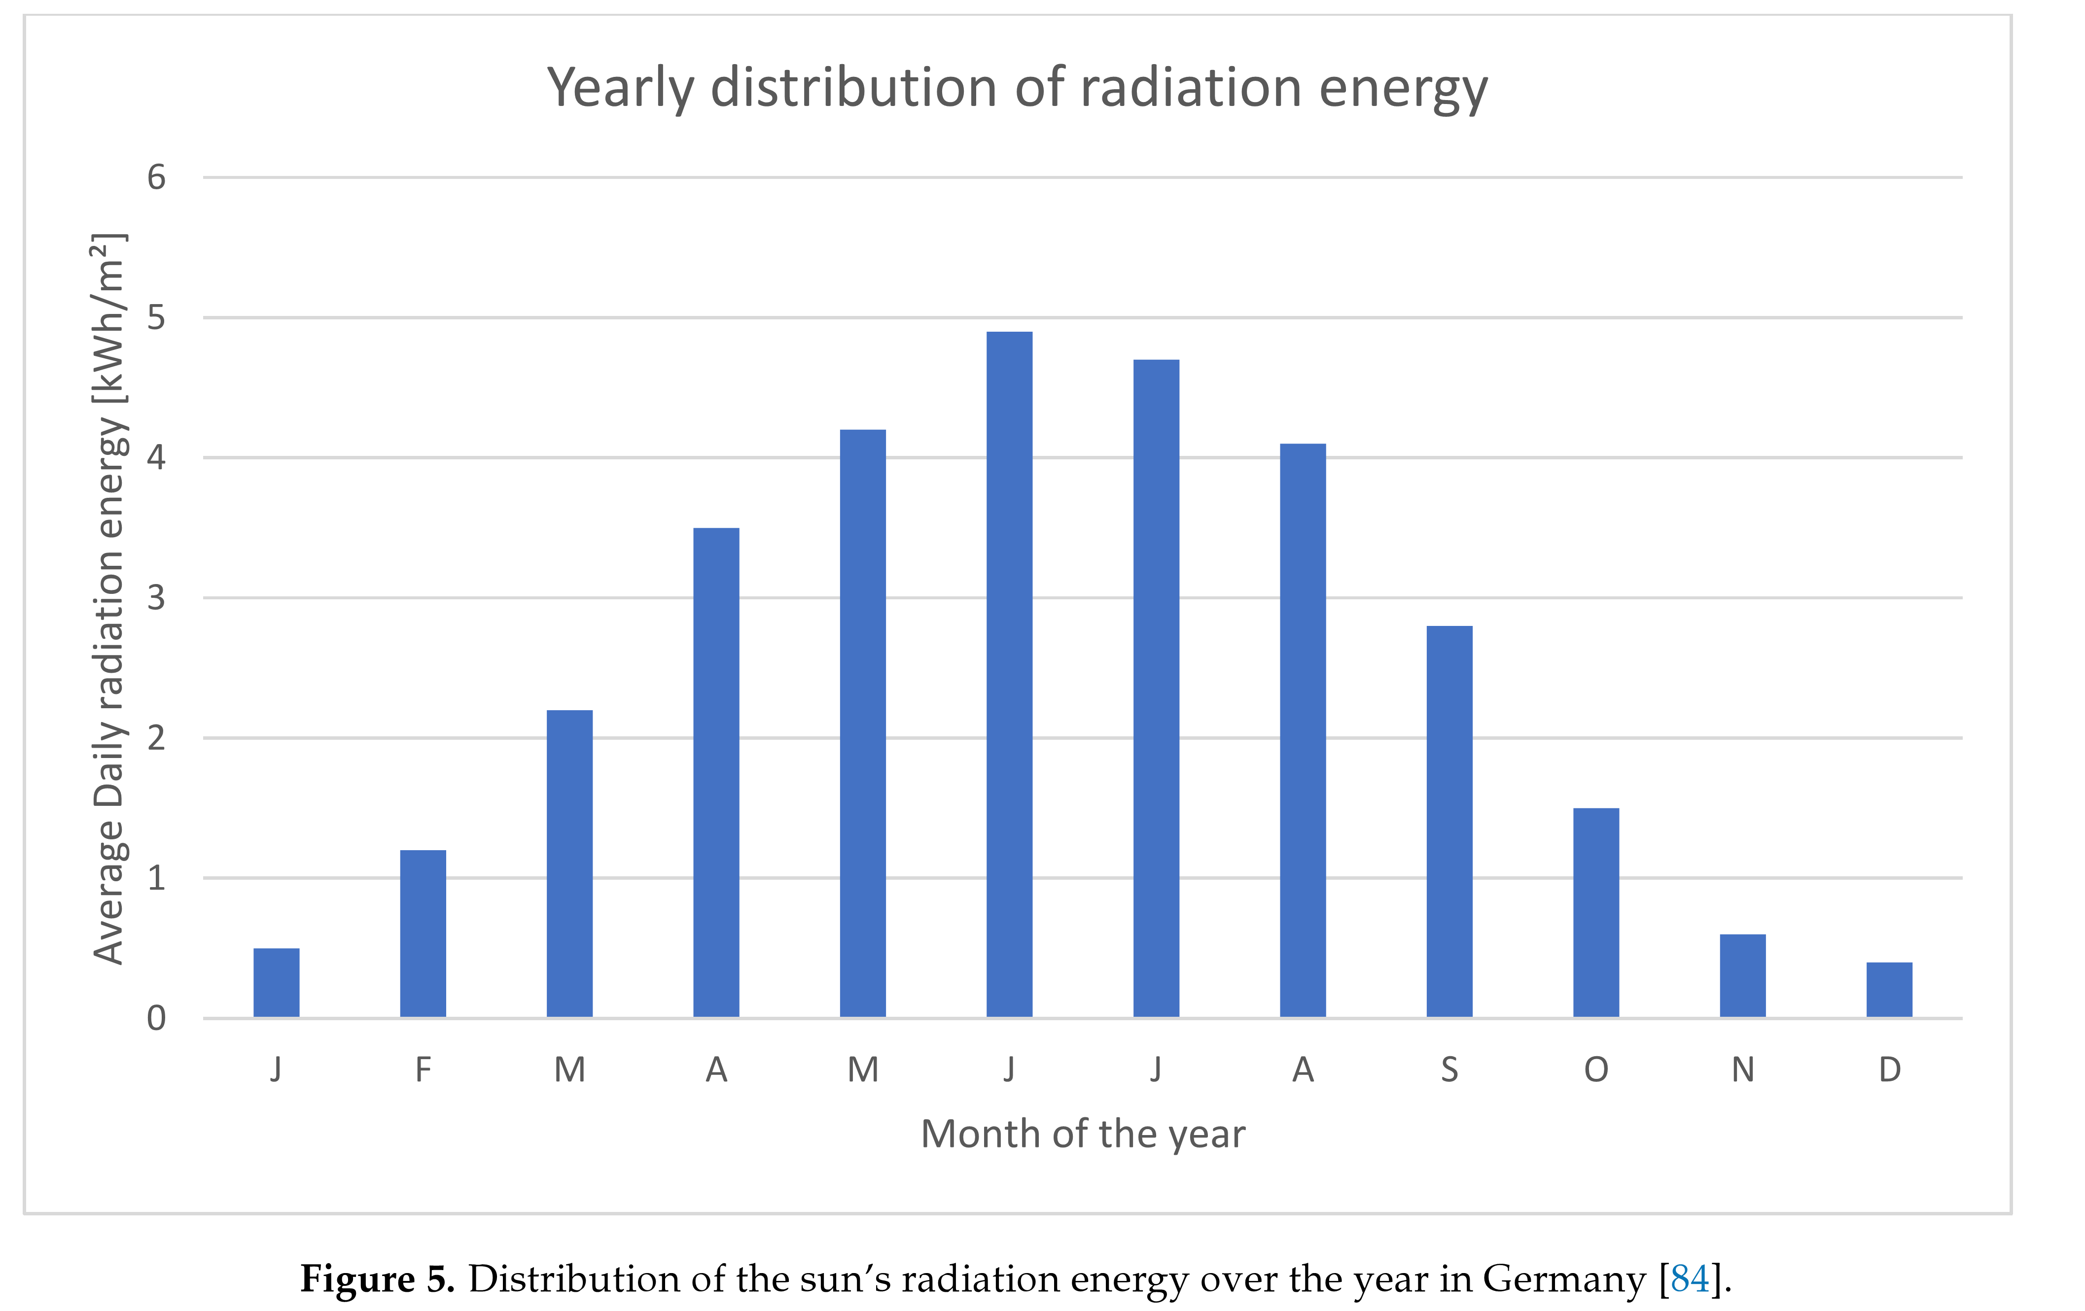
Distribution of the sun’s radiation energy over the year in Germany (Wesselak & Voswinckel 2016)

Slide 15
Wind is highly variable
Reliable capacity as a % of max capacity for wind 7-25% (UK Parliament 2014)
Power production was so erratic it could not be predicted
Variations in power produced can last weeks and, in some cases, months
In practical terms, global power generation operating hours in 2018 (Global Energy Observatory)
Solar PV produced 11.4% of the calendar year
Wind produced 24.9% of the calendar year
Highly variable of when power was produced

Slide 16



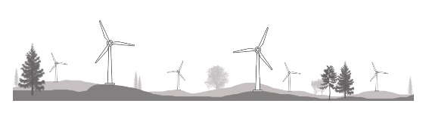
Power supply & demand
DEMAND
SUPPLY
Nuclear can’t vary at all and must be used as a base load
Hydro can vary within a small window
Must Balance
Transport demand could function on a 48-hour buffer
Wind & solar electrical power production could need a buffer of several months if they make up a large portion of the energy mix
Watch this presentation
Professor Jan Blomgren: Så här uppstod elkrisen i Sverige
https://www.youtube.com/watch?v=0Oh_w5KrEVc

Slide 17
Projected New energy split for 2050
2nd generation of work done
Developed from a combination of an IRENA 2022 projection and some of my own assumptions
Global Wind & Solar capacity only (72.8%) = 26 220.7 TWh
4 weeks Wind & Solar capacity only = 2 017.0 TWh
This is the size of the needed power buffer

Slide 18
Number of technology units
Electric Vehicles
EV Batteries
Hydrogen fuel cells
Wind Turbines
Solar Panels
Power Storage Batteries

Slide 19
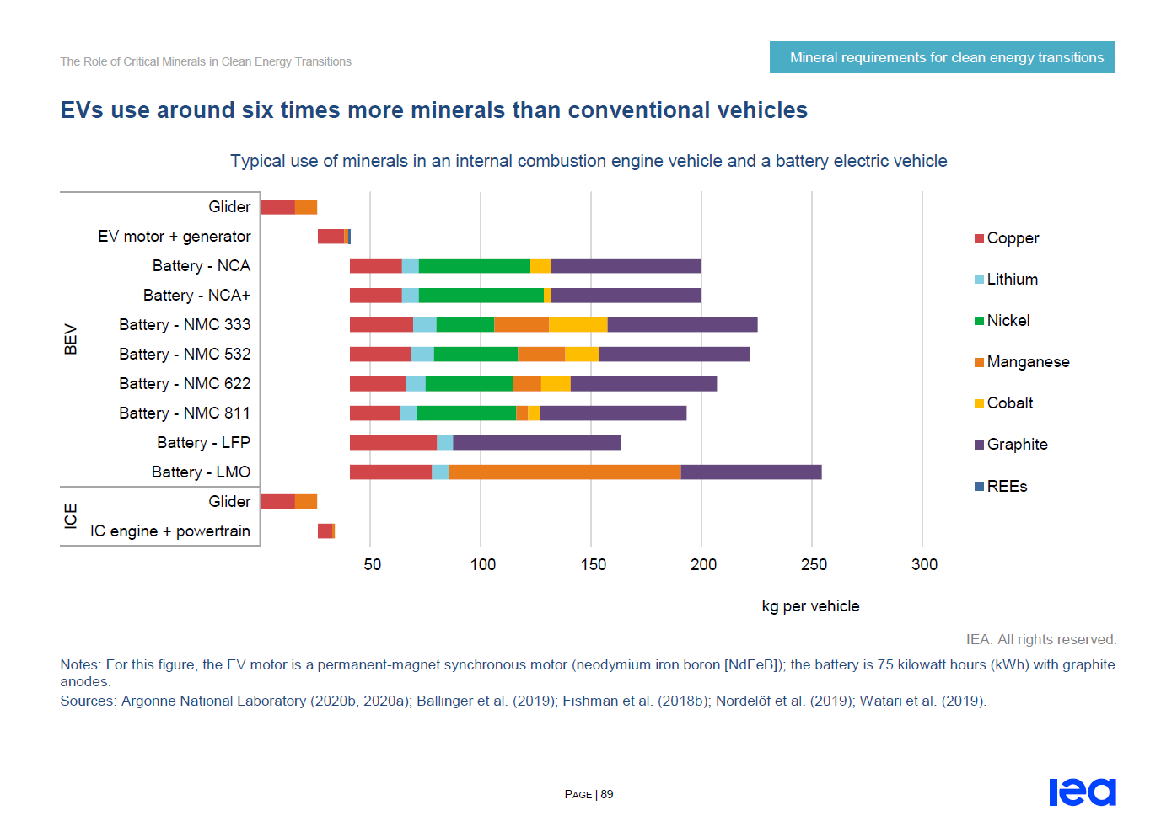
(Source: The Role of Critical Minerals in Clean Energy Transitions IEA)

Slide 20
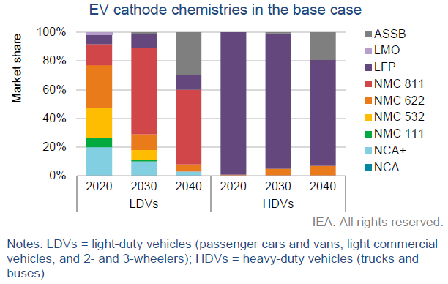
2nd generation of work done
Table A28. Metal required for stationary power storage batteries to phase out fossil fuels
(Source: The Role of Critical Minerals in Clean Energy Transitions IEA)

Slide 21
Metal produced in 2019
(Source: BGR 2021, USGS, Friedrichs 2022)

Slide 22
Metal in 2022 global reserves
Source: USGS
For every 1000 deposits discovered, 1 or 2 become mines
Time taken to develop a discovered deposit to a mine 20 years
For every 10 producing mines, 2 or 3 will lose money and shut down

Slide 23
0.7% of passenger cars were EV in 2020
In 2018, renewables accounted for 4.05% of the global energy generation.
What is not constructed yet, cannot be recycled
If it was all constructed next year, it would not be until 2033 when large volumes would be available for recycling
The 1st generation at least must come from mining
Remember, this is for just the first generation of units. They will wear out in 10 to 25 years, after which they will need to be replaced

Slide 24
Conclusions
Current thinking has seriously underestimated the scale of the task ahead
Nuclear is vital to keep industry going but can’t be scaled up to be the only energy source
Biofuels may be the only way to power aviation and plastics. It cannot be scaled up to replace petroleum.
Battery chemistries other than lithium-ion should/will be developed, each with different mineral resources required
There is a projected mineral shortage to supply raw materials for battery manufacture
2019 production rates are not even close to being appropriate
2022 mineral reserves are also not large enough to deliver the needed volumes
Metals of all kinds are about to become much more valuable
Evolution of the industrial ecosystem and its market is likely
There is a coming Renaissance for the exploration for and mining of minerals

Slide 25


Kiitos
&
Thank you
Simon P. Michaux
Associate Professor Geometallurgy
Unit Minerals Processing and Materials Research - Circular Economy Solutions
Ore Characterization, Process Engineering & Mineral Intelligence
Geological Survey of Finland/Geologian tutkimuskeskus
PO Box 96, (Vuorimiehentie 2)
F1-02151 Espoo, FINLAND
simon.michaux@gtk.fi
Mobile: +358 (0)50 348 6443

Slide 26
Metal Needed

Slide 27
Stewardship of Planet Earth
An industrial ecosystem of unprecedented size and complexity, that took more than a century to build with the support of the highest calorifically dense source of cheap energy the world has ever known (oil) in abundant quantities, with easily available credit, and unlimited mineral resources
We now seek to build an even more complex system with very expensive energy, a fragile finance system saturated in debt, not enough minerals, with an unprecedented number of human population, embedded in a deteriorating environment.

