Slide 1
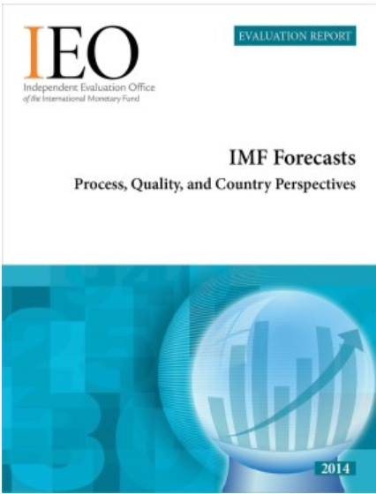
IMF Forecasts
Seven years later
Francesco Luna
Institute for Capacity Development
IMF

Slide 2
Main results of the presentation
Inability to forecast recessions and in particular financial crises.
Different forecasts resemble each other, exhibiting a high degree of collinearity.
IMF-supported program forecasts tend to be more optimistic for large programs.

Slide 3
Focus of the original evaluation
Transparency of process (WEO)
Quality of forecasts
  Short term,
  Medium term 3-4-5 years ahead
  Surveillance and Program
Procedures (linked with quality)
  Learning from systematic errors

Slide 4
Inability to forecast recessions
Same result in the 2014 evaluation… (a few well placed dummies would eliminate the bias)
…and also recoveries…
  Famous spaghetti graphs for Argentina and Greece based on WEO’s different forecast vintages.
  Unwritten rule of “closing the gap”

Slide 5
Different forecasts resemble each other
No incentive to deviate from consensus.
Cross pollination of forecasts .
For medium term projections: not many incentives to invest much time and resources. Furthermore:
    The IMF has procedures in place to learn from past forecast performance, but these procedures are not always utilized to their full potential.

Slide 6
Forecasts are optimistic for large programs
In 2014: Optimistic bias also in Surveillance for medium term forecasts (.8% on average, 60% of member countries)
  Notable exceptions: US (no bias), China (pessimistic)
….Nevertheless, a comparison with Consensus forecasts thwarts the hypothesis of a voluntary bias
  Good enough?
IMF programs: better performance than consensus after first review
Optimistic or Pessimistic Bias?
  Budget deficit?
  Foreign reserves?

