Slide 1
The International Distribution of FDI Income And Its Impact on Income Inequality
Joseph P. Joyce
Department of Economics
Wellesley College

Slide 2
Outline
Distribution of FDI Income Among Countries
Impact of FDI Income on Income Shares within Countries

Slide 3
FDI Income
Current Account:
Trade Balance: Exports – Imports
Net Primary Income: Net Compensation of Employees
Net Investment Income
Net FDI Income: Equity + Interest
Net Portfolio Income
Net Other Income (Banks)
Reserve Assets Income
Net Secondary Income: Net Transfers (Official, Remittances)
Financial Account: Net acquisition of (domestic – foreign) assets

Slide 7
Why does U.S. have large share of FDI income?
FDI was large component of U.S. capital flows pre-1914, post-1950
Return on U.S. FDI assets greater than return on U.S. FDI liabilities
U.S. multinationals shift foreign profits to low-tax financial centers
Other countries’ multinationals also active in minimizing taxes

Slide 8
Special Purpose Entities (SPEs)
Enterprise controlled by a non-resident parent
Core business: conduit to channel funds among other units
Few employees, little or no physical presence in host economy
Almost all assets, liabilities are investments in/from other countries
SPEs allow firms to minimize taxes, regulations
Exaggerate true size of FDI
OECD asks members to record both SPE and non-SPE activities since 2005

Slide 12
Does FDI Income Affect Domestic Income Inequality?
FDI Income can increase inequality:
Public ownership of multinationals (stock) highly concentrated
CEOs compensated for earnings performance
Q: how do remittances affect inequality in home countries?

Slide 13
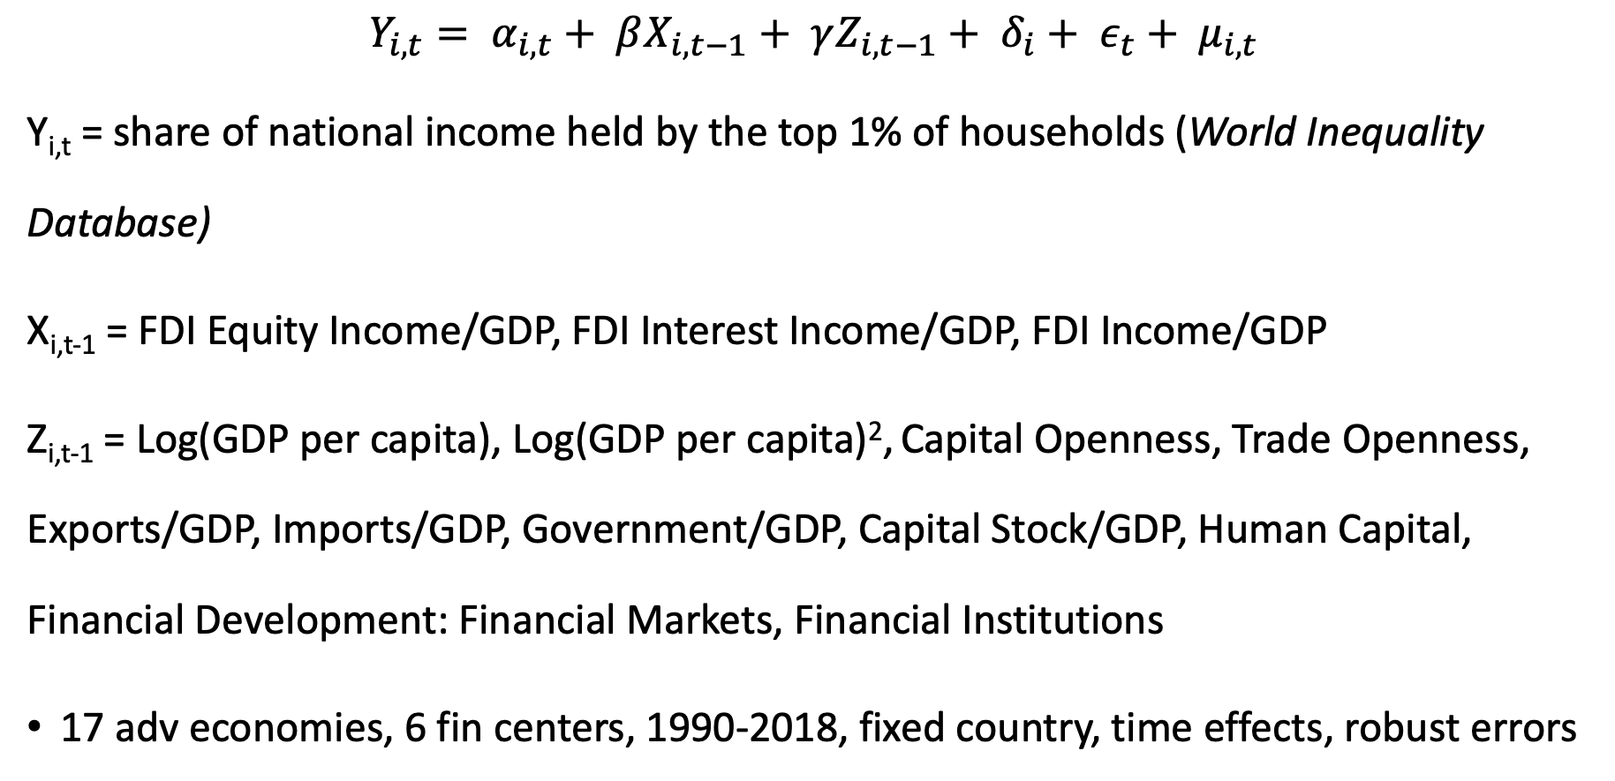
Empirical Analysis: Impact of FDI Income on Income Inequality
$$Y_{i, t}= α_{i,t}+ βX_{i, t−1}+ γZ_{i, t−1}+ δ_{i}+ ε_{t}+ μ_{i, t}$$
Y_{i,t} = share of national income held by the top 1% of households (World Inequality Database)
X_{i,t-1} = FDI Equity Income/GDP, FDI Interest Income/GDP, FDI Income/GDP
Z_{i,t-1} = Log(GDP per capita), Log(GDP per capita)², Capital Openness, Trade Openness, Exports/GDP, Imports/GDP, Government/GDP, Capital Stock/GDP, Human Capital, Financial Development: Financial Markets, Financial Institutions
17 adv economies, 6 fin centers, 1990-2018, fixed country, time effects, robust errors

Slide 14
Income Share of Top 1% and FDI Income: Advanced Economies (IMF Data)

Slide 15
Income Share of Top 1% and Portfolio, Other, Investment and Primary Income: Advanced Economies (IMF Data)

Slide 16
Income Share of Top 1% and FDI Income: Financial Centers (IMF Data)

Slide 17
Income Share of Top 1% and Portfolio Income, Other Income, Investment Income, Primary Income and Current Account: Financial Centers (IMF Data)

Slide 18
Other empirical results:
Use OECD non-SPE data where available
Use 10% income share as dependent variable
Use Prais-Winsten regressions with panel-corrected standard errors

Slide 19
Conclusions
Distribution of FDI income concentrated among few advanced countries
FDI income in these economies consists of equity income, while financial centers benefit from interest income
Top tiers of income distribution benefit from FDI equity profits
FDI income increases inequality both among and within countries

Slide 20
Further reading:
Joyce, “The Sources of International Investment Income in Emerging Market Economies, “ Review of International Economics, 2021 (forthcoming)

