Slide 1
The IMF’s Mandate: Comments on Presentation by John Hicklin, June 8, 2021
Harold James
Princeton University and IMF
hjames@princeton.edu

Slide 2
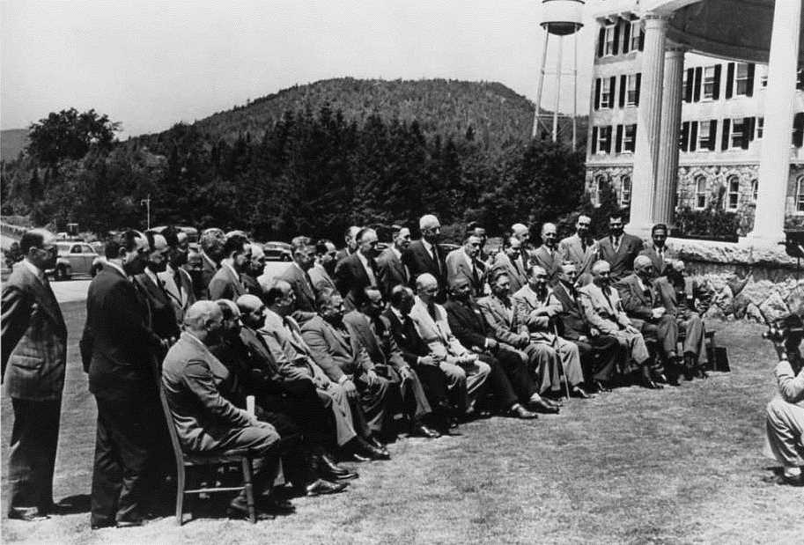
1. Evolution of mandate or response to urgency of deep crisis?

Slide 3
2. Flexibility in mandate: The chances given by a broad formulation
(i) To promote international monetary cooperation through a permanent institution which provides the machinery for consultation and collaboration on international monetary problems.
(ii) To facilitate the expansion and balanced growth of international trade, and to contribute thereby to the promotion and maintenance of high levels of employment and real income and to the development of the productive resources of all members as primary objectives of economic policy.

Slide 4
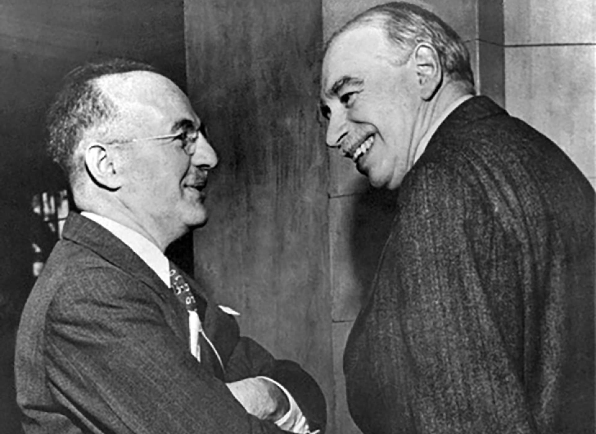
Epistemic community/normative consensus

Slide 5
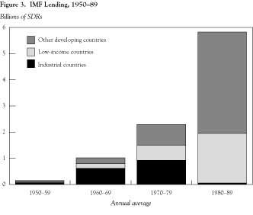
3. Example
James Boughton, The IMF and the Silent Revolution

Slide 6
4. Urgency of Climate Change and the Capacities of IMF Surveillance: The Four Ts
Teeth
Traction
Tracking
Teaching

Slide 7
5. Relationship to Security
Key issue: 1944/45 parallelism of UN Security Council and IMF 5 largest quota holders
Difficulty of distinguishing political and economic aspects of global goods (Morgenthau “Prosperity, like peace, is indivisible. We cannot afford to have it scattered here or there among the fortunate or to enjoy it at the expense of others.”)
Corruption as major governance issue
Climate change as distributional

Slide 8
2019 current $ GDP (trillions) (World Bank)
United States | 21433
European Union | 15626
China | 14280
Japan | 5081.8
Germany | 3861.1
India | 2868.9
United Kingdom | 2829.1
France | 2715.5
Italy | 2003.6
Brazil | 1839.8
Canada | 1736.4
Russian Federation | 1699.9

