Slide 1
IEO webinar on: Inflation: Transitory or Troubling? Presentation by: Surjit Bhalla November 30, 2021
Disclaimer: Views expressed are those of the presenter and should not be ascribed to the IMF, its Executive Board or any other institution with which the presenter or his co-authors are affiliated.

Slide 2
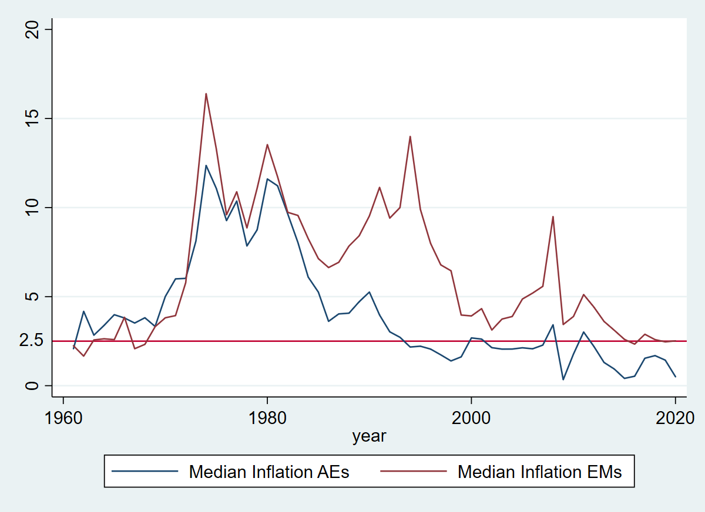
Inflation has been declining almost everywhere …

Slide 3
… and this may not be just a monetary phenomenon
Central bankers claim credit (“better monetary management”) …
Spread of best practices, particularly inflation targeting (IT)
Anchored expectations, in part due to spread of IT
Fewer policy mistakes
… but structural factors may also be at play
Demographics
Globalization (Rogoff, 2003)
Unlimited supplies of skilled labor (Bhalla)
Unfettered mobility of capital (Loungani)
Take-away from this presentation:
take the structural view seriously and be cautious about giving too much credit to better monetary management

Slide 4
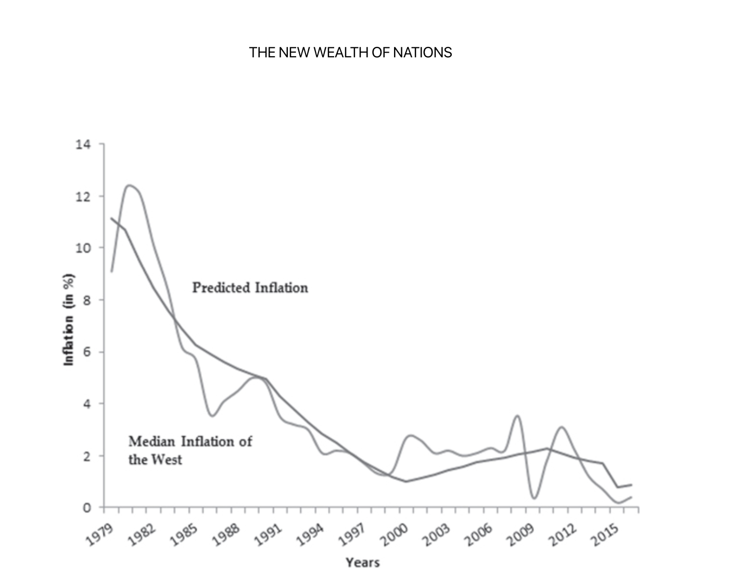

Unlimited Supply of ‘Skilled’ Labor
Steady expansion of college-educated workers in developing world (the “Rest”)
These workers have displaced those with less than a high school education in advanced economies (the “West”) and are now starting to threaten jobs of those with higher skills
Consequence is low wage growth in advanced economies and low inflation
The narrowing gap in skilled labor supplies between the Rest and the West can account for the decline in median inflation in the West

Slide 5

Inflation Targeting: Vaccine or Placebo?
No difference between median inflation in IT vs. non-IT countries
No difference in inflation anchoring between IT and non-IT countries
No guarantee against policy mistakes (Krugman, 2015, “rate hike fever”)

Slide 6
Similar inflation developments in IT and non-IT countries
2000-2009
2000-2009

Slide 7
Similar inflation expectations in IT and non-IT countries

Slide 8
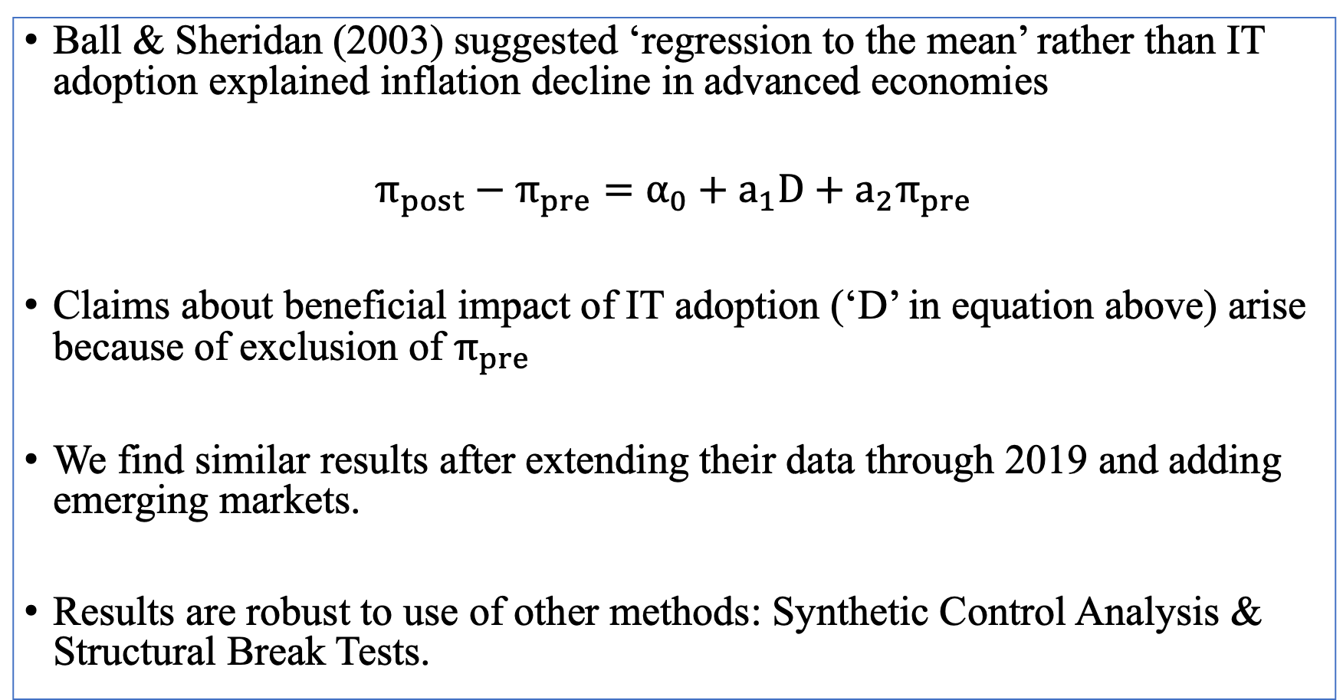
IT adoption and inflation: Updating Ball & Sheridan (2003)
Ball & Sheridan (2003) suggested ‘regression to the mean’ rather than IT adoption explained inflation decline in advanced economies
$$π_{post}−π_{pre}=α_{0}+a_{1}D+a_{2}π_{pre}$$
Claims about beneficial impact of IT adoption (‘D’ in equation above) arise because of exclusion of $π_{pre}$
We find similar results after extending their data through 2019 and adding emerging markets.
Results are robust to use of other methods: Synthetic Control Analysis & Structural Break Tests.

Slide 9
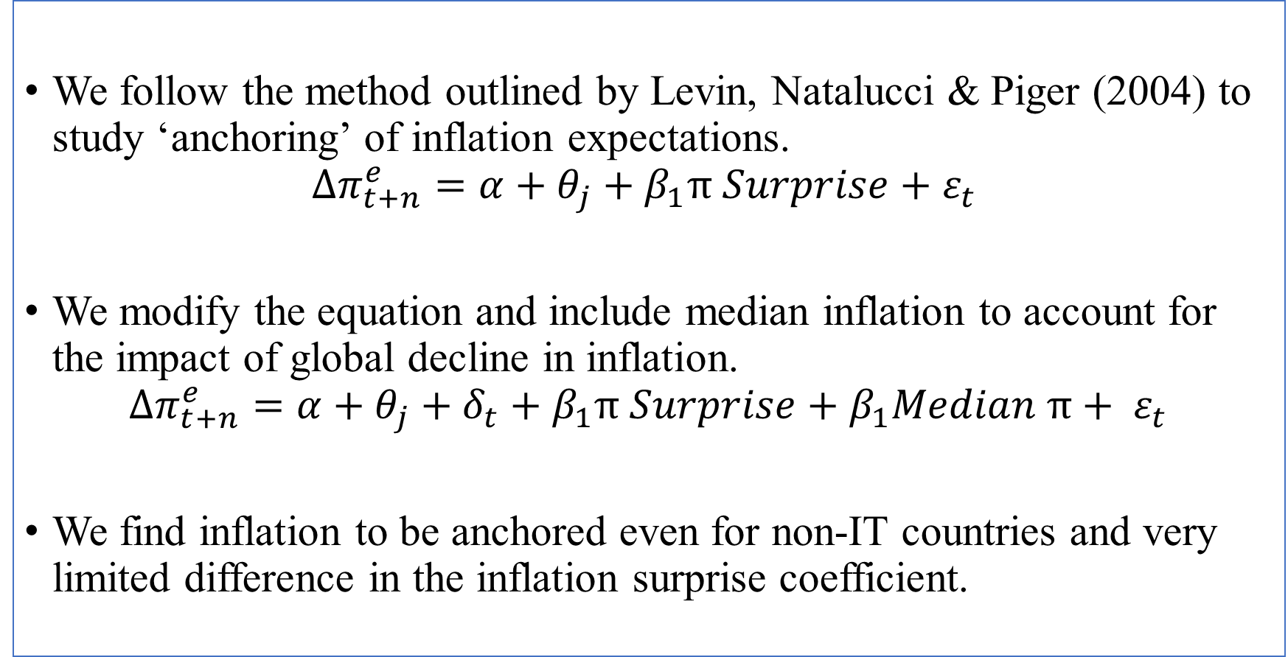
Anchoring of Inflation Expectations
We follow the method outlined by Levin, Natalucci & Piger (2004) to study ‘anchoring’ of inflation expectations.
$$∆π_{t+n}^{e}=α+θ_{j}+β_{1}π Surprise+ε_{t}$$
We modify the equation and include median inflation to account for the impact of global decline in inflation.
$$∆π_{t+n}^{e}=α+θ_{j}+δ_{t}+β_{1}π Surprise+β_{1}Median π+ ε_{t}$$
We find inflation to be anchored even for non-IT countries and very limited difference in the inflation surprise coefficient.

Slide 10
Policy mistakes?
Single-minded attention to inflation can sometimes prove costly (Krugman, 2015, “rate hike fever”)
Greenspan’s Feb. 1995 rate hike based on concerns about inflation
ECB hiked rates in July 2008 worried about impact of oil prices on inflation
ECB hiked rates 50 basis points in July 2011
Roubini, 2011: ECB’s “biggest mistake ever, the rate hike that sharply worsened the Euro Zone crisis”
Swedish central bank raised rates in 2010, with unemployment still at 9% (Svensson, 2011)
India: real policy interest rates in 2016-19 almost always higher than RBI’s ‘neutral’ real policy rate

Slide 11
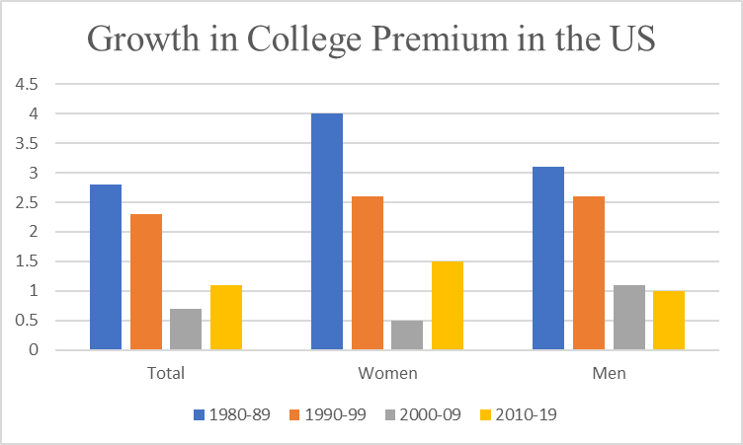
Declining Growth across 4 decades?!

Slide 12
Additional Slides

Slide 13
Average Inflation: IT vs. non-IT countries
 | Number of Countries |  | Average Inflation |  | Median Inflation
 | IT Regime | Non-IT Regime | IT Regime | Non-IT Regime | IT Regime | Non-IT Regime
Advanced Economies
1990-99 | 5 | 22 | 2.0 | 3.1 | 2.3 | 2.7
2000-09 | 7 | 19 | 2.8 | 2.1 | 2.2 | 2.2
2010-19 | 9 | 17 | 1.8 | 1.2 | 1.4 | 1.5
Emerging Markets & LDCs
1990-99 | 6 | 123 | 7.2 | 5.4 | 5.1 | 8.4
2000-09 | 19 | 147 | 4.7 | 5.0 | 5.0 | 4.7
2010-19 | 22 | 139 | 4.0 | 3.5 | 3.1 | 3.1
Columns 1 and 2 take the mean of CPI inflation across countries over the decade. Median inflation is taken for each of the years across countries and is then averaged over the decade for inflation targeters and non-inflation targeters.

Slide 14
Anchoring of Inflation Expectations: IT vs. non-IT countries
 | Inflation Targeters |  |  | Non-Inflation Targeters
 | 3 years ahead | 5 years ahead | 10 years ahead | 3 years ahead | 5 years ahead | 10 years ahead
Advanced Economies
1990-99 | 2.5 | 2.4 | 2.4 | 2.5 | 2.5 | 2.5
2000-09 | 2.0 | 2.0 | 2.0 | 1.9 | 1.9 | 1.9
2010-19 | 1.9 | 1.9 | 1.8 | 1.7 | 1.8 | 1.8
Emerging Markets
1990-99 |  |  |  | 6.0 | 5.5 | 5.2
2000-09 | 3.7 | 3.5 | 3.5 | 3.5 | 3.4 | 3.3
2010-19 | 3.7 | 3.6 | 3.5 | 3.0 | 2.9 | 2.9
Excludes ‘high inflation’ cases (defined as inflation rate above 20 per cent. Results are similar for high-inflation cases.

Slide 15
Wages in US by Education Status
Average Wage Growth
 | Less than HS | High school | Some college | Bachelor's degree | Advanced degree
1980-89 | -6.5 | -3.2 | -1.1 | 1.8 | 4.1
1990-99 | -2.4 | 1.3 | 1.4 | 5.0 | 6.3
2000-09 | 2.3 | 1.6 | 0.8 | 1.8 | 2.8
2010-19 | 2.0 | 0.4 | 0.3 | 2.6 | 2.1

Slide 16
Wages in US by Education Status
Average Wage Growth - Women
 | Less than HS | High school | Some college | Bachelor's degree | Advanced degree
1980-89 | -4.3 | -0.5 | 2.8 | 5.6 | 6.6
1990-99 | 0.6 | 2.5 | 2.3 | 6.2 | 6.9
2000-09 | 2.5 | 2.2 | 1.4 | 1.8 | 2.6
2010-19 | 2.6 | 1.8 | 2.0 | 2.4 | 4.0

Slide 17
Declining Growth across 4 decades?!
Period | College Premium |  |  | Growth in College Premium
 | Total | Women | Men | Total | Women | Men
1980-89 | 11.7 | 8.6 | 13.4 | 2.8 | 4.0 | 3.1
1990-99 | 14.2 | 11.6 | 16.3 | 2.3 | 2.6 | 2.6
2000-09 | 16.7 | 13.7 | 19.7 | 0.7 | 0.5 | 1.1
2010-19 | 18.0 | 14.8 | 21.7 | 1.1 | 1.5 | 1.0

