Slide 1

Real Estate Markets during COVID-19
June 24, 2021
Nina Biljanovska, Chenxu Fu, Deniz Igan
The views expressed here are those of the authors and do not represent those of the IMF, its Management, or Executive Board.

Slide 2
What we expected in an unprecedented year:
Conceptually, both downward and upward pressure on residential real estate prices possible
By contrast, downward pressure on commercial real estate likely to dominate but an open question if transitory or permanent

Slide 3
The channels of impact: Residential real estate
Downward pressure
Disruption in activity and unemployment → Delinquencies and decline in demand for housing
Tighter lending standards → Forced sales
Upward pressure
Slowdown in construction and mobility → Decline in supply of housing
Policy support → Reduced debt burden and improved affordability
Beyond aggregate impact, possible within market reallocation due to shift in preferences and/or heterogeneous impact across households
Notes:
Downward pressure factors. The disruption in activity due to COVID-19 and the sudden increase in unemployment may lead to a rise in delinquencies and defaults on household debt as well as a decline in demand for housing. The decline in demand could be intensified if lockdown measures or voluntary social distancing put limits on in-person viewing of properties and in-person completion of transactions—although a third of recent buyers reportedly have not seen the property they ended up buying before they made the decision to do so. Moreover, households’ access to credit may be restricted by tighter lending standards due to worsening employment and income prospects. If homeowners cannot use their house as collateral to borrow against when faced with a liquidity crunch, they may be forced to put it on the market for sale. These factors may put downward pressure on residential real estate prices.
Upward pressure factors. The decline in demand may be offset by lower supply from slowdown in the construction of new houses. In addition, fiscal support to households and (voluntary or publicly-assisted) loan forbearance may help prevent an increase in distressed transactions. Finally, lower mortgage rates due to monetary policy accommodation could ease debt service burden and improve affordability and, hence, help alleviate the downward pressure on house prices.
Within market forces. In the longer run, there may be a shift in housing preferences: If people believe that a second wave of pandemic would bring another round of stay-at-home orders or that they would be working from home more frequently than they did pre-COVID, demand for larger homes in suburban/rural areas may increase while that for properties in city centers may decrease. It is not clear how this would affect house prices in the aggregate but the reallocation across housing segments may have profound implications. This could be the case, for instance, if those currently owning properties in city centers have higher income and would be able to bid out lower-income buyers in newly popular suburban/rural areas.

Slide 4
The channels of impact: Commercial real estate
Differential impact across segments
Uneven disruption in activity → Hospitality and retail hardest hit
Persistence of the shock
If transitory, government programs and intertemporal borrowing to weather out
If persistent, defaults and downward pressure on prices inevitable (how disruptive depends on the speed of adjustment)
Shift in preferences, including work modalities, may put additional downward pressure
Notes:
Differential impact across segments. The severe disruption in economic activity following the outbreak could reduce prices of commercial real estate by bringing down business earnings and increasing the need for credit used to weather the downturn. The impact on some sectors—such as hospitality, retail, and services requiring close contact—may be more pronounced given the stay-at-home orders and voluntary social distancing.
Persistence of the shock. Some of the monetary, fiscal, and financial policies that have been put in place may help bridge the difficulties faced by businesses, but it all depends on how long the shock lasts. If the shock is transitory, the adverse effects on production could be smoothed out to an extent by government programs or by inter-temporal borrowing. However, if the shock continues for a longer period, firms’ borrowing capacity may be limited—especially for those in more leveraged sectors—and hence firms may experience defaults. This could result in sales of commercial property, putting a downward pressure on prices.
Preferences. Similar to residential real estate, there may be a shift in preferences away from city centers to suburban places. In addition, some businesses could permanently move to a work-from-home modality. On the aggregate, however, demand for office space may hold up as social distancing would require more square-foot space per worker. For retail and hospitality, the net effect may be on the downside as the decline in demand may prove to be more permanent and the potential to switch to work-from-home is considerably more limited. In addition, office-based businesses switching to work-from-home modality may have negative spillovers to the hospitality segment as business travel becomes less frequent.

Slide 5
Residential real estate markets are up
A quick recovery in activity
Rapid increase in prices while rents stagnate
Sources: Haver, staff calculations.
Sources: BIS, OECD, staff calculations.
Notes:
Evidence at the end of 2020 pointed to a short-lived downturn in activity with little or no negative impact on residential real estate prices but notable downward pressure on commercial real estate. Half way into 2021, we are seeing signs of a turnaround. Similar to some other parts of the economy, residential real estate activity seems to have rebounded after a very sharp decline. This pattern is pretty broad-based and is reflected in undisrupted—even accelerating—increase in house prices while rents have stagnated.

Slide 6
But not at the same degree in all segments, while discrepancy within CRE segments is disappearing
Houses gaining faster than apartments in most countries
Commercial real estate has recovered but remains fragile
Sources: Haver, staff calculations.
Sources: NAREIT, staff calculations.
Notes:
Residential prices are up, in particular for single-family houses. This is mostly the case for Northern America and Europe, with some Asian countries (notably, Korea) showing the opposite pattern.
The distress on commercial real estate indeed appears to have been short-lived with even the hardest-hit segments coming back to pre-COVID levels, at least in the western hemisphere and Europe. [Asia is yet to recover fully, while Middle East & Africa has been on a downward trend even before the pandemic.]
What is next for these hardest-hit CRE segments? Lodging & resorts showed a strong performance with vaccine news but remain sensitive to sentiment. Office and retail is not out of the woods yet, with limited data showing some pressure on rents and some companies publicly announcing permanent work-from-home arrangements.

Slide 7
A closer look at the US
Inventory very tight, esp. for single-family homes
Construction material costs on the rise
Sources: Redfin, Haver, staff calculations.
Sources: BLS, Haver, staff calculations.
Notes:
What factors could be behind the heated housing markets in the US?
low inventory because sellers are waiting for the end of the pandemic to sell,
low construction activity because of lockdowns further exacerbating the already tight inventory due to a decade of sluggish construction activity as developers waited to see whether preferences of millenials would differ from the earlier generations,
higher construction costs because of pressure on material prices (partly due to tariffs imposed under the Trump administration and partly because of curbs on raw material production in China),
low interest rates.
Temporary or permanent? Remains to be seen.

Slide 8
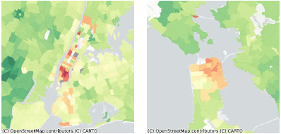
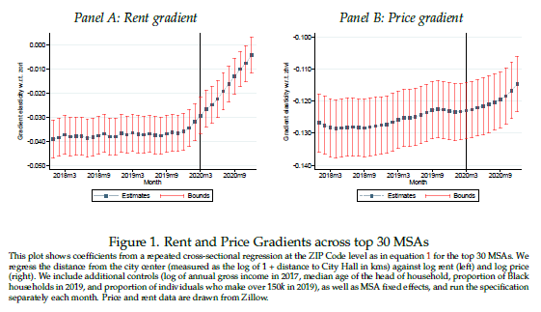
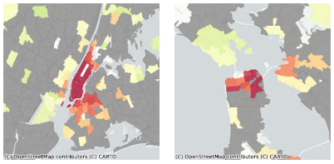
Work-from-home enabling moves away from the urban core to suburbs
House prices declined in formerly bubbly cities such as NYC and SF
…rents declined even more
Weakening link between distance to city center and rents/prices
Source: Gupta et al. 2021, NBER WP 28675.
Notes:
Surveys and patterns observed so far suggest that we may see significant shifts reflecting a switch to permanent telework. Estimates vary widely but about 25 percent of the workforce could be working remotely full time in the post-pandemic normal, up from about 10 percent before COVID (https://www.cnbc.com/2020/12/15/one-in-four-americans-will-be-working-remotely-in-2021-survey.html). And housing preferences are affected as a result with half of remote-working home buyers saying that WFH influenced their decision to move to a different home or to a different location altogether (https://www.zillow.com/research/commutes-remote-work-chtr-26506/).
This is in line with the divergences we showed across different types of housing. A more granular look at within-city patterns suggest that urban cores suffered, in particular in locations with less affordable housing and more teleworkable jobs, such as NYC and SF. Analysis of the link between distance to the city center and rents or prices shows that the relationship has weakened, consistent with people moving farther away from the city center but perhaps remaining within the city boundaries. This is particularly the case for rents and less so for prices.
Migration patterns across states also support these surveys and patterns in the price & rent data, yet it may be too early to call it a permanent urban exodus. For instance, NYC experienced the most outbound migration in 2020 (https://www.forbes.com/sites/forbesrealestatecouncil/2020/12/01/are-people-really-moving-out-of-cities-due-to-the-pandemic/?sh=3b271eca6279)
but Jan-Feb 2021 data already shows a rebound (https://www.unacast.com/insights/migration-pattern-report).

Slide 9
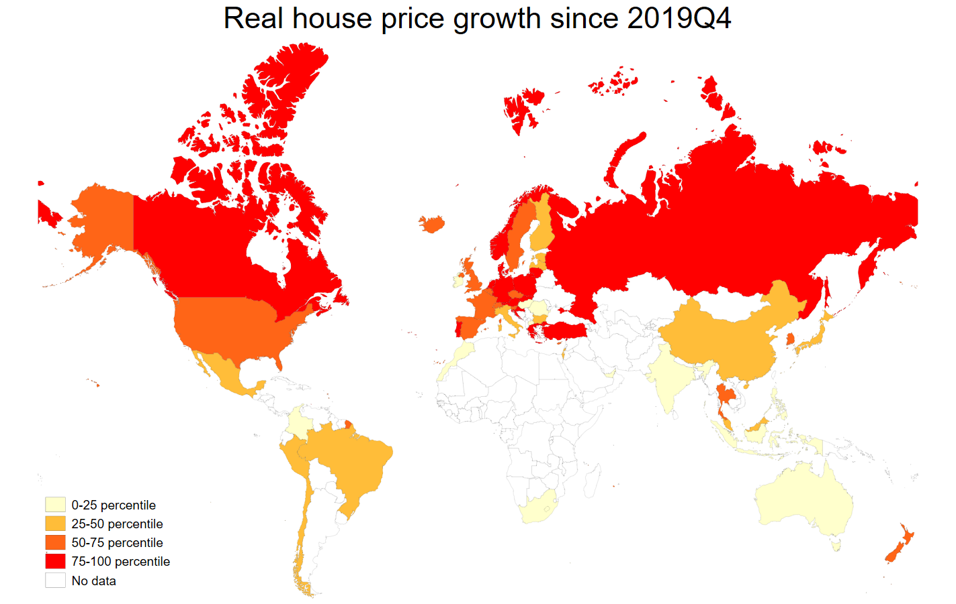
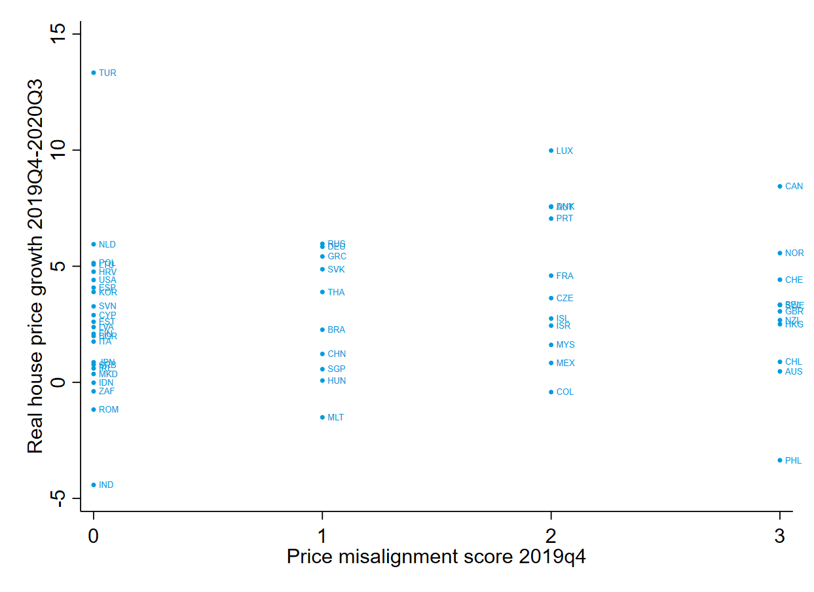
Is there a more general bubble forming?
Sources: BIS, OECD, IMF staff calculations.
Notes:
Going back to the global picture, we have seen strong price growth over the last year in most parts of the northern hemisphere. How worried should we be about another house price bubble in multiple countries? One concern, for instance, would be that we are seeing price growth accelerating in places where housing markets were already overheated. For this assessment, we look at three indicators—price-income ratio, price-rent ratio, and a regression model to gauge deviation of house prices from historical patterns and fundamentals. If an indicator exceeds a certain threshold, it is assigned a value of one, otherwise it is set to zero. This is then summarized in a price misalignment score that takes values between 0 and 3.
Somewhat comfortingly, we do not detect a systematic relation between pre-pandemic indicators of house price misalignment and the growth in prices since the pandemic.

Slide 10
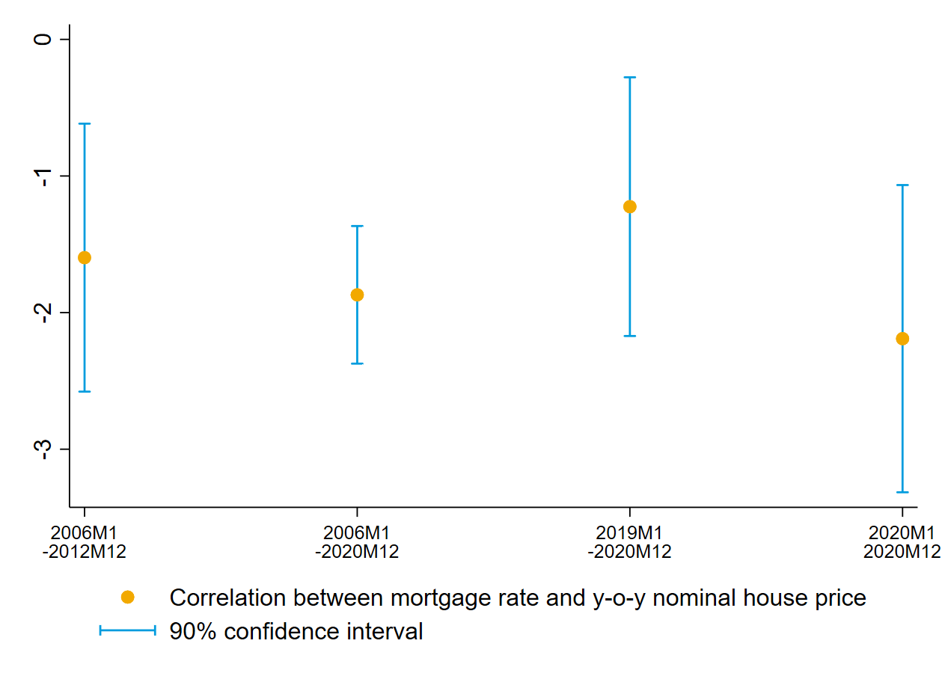
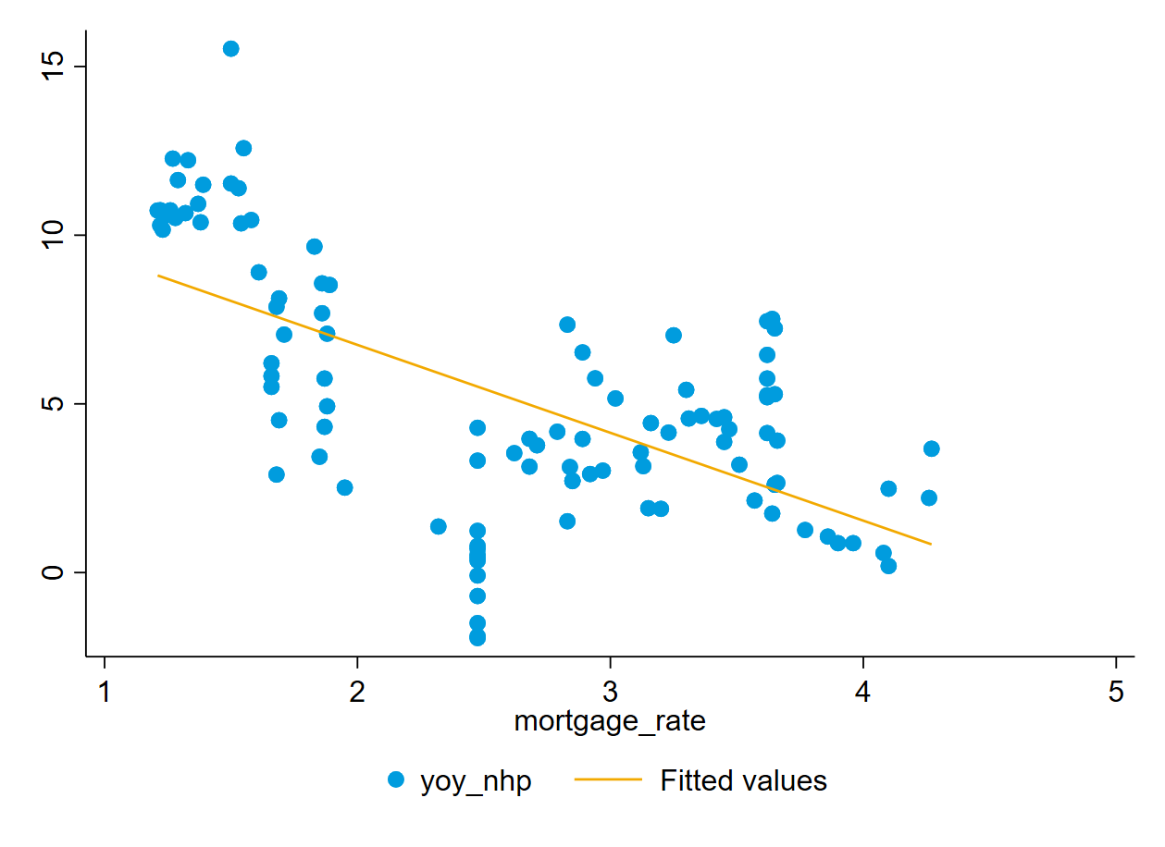
Interest rates an important factor
Source: RES Real Estate Module.
Notes:
Another important question is to what extent the increase in house prices might be driven by the decline in interest rates. We indeed observe larger increase in house prices when mortgage rates are lower. Notably, the relationship between interest rates and house prices seems to have strengthened in the past year.
Could an increase in the interest rates then prompt a correction in house prices? The answer would depend on in what context interest rates are rising, but the likely outcome is that an increase in borrowing costs would have a cooling effect on house prices by curbing demand. In terms of magnitude, the regression model we use in the IMF Research Department gives some clue, suggesting that a 100-bps change in the interest rate would typically have a 1.5-2 percent impact on house price growth.

Slide 11
Is this time different?
Sources: BIS, staff calculations.
Notes:
More broadly, are there other signs that could be concerning? The twin booms observed before the GFC where household credit and house prices increased in lock step are not dominant this time around. If anything, in the five years prior to the global pandemic declaration, house prices increased more in countries where households deleveraged more.

Slide 12
Mortgage activity this time driven by the least risky borrowers, and households (and banks) are more resilient
Sources: Federal Reserve Bank of New York, Equifax, staff calculations.
Sources: BIS, staff calculations.
Notes:
At the height of the subprime mortgage boom, one in four new mortgages were extended to a borrower with a credit score below 659. By contrast, in 2020, the share of these risky borrowers was just about 5 percent while roughly 70 percent had a credit score above 760. Importantly, the share of risky borrowers has been low since the GFC.
Underlying credit dynamics appear to be better in other countries as well. Household debt service ratios in most countries (10 out of 17) are lower today than they were when GFC hit.

Slide 13
Takeaways
Real estate markets are in the up phase
The downturn in the commercial segment has been mostly short-lived, but a shift in preferences still a threat to the hardest-hit segments
House price increases are accelerating in many countries but weak link to pre-COVID vulnerability factors, and could be a transitory bump due to demand-supply mismatch
That said, low interest rates are a factor in driving prices up—a sharp increase in rates could be disruptive through the negative impact on demand and affordability
Things to watch:
End of foreclosure moratoria and forbearance
Move from city centers to less dense areas (potential implications for inequality)
Notes:
Summary:
At the beginning of the pandemic, we argued that both upward and downward pressure on house prices were possible while downward pressure on commercial real estate would likely dominate. For the latter, we have observed a sharp downturn followed with some recovery but the uncertainty associated with the post-pandemic normal still poses a threat.
On the residential side, for the most part, we have been seeing signs of strong housing demand combined with supply-side issues. This combination, reflecting in part the effect of policy support measures and continuation of some pre-pandemic trends, have pushed considerable pressure on house prices.
While there are a number of factors that mitigate concerns about the surrounding macro-financial risks—including more resilient household and bank balance sheets as well as more prudent lending standards, we cannot rule out the possibility of a correction and potential disruptions.
In a plausible scenario, a further rise in prices accompanied with a rise in interest rates could over the course of the year lead to some normalization in demand following the intense activity provoked by a confluence of low rates, excess savings, and working-from-home. Further, the end of foreclosure moratoria and forbearance is pending, which could generate some losses in the financial system. From a broader perspective, a sustained from urban to rural areas could not only lead to short-term disruptions but also set in motion dynamics that could affect housing affordability for incumbents due to an inflow of newcomers. We will be monitoring upcoming data closely in this context.

Slide 14
ADDITIONAL FIGURES

Slide 15
House price and rent developments, sample of 33 countries
Sources: BIS, OECD, Haver, IFS, staff calculations.

Slide 16
Global indices for CRE and construction costs
Sources: NAREIT, staff calculations.
Sources: Haver, staff calculations.

Slide 17
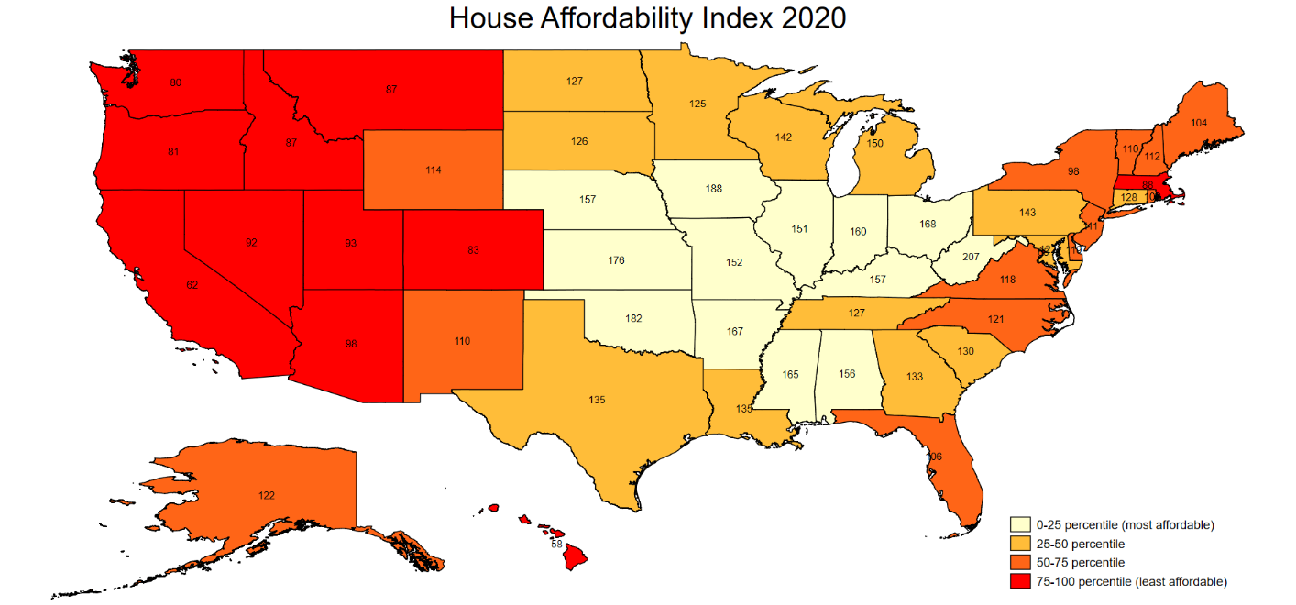
Housing affordability in the US Ratio of median household income to income necessary to qualify for a 20-percent down, 30-year, fixed-rate mortgage to purchase a median-priced home
Sources: Census Bureau, FHFA, Zillow, staff calculations.

Slide 18
Loan performance in the US
Sources: Federal Reserve Bank of New York, Equifax, staff calculations.

