Slide 1
Will Inflation
Return from the Dead?

Slide 2
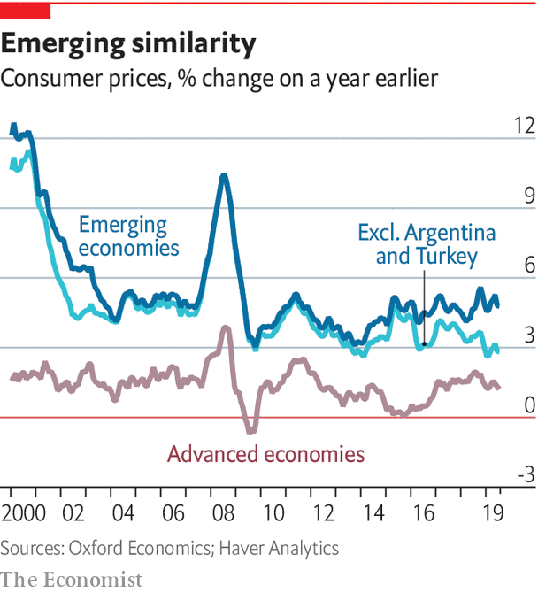
Inflation has been low for two decades

Slide 3
Success has many (inter-related) fathers
Improved monetary frameworks
Assist from structural factors
Anchored expectations
Flat Phillips curve

Slide 4
Monetary or Structural?
Monetary
structural
Adoption of inflation-targeting or similar frameworks
Central bank independence; less fiscal dominance
Focus on core inflation
Globalization
Demographics
Lower sensitivity to oil price shocks

Slide 5
NET RESULTS
Source: Blanchard, cerutti, summers (2015)
Anchored expectations
Flat Phillips curve

Slide 6
Predictions: Goodhart and Pradhan (2021)
Globalization (rise of China; re-integration of Former Soviet Union) and demography (fall in dependency ratio; increased female labor force participation) created a massive increase in global labor supply
This combined to lower the bargaining power of workers, particularly low-skilled workers
This is the reason for the low inflation of recent decades
But this will change:
  “The balance of bargaining power is now swinging back to workers, away from employers … wage trends will change … [we are at] the dividing line between the deflationary forces of the last 30-40 years and the resurgent inflation of the next two decades”

