Slide 1


WORKING PAPER
19-6 Low Inflation Bends the Phillips Curve
Joseph E. Gagnon and Christopher G. Collins April 2019
Abstract
The Phillips curve, which traces out a negative relationship between inflation and unemployment, has undergone tremendous changes over more than 100 years. Some researchers argue that the slope of the curve in the United States fell substantially around 20 years ago so that unemployment now has little or no effect on inflation. This paper shows that another hypothesis is equally consistent with the data: The Phillips curve may be nonlinear when inflation is low, with the economy having operated in the flat region of the curve for most of the past 20 years. The next few years may be decisive in the debate between these hypotheses, as unemployment has returned to a range in which a nonlinear curve ought to display significant steepness. A flat Phillips curve implies little change in inflation going forward, but a nonlinear curve implies moderate increases in inflation over the next few years.
JEL codes: E31
Keywords: Non-accelerating inflation rate of unemployment (NAIRU), unemployment rate
Joseph E. Gagnon is senior fellow and Christopher G. Collins is research analyst at the Peterson Institute for International Economics. They thank Laurence Ball, Olivier Blanchard, William Cline, Olivier Jeanne, David Lebow, Adam Posen, David Stockton, and Dan Wilson for helpful comments. All errors and opinions are their own and do not necessarily reflect the views of the Peterson Institute or other members of its research staff.

Slide 2
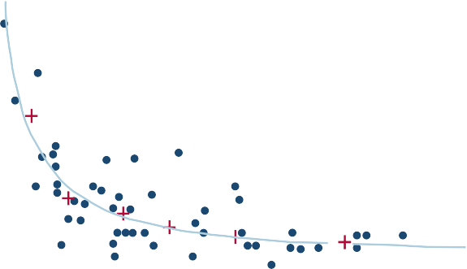
Figure 1 Original Phillips (1958) curve, United Kingdom 1861–1913
rate of change of money wage rates, percent per year 10
8
6
4
2
0
–2
–4
0
1
2
3 4
5
6
7 8 9 10 11
unemployment, percent
Source: Phillips (1958), retrieved from Wiley Online Library.

Slide 3
Figure 2 Phillips curves for different rates of expected inflation
ΔW, percent
15
10
5
0
−10
−5
0
5
10 15
GAP, percent
ΔP^{e} = 0
ΔP^{e} = 3
ΔP^{e} = 10
ΔP^{e} = 1
ΔP^{e} = 5

Slide 4


WORKING PAPER
20-6 Low Inflation Bends the Phillips Curve around the World
Kristin J. Forbes, Joseph E. Gagnon, and Christopher G. Collins March 2020
ABSTRACT
This paper models inflation by combining the multicountry framework of one of its authors (Forbes) with the nonlinear specification proposed by the other two (Gagnon and Collins). The results find strong support for a Phillips curve that becomes nonlinear when inflation is low, in which case excess economic slack has little effect on inflation. This finding is consistent with evidence of
downward nominal wage and price rigidity. The estimates also show a significant and economically meaningful Phillips curve relationship between slack and inflation when slack is negative (i.e., when output is above long-run potential).
In this nonlinear model, international factors play a large role in explaining headline inflation, a role that has increased over time, supporting the results of Forbes’ linear model.
Kristin J. Forbes is the Jerome and Dorothy Lemelson Professor
of Management and Global Economics at the MIT Sloan School of Management. Joseph
E. Gagnon is Senior Fellow and Christopher
G. Collins is Eranda Rothschild Foundation Junior Fellow at the Peterson Institute
for International Economics.
JEL codes: E31, E37, E52, E58, F62
Keywords: Economic slack, globalization, output gap, price dynamics

Slide 5
Figure 3 US price inflation, 1958Q2–2018Q4
8-quarter changes, percent annualized rates
1967Q4
1995Q1
12
9
6
3
0
1960
1970
Core CPI Core PCE
1980
1990
2000
2010
2020
Note: This figure displays 8-quarter annualized rates of change of the consumer price index (CPI) excluding food and energy and the personal consumption expenditures (PCE) deflator excluding food and energy.
Source: Authors’ calculations using data defined in appendix B.

Slide 6

Figure 4 US wage inflation, 1954Q1–2018Q4
8-quarter changes, percent annualized rates
1967Q4
1995Q1
12
9
6
3
0
1960
COMP ECI
1970
1980
1990
2000
2010
2020
Note: This figure displays 8-quarter annualized rates of change of compensation per hour (COMP) for the nonfarm business sector and the employment cost index (ECI) for civilian worker wages and salaries.
Source: Authors’ calculations using data defined in appendix B.

Slide 7

Figure 5
US unemployment GAP, 1954Q1–2018Q4
percent
1967Q4
1995Q1
6
4
GAP>0, ΔP>3
GAP>0, ΔP<3
GAP>0, ΔP<3
2
0
GAP<0, ΔP<3
−2
GAP<0, ΔP<3
GAP<0, ΔP>3
1950
1960
1970 1980 1990 2000 2010 2020
GAP>0, ΔP>3 GAP<0, ΔP<3 GAP<0, ΔP>3 GAP
GAP>0, ΔP<3
Note: GAP is the unemployment rate minus the Congressional Budget Ofice estimate of the equilibrium rate or NAIRU. Inflation thresholds are based on lagged 8-quarter core CPI inflation as shown in figure 3.
Source: Authors’ calculations using data defined in appendix B.

