Slide 1
The IMF’s Mandate:
Is it fit for purpose to face challenges of pandemics, climate change and biodiversity?
IEO Webinar June 8, 2021
John Hicklin

Slide 2
Motivation
1
Alarm at the failures of international cooperation before our eyes
Looking back from 2045 (IMF@100): What more should the IMF have done with 2020 foresight of “existential” risks ahead?
Need to rethink framework for evaluation of IMF activities (IEO@20)
Scope: Pandemics, Climate Change, Biodiversity

Slide 3
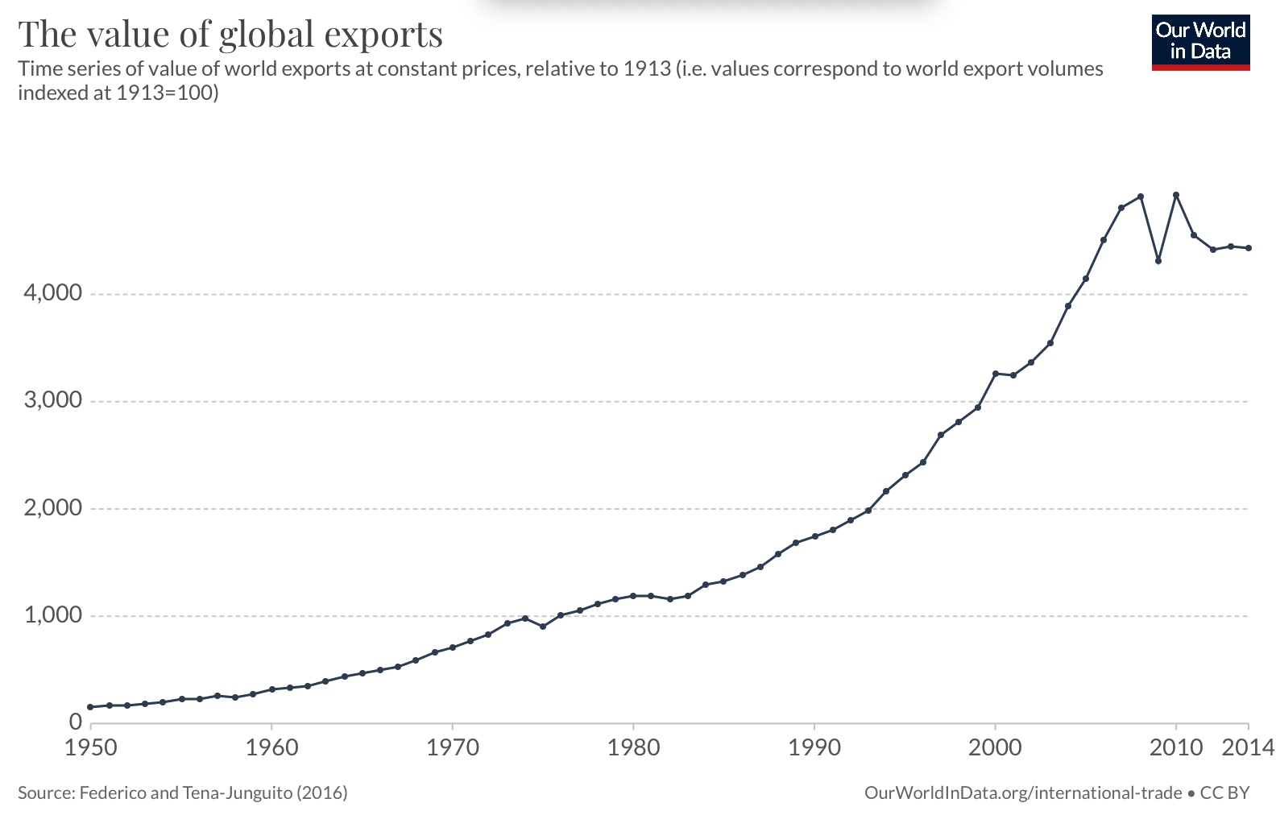

Slide 4
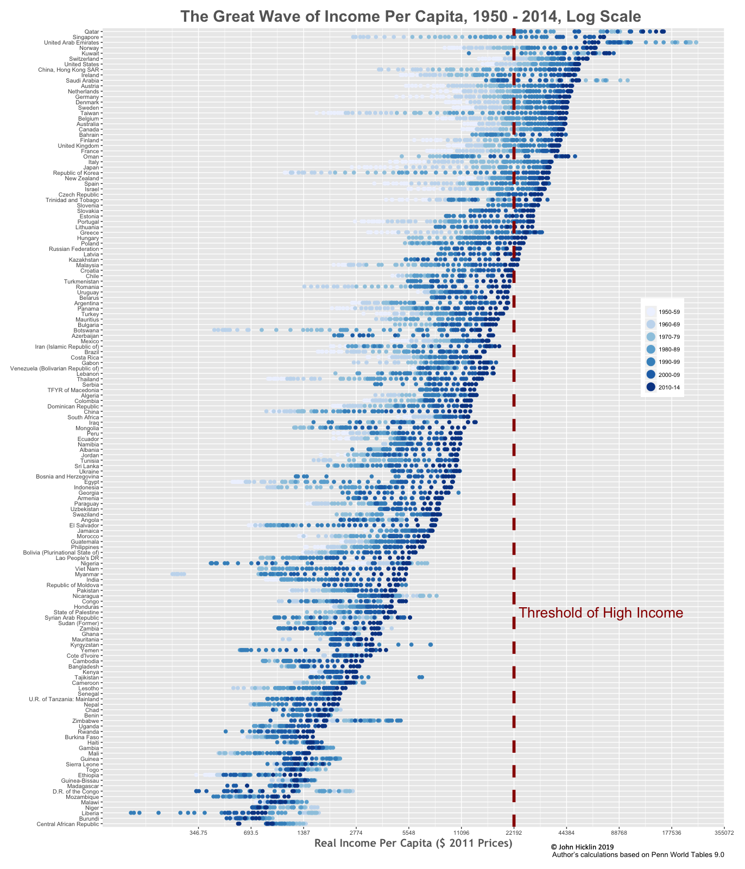
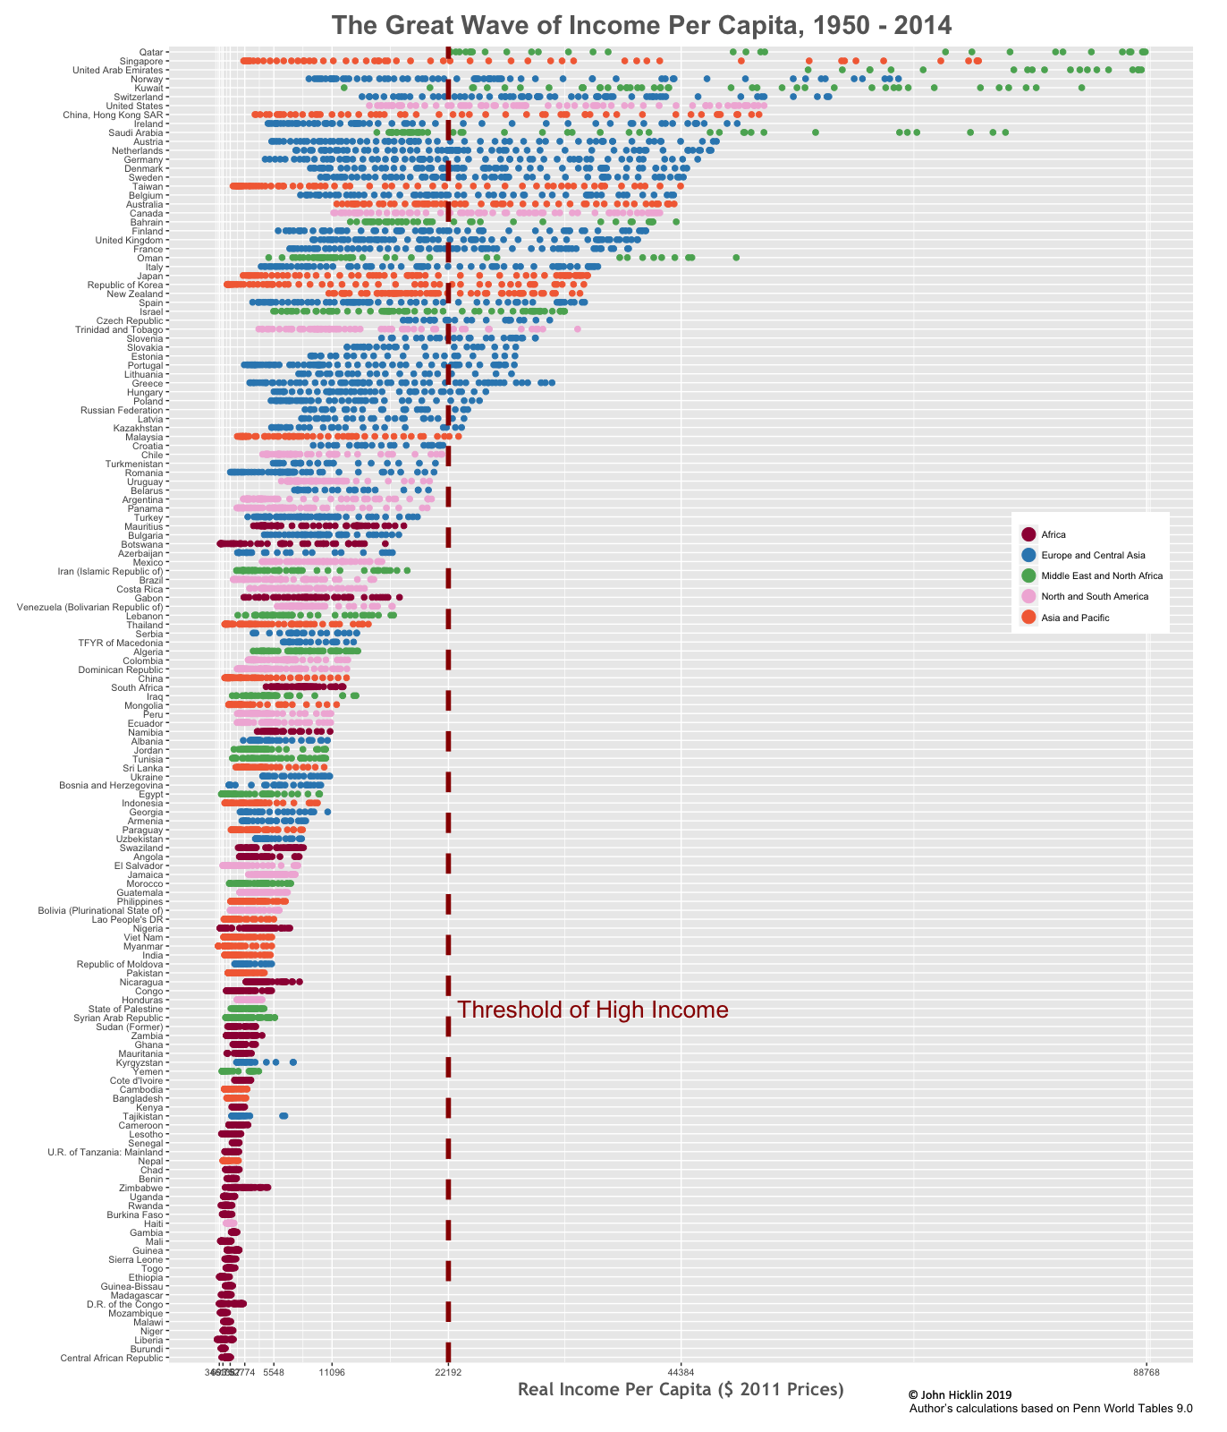

Slide 5
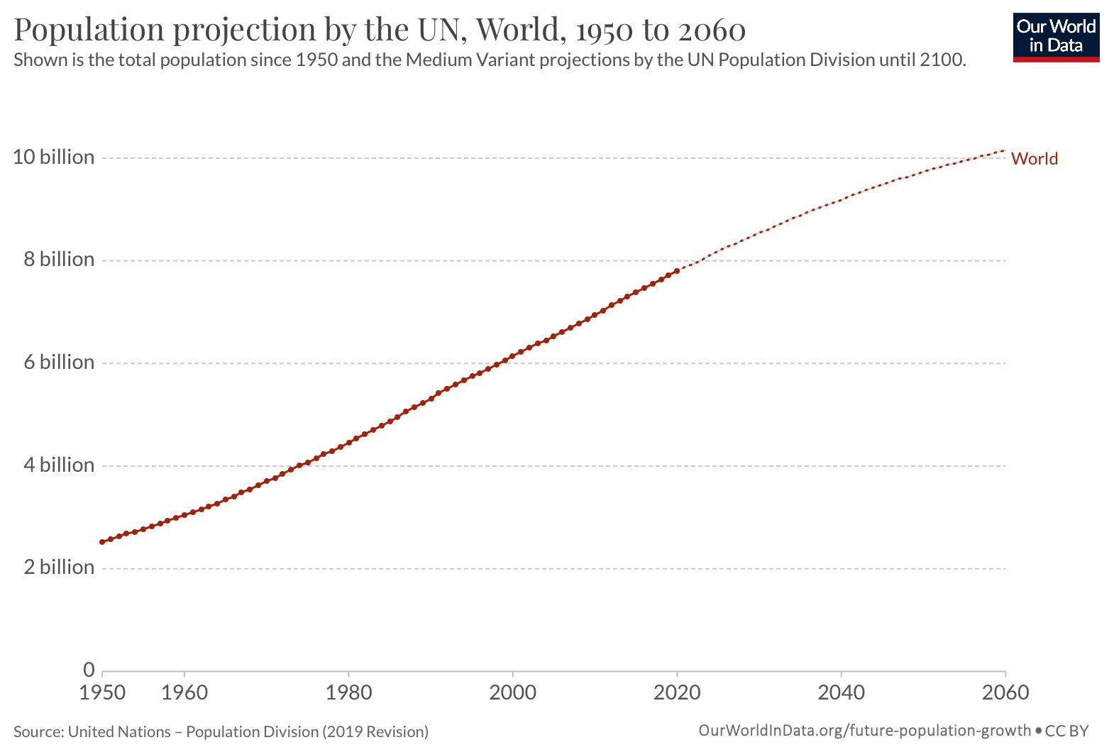

Slide 6
Outline
5
What role does the IMF mandate play?
What can the IMF do to meet new challenges with present mandate?
How could the IMF mandate be modified?
Conclusion

Slide 7
6
What role does the mandate play? Justification, flexibility, scope
Provides a clear legal justification for each IMF activity
Allows flexibility for the mandate itself to be modified
“…from the rigidity of a legal code to the flexibility of a living organism.” (Horsefield, IMF, 1969)
Allows considerable scope for the amount and depth of IMF activity

Slide 8
What role does the mandate play? Legitimacy
7
IMF legitimacy depends on much more than mandate:
moral authority – the “normative consensus” -- requires trust and engagement.
Yet, legitimacy also requires “consonance” between expectations and legal framework
Mandate changes can renew the IMF’s relevance to its purposes
Often spurred by crises or good leadership

Slide 9
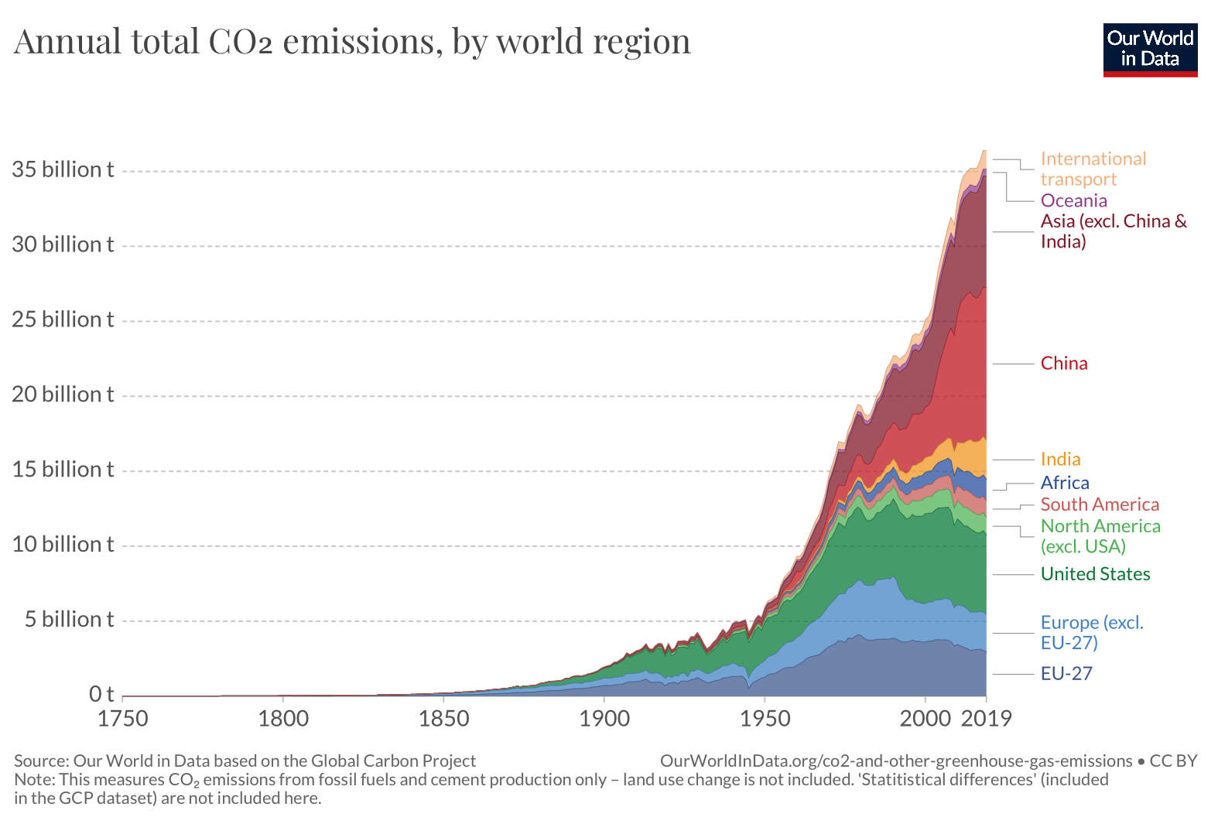

Slide 10
What can the IMF do with present mandate?
9
Pandemics
Rapid financing instruments, debt relief initiatives
Climate change, green transition
Surveillance – multilateral and new roles
Ways to increase engagement and trust
Invest in an increase in staff and staff expertise to gain traction through high quality advice (taxation, expenditure, financial system)
Integrate capacity development into surveillance and program work
Balance confidential advisor role with increasing transparency to signal private sector investment, civil society involvement.

Slide 11
Priorities for climate change and the green transition
10
Multilateral priorities
Highlight the limited global carbon budget; update on the pace of exhaustion and its economic implications
Assert the role of price mechanisms (carbon price, methane tax) and subsidy reductions to incentivize private finance and the reallocation of resources
Report on the global energy supply and how it will meet national growth targets

Slide 12
Priorities for climate change and the green transition
11
Country engagement
Understand incentives for change for each country, and when drivers for health, growth, employment coincide with green transition
Discuss each country’s “green transition action plans”: economic policies on mitigation, adaptation and transition in the context of other objectives
Discuss biodiversity obligations and economic implications
These priorities can be met with existing mandate; but will require resources & expertise

Slide 13
How could the IMF mandate be modified? Idea 1. Surveillance: From Zeitgeist to Zeitgeber
12
From happy talk of pledges to a regular IMF check on progress
Regular interim surveillance reviews on progress to global targets
Insufficient global progress would trigger review of the Integrated Surveillance Decision
N.B. Revising surveillance decisions is complex and time-consuming

Slide 14
How could the IMF mandate be modified? Idea 2. Lending: Updating the toolkit
13
Introduce a vaccine financing window
Financing for mitigation, adaptation and the green transition
Ample precedent for new financing instruments. Also…
Purpose (v) To give confidence to members by making the general resources of the Fund temporarily available to them with adequate safeguards, thus providing them with opportunity to correct maladjustments in their balance of payments without resorting to measures destructive of national or international prosperity
… clarify the meaning of “prosperity”

Slide 15
How could the IMF mandate be modified? Idea 3. The UN/IMF Link
14
1947 Agreement between the UN and IMF
Two suggestions
Formal representation to the UN of concern over mitigation efforts.
UN resolutions on climate security and biodiversity affecting IMF policy on restrictions

Slide 16
How could the IMF mandate be modified? Idea 4. Policy for new restrictions?
15
IMF purposes highlight expansion of trade, eliminating exchange restrictions
(ii) To facilitate the expansion and balanced growth of international trade, and to contribute thereby to the promotion and maintenance of high levels of employment and real income and to the development of the productive resources of all members as primary objectives of economic policy.
(iv) To assist in the establishment of a multilateral system of payments in respect of current transactions between members and in the elimination of foreign exchange restrictions which hamper the growth of world trade.
Justifications for restrictions have gained ground
If trade and exchange arrangements become a policy tool for the green transition, IMF and WTO should collaborate to establish a policy framework

Slide 17
Conclusion
16
Risks are too serious to assume that the IMF mandate is fit for purpose to deal with immense challenges ahead
Given the time constraint before irreversible consequences could emerge…
Pursue a two-track approach:
With no change in mandate: An enormous, vital, and urgent agenda
At same time, the relevance of the IMF mandate to its purpose should be reviewed urgently for new ideas
Four ideas to consider:
surveillance, lending, UN-IMF link and restrictions

Slide 18
Backup

Slide 19
What role does the mandate play? Evaluation
Provides a basis for evaluation, especially of “relevance”
“Relevance” must be linked to ultimate purpose
With new risks, the IMF should regularly review its mandate

