Slide 1

The Climate Crisis after COP27
Noah Gordon, Carnegie Endowment
For the IMF IEO
December 2022

Slide 2
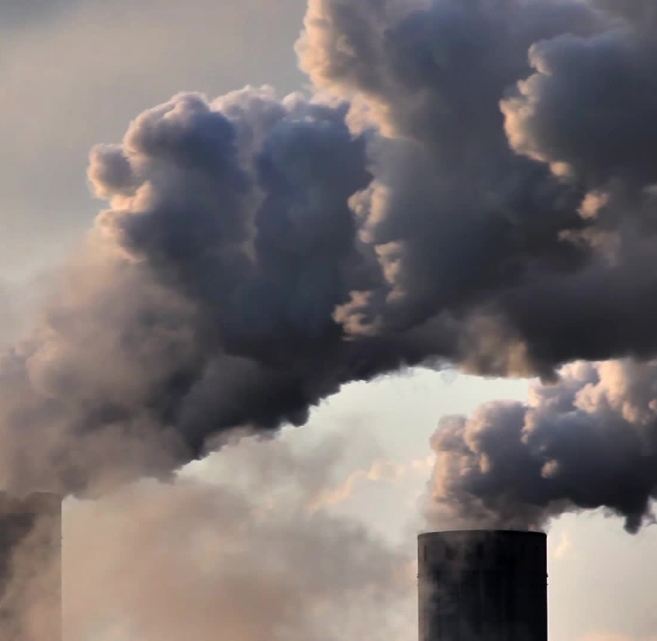
The Big Picture: Temperature Targets & Emissions

Slide 3
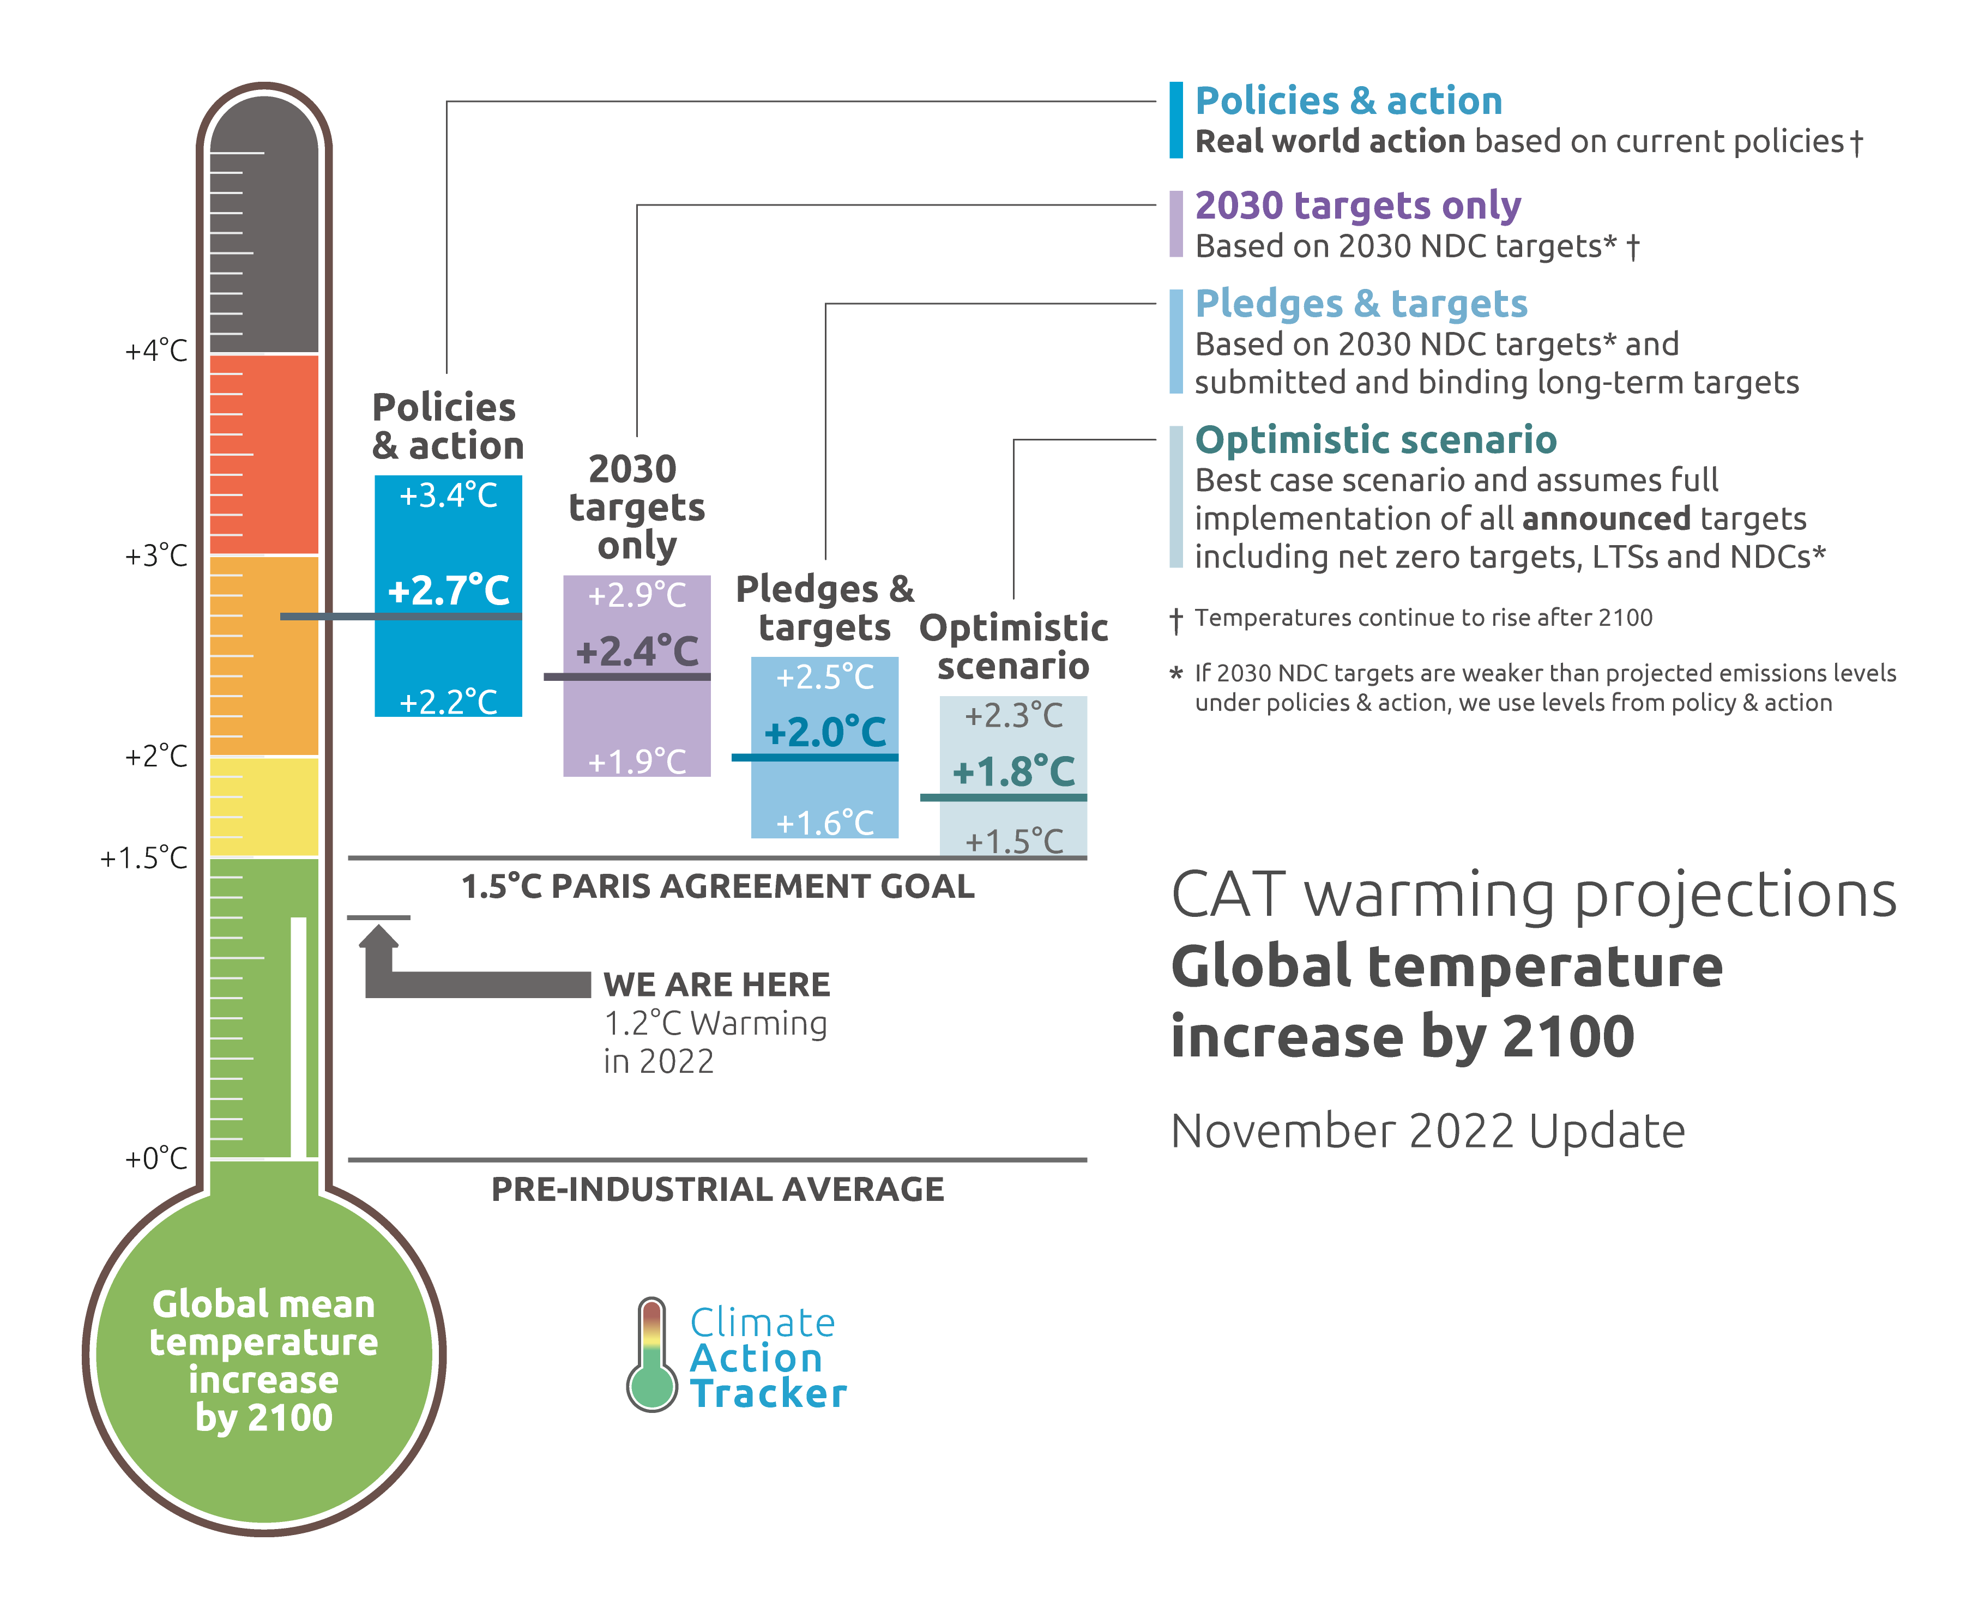
1.5˚C likely gone

Slide 4
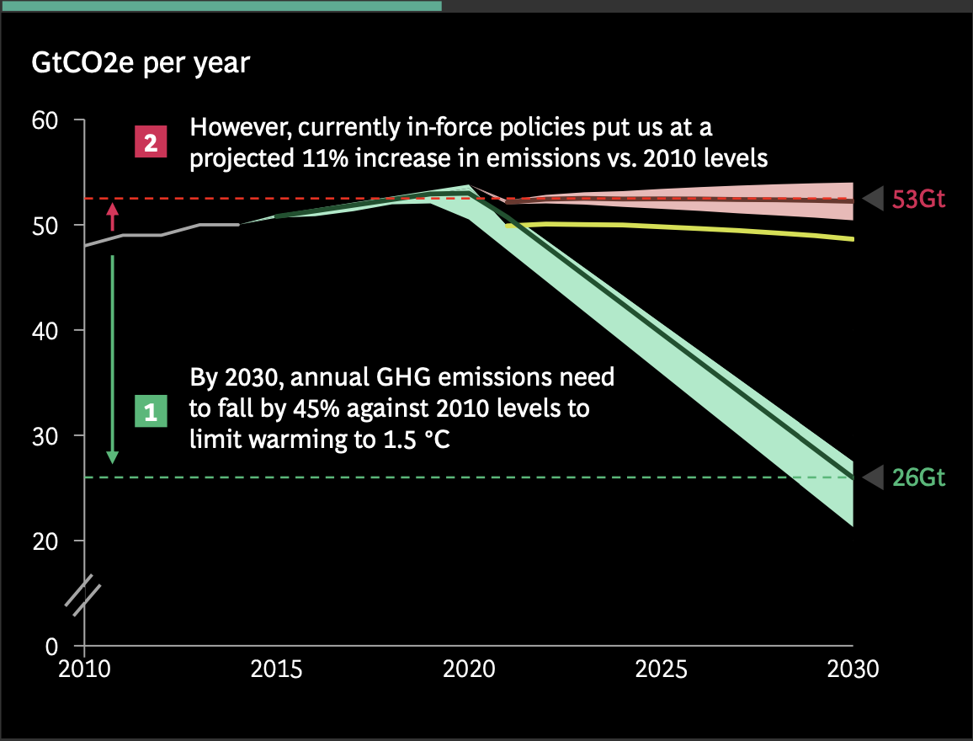
Emissions rising, not falling
Source: BCG COP27 presentation

Slide 5
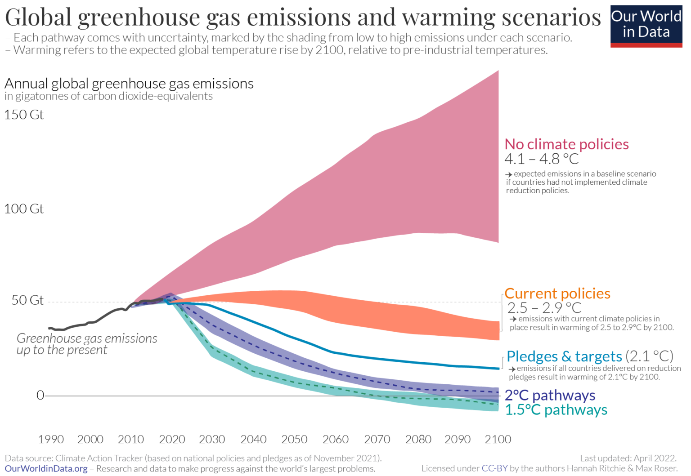
But so is 4-5˚C

Slide 6
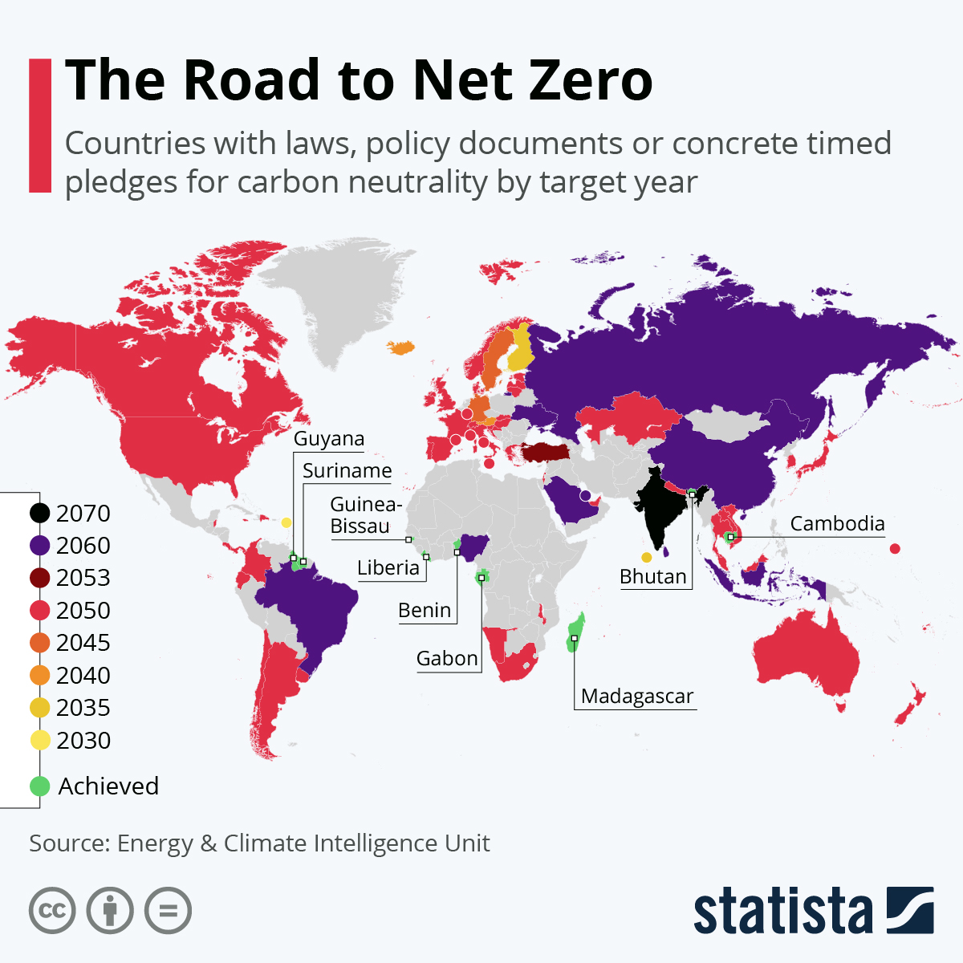
Thanks to policies & pledges

Slide 7
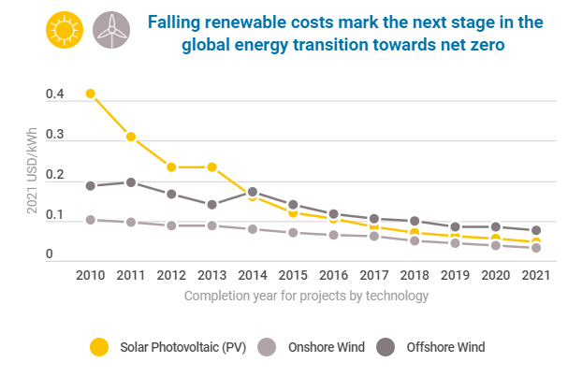
and technology
Source: Stephen Hall, WEF, 2022

Slide 8
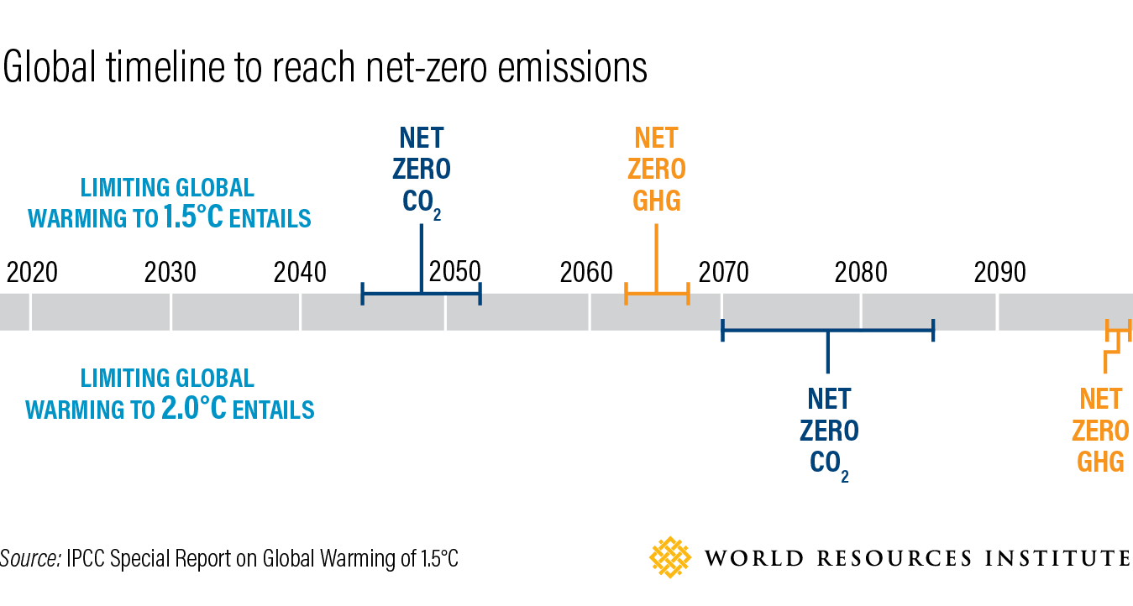
A long journey

Slide 9
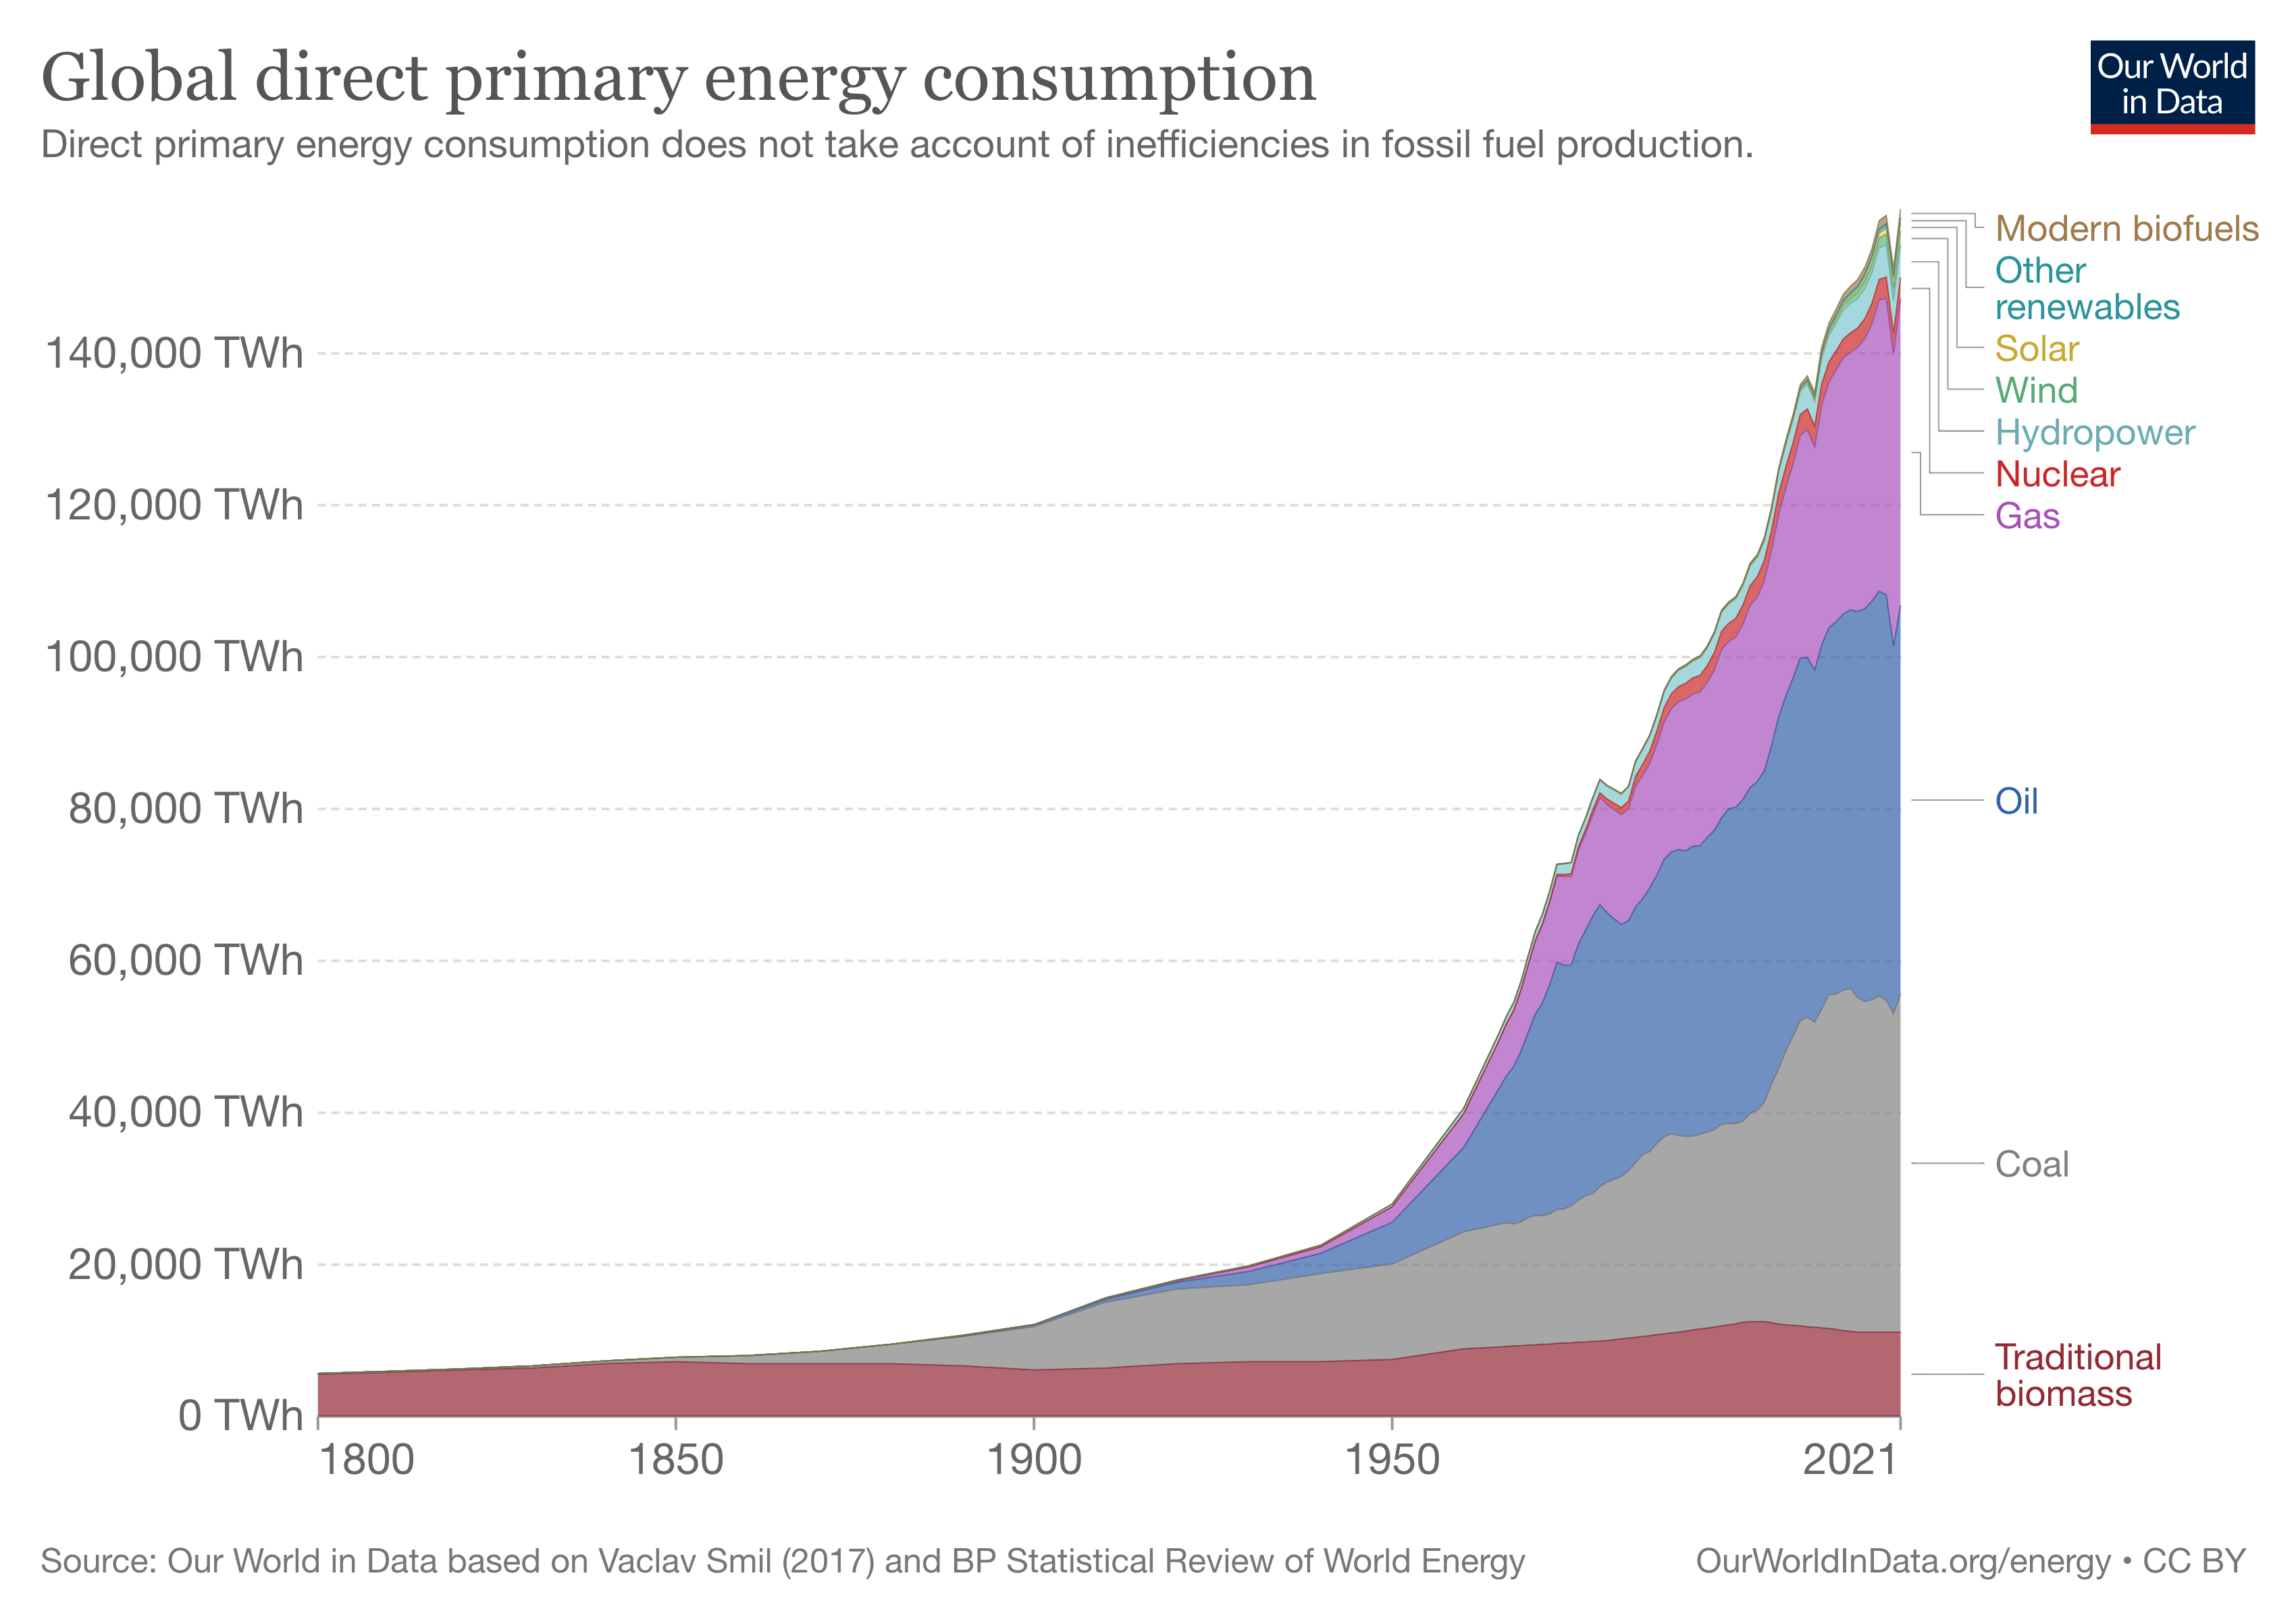
Energy additions, not transitions

Slide 10
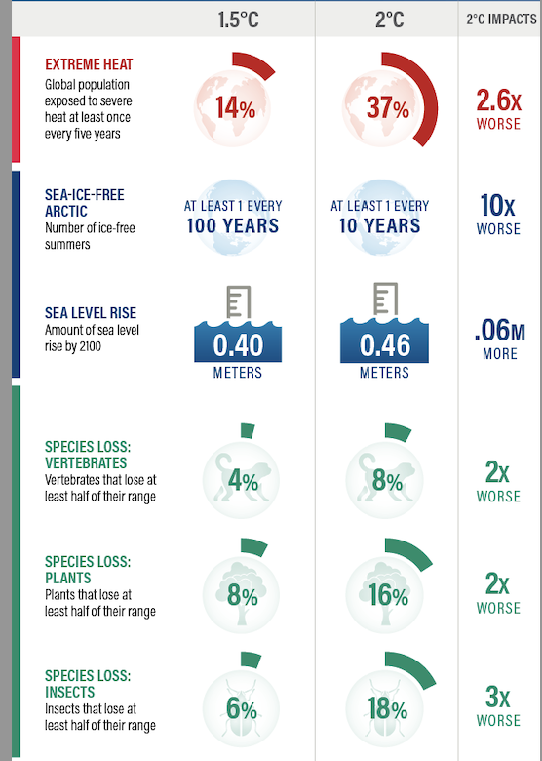
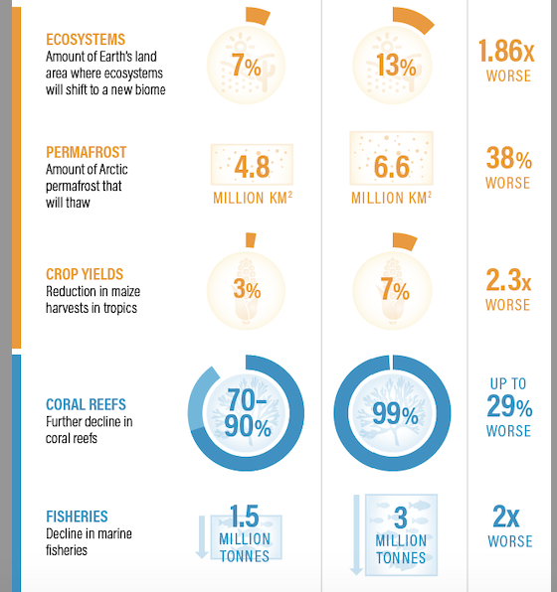
Climate impacts: 1.5˚C vs 2˚C
Source: WRI and IPCC,
Special Report on 1.5C warming, 2018

Slide 11
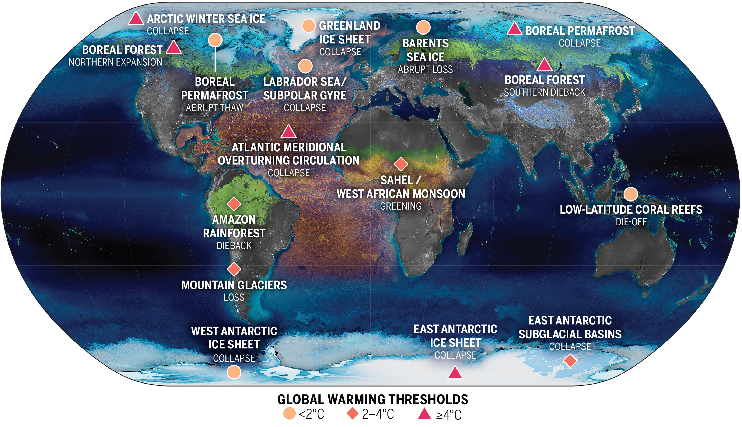
Tipping points
Source: Mckay et al, Science, 2022

Slide 12

Messy Climate Geopolitics

Slide 13
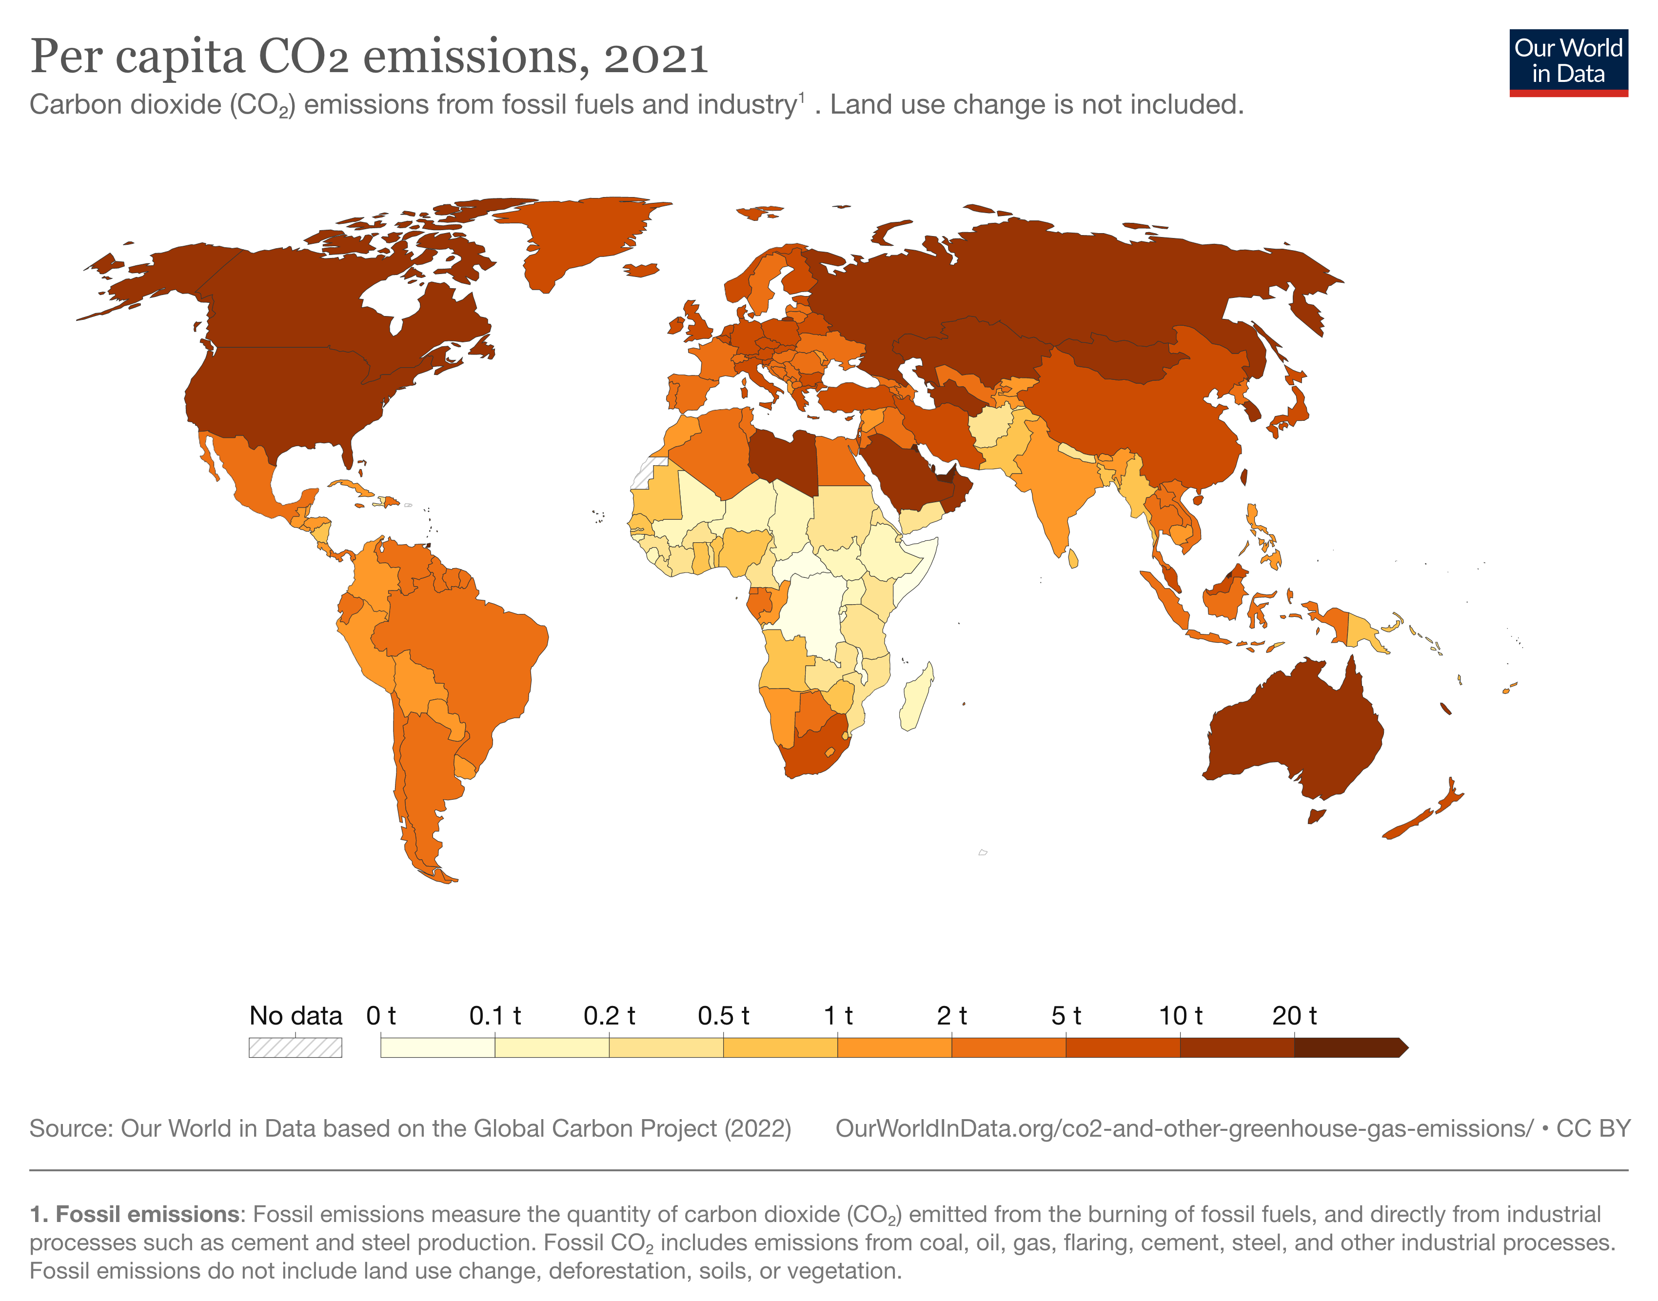
Emissions from one place…

Slide 14
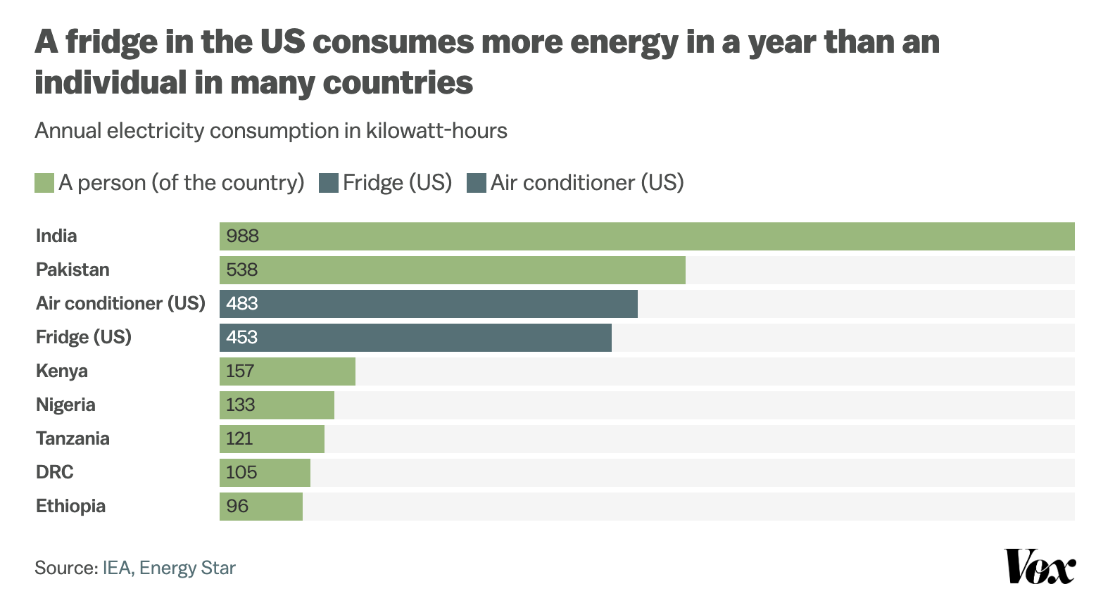
A US Fridge vs a Kenyan person

Slide 15
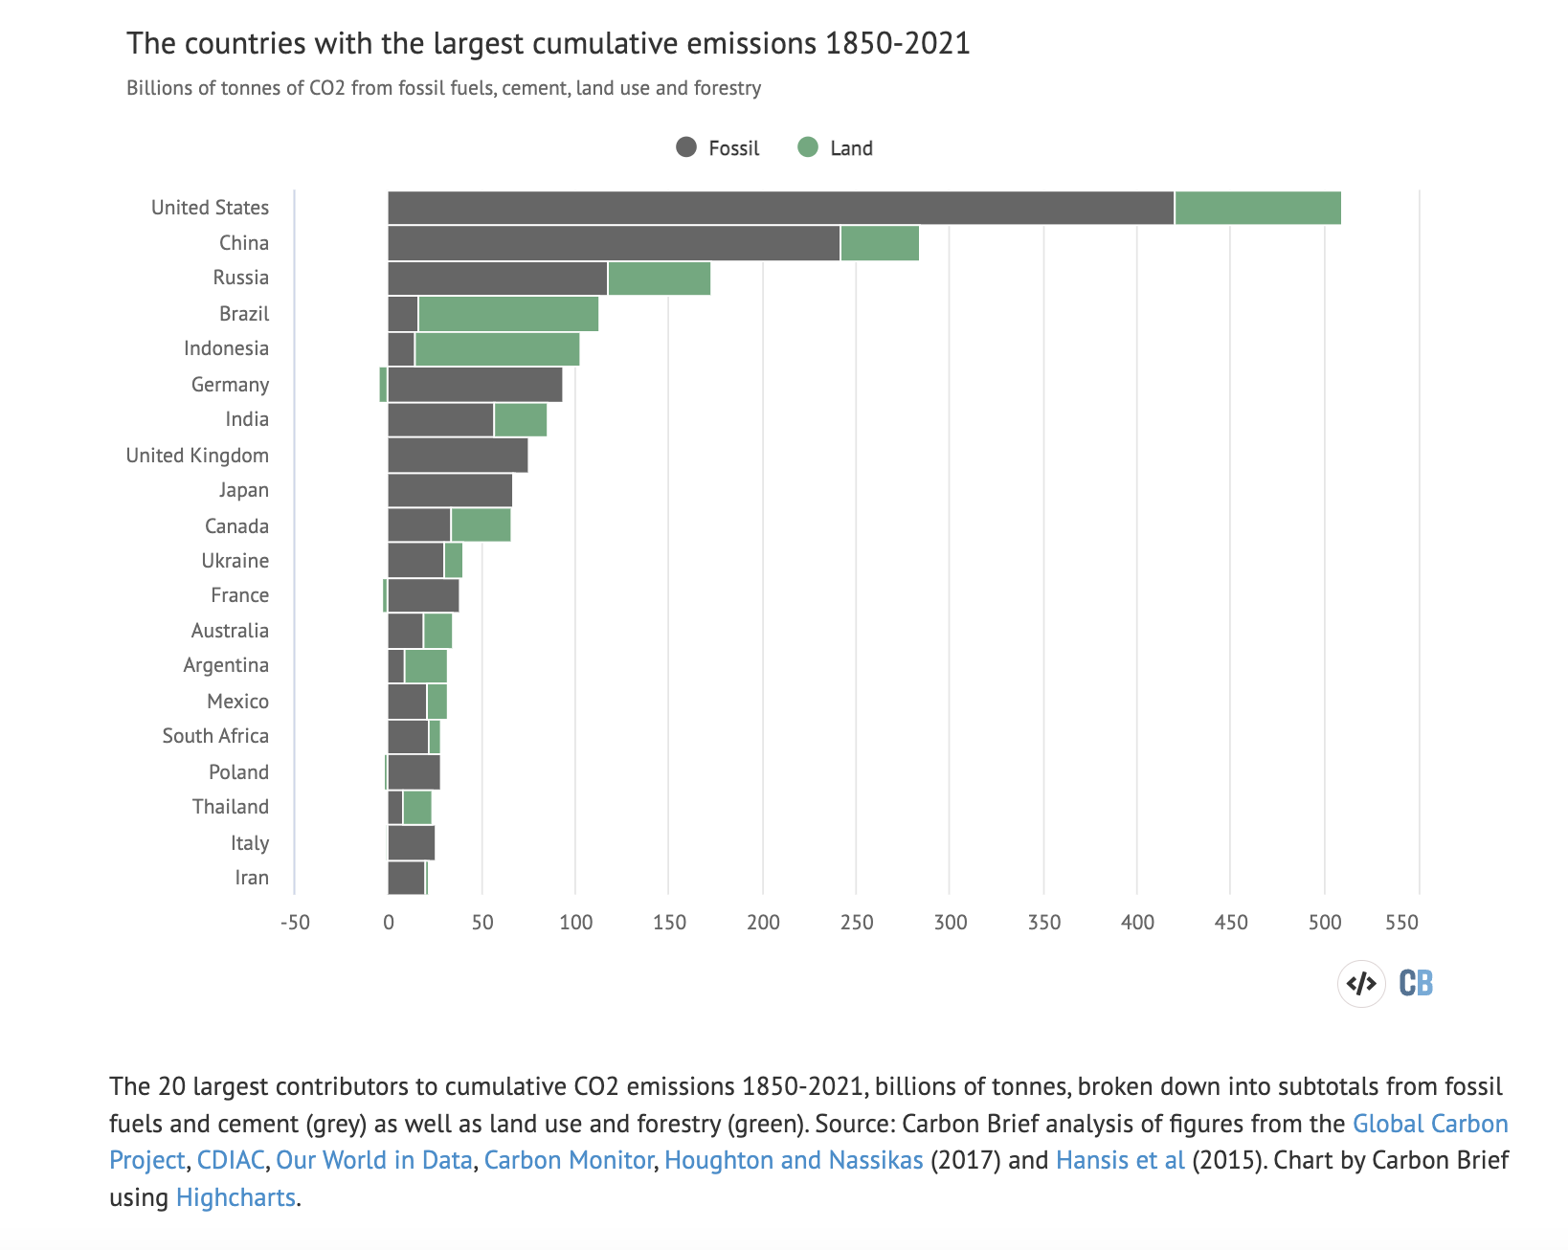
Historical Responsibility

Slide 16
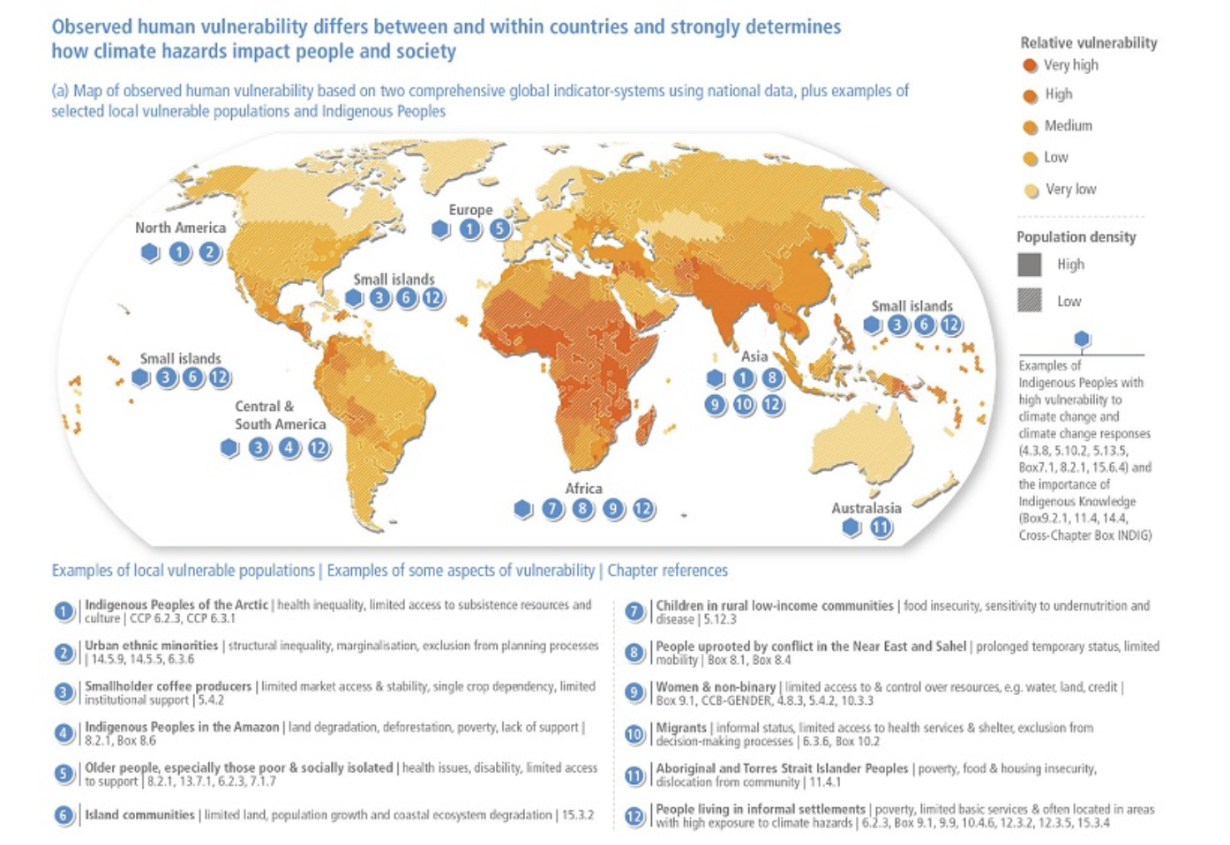
... And impacts in another
Source: IPCC 6th assessment report working group 2

Slide 17
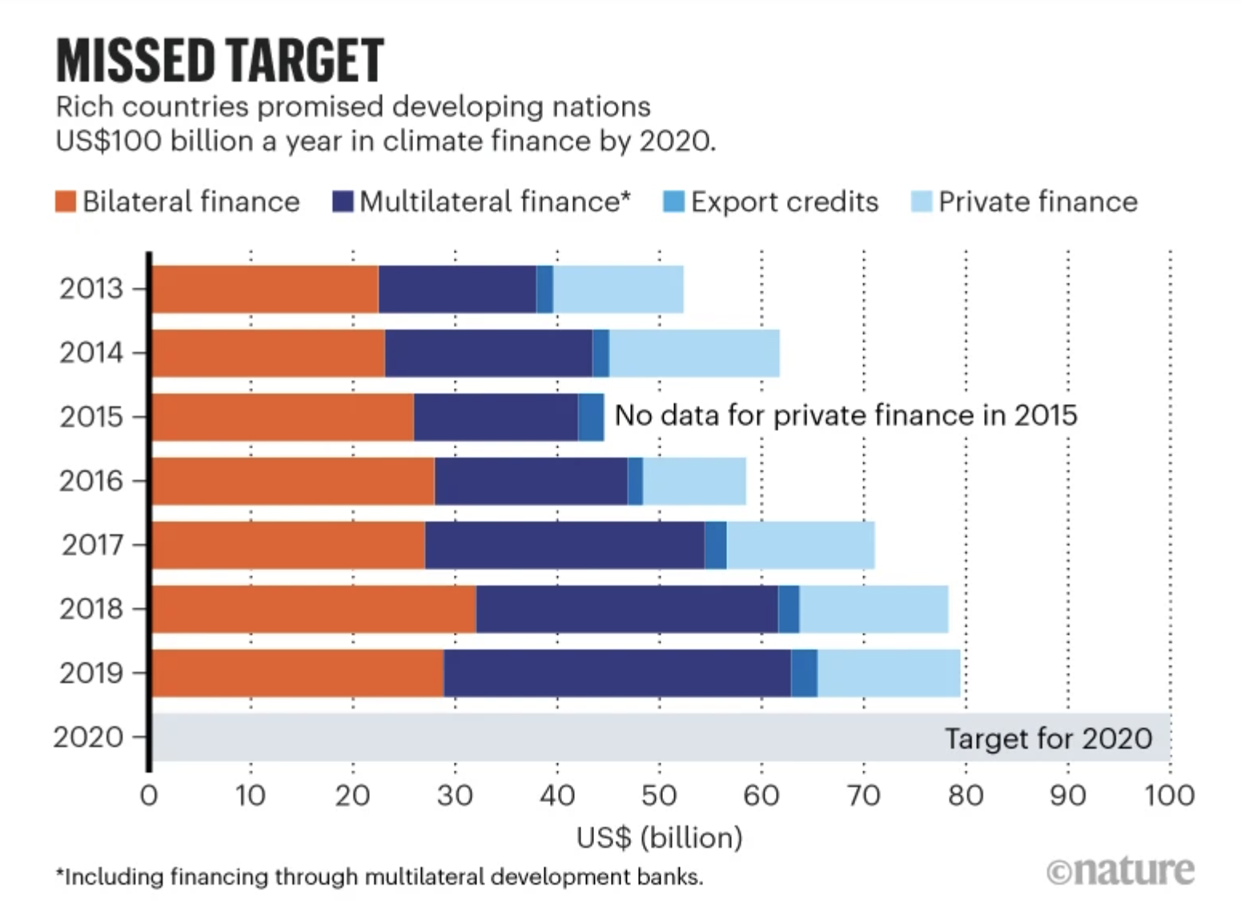
The missing $ 100 billion
Source: Jocelyn Timperly, Nature, 2021

Slide 18
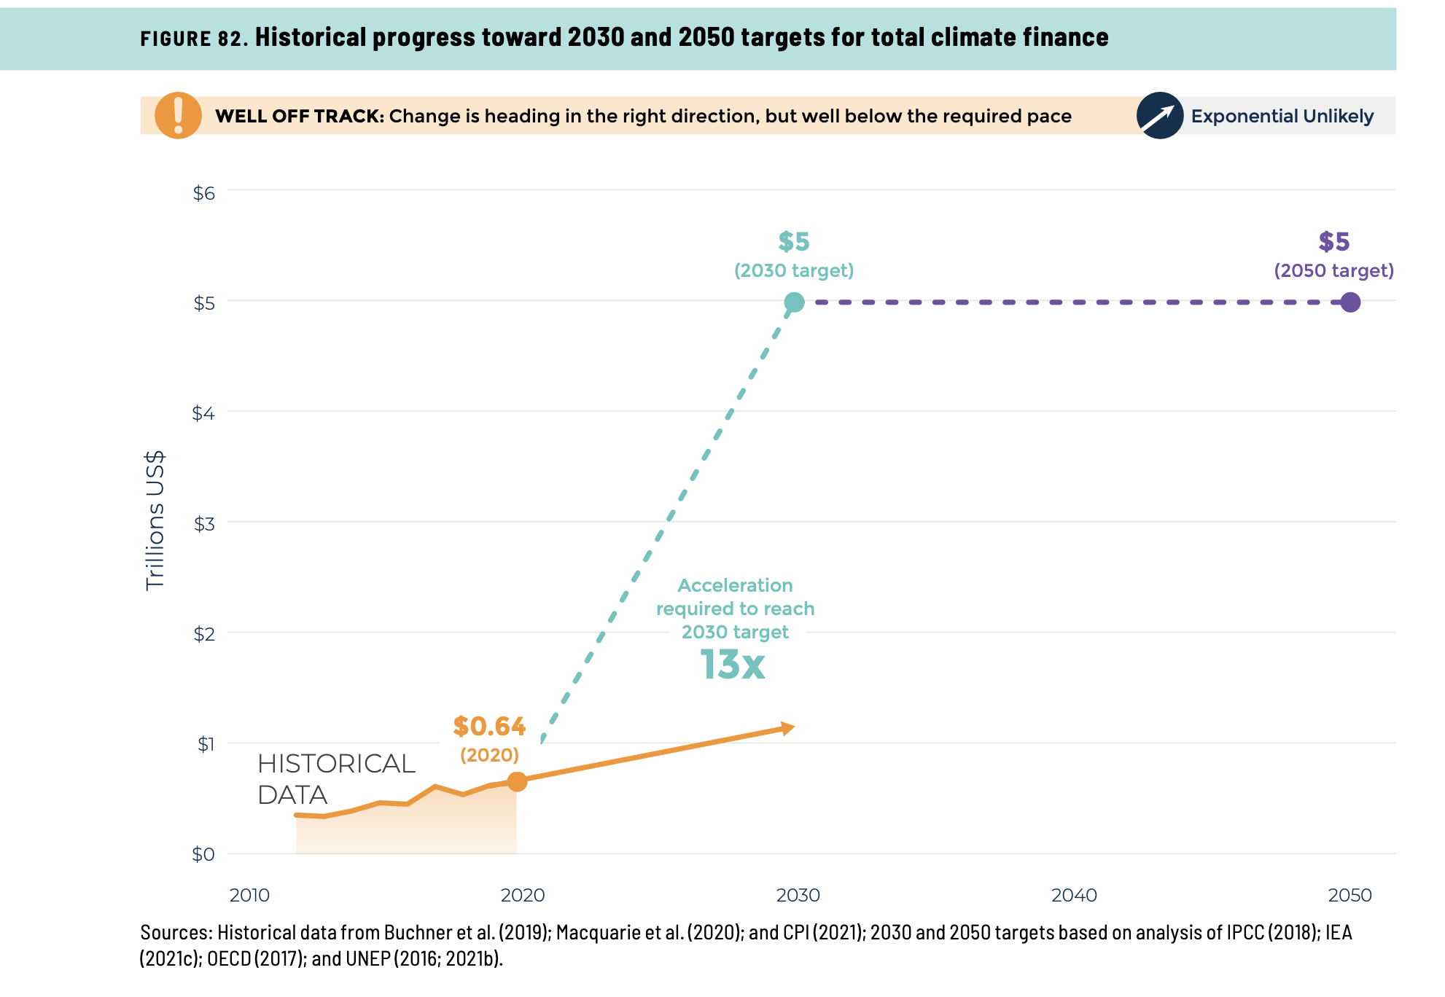
And much bigger total needs…
Source: WRI, State of Climate Action 2021

Slide 19
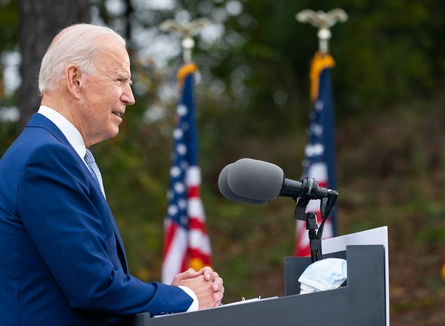
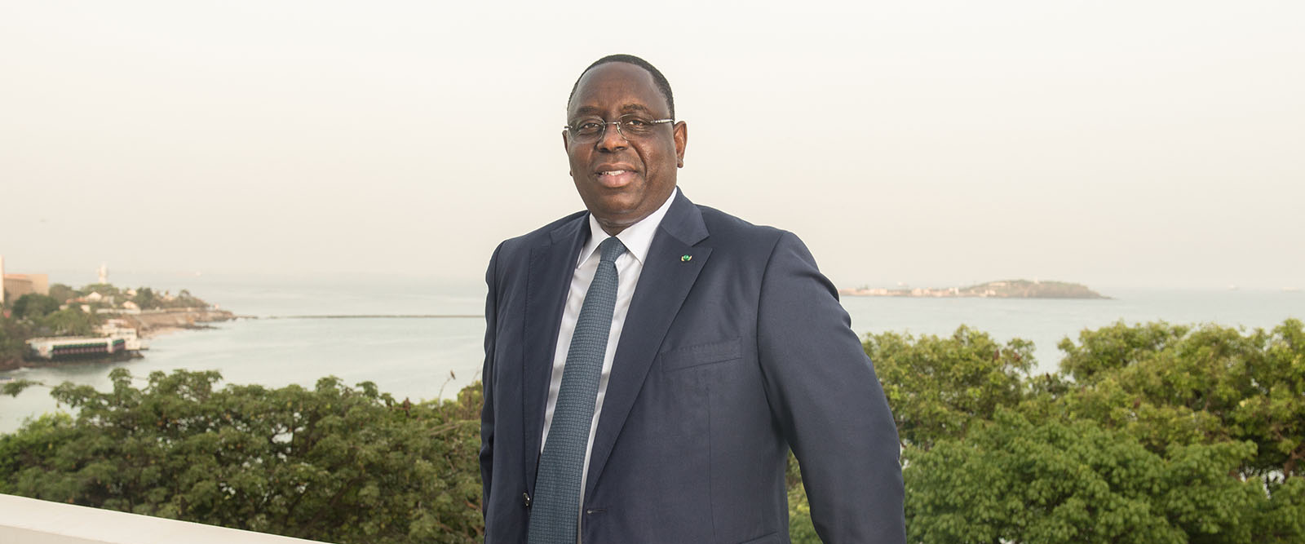
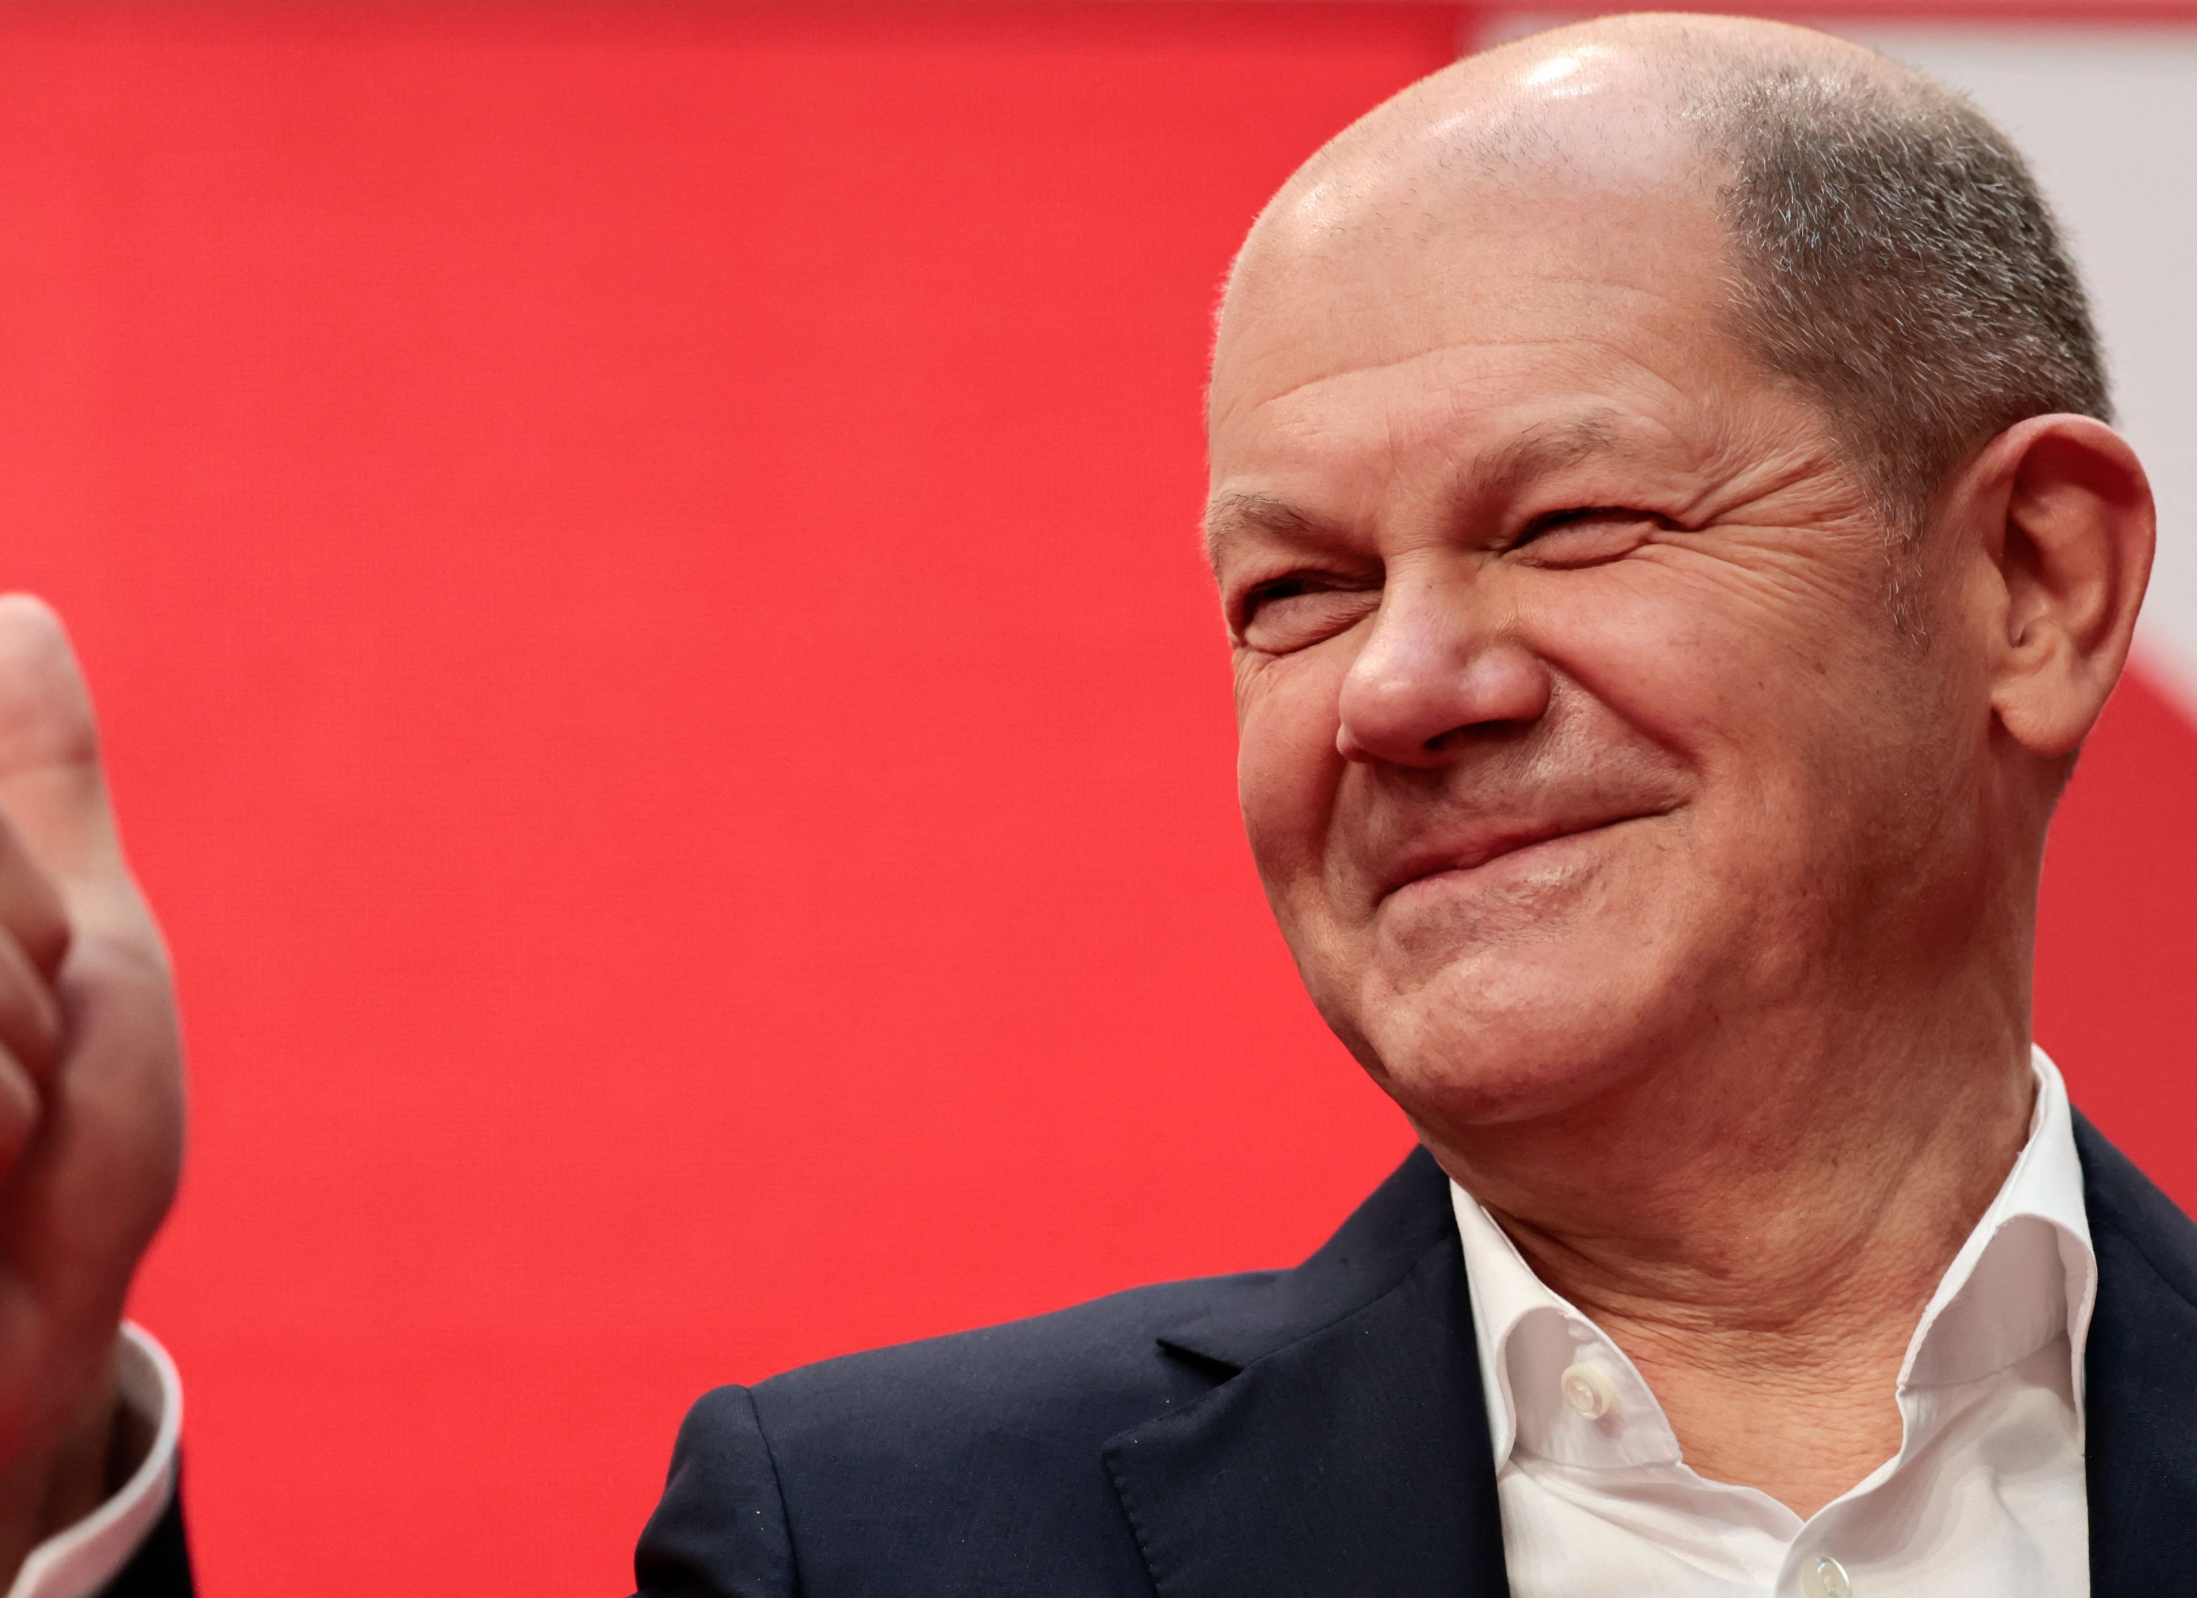
Climate, sovereignty, & hypocrisy

Slide 20
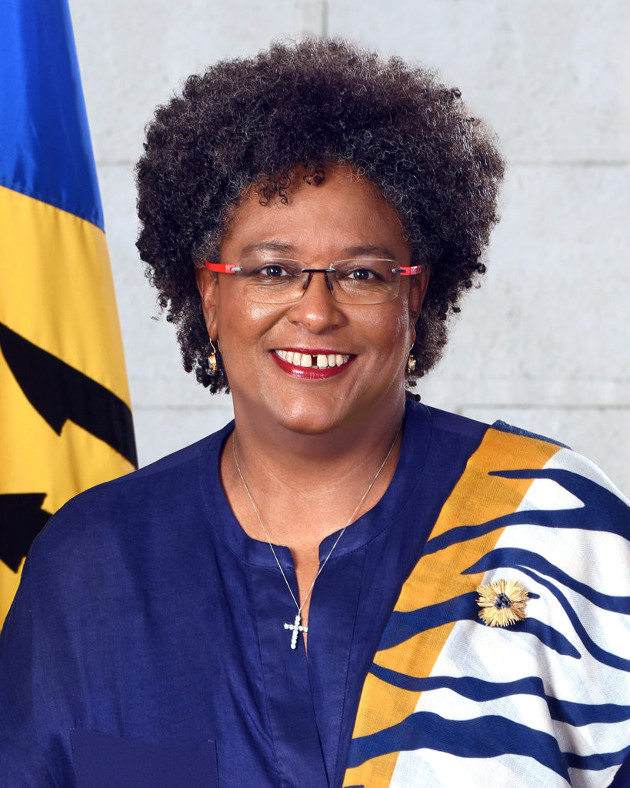
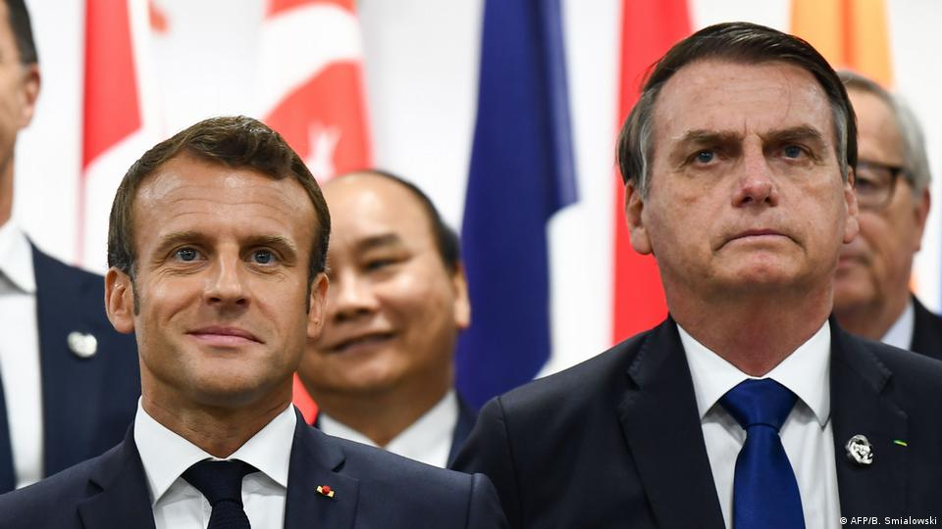
Climate, sovereignty, & hypocrisy

Slide 21
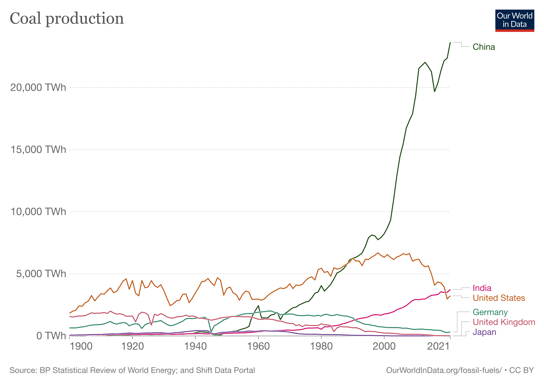
Winners and losers, coal:

Slide 22
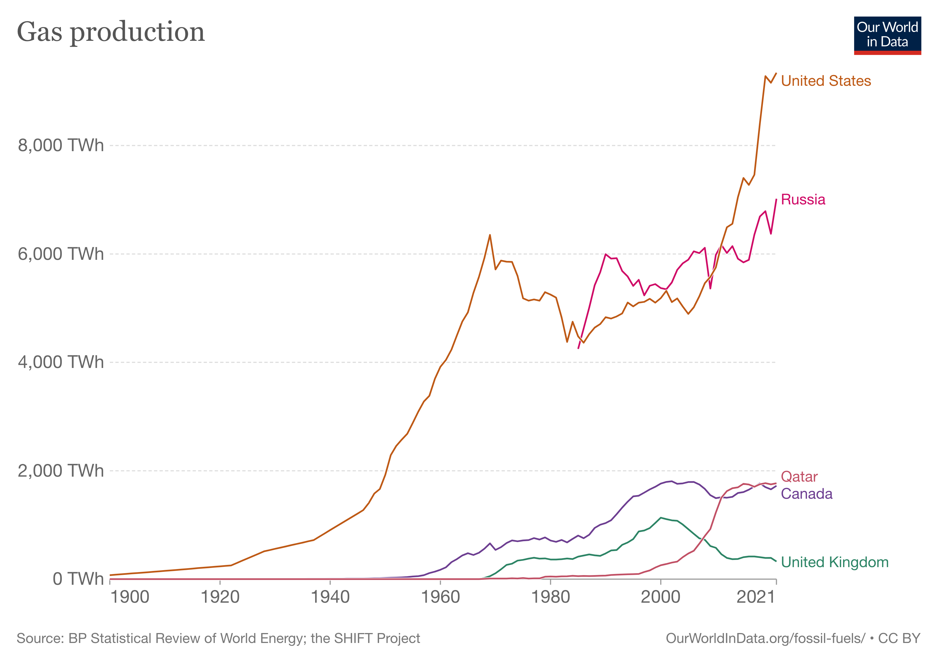
Winners and losers, gas:

Slide 23
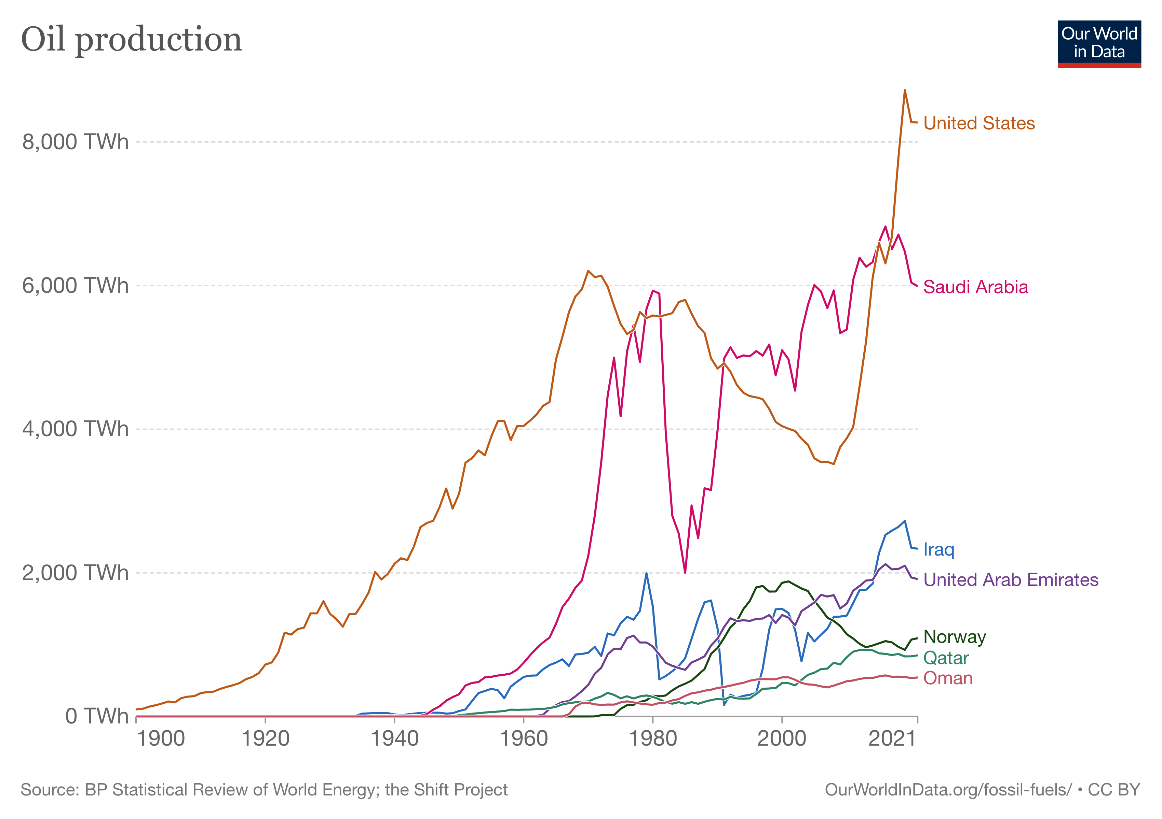
Winners and losers, oil:

Slide 24
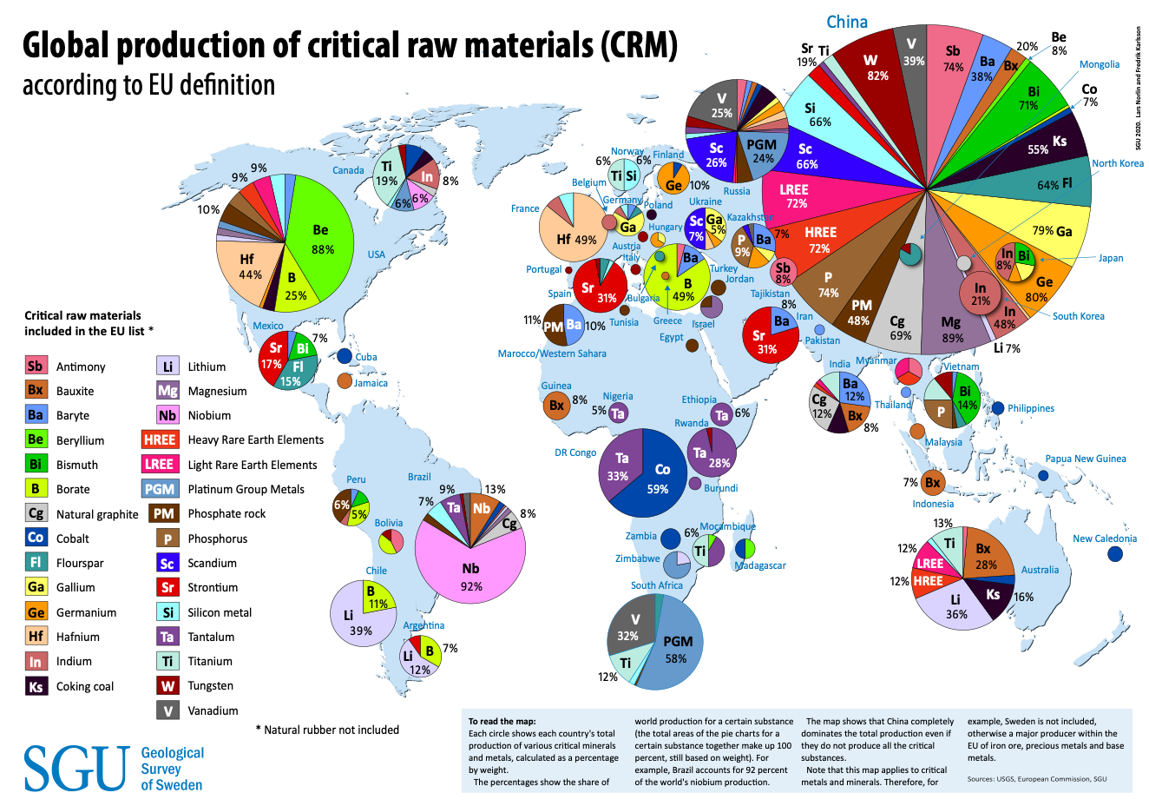
Winners and losers, critical raw materials:

Slide 25
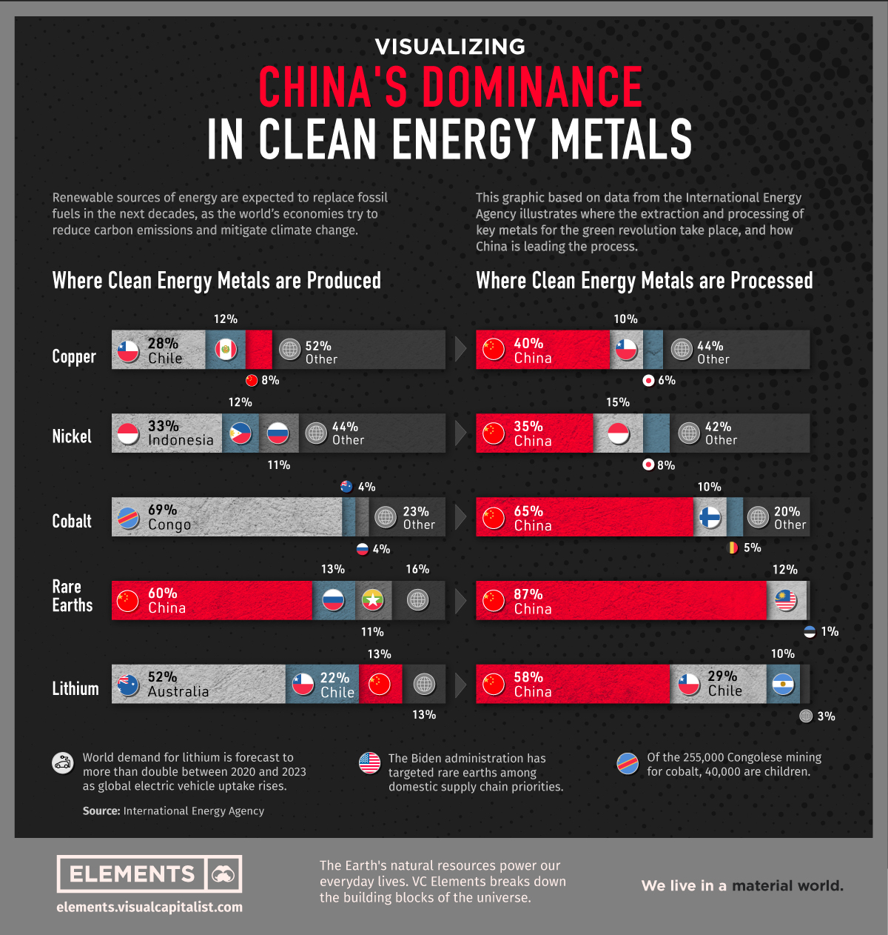
Winners and losers, metal processing

Slide 26
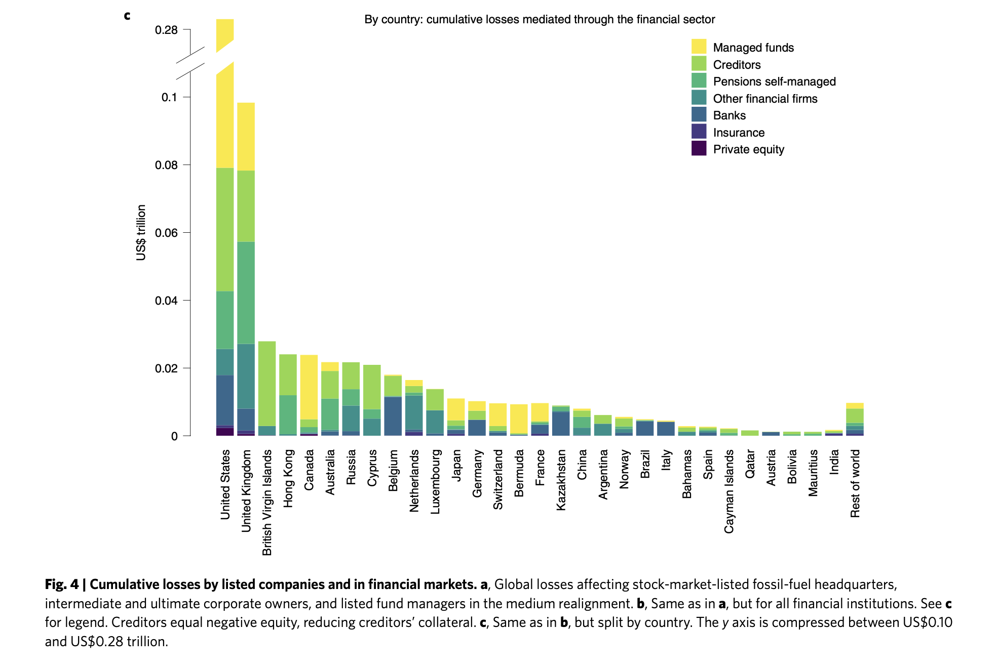
Winners and losers, finance
Source: Semieniuk et al, Nature, 2022

Slide 27
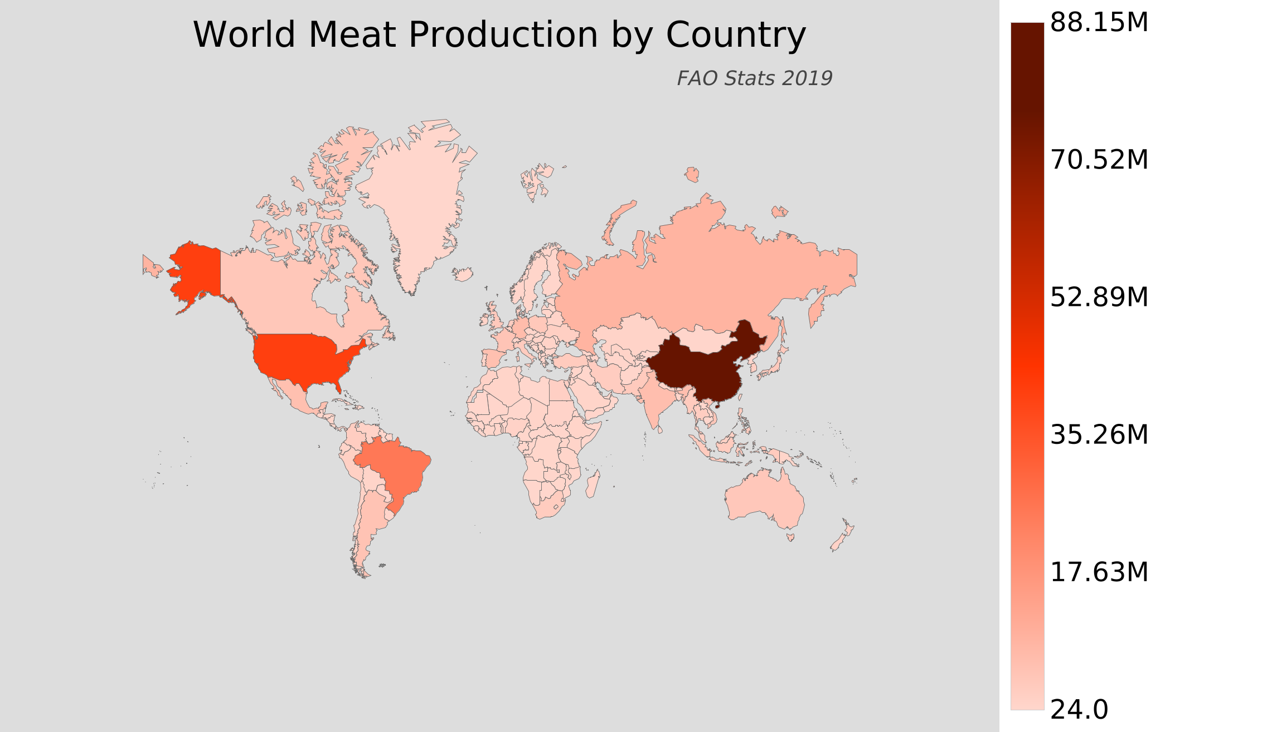
Winners and losers, meat
Source: Atlasbig, FAO

Slide 28
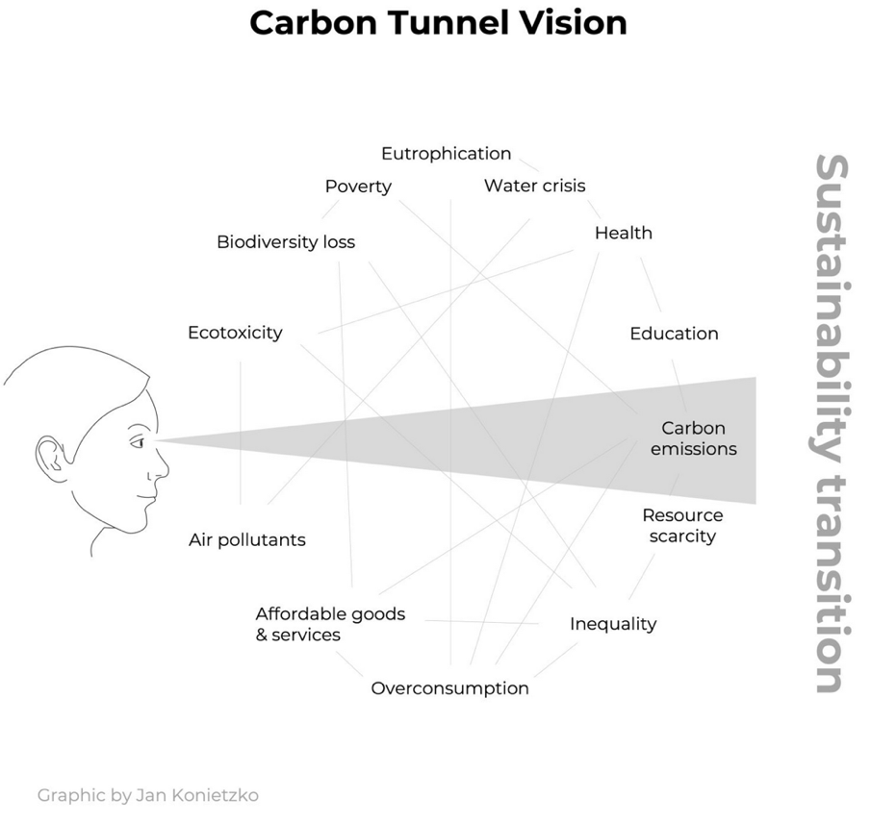
Carbon tunnel vision?
Source: SEI

