Slide 1

“Homing in on the global Housing cycle”
IMF/IEO Webinar Series
The Global Real Estate Boom: Is it Time to Worry Again?
June 24, 2021
Enrique Martínez García (Federal Reserve Bank of Dallas)
The views expressed in this presentation are those of the authors and do not necessarily reflect the views of the Federal Reserve Bank of Dallas or the Federal Reserve System.

Slide 2
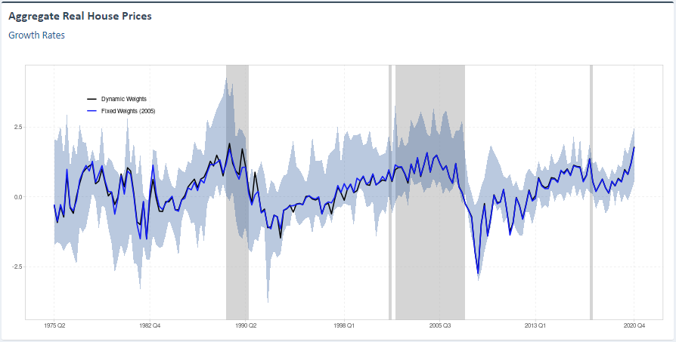
global real House Price growth accelerated during the pandemic
Countries Showing Signs of “Housing Fever”
U.S. | Denmark
Canada | Sweden
Germany | Croatia
France | Slovenia
Netherlands | Switzerland
Belgium | New Zealand
Luxembourg
Is global housing about to catch a cold?
SOURCE: International Housing Observatory (https://int.housing-observatory.com/).

Slide 3
Housing market hangover?

Slide 4
Housing supply constrained during the pandemic—how long to catch up?

Slide 5
Concluding remarks
Real house price growth accelerated during the pandemic—while not every country is in the same situation, we find that signs of housing market overheating is growing/spreading
a novel statistical toolkit to monitor housing markets in real-time (International Housing Observatory)
through this lens, about half the countries we track are showing signs of overheating (“housing fever”)
Overheating to some extent predates the pandemic, although the heat has spread significantly in 2020
there are differences across countries, but housing markets differ greatly also within countries (e.g., U.S.)
Should we worry about these signs of overheating?
overheating may partly reflect imbalances between supply and demand (partly as a result of policy actions that have supported income and lowered long-term rates during the pandemic while housing supply was constrained)
what will happen with household savings that have so markedly increased during the recession?
what will be the implications of trends affecting housing demand—some predate the recession, but have been accelerated by it—such as work-from-home arrangements, lifestyle changes, the impact of greening policies, etc.
how these issues develop over the next quarters and years and how fast supply catches up with demand will be determinant to avoid a boom-bust cycle of severe consequences

Slide 6
Heterogeneity within countries: “Housing fever” spreading during the pandemic (U.S.)
December 2019
April 2021
NOTE: Red indicates signs of “housing fever,” while green indicates no signs of “housing fever.”
SOURCES: Freddie Mac; U.S. Bureau of Labor Statistics; authors’ calculations.

Slide 7
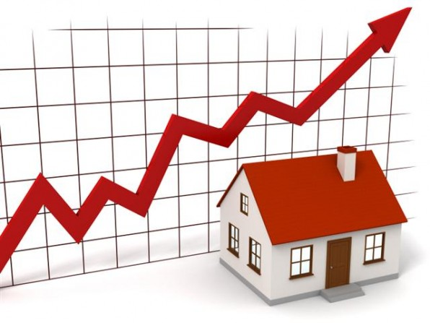
THANK YOU!!
THANK YOU!

Slide 8


For questions/feedback, contact the authors at:
Enrique Martínez García (FRB of Dallas)
enrique.martinez-garcia@dal.frb.org
Further readings on the data and the indicators mentioned in this presentation:
"Through the roof" – website on housing economics (Enrique martínez-garcía)
"A Cross-Country Quarterly Database of Real House Prices: A Methodological Note“ (Adrienne Mack, Enrique martínez-garcía, and Valerie Grossman), Globalization and Monetary Policy Institute Working Paper no. 99, December 2011 (Revised: January 2018)
"Episodes of Exuberance in Housing Markets: In Search of the Smoking Gun" (Efthymios Pavlidis, Alisa Yusupova, Ivan Paya, David Peel, Adrienne Mack, enrique martínez -garcía, and Valerie Grossman), The Journal of Real Estate Finance and Economics, Vol. 53(4), pp. 419-449, 2016.

