Slide 1
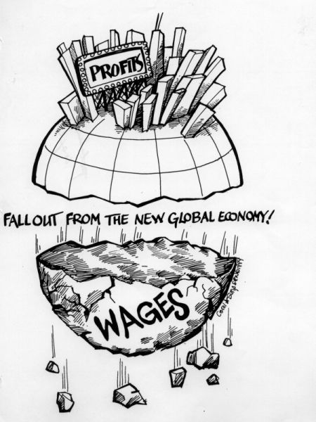
Financial Globalization and Inequality
May 13, 2021
Distributional Effects of Capital Flows
IMF, IEO Webinar series
Barry Eichengreen (University of California, Berkeley)
Balazs Csonto (IMF)
Asmaa El-Ganainy (IMF)
Zsoka Koczan (EBRD)

Slide 2
Content
  Stylized Facts
    Transmission Channels
        Foreign Direct Investment
        Non-FDI Private Capital Flows
        Official Capital Flows
        Remittances
  The Case of Mexico
  Policy Implications

Slide 3
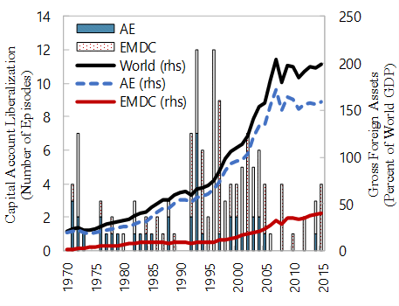
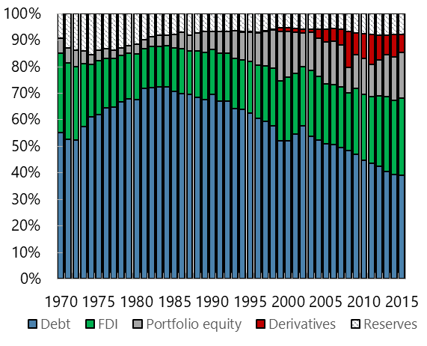
Rapid financial integration over the last few decades
Capital Account Openness and
Financial Integration
Composition of Global External Assets
(In percent)
Sources: Chinn-Ito (2006), Lane and Milesi-Ferretti (2018), and authors’ calculations.
Note: Capital account liberalization occurs when the change in the Chinn-Ito index exceeds its average by at least two standard deviations and there is no reversal of liberalization over the following 10 years.

Slide 4
Steady increase in remittances since mid-1990s

Slide 5
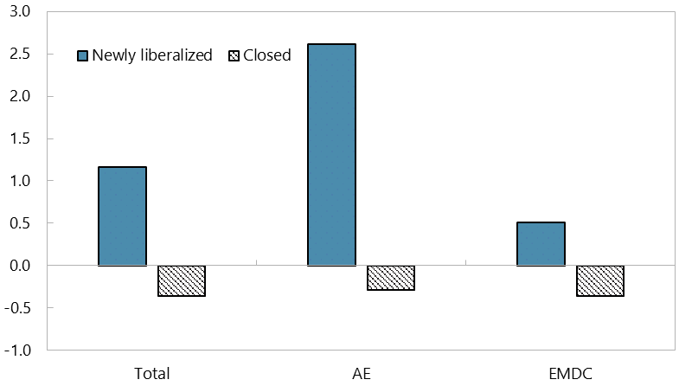
Financial globalization was accompanied by rising inequality
Financial Globalization and Inequality
(Change in Gini Index after Capital Account Liberalization, percent)
Sources: Chinn-Ito (2006), SWIID, Lane and Milesi-Ferretti (2018), and authors’ calculations.
Notes: The figure shows the median change in the average market Gini index during the 10-year periods before and after capital account liberalization. Newly liberalized countries correspond to those liberalizing their capital account according to the methodology described in Figure 1. Closed countries are those with Chinn-Ito Index that is below the lowest value of the index at the time of capital account liberalization across episodes and those that do not liberalize their capital account over the following 10 years.

Slide 6
Content
  Stylized Facts
  Transmission Channels
        Foreign Direct Investment
        Non-FDI Private Capital Flows
        Official Capital Flows
        Remittances
  The Case of Mexico
  Policy Implications

Slide 7
FDI and inequality in recipient countries
Inclusive growth
Positive impact of FDI on growth (Aizenman et al. 2011; Choong et al. 2010; Kose et al. 2009) via transfer of technology and know-how, positive spillovers to international trade and human capital accumulation, etc.
Depending on the inclusiveness of growth, inequality increases or decreases
K/L mix
FDI is associated with higher investment and therefore capital stock (Amighiani et al. 2017)
Higher capital-labor ratio potentially increases labor income share → reduce inequality (IMF 2017)
Relative demand for skills
If capital substitutes unskilled labor and complements skilled labor, FDI raises the relative demand for skills and the skill premium → increase inequality (Krusell et al. 2000;Jaumotte et al. 2008; Larrain 2017)
  Inward FDI associated with rising inequality:
    Tsai (1995); Gopinath and Chen (2003); Te Velde (2003); Te Velde and Morrissey (2003); Lee (2006); Basu and Guariglia (2007); Jaumotte et al. (2008); Asteriou et al. (2014); Herzer et al. (2014); Suanes (2016)
  Mixed or no effects:
    Te Velde and Morrissey (2004); Milanovic (2005); Sylwester (2005)

Slide 8
FDI and inequality in source countries
K/L mix
Lower capital-labor ratio potentially reduces labor income share → increase inequality (IMF 2017)
Bargaining power of labor
The threat of relocating production could lower the bargaining power of labor and thus labor income share → increase inequality
Relative demand for skills
The outsourcing of activities could lead to a decline in the relative demand for unskilled workers → increase inequality (Feenstra and Hanson 1997; Geischecker 2006)
Tax avoidance
“Phantom FDI” is estimated at 40 percent of global FDI (Damgaard et al. 2019)
It could raise returns for capital owners → increase inequality
“the 5.7 million most offshorable jobs seem to pay a wage penalty – estimated to be about 14 percent” in the United States (Blinder 2009)
  Outward FDI associated with rising inequality:
    Choi (2006); Jaumotte et al. (2008)
  Mixed or no such evidence:
    Herzer and Nunnenkamp (2013)

Slide 9
FDI and inequality – mitigating factors
Sectoral distribution of FDI
FDI into unskilled-labor-intensive sectors (e.g., manufacturing assembly) could reduce inequality, while FDI into capital- and skilled-labor-intensive sectors could increase inequality (Bogliaccini and Egan 2017)
Level of economic development
The inequality-increasing impact of FDI tends to diminish with rising educational level (Mihaylova 2015)
Competitiveness and resource reallocation
Inter-sectoral resource reallocation (e.g., via education and training of workers, and new entrants to the labor market) could mitigate the distributional effects in both recipient and source countries in the long term (Figini and Görg 1999; Head and Ries 2002)
Competitiveness gains from outsourcing could help protect employment of less-skilled in source countries (Baldwin 2006)

Slide 10
Non-FDI private capital flows and inequality
Inclusive growth
Mixed evidence, ranging from positive relationship between capital flows and growth (Ferreira and Laux 2009) through no impact (Durham 2004) to negative relationship (Choong et al. 2010)
Volatility of growth
Capital flows tend to amplify the business cycle but the pro-cyclical nature of flows differs across countries and types of flows (Araujo et al. 2015; Kalemli-Ozcan et al. 2017)
Financial inclusion
Capital flows could help enhance financial inclusion (e.g., the introduction of M-PESA in 2007 in Kenya by partly foreign-owned Safaricom) (Sy 2009)
Access to financial services, in turn, could help manage income shocks, thereby protecting against falling into poverty (Demirguc-Kunt et al. 2017)
Depending on the inclusiveness of growth, inequality increases or decreases
Higher growth volatility is associated with higher inequality:
Disproportionate impact in terms of employment (Agenor 2001) and education (Hausmann and Gavin 1996)

Slide 11
Non-FDI private capital flows and inequality
Asset prices
Opening the capital account could lead to increasing asset prices (Azis and Shin 2015; Kim and Yang 2009)
Redistributive policies
External financing could ease fiscal financing constraints, thereby enhancing the social safety net and reducing inequality
Tax evasion and illicit financial flows
Offshore tax evasion could increase inequality as it is mainly engaged in by the rich, with the 0.01 percent richest households estimated to evade around 25 percent of their taxes (Alstadsæter et al. 2019)
Similarly, capital flight, estimated at US$1.4 trillion in 30 African countries between 1970 and 2015 (Ndikumana and Boyce 2018), could give rise to tax evasion for high-income individuals, thereby increasing inequality
This could increase inequality if the prices of riskier assets typically held by high-income households (e.g., equity) increase (Lenza and Slacalek 2018) or reduce inequality if the prices of assets typically held by low-income households (e.g., housing) rise (Woloszko and Causa 2020)

Slide 12
Non-FDI private capital flows and inequality – mitigating factors
Institutional development
Positive impact of capital account liberalization on growth is more pronounced in countries with well-developed institutions (Eichengreen et al. 2009)
Financial system and exchange rate regime
Financial globalization could amplify weaknesses of financial institutions and underlying distortions such as inadequate financial regulation (Lane 2012; Rodrik 2018)
Composition of flows
While a surge in capital inflows increases the probability of a banking or a currency crisis, this effect may be absent in the case of portfolio equity flows (Furceri et al. 2011)
Floating exchange rate regimes could be less efficient in anchoring inflation, with potential negative effects on the poor (Berg and Kpodar 2019)
Floating exchange rates tend to be characterized by lower real GDP volatility (Hausmann and Gavin 1996; Bleaney and Fielding 2002), with potential positive effects on the poor

Slide 13
Official flows and inequality
  Official Development Assistance:
    Most papers find a positive impact on growth (Roodman 2007)
    “Pro-poor” distribution of aid
      Increases growth of inequality-adjusted GDP per capita (Tezanos et al. 2013)
      Dampens the negative distributional impact of income volatility (Chauvet et al. 2017)
      The inequality-reducing impact of aid depends on the quality of institutions (Calderón et al. 2006)
  International reserves:
    The pre-GFC reserve accumulation by several EM central banks contributed to the global savings glut and the low interest rate environment. Search-for-yield behavior in this environment, in turn, could have increased inequality by increasing the prices of riskier assets typically held by richer households.
    Reserve accumulation aimed at keeping the currency undervalued could facilitate the redistribution of income between countries as well as between labor and capital owners. Current account surplus countries “acquire these reserves at the expense of domestic spending – a transfer of wealth in the reserve-buying countries from consumers to the owners of exports industries” (Klein and Pettis 2020).

Slide 14
Remittances and inequality
  Mixed findings in the literature:
    Remittances increase inequality in Kosovo (Möllers and Meyer 2014) but reduce inequality in Pakistan (Mughal and Anwar 2012) and Mexico (Koczan and Loyola 2016)
  Changing effects over time:
    Remittances might first increase inequality and then reduce inequality in source countries:
      “Pioneer migrants” who lack pre-existing migrant networks and therefore face higher costs of migration may come from wealthier households, while later migrants, who come from poorer households, may benefit from falling costs (Stark et al 1988; Taylor et al. 2009)
      Migrants and remittance-receiving households are more likely to be from the bottom of the income distribution in Mexico and Paraguay, with longer migration histories and lower costs of migration, whereas migrants tend to be drawn from higher-income households in Haiti, Peru and Nicaragua (Acosta et al. 2008)

Slide 15
Content
  Stylized Facts
    Transmission Channels
        Foreign Direct Investment
        Non-FDI Private Capital Flows
        Official Capital Flows
        Remittances
  The Case of Mexico
  Policy Implications

Slide 16
Mexico – “A country of inequality”
Pre-NAFTA
FDI contributed to increasing inequality
Outsourcing of activities from the U.S. to Mexico → ↑ the relative demand for skilled labor and thus contributed to the increase in the skill premium (Feenstra and Hanson 1997), mostly reflecting a rapid increase in wages at the upper part of the income distribution (Esquivel 2010)

Slide 17
Mexico – Capital flows and inequality
Post-NAFTA
  Inequality decreased as a result of increasing relative demand for unskilled labor thanks to FDI (the expansion of assembly activities of foreign investors) (Robertson 2007)
    The increase in low-skilled wages was larger in states closer to the U.S.-Mexico border where there is a larger concentration of manufacturing production and FDI (Chiquiar 2008)

Slide 18
Mexico – Remittances and inequality
  Remittances are pro-poor:
    Remittance-receiving households are on average poorer than non-remittance-receiving households, even when taking remittances into account The Gini coefficient of income including remittances is lower than that of both income excluding remittances and a no-migration counterfactual scenario
  Remittances become even more pro-poor during crises:
    During the peso crisis and the GFC, both the likelihood of receiving remittances and their amount as share of income fell for the top income deciles while there was little change for lower income deciles

Slide 19
Content
  Stylized Facts
    Transmission Channels
        Foreign Direct Investment
        Non-FDI Private Capital Flows
        Official Capital Flows
        Remittances
  The Case of Mexico
  Policy Implications

Slide 20
Policy implications
  Macroeconomic policies
    Fiscal and monetary policy to enhance inclusive growth and reduce growth volatility
    CFMs as part of broader package to manage risks from large and volatile capital flows
  Labor market policies
    Improve the education attainment of the population
    Enhance labor market flexibility to facilitate the reallocation of labor across sectors
    Reduce barriers to migration to make migration (and remittances) more available
  Product market policies
    Market-friendly product-market regulation and strengthened institutions to attract FDI and mitigate capital flight
    Investment promotion agencies to attract “high-quality” capital flows
  Redistributive policies
    Redistributive policies to mitigate the potentially adverse distributional impact of financial globalization
    Tax system to reduce tax avoidance and evasion
    Stronger social safety nets to help consumption smoothing during crises
  Financial sector policies
    Prudent use of external funds by banks (MPPs) to smooth the business cycle
    Strong institutions and developed markets to reduce vulnerability and enhance financial inclusion
    Lower costs of remittances to fully reap benefits

Slide 21
Thank you

