Slide 1
Dealing with Volatile Capital Flows: What Toolkit Do Countries Need?
Anton Korinek
University of Virginia and Darden, NBER, CEPR, Oxford FHI
IEO Webinar
Feb 23rd, 2021

Slide 2
I. Overview: What I Will Cover
New Theoretical Developments
Implementation and Practical Toolkits
Role of Welfare Objectives in Economic Policy Analysis
International Spillovers

Slide 3
New Theoretical Developments
An Externality View of Capital Flows:
when markets are imperfect, prices may not correctly reflect the social benefits and costs of capital flows:
financial amplification → pecuniary externalities
demand imbalances → aggregate demand externalities
role for intervention
need to differentiate policies by resident status
note: significant contributions to the literature by IMF staff

Slide 4
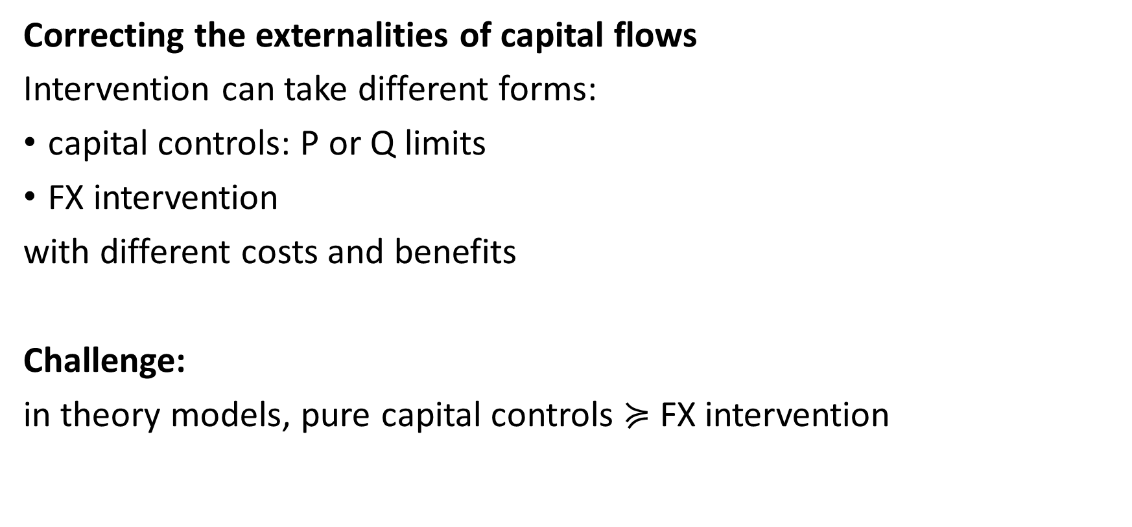
New Theoretical Developments
Correcting the externalities of capital flows
Intervention can take different forms:
capital controls: P or Q limits
FX intervention
with different costs and benefits
Challenge:
in theory models, pure capital controls $≽$ FX intervention

Slide 5
IMF Policy Frameworks
Management of Capital Flows:
Institutional View represented a sea change
but too restrictive on capital controls:
prudential use, preconditions, temporary nature
bias towards MPM
Integrated Policy Framework:
very impressive body of work
nuanced perspective on CFMs and FX intervention
takes better account of differences in countries’ objective circumstances

Slide 6
Role of Welfare Objectives
Starting point of modern economic policy analysis
= clear statement of welfare objectives
economic policy usually involves trade-offs
in contrast to targets & instruments approach by Tinbergen (1954)
capital flow policies are inherently 2nd-best → stark trade-offs
FX intervention is inherently 3rd-best → even starker trade-offs
different member states have different preferences
one-size-fits-all welfare objective risks backlash against technocrats

Slide 7
Role of Welfare Objectives
Capital flow policies affect a range of intermediate objectives:
volatility
growth
income distribution
financial development
…
Role for a “New IV:” spell out the menu of efficient policy options, letting countries choose their own welfare objectives

Slide 8
International Spillovers
A) Spillovers are general equilibrium effects
natural and necessary for functioning of the international monetary system
not a club to indiscriminately push countries to avoid policies with spillovers
B) Role for cooperation in three specific instances
strategic behavior / terms-of-trade manipulation
incomplete/imperfect policy instruments
international market imperfections
Potential role for IMF:
A) clarify specific circumstances when there is role for cooperation and when not
B) provide operational frameworks for cooperation

