Slide 1
Rethinking AI
Daron Acemoglu
MIT
June 2023

Slide 2


Promise of AI
Generative AI and large language models (LLMs) are now everywhere.
The promise is intelligent, flexible and easily usable complementarity to human decision-making and creative tasks, such as programming, management, arts and sciences.
Can Generative AI and LLMs make this aspiration a reality?
Yes, there is that promise, but also major roadblocks on the way.
It depends on the right vision, the right use, the right business models, the right regulation.

Slide 3
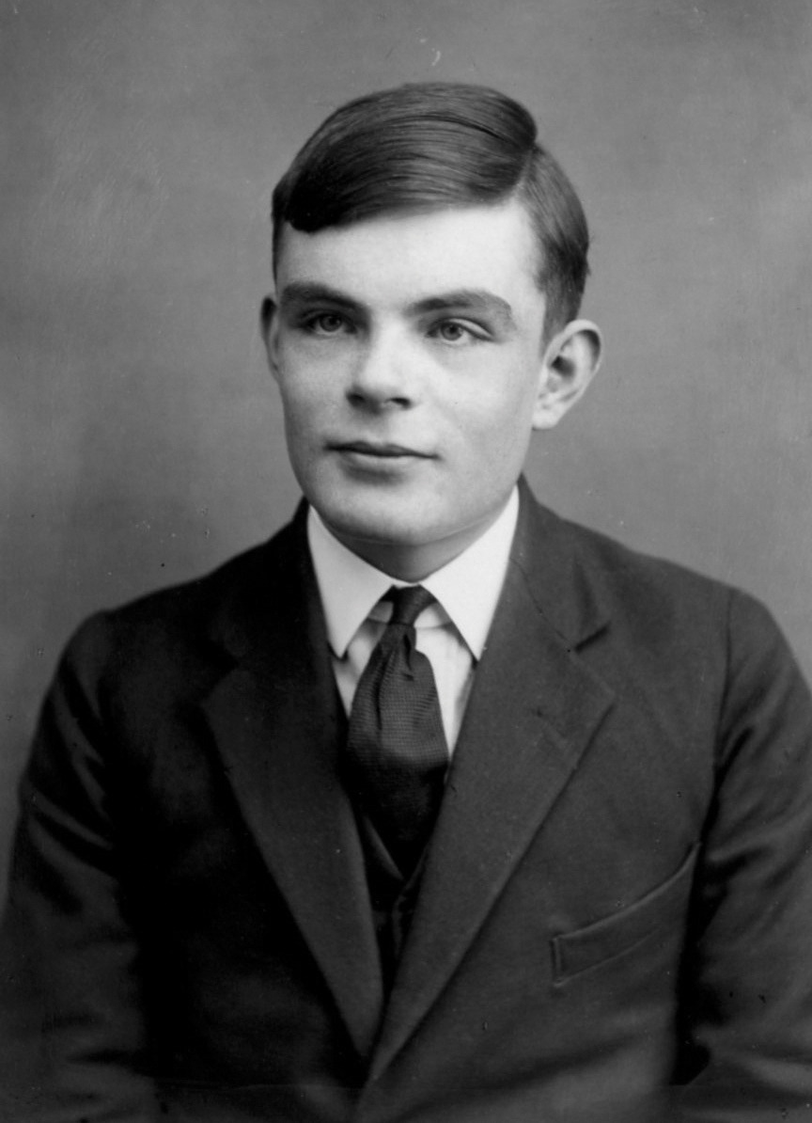
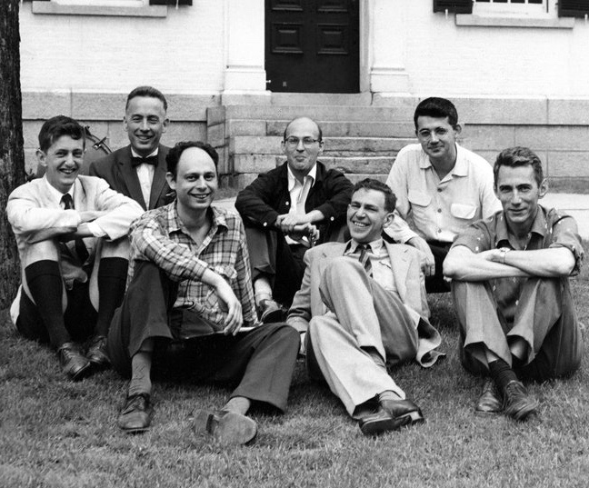
AI Beginnings: The Battle of Two Visions
Two fundamentally different visions of AI:
Machines designed to be smarter and more powerful than (most) humans.
The first vision – machine intelligence – refers to Alan Turing’s conceptualization of how the mind works and how computers could imitate.
Dartmouth Project on AI, 1956
Alan Turing
Source: American Academy of Achievement
Notes:
As useful tools for humans
Dartmouth workshop on AI considered to be the founding moment of artificial intelligence as a field of research.
Held for eight weeks in Hanover, New Hampshire in 1956 the conference gathered 20 of the brightest minds in computer- and cognitive science for a workshop dedicated to the conjecture:
"..that every aspect of learning or any other feature of intelligence can in principle be so precisely described that a machine can be made to simulate it. An attempt will be made to find how to make machines use language, form abstractions and concepts, solve kinds of problems now reserved for humans, and improve themselves. We think that a significant advance can be made in one or more of these problems if a carefully selected group of scientists work on it together for a summer.”
Minsky wondered whether these machines could be used to imitate—and better understand—the brain.
Lick dedicated his imagination, empathy, and polymathic skill set to making machines accessible and relevant to everyday life, eventually becoming known as the “Johnny Appleseed of Computing.”
As he wrote in his 1960 paper “Man-Computer Symbiosis,” he began envisioning a world in which people and computers cooperate. No longer the domain of trained experts, Lick’s machines would be networked and easily searchable. They would talk to people and to each other.
Man-computer symbiosis is an expected development in cooperative inter- action between men and electronic computers. It will involve very close coupling between the human and the electronic members of the partner- ship. The main aims are 1) to let computers facilitate formulative thinking as they now facilitate the solution of formulated problems, and 2) to enable men and computers to cooperate in making decisions and controlling com- plex situations without inflexible dependence on predetermined programs. In the anticipated symbiotic partnership, men will set the goals, formulate the hypotheses, determine the criteria, and perform the evaluations. Com- puting machines will do the routinizable work that must be done to prepare the way for insights and decisions in technical and scientific thinking. Pre-
liminary analyses indicate that the symbiotic partnership will perform intellectual operations much more effectively than man alone can perform them. Prerequisites for the achievement of the effective, cooperative association include developments in computer time sharing, in memory components, in memory organization, in programming languages, and in input and output equipment.

Slide 4
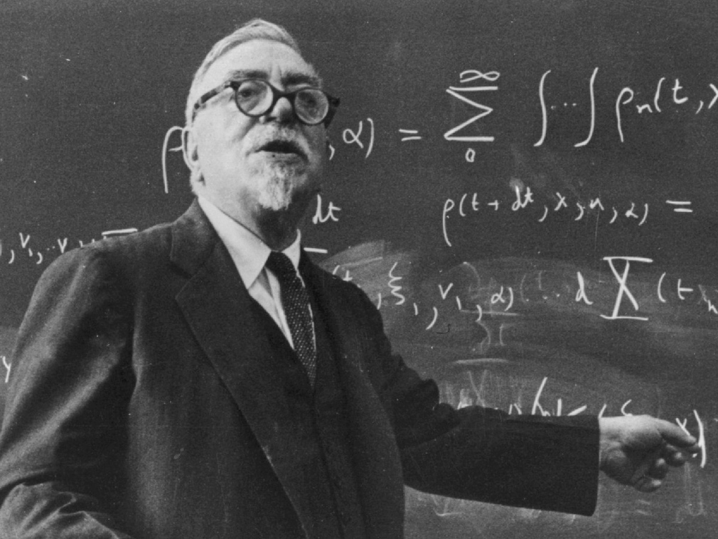

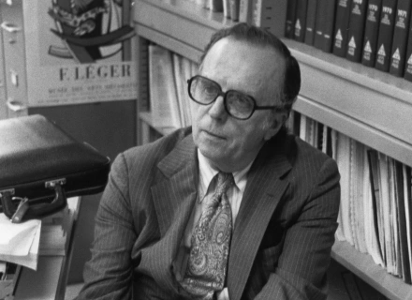

Better AI: A Pro-Human Vision
Two fundamentally different visions of AI:
Machines designed to be smarter and more powerful than (most) humans.
Machines to complement human abilities.
The first vision – machine intelligence – refers to Alan Turing’s conceptualization of how the mind works and how computers could imitate.
The second vision – let’s call it machine usefulness or “pro-human AI”– starts with Norbert Wiener (but also Edgar Allan Poe).
Articulated and put into practice by computer scientists such as JCR Licklider and Douglas Engelbart – “human-machine symbiosis”
Norbert Wiener
JCR Licklider
Douglas Engelbart’s mouse, 1968
Source: Ben Shneiderman
Notes:
As useful tools for humans
Dartmouth workshop on AI considered to be the founding moment of artificial intelligence as a field of research.
Held for eight weeks in Hanover, New Hampshire in 1956 the conference gathered 20 of the brightest minds in computer- and cognitive science for a workshop dedicated to the conjecture:
"..that every aspect of learning or any other feature of intelligence can in principle be so precisely described that a machine can be made to simulate it. An attempt will be made to find how to make machines use language, form abstractions and concepts, solve kinds of problems now reserved for humans, and improve themselves. We think that a significant advance can be made in one or more of these problems if a carefully selected group of scientists work on it together for a summer.”
Minsky wondered whether these machines could be used to imitate—and better understand—the brain.
Lick dedicated his imagination, empathy, and polymathic skill set to making machines accessible and relevant to everyday life, eventually becoming known as the “Johnny Appleseed of Computing.”
As he wrote in his 1960 paper “Man-Computer Symbiosis,” he began envisioning a world in which people and computers cooperate. No longer the domain of trained experts, Lick’s machines would be networked and easily searchable. They would talk to people and to each other.
Man-computer symbiosis is an expected development in cooperative inter- action between men and electronic computers. It will involve very close coupling between the human and the electronic members of the partner- ship. The main aims are 1) to let computers facilitate formulative thinking as they now facilitate the solution of formulated problems, and 2) to enable men and computers to cooperate in making decisions and controlling com- plex situations without inflexible dependence on predetermined programs. In the anticipated symbiotic partnership, men will set the goals, formulate the hypotheses, determine the criteria, and perform the evaluations. Com- puting machines will do the routinizable work that must be done to prepare the way for insights and decisions in technical and scientific thinking. Pre-
liminary analyses indicate that the symbiotic partnership will perform intellectual operations much more effectively than man alone can perform them. Prerequisites for the achievement of the effective, cooperative association include developments in computer time sharing, in memory components, in memory organization, in programming languages, and in input and output equipment.

Slide 5
Pro-Human Generative AI
A simplified history of human activity:
From around 100,000 BC to 1800s, mostly centered on food production.
From 1800s to 1970s, growth of industrial production.
From 1970s to today, growth of knowledge work — design, education, entertainment, health care, management, planning, programming…
Generative AI could provide the tools for humans to get better in knowledge work.
This is JCR Licklider’s vision from 60 years ago:
It requires generative AI tools to be useful to humans in better decision-making, information filtering, retrieval and curation, and performance of creative tasks.
The hope is that, in not too many years, human brains and computing machines will be coupled together very tightly, and that the resulting partnership will think as no human brain has ever thought and process data in a way not approached by the information-handling machines we know today.
Notes:
(hunting, gathering, agriculture).
by helping the productivity of lower-skilled workers

Slide 6
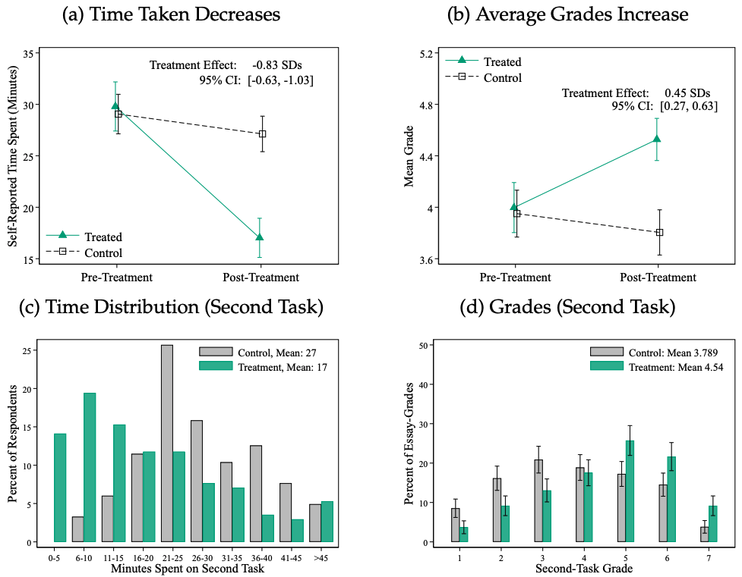
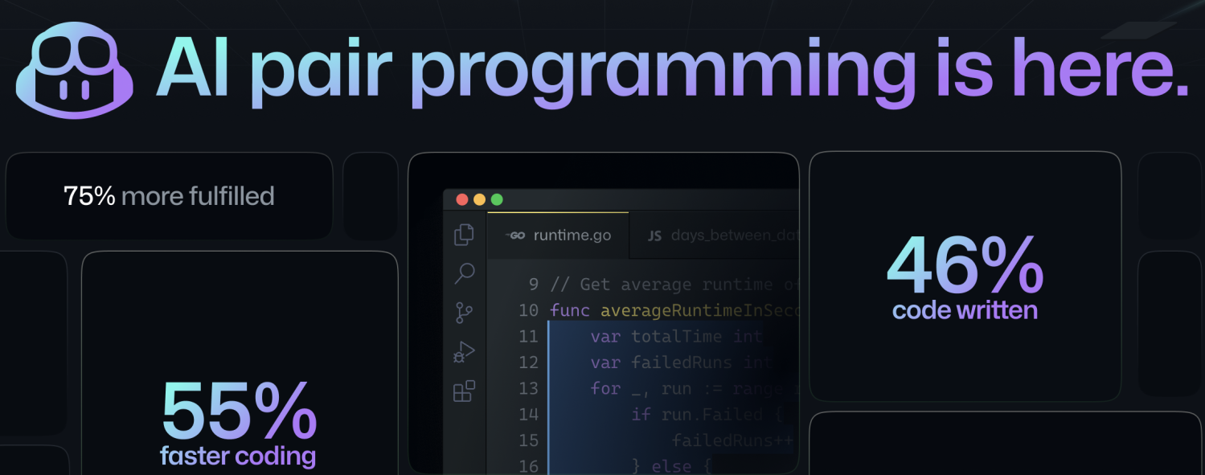
How Generative AI Can Help Human Decision-Making
Programming: Peng et al. (2023) software engineers with GitHub Copilot can be twice as fast.
Writing tasks: Noy and Zhang (2023) show that lower-productivity workers, given access to ChatGPT, improve performance in writing tasks.
Customer service: Brynjolfsson, Li and Raymond (2023) show improvement in worker productivity when ChatGPT is used in a human complementary manner — to provide information to operators.
Common element: the use of better information (from LLMs) as input for human decision-making to increase the effectiveness of human skills and expertise.
Notes:
[[some research to be done here. My understanding is that generative AI can be very useful as a first draft, but it requires decent programming skills to debug and improve the program.]]
[[Show figure from their paper, indicating significant improvement, of about 25% or so for lowest-performance workers and no improvement for high-performance workers. We can label the figure to indicate that this is related to equality of opportunity/access as well]]

Slide 7
Roadblocks to the MIT Vision of Generative AI
Four related, but distinct, roadblocks can be identified:
Automation rather than input into human decision-making.
Unforeseen consequences of better information for humans — e.g., greater conformity, less diversity and externalities from new information.
Platform incentives to exploit information — e.g., information filtration and curation by generative AI to manipulate rather than help people.
Misalignment between human cognition and AI algorithms — e.g., incorrect perception or processing of AI inputs, in the limit leading to bad feedback loops between machine and human.
All four of these roadblocks have parallels with (but also differences from) previous digital technologies and waves of AI, from which we can learn.
Notes:
These benefits will not be realized if the technology is not developed in a way that complements human-decision-making or its inputs are misused.

Slide 8
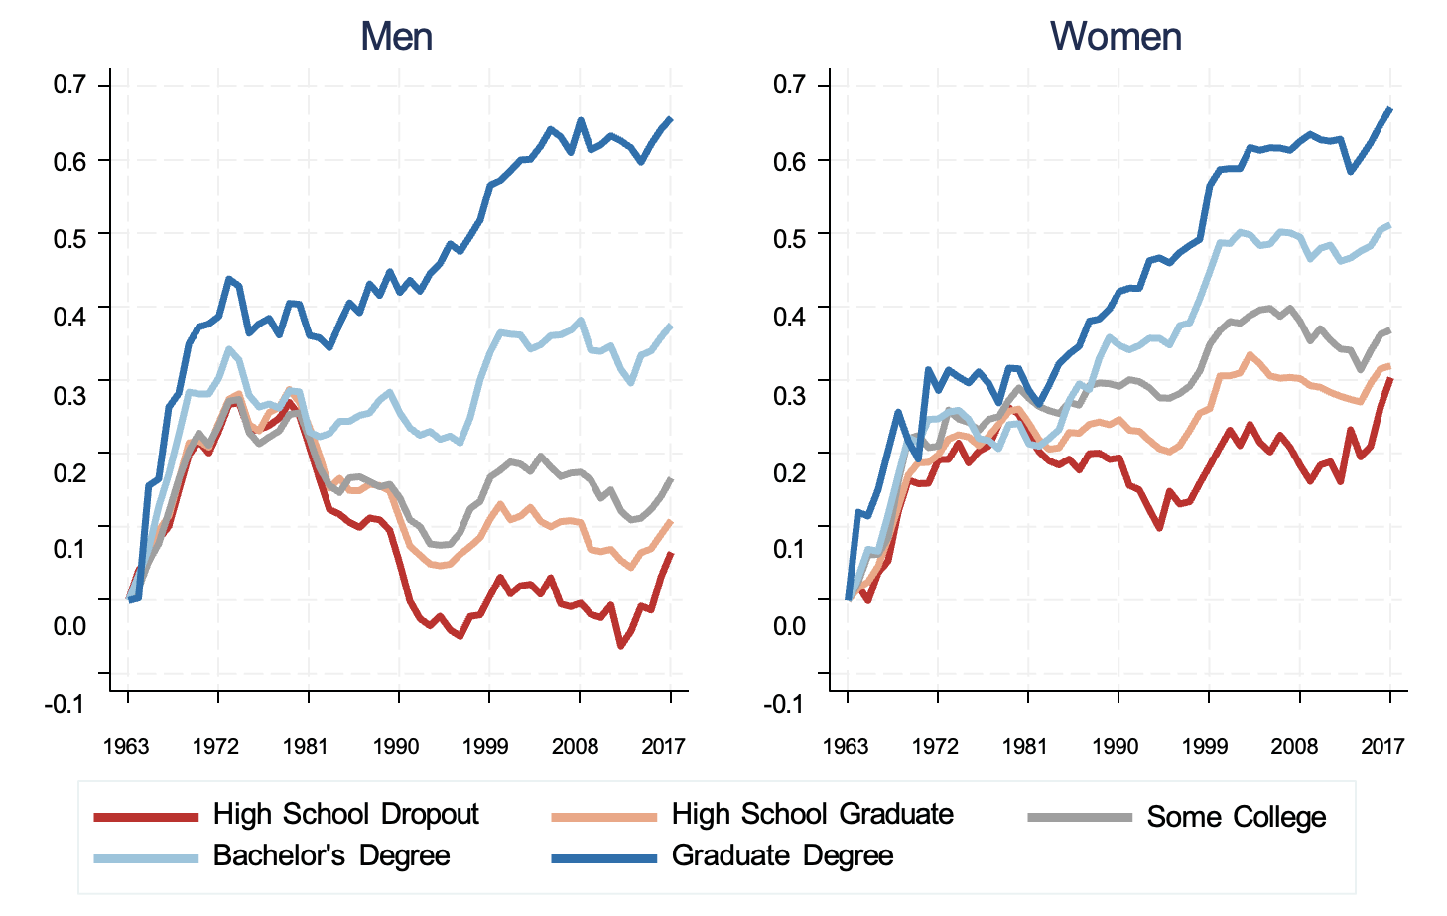
Roadblock I: Inequality in the Age of Digital Technologies
Breakdown of shared prosperity during the era of digital technologies
Source: Autor, David. 2019. "Work of the Past, Work of the Future." AEA Papers and Proceedings, 109: 1–32.

Slide 9
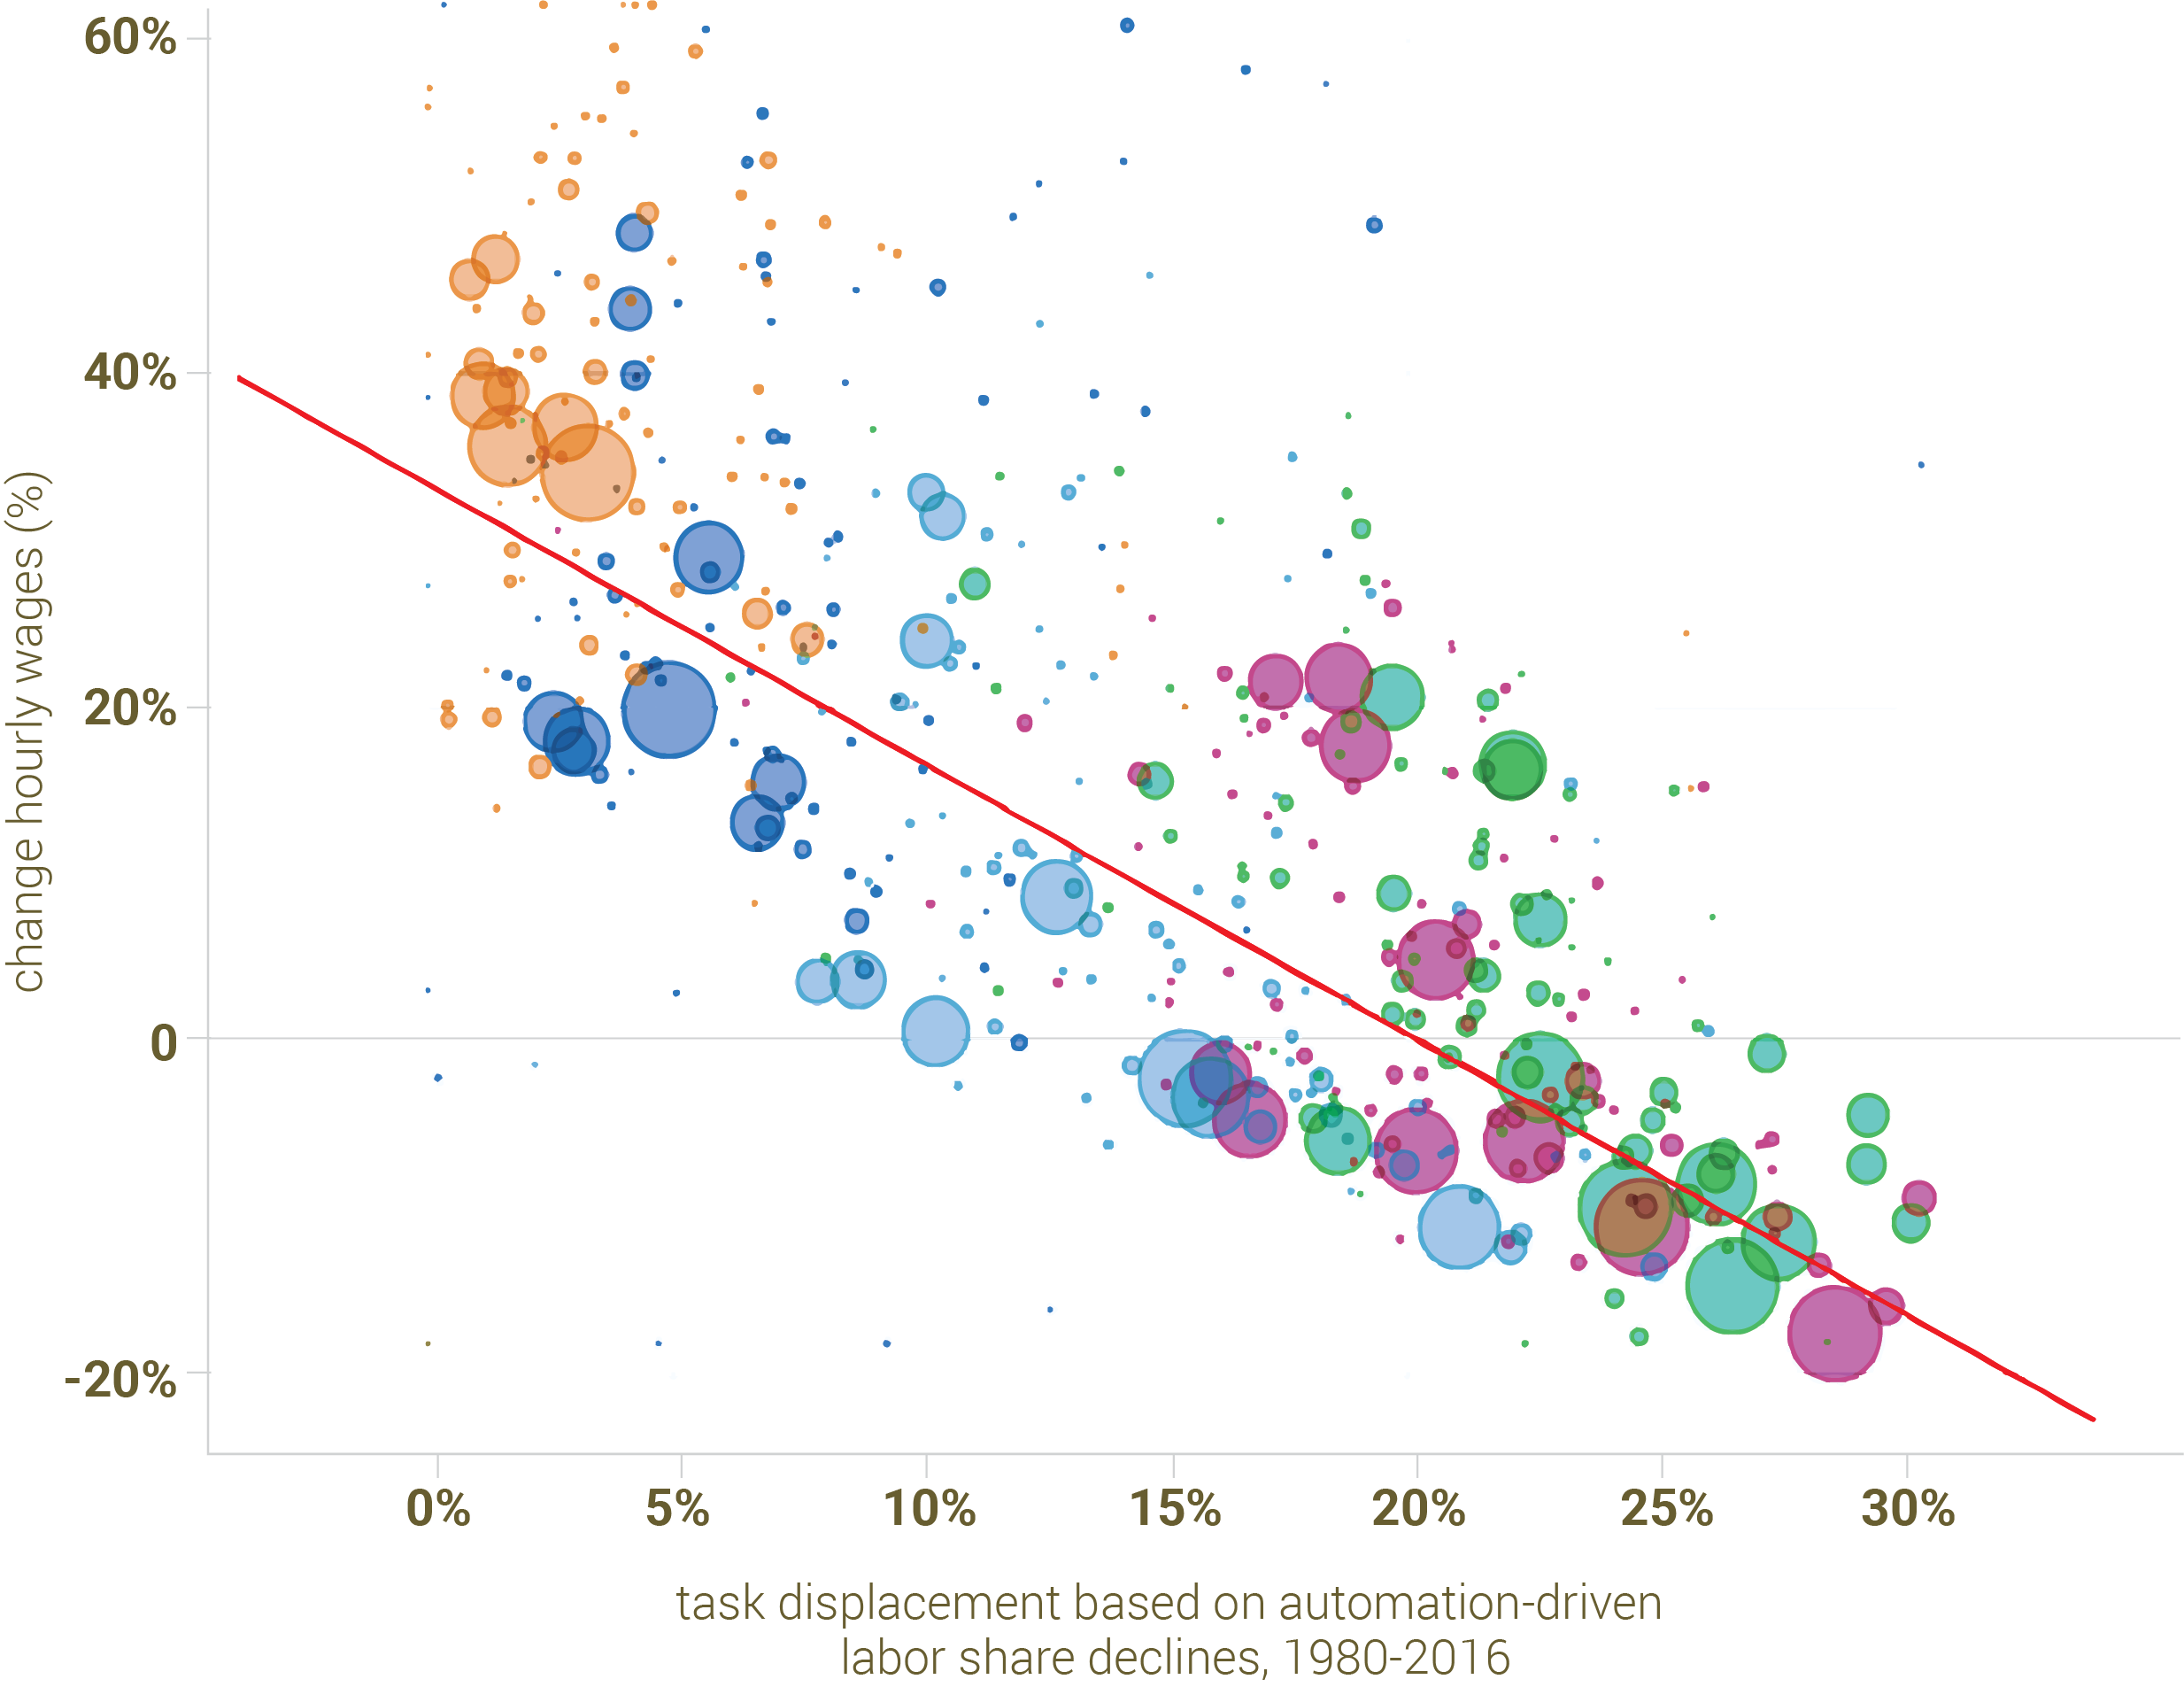
Roadblock I: Automation’s Effects: Inequality and Stagnation
Changes in Real Wages due to Automation of Job Tasks
Companies may be tempted to use generative AI just for automation.
This will not unleash the full potential of generative AI in complementing human-decision-making. And it will likely create even more inequality.
Learning from the past: Past digital technologies used for automation, with adverse distributional and wage consequences (Acemoglu and Restrepo (2022)):
Limited productivity benefits because of “so-so automation”
Inequality: groups that were more affected by automation suffered wage declines
High School dropout
High School graduate
Some College
College degree
Graduate degree

Slide 10
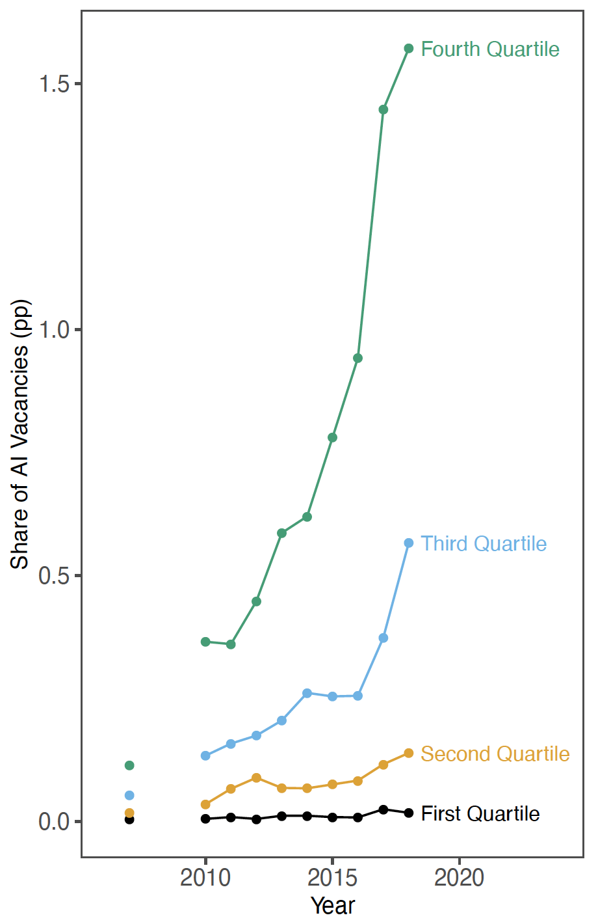

Roadblock I: AI and Automation
AI Adoption by Quartile
of AI Task Exposure
There is already evidence that AI has been used for automation (rather than complementing humans).
Establishments investing most in AI are those that used to perform tasks that were replaceable by basic AI (Acemoglu, et al. (2022)).
And these same establishments slowed down their hiring after AI adoption.
Also, concerns of so-so automation.
LLMs seem to be going the same way — simple writing and analytical tasks are being automated in companies such as Buzzfeed.
The control of data from creative output, at the center of the Writers Guild strike, is going to be crucial for AI’s use for automation.
Self-Checkout: So-so Automation

Slide 11
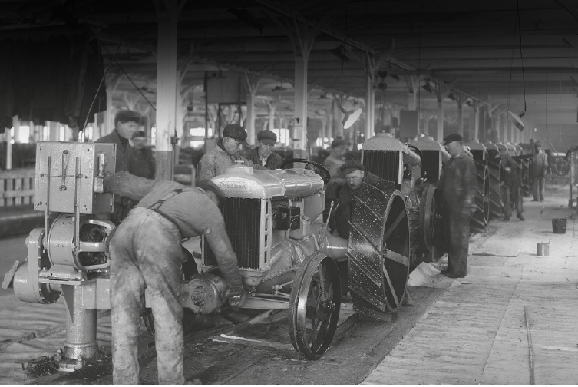

Roadblock I: Better AI
Henry Ford’s electrified Rouge Plant, 1919
The alternative path for AI is to create new human tasks.
Even using generative AI in existing human tasks to help workers is not enough.
If this happens, it will likely devalue specific human skills (better AI-assisted writing would mean lower prices for writing skills and knowledge).
This conundrum is solved with new tasks. These reinstate workers into the production process, increase worker contribution to productivity and boost earnings (Acemoglu and Restrepo (2018)).
The promise of LLMs (and generative AI more broadly) should be in this type of new-task creation.
3D-printing and advanced fabrication, 2021
Source: 3D World’s Advanced Saving Project, TECLA

Slide 12
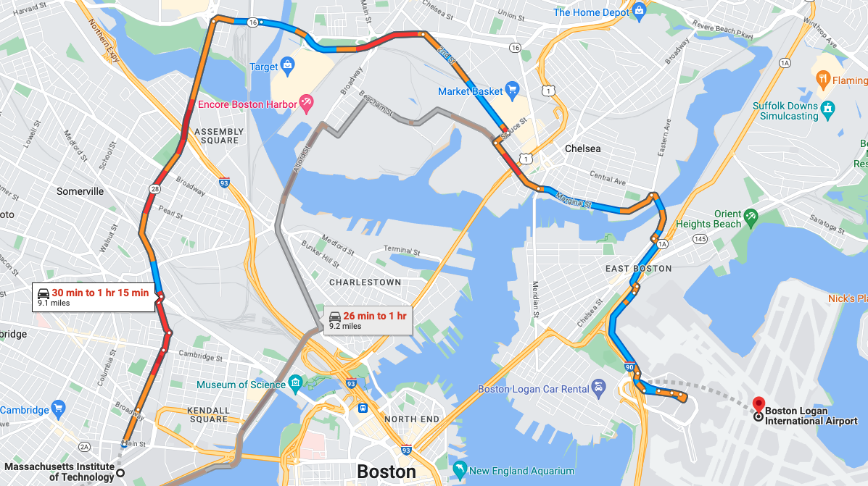
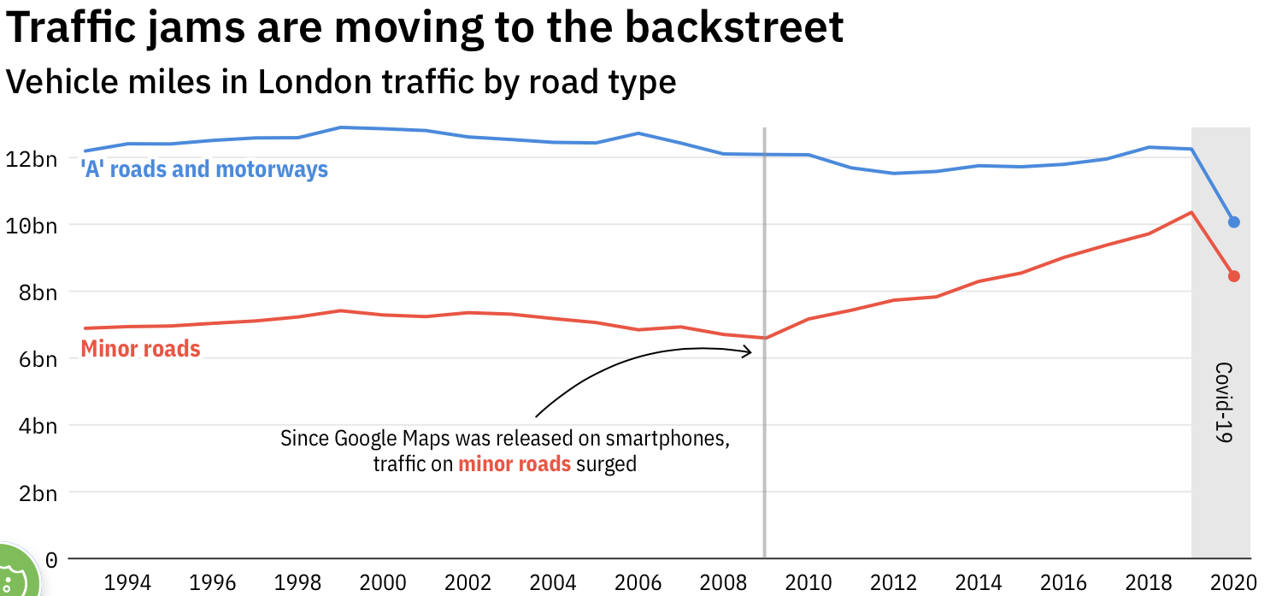
Roadblock II: Unforeseen Consequences of Better Information
The promise of Generative AI is in improving human decisions.
This change brings systemic consequences, some of them unforeseen.
Learning from the past: GPS.
One of the first “intelligent” systems.
Its use for navigation hugely beneficial to individual drivers.
But systemic effects may have been negative.
Why? Because traffic rerouted towards minor roles where congestion is more sensitive to traffic volume (theory: (Acemoglu et al. (2018)).
Notes:
Particularly costly if diversity is important for deliberations and adaptation to changing environments.

Slide 13
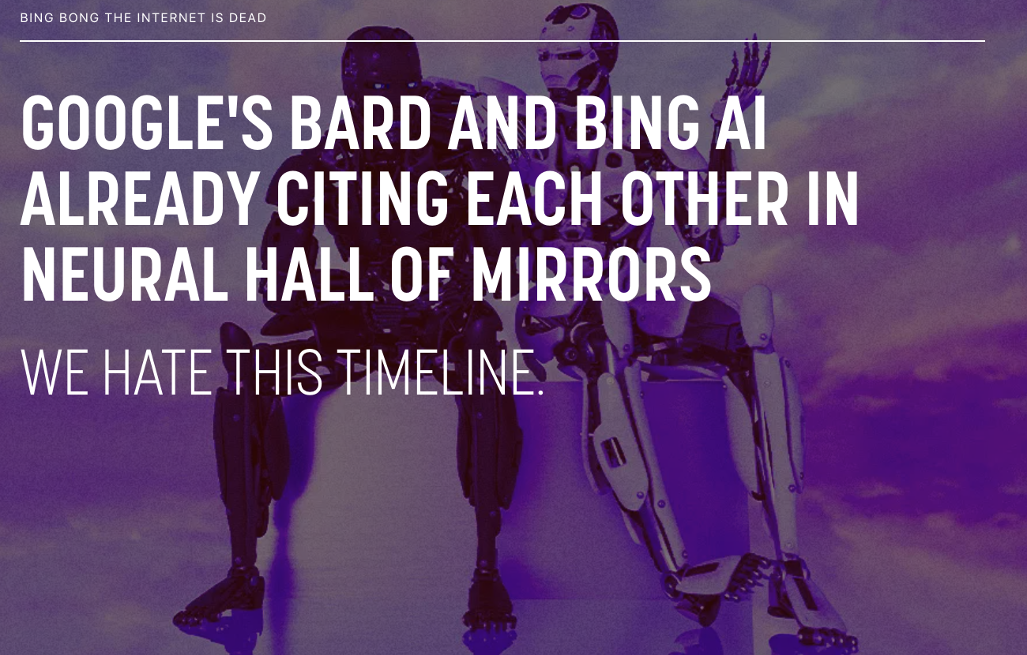
Roadblock II: Unforeseen Consequences of Generative AI
Generative AI intensifies these concerns:
Greater conformity and informational “herding”: If everybody turns to LLMs for information, this reduces diversity and also creates herding.
Bad information feedbacks: Could mistakes multiply because of AI-AI or AI-human interactions?
Source: Futurism
Example:
1. Human Query: “Is policy X effective?”
2. LLM: “No”
3. Future Human Communication (e.g., on social media): “Policy X is not working”
4. LLM’s new training data: “Policy X is not working”
Notes:
Particularly costly if diversity is important for deliberations and adaptation to changing environments.

Slide 14


Roadblock III: Platform Exploitation of Information
Platforms can use generative AI to increase their control over individuals.
Learning from the past: Algorithmic recommendations that create filter bubbles and viral extremist and misleading comment.
The root cause of the problem is the business model of tech companies and platforms — based on individualized digital ads (and limitless data collection).
Source: Snopes
Notes:
“You can build very finely tuned campaigns to resonate with an audience… On the other hand, you could make up imaginary scenarios that never existed in real life,” Greg Estes, vice president of developer programs at Nvidia told CNN.
The platform is the latest example of how AI is being rapidly deployed by major companies to enhance productivity and deliver new products to customers.

Slide 15



Roadblock III: Generative AI and Misinformation
Generative AI could massively expand how information is presented in misleading ways.
Much greater ability to manipulate via individually curated, emotionally charged material; deep fakes.
Creating ads that are “more immersive and tailored” using generative AI.
In the short run, this may amplify the amount of misinformation and disinformation.
In the medium run, we may be in a world that Hannah Arendt foresaw:
“If everybody lies to you, the consequence is not that you believe the lies, but rather that nobody believes anything any longer.”
Sources: Chris Ume (top)
NVIDIA and WPP (bottom)
Notes:
“You can build very finely tuned campaigns to resonate with an audience… On the other hand, you could make up imaginary scenarios that never existed in real life,” Greg Estes, vice president of developer programs at Nvidia told CNN.
The platform is the latest example of how AI is being rapidly deployed by major companies to enhance productivity and deliver new products to customers.

Slide 16
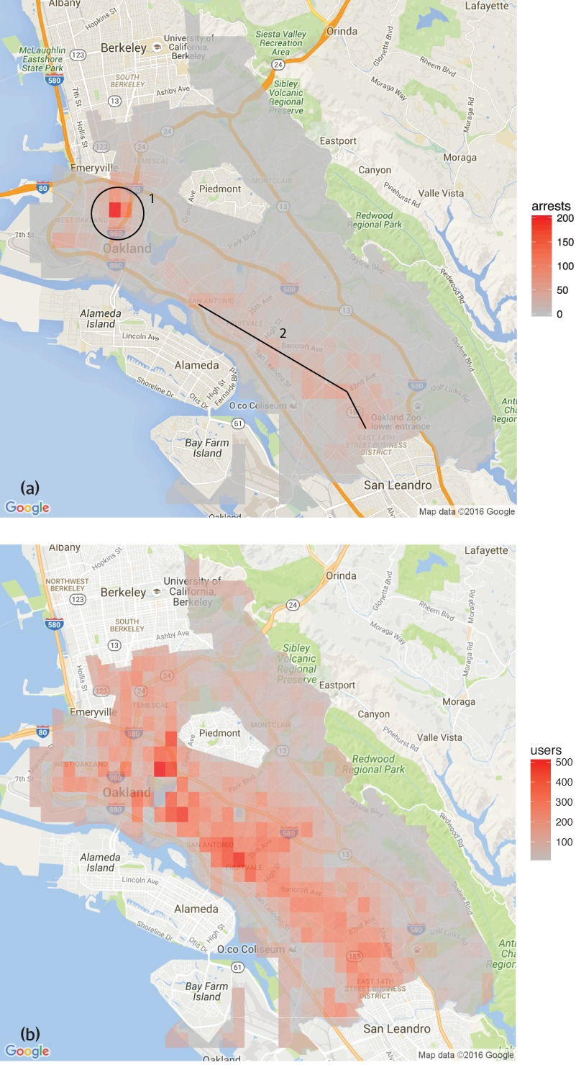
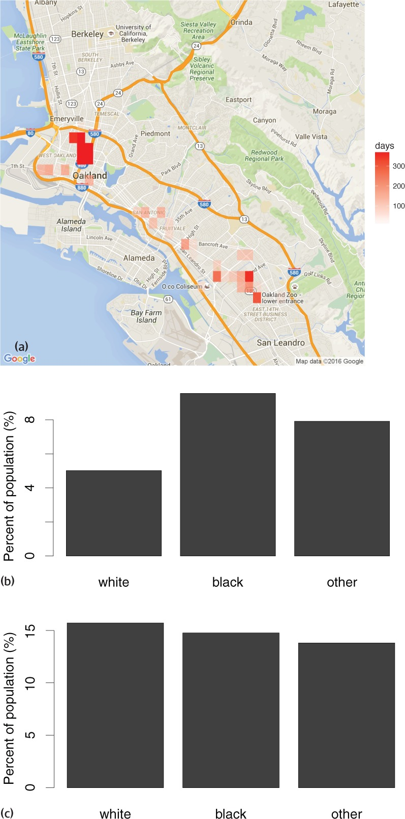
Roadblock IV: AI-Human Misalignment
Input into human decision-making is useful to the extent that humans use it correctly.
Cognitive misalignment is a major problem.
Humans may misinterpret or mistrust algorithmic recommendations, or they may overreact to certain types of information and excessively change behavior.
Learning from the past:
Predictive policing: Lum and Isaac (2016) find an overemphasis on where to expect crime will take place.
Misuse admits calibration of information: Agarwal et al. (2023) show that physicians put more weight on information that AI recommends, and they know already, and systematically underweight other information.
Notes:
Danger: even worse feedback loops---algorithmic prediction crime will take place in area A; police expect crime in area A and make a lot of arrests there; the algorithm doubles down on its prediction

Slide 17
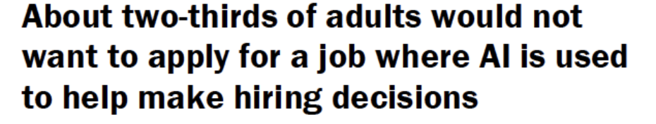
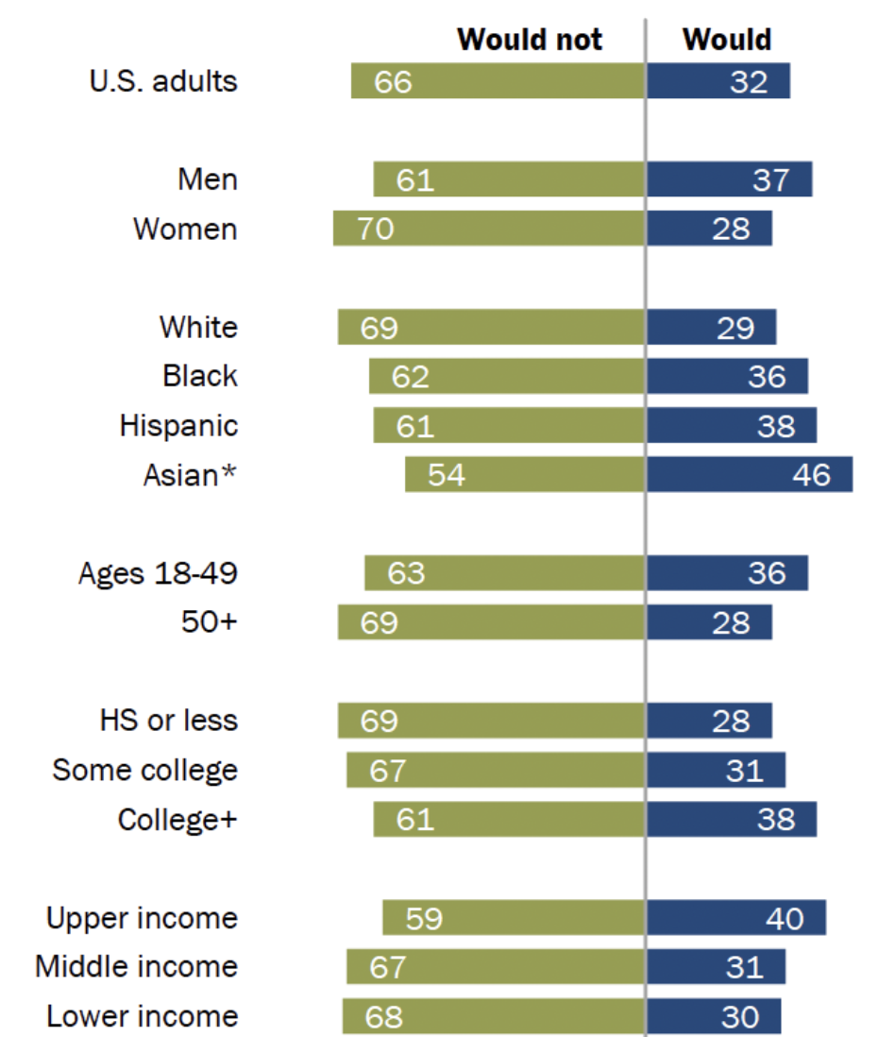
Roadblock IV: Generative AI Misalignment
Generative AI amplifies misalignment concerns:
With better recommendations from generative AI tools, humans will rely more on these recommendations.
Any negative feedback loop may be amplified.
Bias may become more widespread.
If humans use generative AI more, then biases in AI, resulting from input data or architecture, will become more widespread.
Bias may become more legitimized.
If humans start trusting generative AI more, biases in AI become more legitimized.
Particularly problematic in race issues in both crime and hiring.
Source: Pew Research Center, April 2023, “AI in Hiring and Evaluating Workers: What Americans Think”
Notes:
Danger: even worse feedback loops---algorithmic prediction crime will take place in area A; police expect crime in area A and make a lot of arrests there; the algorithm doubles down on its prediction

Slide 18
How to Do Generative AI Better?
Better architecture – especially “legible AI” – to keep humans in the driving seat.
There is the possibility of a positive loop: better architecture of LLMs enable businesses to use them more productively and encourage more useful technologies to develop.
Some elements of such an architecture may be:
incorporate reliability scores together with accurate source information
allow reasoning exchanges, sensitivity analysis and broader interrogation by humans
structure that facilitates human-complementary applications
more selective use of (higher-quality) data
domain specificity (for more interpretable and reliable recommendations)
internal guardrails, perhaps with two LLMs consistently checking each other (to prevent venturing into excessive authoritativeness) and internal structure to facilitate regulation
Good news: It is possible.
Bad news: There is not where we are heading, for a variety of reasons (industry organization, the power of big tech companies and dominant visions in the field).

