Slide 1
A Reconsideration of Fiscal Policy in the Era of Low Interest Rates
Jason Furman
IMF/IEO Webinar
January 13, 2021

Slide 2
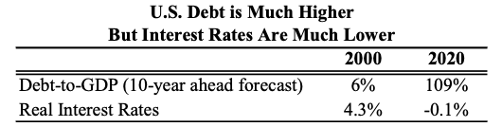
Interest rates are low despite debt being high
Note: Debt-to-GDP forecast is the CBO 10-year ahead forecast (2030 from June 2019 Alternative Fiscal Scenario for 2020). Real interest rates are based on 10-year Treasury Inflation Protected Securities (TIPS) from January 2000 and February 2020.
Source: Congressional Budget Office; U.S. Department of the Treasury; authors' calculations.

Slide 3
Interest rates have fallen everywhere, starting before the financial crisis and continuing after it
Note: Inflation measured by one-year changes in the core consumer price index (core personal consumption expenditures for United States).
Source: Bank of Canada; Statistics Canada; Eurostat; Japanese Statistics Bureau; U.S. Bureau of Economic Analysis; Macrobond; authors’ calculations.

Slide 4
Interest rates are expected to stay low
Market expectations:
72% probability FFR < 0.25 five years from now
1.4% FFR a decade from now
-0.9% real FFR a decade from now
2% nominal 10-year rate a decade from now
Note: Dashed lines are projections. Market-implied rates as of November 27, 2020.
Source: Congressional Budget Office; Bloomberg.

Slide 5
Three challenges posed by low interest rates
Less scope for monetary policy in recessions
Average 630 basis point cut in past recessions
Increased financial stability risks
Increased risk taking
Increased fragility for banks
Possibility of demand shortfalls in normal times
Monetary and fiscal policy in 2018-19 looked like the response to a medium-sized recession with the fed funds rate cut to 1.15 percentage point and a 2.6 percent of GDP fiscal expansion.
If Bowles-Simpson had passed after 2010 would have been hard to have reasonable growth over the following decade.

Slide 6
Three implications of low interest rates and the opportunities they afford
Active use of fiscal policy is essential in order to maximize employment and maintain financial stability in the current low interest rate world
Lower interest rates necessitate new measures of a country’s fiscal situation
The scope and need for public investment has greatly expanded

Slide 7
Implication 1: Countries cannot afford not to undertake fiscal expansions in recessions
Similar findings in:
IMF modelling (Gaspar, Obstfeld and Sahay 2016)
OECD modelling (2016)
Auerbach and Gorodnichenko (2017)
Works the same way or even more in countries with high debt levels.
Source: Reifschneider and Summers as reported in Ball, DeLong, and Summers (2017).

Slide 8
Other steps that should be taken
Automatic recession insurance
U.S. automatic stabilizers relatively weak
Triggers for state assistance, unemployment insurance, nutritional assistance, etc.
Further demand increases in a budget neutral manner
Balanced budget multiplier
More progressive fiscal policy
Expanded social insurance

Slide 9
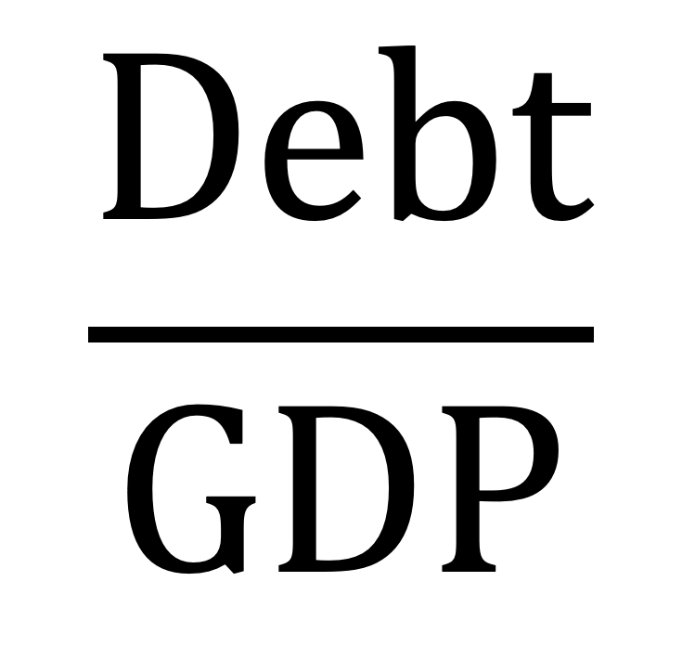
Implication 2: Lower interest rates necessitate new measures of a country’s fiscal situation
$$\frac{Debt}{GDP}$$
Stock
Backward looking
Flow
NPV of U.S. GDP is $3.9 quadrillion (SS Trustees) or ∞ (if r<g).

Slide 10
Stock-stock: debt stable relative to future GDP even while tripling relative to present GDP
Note: 2021 value is based on debt as of November 19, 2020.
Source: The Board of Trustees, Federal Old-Age and Survivors Insurance and Disability Insurance Trust Funds; Federal Reserve Bank of Philadelphia, Survey of Professional Forecasters; Department of the Treasury; Macrobond; authors’ calculations.

Slide 11
Flow-flow: real debt service has fallen even while debt has increased
Note: 2021 values are projections.
Source: Office of Management and Budget; Congressional Budget Office; Macrobond; authors’ calculations.

Slide 12
Technical aside: should exclude financial assets from debt & Federal Reserve remittances from interest
Source: Office of Management and Budget; Richard Kogan’s calculations; authors’ calculations.

Slide 13
Looking forward: debt projected to be stable over the next decade & beyond if Social Security reformed
Looking forward: debt projected to be stable over the next decade & beyond if Social Security reformed
Note: Social Security reform phased in linearly from 0.5% of GDP to 1.7% of GDP over 10 years beginning in 2025.
Source: Office of Management and Budget; Congressional Budget Office; Macrobond; authors’ calculations.

Slide 14
The more relevant metric of real debt service expected to stay low relative to the economy
Note: Social Security reform phased in linearly from 0.5% of GDP to 1.7% of GDP over 10 years beginning in 2025.
Source: Office of Management and Budget; Congressional Budget Office; Macrobond; authors’ calculations.

Slide 15
Thirty-year ahead budget forecasts are incredibly uncertain
Note: Social Security reform phased in linearly from 0.5% of GDP to 1.7% of GDP over 10 years beginning in 2025
Source: Office of Management and Budget; Congressional Budget Office; Macrobond; authors’ calculations.

Slide 16
Implication 3: The scope and need for public investment has greatly expanded
Blanchard (2019) argues that r – g being negative should change how we think about intergenerational fiscal policy.
Demand perspective: Fiscal expansions in recessions may improve debt-to-GDP ratio
Supply perspective: At low interest rates more public investments pay for themselves:
Children (Hendren and Sprung-Keyser 2020)
Infrastructure
Research and development

Slide 17
Going forward we need a fiscal framework that is a combination of:
Optimal
Understandable
Achievable

Slide 18
New objectives, guideposts and guidelines
Context: Interest rates are dangerously low, debt is projected to be stable, real debt service is projected to be low. More fiscal expansion needed.
Objective: Growth and financial stability including the avoidance of recessions and stronger long-term growth.
New guidepost: Real interest payments should not be rising sharply or projected to exceed around 2 percent of GDP over the next decade.
Guidelines:
Temporary emergencies should not be paid for, broad definition
Long-term programs should be paid for, broad exceptions
Improve composition of government to support demand and efficiency

Slide 19
A Reconsideration of Fiscal Policy in the Era of Low Interest Rates
Jason Furman
IMF/IEO Webinar
January 13, 2021

