Slide 1

IMF engagement with Small developing states
Evaluation report
ISSI-University of Malta – June 27 , 2022

Slide 2










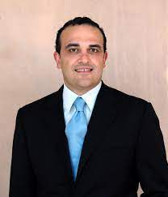


Presentation Outline
Cyrus Rustomjee
Lead, IEO
Chris Lane
External consultant
Xavier Maret
External consultant
Lino Briguglio
External consultant
Miguel de Las Casas
Co-lead, IEO
Sriram Balasubramanian
IEO
Michael Da Costa
External consultant
Alisa Abrams
IEO
Yishu Chen
IEO
Domenico Lombardi
External consultant
Jiakun Li
IEO
Peter Heller
External consultant
David Marston
External consultant
Motivation
Findings
Recommendations
Next steps

Slide 3
Motivation Special Challenge for the Fund
34 SDS IMF members: under 1.5 mill., excluding AEs and high-income fuel exporters.
    SDS are heterogeneous but most share important characteristics:
    Narrow production bases, limited economic diversification, high dependence on trade, and macroeconomic volatility.
    Extreme vulnerability to disasters and CC.
    Constrained human resources and institutional capacity.
    Social and political economy issues including unemployment, brain drain, and instability; 19 are PRGT-eligible, of which 10 are also FCS.
    Special challenge for the Fund
    Micro-economic issues outside the IMF core expertise are often macro-relevant.
    Capacity constraints limit SDS ability to implement policy advice.
    Particular financing needs; emergency and long-term.
    Hard to staff teams for SDS work

Slide 4
Findings Overall Progress
    The IMF deserves credit for substantially stepping up its engagement over the evaluation period (2010-2020).
    Development of specific guidance to staff on SDS work.
    Increased attention to disaster and CC issues.
    Augmented capacity to provide emergency financing in the aftermath of a disaster.
    Increased resources to capacity development work, outstanding role played by Regional Capacity Development Centers (RCDCs).
    Commitment by Board members, Management teams, and staff to support SDS.

Slide 5
Findings Surveillance
    IMF policy advice is generally appreciated as high quality and well tailored, but…
    Sometimes lacking actionability and specificity, particularly in macro-relevant areas outside the IMF’s core competence.
    Limited access to tools useful to SDS such as FSAP and CCPA (now CMAP).
    Low frequency engagement and lack of continuity in country teams hampered the IMF’s trusted advisor relationship and the depth of country understanding.
    Challenging to meet standard surveillance requirements and apply complex diagnostic tools in SDS context.
    End result: traction is uneven.

Slide 6
Findings Programs and Lending
IMF emergency financing was useful to SDS facing disasters and COVID-19, but…
The IMF lending framework is not specially well suited for SDS’ needs.
Little use of programs with conditionality relative to other members. Reasons:
    Stigma, political considerations, and availability of alternative sources.
    Low access levels relative to scale of need.
    Considerable administrative burden relative to capacity.
    Short time frame relative to long-term needs.
Even with IMF emergency financing, including during COVID-19, access levels are low compared to scale of financing need.

Slide 7
Findings Capacity Development
CD represents a higher share of IMF activity than for other countries.
CD support greatly appreciated; good quality, right content, and sufficiently tailored.
Regional Capacity Development Centers have been a key driver of success.
Main concern: traction and impact are uneven. Reasons:
    Limited absorption capacity of recipients, sometimes compounded by lack of ownership.
    Tendency to focus on first-best solutions and not recognizing limitations to absorption.
Risk: CD support may be too reliant on sustained external financing.

Slide 8
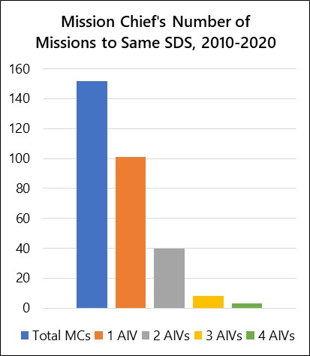
Findings Internal HR Management
In general, IMF staff working on SDS are appreciated and valued, but…
IMF work on SDS has been adversely affected by
    High turnover and short tenure of staff, reflecting poor institutional incentives; insufficient recognition, lower ratings and promotion rates.
    Challenges from small team sizes and limited access to specialist skillsets.
    Lack of resident representatives and presence on the ground.
Sources: SDS AIV Mission Reports (2010-2020); IEO calculations.

Slide 9
Recommendation 1 Framework for Engagement
The Fund should pursue a targeted recalibration of its overall approach for engagement with SDS to strengthen the value added and impact of its work
Refresh the guidance provided to IMF staff working on SDS to bring further attention to:
    Integration of surveillance, lending, and CD work.
    How best to apply surveillance requirements and diagnostic tools recognizing capacity limitations in SDS.
    Coordination with partner institutions.
Ensure internal coordination mechanisms support the continuity, accountability, and momentum of SDS work.

Slide 10
Recommendation 2 Focus and Traction
Steps should be taken at the operational level to enhance the focus and traction of the IMF work on SDS in the areas of surveillance and CD.
Greater selective attention to policy issues that are macro-critical in SDS.
Tailored engagement strategies to foster impact and integration of IMF work.
Increased efforts to apply diagnostic tools in a manner suitable to SDS circumstances.
Greater focus of CD support on SDS’ institutional capacity constraints and political economy circumstances.

Slide 11
Recommendation 3 Use of the Lending Framework
The IMF should consider how to use its lending framework in ways that better address the needs and vulnerabilities of SDS.
Greater attention to growth and resilience outcomes in programs with SDS, including by drawing on expertise in partner institutions.
The newly designed RST should be implemented taking into account the particular needs and institutional constraints of SDS.
Access limits under the IMF’s emergency financing instruments for large disasters could be increased further for countries with robust macroeconomic frameworks and governance standards.

Slide 12
Recommendation 4 Enhancing HR Management
The IMF should adopt further HR management and budgetary commitments to increase continuity and impact of staff’s engagement with SDS.
Greater departmental commitment to reducing the turnover of staff working on SDS and avoiding gaps in assignments.
Strengthen incentives by increasing recognition, limiting use of co-desks, greater use of functional departments and research assistants, and limiting stopgap measures.
Additional budgetary resources should be provided to expand the footprint of the IMF in SDS; e.g. regional resident representative offices and RCDCs.

Slide 13
Next Steps Priorities for Implementation
Executive Board discussion on May 10: generally broad support from Directors and partial/qualified support from the MD for all four recommendations.
A Management Implementation Plan (MIP) to be prepared by staff, within six months, in response to recommendations endorsed by the Board; concrete actions, with a time frame, and responsibility assignments.
After its discussion by the Evaluation Committee, the MIP must eventually be approved by the Board.
Following its approval, the implementation of the MIP will be monitored annually, together with other MIPs, by the IMF’s Office of Internal Audit.

Slide 14
Thank you!
Visit us at ieo.imf.org

Slide 15
IMF and World Bank SDS Classifications
Sources: IMF and World Bank.
Note: Microstates are shown in italics; * denotes FCS; countries in orange are the evaluation country cases. AFR=African Department, APD=Asia and Pacific Department, EUR=European Department, MCD=Middle East and Central Asia Department, WHD=Western Hemisphere Department.
back

Slide 16
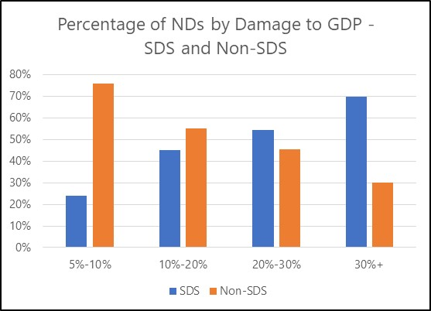
Damage from Disasters: SDS vs. Non-SDS
Sources: International Disasters Database (EM-DAT); IEO calculations.
back

Slide 17
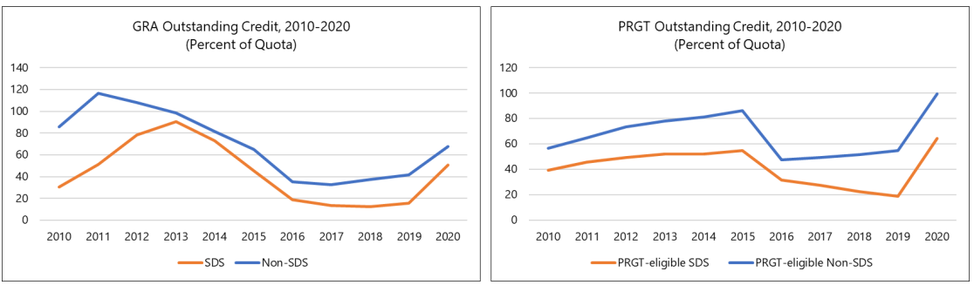
IMF Lending Support, 2010-2020
Sources: IMF; IEO calculations.
back

Slide 18
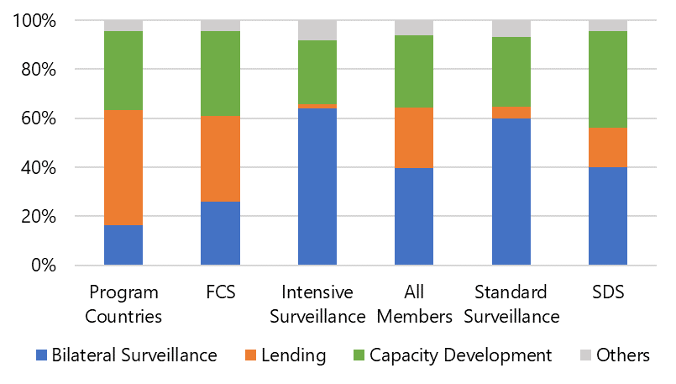
IMF Spending by Country Type, FY2020
Sources: IMF; IEO calculations.
back

Slide 19
Emergency Financing for COVID-19
Sources: IMF; IEO calculations.
Note: Covers EF Requests over March 2020-August 2021
back

Slide 20
Background Papers
Country Cases
IMF Engagement with SDS—AFR+2 Case Studies (BP1).
IMF Engagement with SDS—Case Studies in the Asia and Pacific Region (BP2).
IMF Engagement with SDS—Caribbean Case Studies (BP3).
Cross-cutting Issues
The Capacity Development Work of the IMF in SDS (BP8).
The IMF’s Support to SDS During the COVID-19 Pandemic (BP9).
The IMF Framework for Engaging with SDS (BP10).
The IMF and SDS: Human Resource Issues (BP11).
IMF Engagement with SDS: IEO Surveys of Country Officials and IMF Staff (BP13).
Thematic Papers
IMF Engagement with SDS on Growth Issues (BP4).
The IMF’s Engagement on Natural Disasters and Climate Change Issues Affecting SDS (BP5).
IMF Fiscal Policy Engagement in SDS (BP6).
IMF Engagement on Financial Sector Issues in SDS (BP7).
Economic Growth of SDS—A Literature Review (BP12).
back

Slide 21
Reactions May 10 Board Discussion
Managing Director statement
    MD agreed that a targeted recalibration would be effective to enhance traction and offered qualified and/or partial support to all four recommendations.
    Raised concerns about budgetary constraints, compatibility with the IMF legal framework and strategic plans, and overlap with other initiatives.
Executive Board
    Welcomed finding that IMF engagement has substantially stepped up and a major overhaul is not required.
    Many Directors, including all those representing SDS, offered broad support to all four general recommendations and most specific suggestions.
    Other Directors agreed with the MD’s statement as providing a broadly balanced approach.
back

Slide 22
Issues for Discussion
Does the evaluation provide a fair representation and accurate diagnosis of the IMF engagement with SDS, according to your experience?
Are the recommendations appropriate, both in terms of substance and ambition?
Which should be the main areas of priority?
How to support a strong implementation plan?

