Slide 1
Some Economics of Pandemic Policies

Slide 2
A Look-back at Our 2020 Look-forward
Early in the Covid-19 pandemic 2020 we analyzed information challenges and policy alternatives
The pandemic was (is) a unique event, about which little was known (but much was learned)
Looking forward from today, it is unlikely to be “unique”
Despite mitigation efforts, from January 2020 to March 2023 the US suffered 1.8 million “excess deaths”, along with myriad other costs
Mortality was highly concentrated among the elderly
  82% of excess deaths among among those aged 60 and over
  Over half among those aged 75 and over

Slide 3
The Primary Costs of The Pandemic
Three main costs of the pandemic
  Loss of life, due to direct (disease) and indirect effects
  Economic costs of reduced activity, present and future, including costs generated by poor policy choices
  The lost value of human capital from reduced activity and education of the young. These are permanent effects on a generation
The direct resource costs of medical care, investments in capacity to treat and track the disease, etc. are likely small in comparison to these costs
Regarding non-illness costs, it is important to recognize both current and long-term costs—many of which are policy-related

Slide 4
CDC Covid-identified and Total Excess Deaths During the Pandemic
“Excess”: relative to 2015-19 benchmark mortality rates
Cumulative Deaths 2020-2023:
Covid19: 1.2 million
”Excess”: 1.8 million

Slide 5
Pandemic-related mortality was concentrated among the elderly
Age 75+ : > 50% of all excess deaths
Age 60+: > 80% of all excess deaths
“Undercount” is often severe, including among the young
Very young (0-14, not shown) had lower mortality during the pandemic

Slide 6
VSL: What are people willing to pay to avoid a risk that
would claim one life in a large population?
VSL at age “a” is present value of remaining life-years, VSL(a)
EPA average VSL for cost/benefit
analysis: about $11 million
VSL(a) declines over lifecycle
for two reasons:
Life-years at older ages
are less valuable
Fewer remaining years
of life at older ages

Slide 7
Facing a Hard Tradeoff:
Mortality Risks Were Highest Among Those with Lowest VSL

Slide 8
Though VSL Declines with Age, Further Protection of the Elderly
Would Have Been Highly Valued
Cumulative value of lives lost over all ages = $6.2 trillion
30% of annual US GDP
More than Federal Govt spending ($5.8T)
Despite declining VSL with age, strongly related to age except among the very oldest:
More than 1/3 among 60-74
More than 50% among 60+
But the young were not spared …..

Slide 9
The Young Were Not Spared:
Loss of Human Capital May Exceed Mortality Costs
Education
  Kids were not at risk, and we knew it early on. Huge mistake to keep schools closed or remote
  Hanushek: K-12 students lost about 0.7 years of effective education. Permanent effect—equivalent to a 5.7% reduction in lifetime earnings
  PV of lost earnings is about $140,000 reduction in lifetime wealth per student
  With 55 million K-12 students the total loss of human capital is about $7 trillion, even ignoring college students. Comparable to mortality costs.
Loss of Labor Market Experience
  Human capital (productivity) accumulates with work experience, with most rapid growth up to about age 35
  ”Shutting down” sacrificed that experience for a generation of young workers
Other losses of human and physical capital, lower economic growth in the future

Slide 10
Strategies for Tackling Pandemics
Three primary strategies that were on the table:
Reductions in activity (forms of social distancing) for the general population that reduce the potential to spread the disease
  Applied broadly (Large Scale SD) these types of restrictions are very costly because they are poorly targeted
  May be effective at reducing/delaying the spread of the disease for a limited time, but are not viable long-run strategies
  Focused SD policies targeted at the most vulnerable make sense
Targeted policies that screen individuals, test for infections, trace movements and contacts, and quarantine those found to be infected (STTQ)
  STTQ can buy time or even keep an infection contained long-term
Efforts to find improved treatments, a cure, or a vaccine. These complement the above by reducing the amount of time containment measures need to be applied

Slide 11
Comparing LSSD and STTQ
LSSD is a fixed cost technology – cost of implementing is largely independent of the level of infection
STTQ has a significant variable component – costs more when there are more infections, less when there are fewer infections
LSSD has a comparative advantage when infection rates are high
STTQ has an advantage when infection rates are low
The high costs of LSSD make it unattractive for long-term application
STTQ can be applied long term if screening costs are relatively low
  The “TTQ” components of costs are proportional to the infected population, which can be low for a contained pandemic

Slide 12
Objectives for Limiting the Loss of life
Buy time to find a cure or effective treatment
Limit the speed of the infection in order to limit stress on the healthcare system. Reduces mortality rates of those infected
Control deaths for a given level of infection by selectively isolating those most likely to have severe reactions to the disease. Elderly and co-morbidities
Limiting overall mortality by managing the risks rather than simply delaying the costs of the pandemic. Strategically flatten the curve while awaiting population immunity—natural or vaccine
Contain the virus long-term

Slide 13
Objectives for limiting the economic costs
Focus on the low cost/high benefit actions
  For covid, the costs of the disease vary greatly across individuals
  Activities vary greatly in the impact they have on the spread of the disease
  With large variation in both costs and effectiveness one-size-fits-all strategies (lockdowns) are highly inefficient
  Policies that leverage individual information are likely to be helpful. People engage in self-protection when they are aware of their own risks
Consider both current and future costs and benefits
  Strategies that simply postpose costs a year or two provide little value
  Both the pandemic and our responses are likely to affect our future productivity by reducing current investments in human and physical capital and by destroying the value of existing human and physical capital

Slide 14
The critical role of uncertainty
Covid-19 pandemic was characterized by a high level of uncertainty, especially at the beginning
If we knew a vaccine was coming in 18 months then a strategy of buying time could be very successful, even if delaying on its own would not provide long-run protection from the disease.
  And it was—”Operation Warp Speed” yielded huge benefits
If a vaccine, effective treatment or cure is a long way off then a strategy of mitigating the overall cost of a pandemic that runs its course could be in order
Even if a vaccine were coming in 18 months, a long term lockdown is not a viable option– we still must manage the pandemic
When we don’t know which is coming, a strategy that attempts to both slow progression, while managing mortality and other costs is the best course

Slide 15
Managing the pandemic’s cost (overview)
Achieve containment at the lowest cost in terms of reduced activity and loss of life
Limit the long run loss of life by limiting the excess of infections over that required to contain the disease long-term
Limit infections among the groups most likely to be adversely affected by the disease while still building resistance to help limit the spread
If possible, limit the spread through testing, tracing and quarantining those infected and their contacts rather than broad restrictions (This is particularly true where and when the level of incidence is low)
Impose broad restrictions only when they provide the greatest benefit
  Target activities with the greatest externalities
  Incur costs of restrictions when infection is wide-spread—shutdowns are very costly, so timing is key

Slide 16
Strategies for Opening the Economy
Maintaining the early lockdown until a vaccine arrives is not a viable option—the horizon was too long
  The potential costs of the disease are high but the lockdown costs at least $20 billion per day (and likely more once we factor in more long-term costs)
  The per-day costs of lockdown will likely rise over time as the ability to shift economic activity over time is diminished
Even if all restrictions are removed the economy will still be far from full recovery

Slide 17
Strategies for opening (continued)
When the disease burden is moderate—as it was in the early stages–the policy should be consistent with three broad goals
  Limit infections of those most vulnerable
  Shift the infection burden to those with the lowest cost of infection, who will obtain immunity for some time
  Limit the spread by screening, testing and quarantining those in the active population found to be infected
    Do random testing (both for infection and antibodies) of those that are socially active to monitor the spread of the virus
    Focus restrictions on activities where individuals are likely to infect others – rely more on individual incentives to prevent individuals from getting infected to take advantage of individual information and incentives
    Lower the cost to employers of testing and screening – rely on them as a source of testing for testing of the active population and to help with tracing (can help defer the costs of this)

Slide 18
Don’t stop learning and building capacity
Our early strategy profile was hampered by lack of knowledge and the capacity to manage the pandemic—everything was new
  We needed to know more about the disease profile
    How good are symptom profiles (rather than specific testing of the asymptomatic) at predicting who is likely contagious?
    Are the recovered immune, and if so, for how long?
    How do death rates vary across individuals and groups?
    Others
  We need to build the capacity to limit the burden of disease
    Widespread testing and tracing will be needed to limit the spread of the disease and allow us to open further
    Increased capacity to deal with those infected will allow us to open more broadly and limit activity for less time

Slide 19
Other thoughts on re-opening
Focus on opening schools (for particularly for K-12 students – most importantly for those K-5) in the fall
  They are losing a lot from being out of school – this will have large long-run consequences. See above
  Adopt a screening, testing, trace and quarantine policy for schools.

Slide 20
Policies for employers
Limit the range of employers that are forced to stay closed
  Many of those that should stay closed/greatly reduce activity will do so anyway – airlines, hotels, movie theaters, sporting events
  Focus restrictions on activities where the effects are less likely to be internalized (e.g. customer-customer transmission) though self-protection will help with this when infection levels are high
  Restrictions will likely vary over time and space as the disease progresses
Require/encourage employers that open to
  Engage in the screen, test, trace, and quarantine policy
  Have some (maybe large employers) provide data to help with population monitoring – cover the costs to encourage participation

Slide 21
Potential Strategies

Slide 22
Containment Through a STTQ Regime
An STTQ regime is attractive for long-term use aimed at containment
Long-term containment requires maintaining active infections at a low level where STTQ has a significant cost advantage
  Individual incentives to protect for the susceptible population are low in such a case requiring a policy to find and quarantine the infected
  A STTQ policy that generates R<1
    Reduces the cumulative number infected to CI⁰+NI⁰/(1-R) , where NI⁰ is the level of new infections at the time the policy is implemented and CI⁰ is the number previously infected
    Has declining costs over time as the infected population shrinks
    The fixed (e.g. screening) costs are the major long-run costs
  A LSSD policy might be necessary up front if initial infections are high (where LSSD is cost efficient) or it takes time to develop and implement the STTQ strategy

Slide 23
Buying time for a vaccine
Very similar to long-term containment
Given plausible horizons STTQ is the core strategy
As with long-term containment LSSD largely a stop-gap measure
Best to apply STTQ strategy early
  Limits overall cost by reducing I⁰ and NI⁰
  This reduces both the loss of life and the costs of implementation

Slide 24
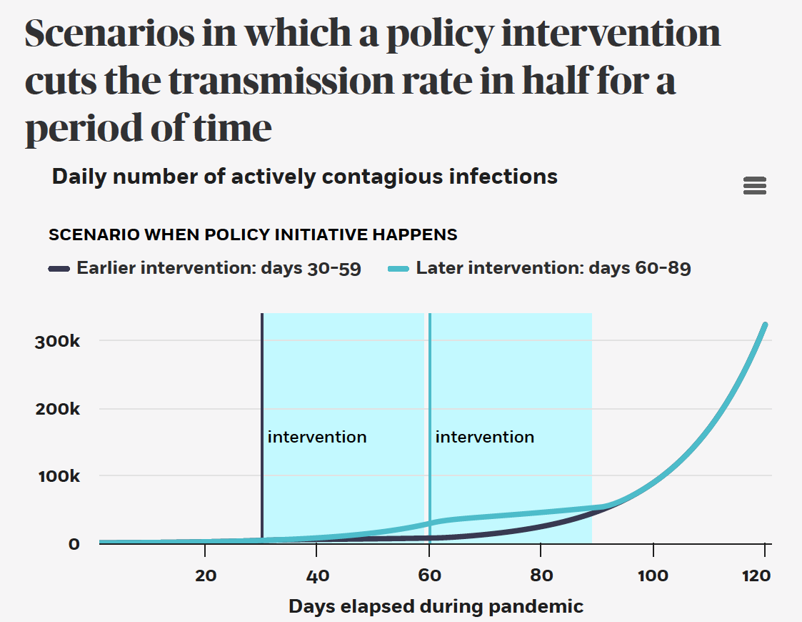
When to incur costly restrictions?
When the restriction has the largest marginal impact
Example: 30 day restriction on interactions that reduces transmission by 50%
Early in the pandemic (days 30-59) or later (days 60-89)

Slide 25
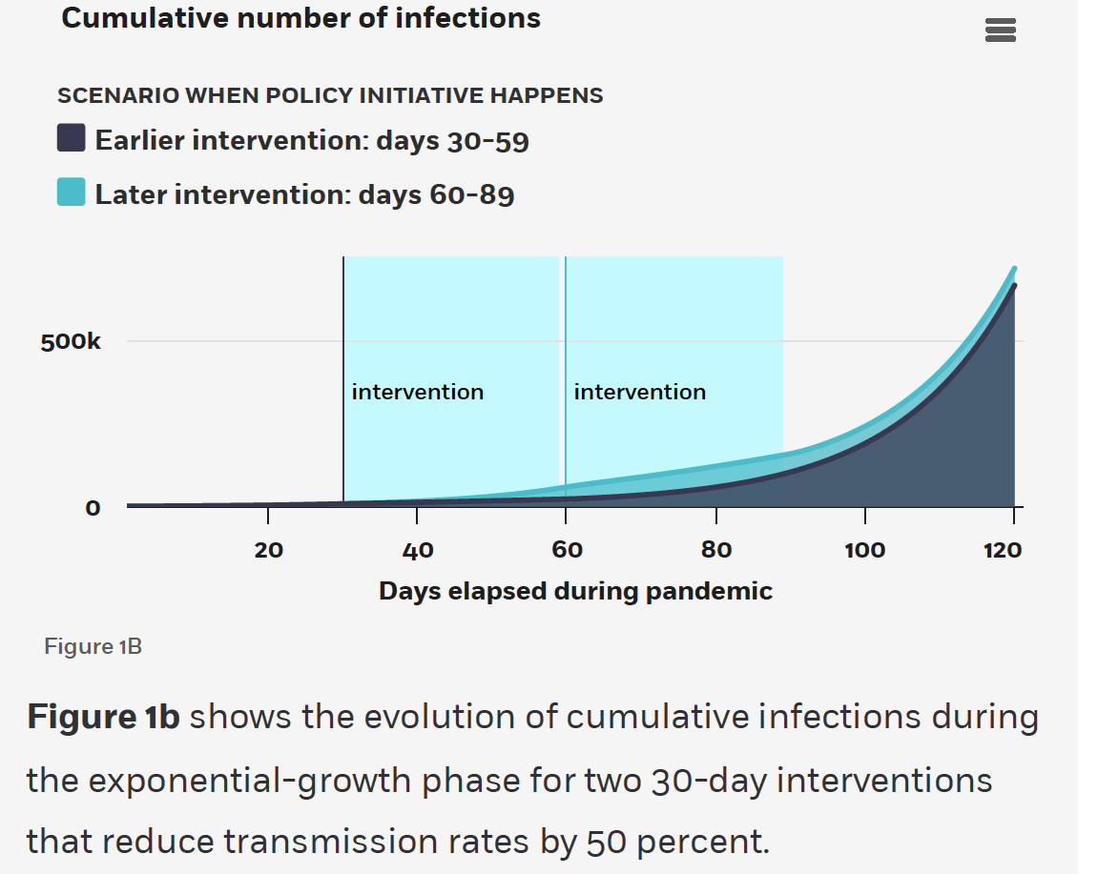

Slide 26
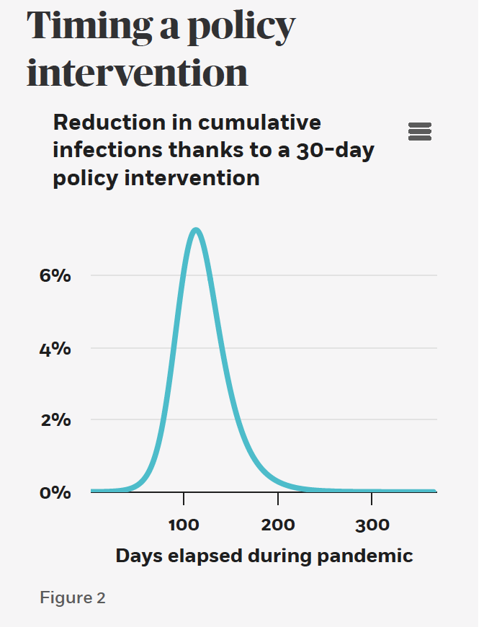

Slide 27
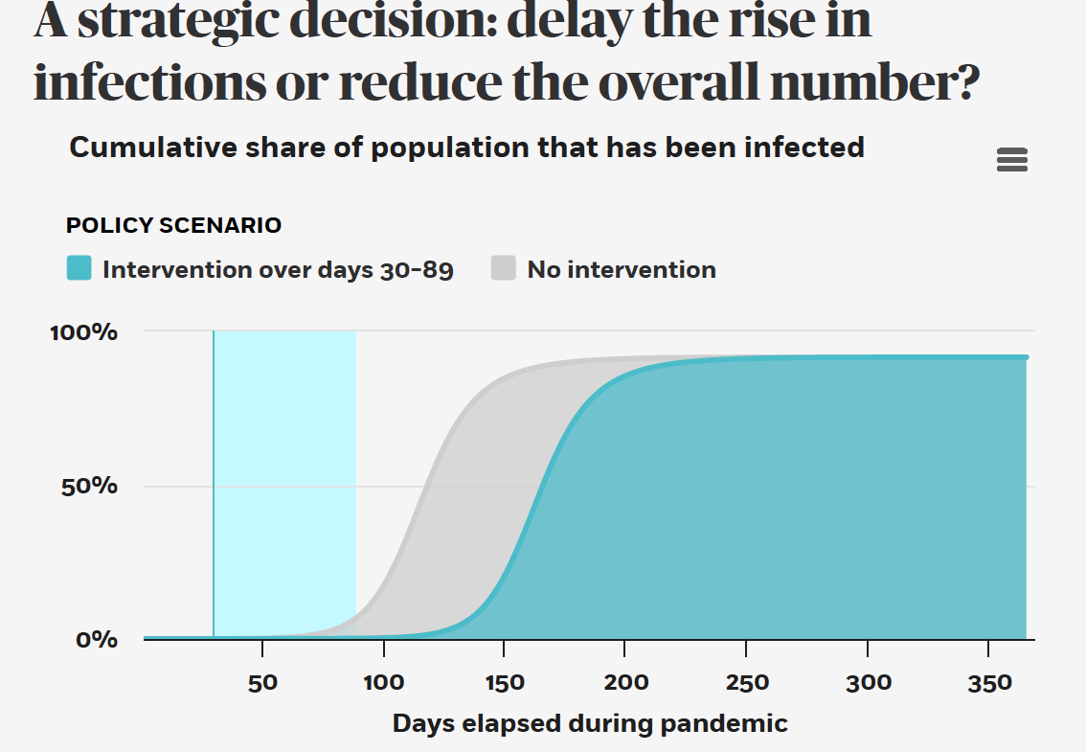

Slide 28
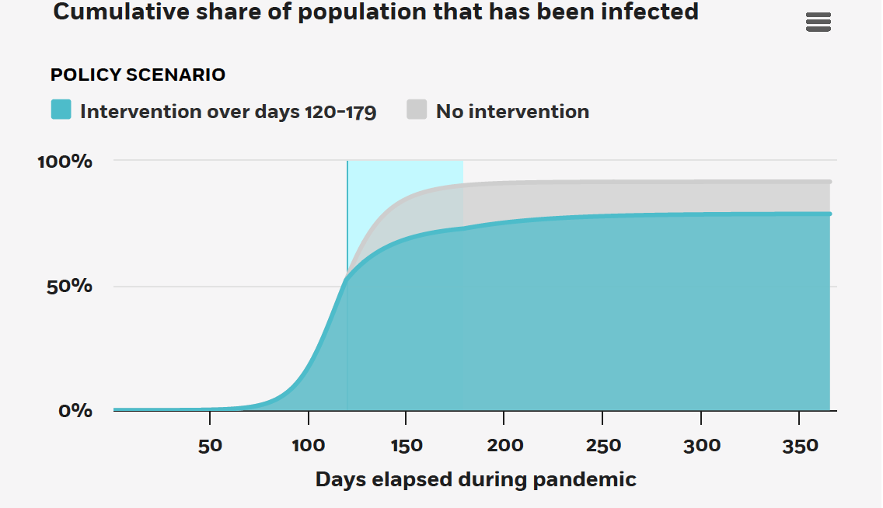

Slide 29
Limiting the Long-Run Costs of A Pandemic
Strategically apply an LSSD policy to limit the excess of the long-term cumulative number infected over the minimum level needed to achieve herd immunity
  Best applied when the level of infections is high and we are approaching population immunity
  Very costly to apply for a long period
Limit total economic costs and loss of life by achieving immunity at the lowest cost
  Limit infections of the most vulnerable (old & individuals with comorbidities)
  Quarantine those with the least cost of being inactive
  Achieve immunity among those otherwise most likely to spread
Limit the loss of life by avoiding overloading the healthcare system (“flattening the curve”)

Slide 30
Some key takeaways
Fight hard early if you think you can win
Try to use LSSD when infection rates are high and STTQ when infection rates are low
An anticipation of using STTQ in the future pushes for reducing infections upfront
LSSD for the vulnerable is likely to be a part of any policy – it is relatively cost effective for them (maybe 20x) and reducing their exposure is important in any scenario
The slow growth scenario (limiting strain on the health system) likely calls for a mixed strategy (LSSD for the vulnerable and STTQ for the less vulnerable
More details in the paper

