Slide 1
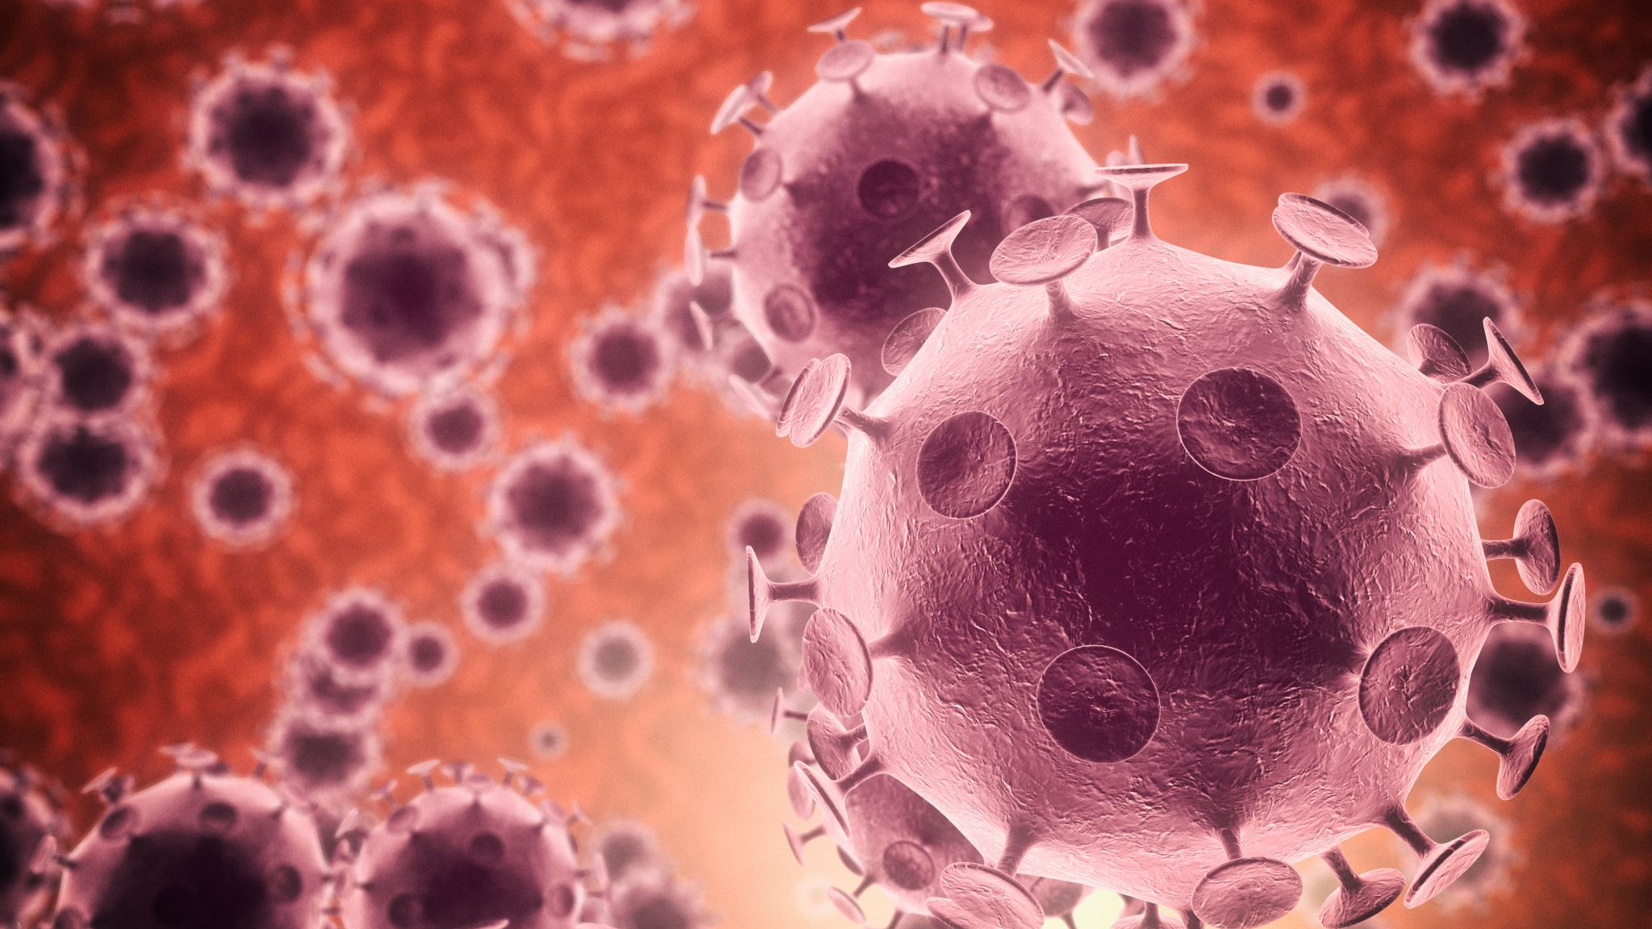
Reducing Pandemic Risk by regulating research with enhanced potential pandemic pathogens
Marc Lipsitch, D.phil.
Harvard University
IMF
May 16, 2023

Slide 2
summary
Laboratory-associated infections occur with surprising frequency, including in the highest-containment laboratories
For 90+% of virology, and a much higher proportion of biology, the risks are to lab workers – occupational health
In some specific types of research, involving pathogens with virulence and human-to-human transmissibility, the risk extends beyond the laboratory to the public and, for novel, transmissible pathogens, to the globe
Public health benefits of these studies are limited and can typically be accomplished with safer approaches
We need to improve oversight of this limited class of studies to reduce the risk of an accidental pandemic

Slide 3
I am not arguing
…that SARS-CoV-2 came from a lab or was engineered
I believe it probably originated from a nonhuman animal, though a lab origin is plausible.
The fact that a lab origin is a plausible hypothesis is a particular case of why careful review is needed
…that all “gain-of-function” research should be stopped
This broad term encompasses mostly safe, often useful research that is not the topic; my claims are about research that could start an accidental pandemic
Even some research that poses risk of an accidental pandemic may be of sufficient public health value to be worth the risk, though claims of benefit should be rigorously evaluated.

Slide 4
terms
“gain of function”: A common experimental technique in biology whereby organisms/viruses acquire a new function. Almost always, this is safe or poses at most occupational risk, almost never needs more scrutiny
“gain of function of concern” (GOFROC): a small class of research that uses, or risks creating biological entities in which the function gained confers or increases risk of a public health disaster, such as a pandemic
“enhanced potential pandemic pathogen”: the thing that may be produced or is used in GOFROC

Slide 5
summary
Laboratory-associated infections occur with surprising frequency, including in the highest-containment laboratories
For 90+% of virology, and a much higher proportion of biology, the risks are to lab workers – occupational health
In some specific types of research, involving pathogens with virulence and human-to-human transmissibility, the risk extends beyond the laboratory to the public and, for novel, transmissible pathogens, to the globe
Public health benefits of these studies are limited and can typically be accomplished with safer approaches
We need to improve oversight of this limited class of studies to reduce the risk of an accidental pandemic

Slide 6
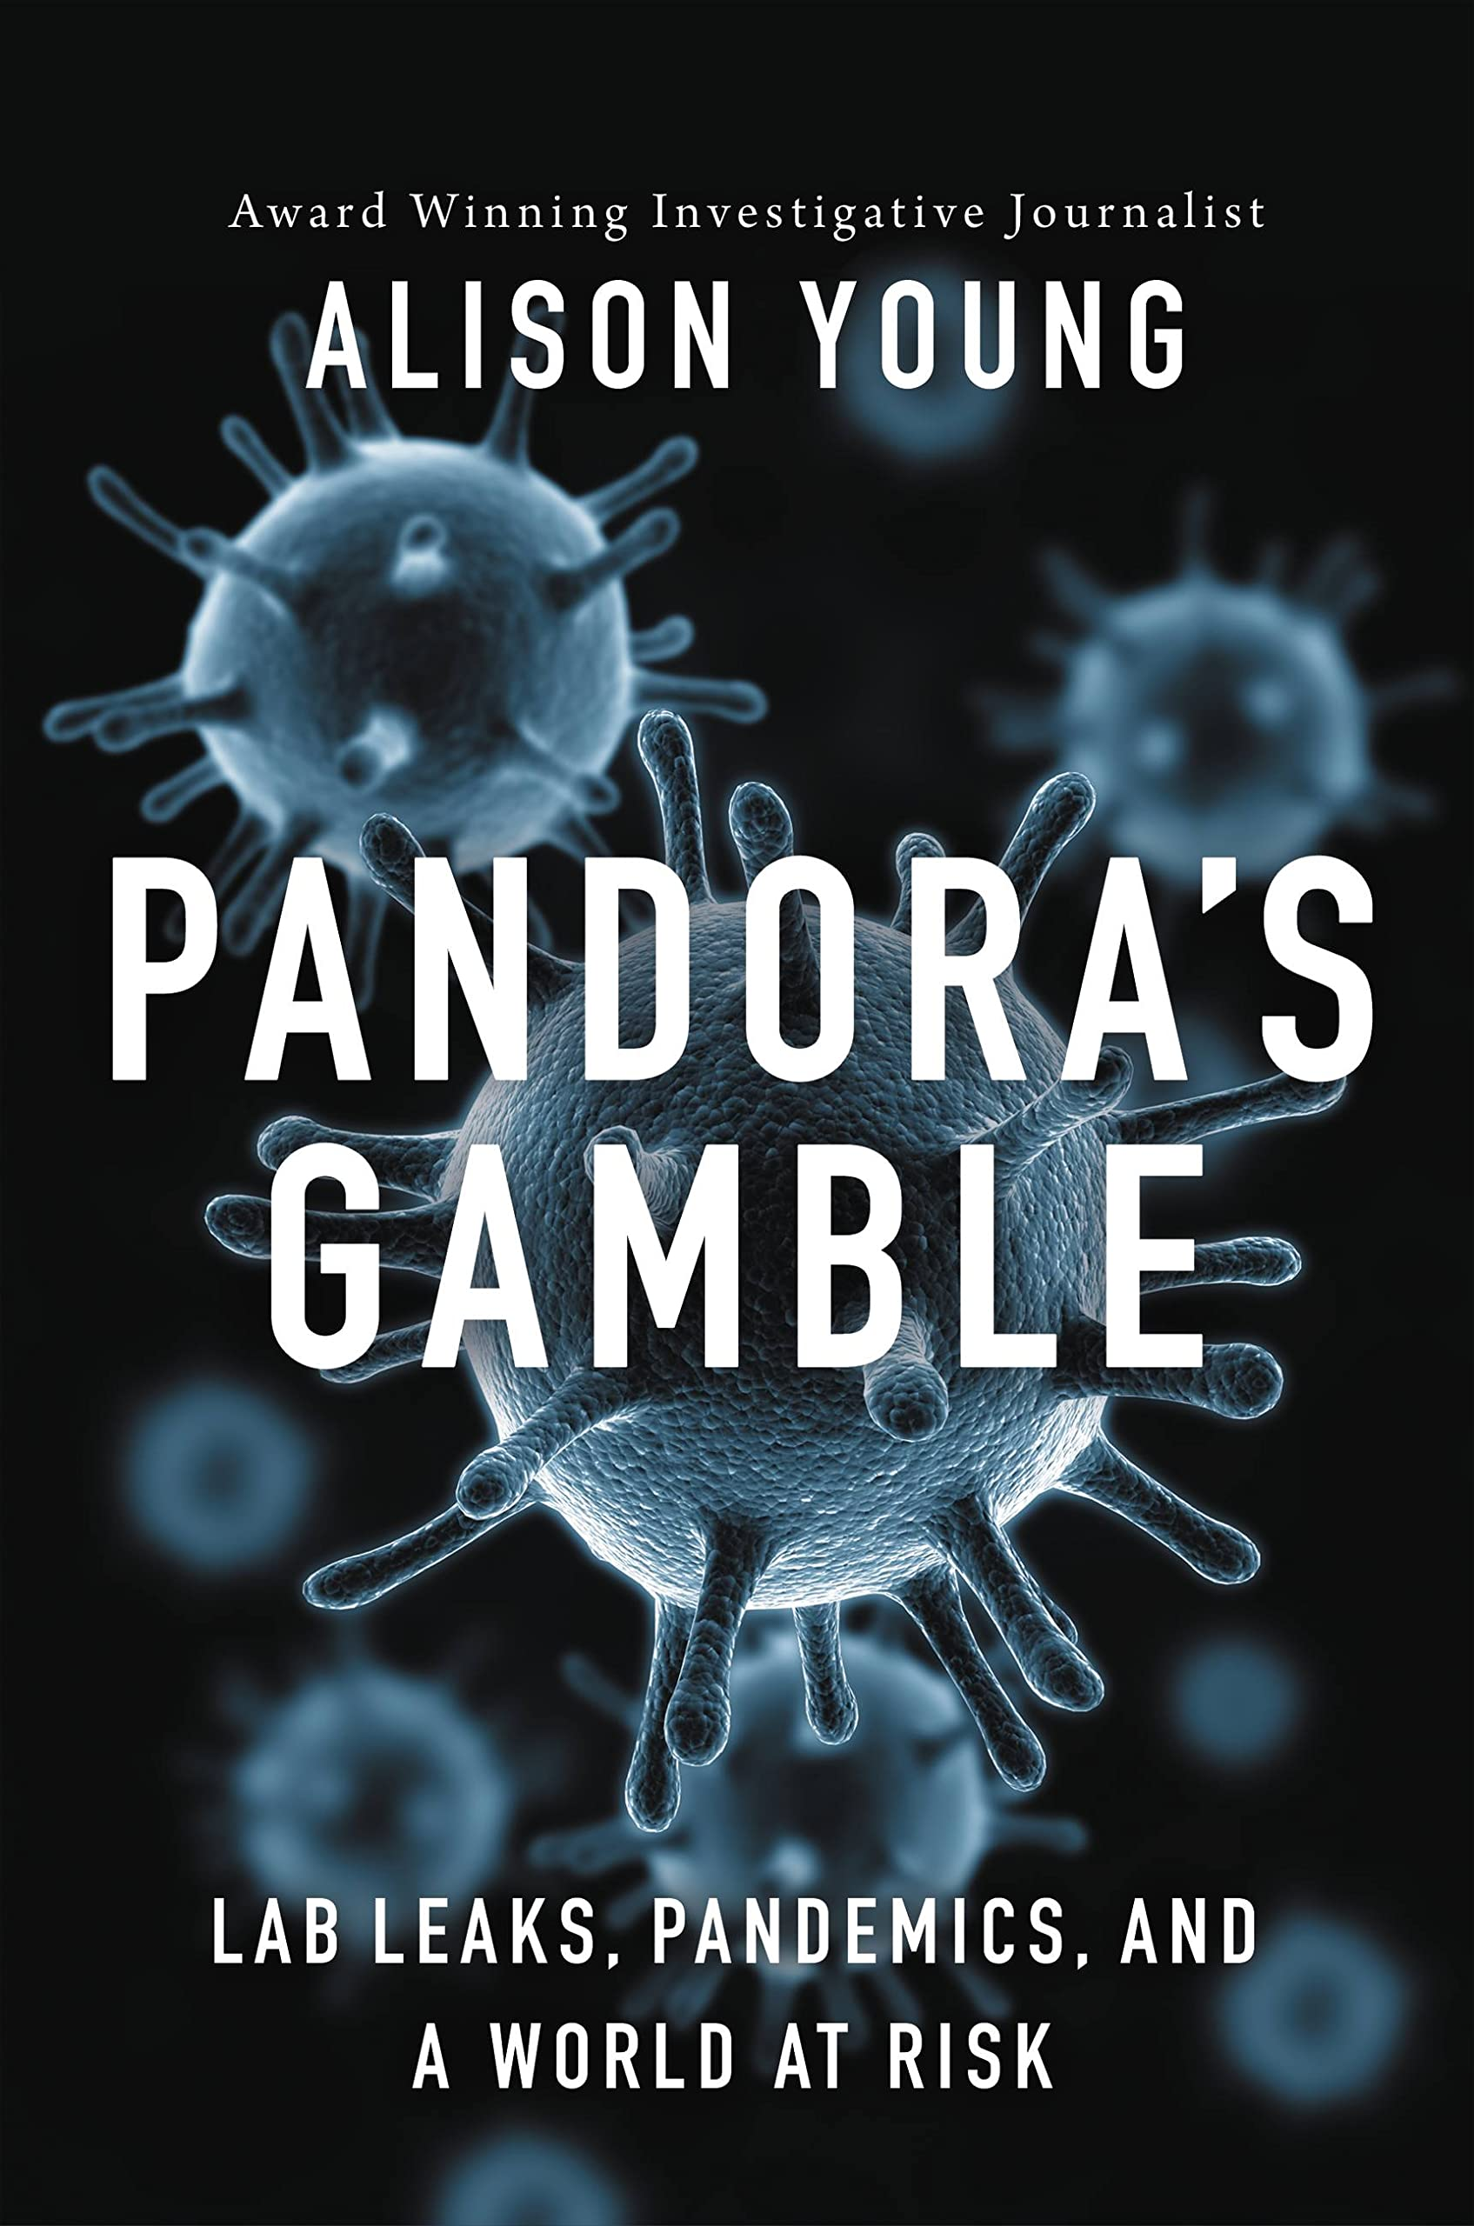
Laboratory incidents and accidents are common, and rarely transparently reported
2004-15 Army Dugway Proving Ground accidentally shipped live anthrax to every state and 9 other countries
2014: Smallpox, Q fever, other pathogens found outside biocontainment at NIH
2014: 75 CDC employees potentially exposed to anthrax due to failed decontamination
2014: CDC accidentally shipped highly pathogenic avian flu as a contaminant of a lower-risk flu strain
2014: CDC workers exposed to Ebola due to vial mixup
2014-5: Tulane B. pseudomallei outbreak in monkeys due to unexplained infections with laboratory strain
2018: USAMRIID large escape of unsterilized wastewater

Slide 7
A subset of these cause infections, sometimes fatal
3230 infections, 41 deaths 1979-2015
Including some with potential for significant spread
1977 influenza H1N1 reemergence from a frozen 1950s strain
Taiwan, Singapore SARS 2003
Beijing SARS 2004. 2 primary, 7 secondary cases
2007 FMDV release from Pirbright: major agricultural consequences
2019-20: Brucella outbreak in Lanzhou from vaccine production: 10,000 infections
Harding and Byers 2006. in Biological Safety Principles and Practices ed. D Fleming & D Hunt. ASM Press
Young, Pandora’s Gamble 2023

Slide 8
Although serious, such releases in most cases pose little risk to the globe
Many pathogens under study in high-containment labs are nontransmissible or poorly transmissible in developed settings
Anthrax etc. not transmissible
Ebola etc. readily contained with enough resources
Other pathogens under study are already locally common, along with immunity
Respiratory pathogens eg seasonal flu: already common everywhere, as is immunity
Vector-borne pathogens: either vector is rare/absent or pathogen is already present

Slide 9
summary
Laboratory-associated infections occur with surprising frequency, including in the highest-containment laboratories
For 90+% of virology, and a much higher proportion of biology, the risks are to lab workers – occupational health
In some specific types of research, involving pathogens with virulence and human-to-human transmissibility, the risk extends beyond the laboratory to the public and, for novel, transmissible pathogens, to the globe
Public health benefits of these studies are limited and can typically be accomplished with safer approaches
We need to improve oversight of this limited class of studies to reduce the risk of an accidental pandemic

Slide 10
Population-level risks: Potential pandemic pathogens and their enhanced versions
Readily transmissible in humans: or modified to be so
Virulent: not necessarily highly so
Public health risk: Significant increase in risk over background from naturally occurring strains
Examples
Smallpox
Enhanced avian flu for human transmissibility
SARS1
Extinct flu (eg 1918 strain)

Slide 11
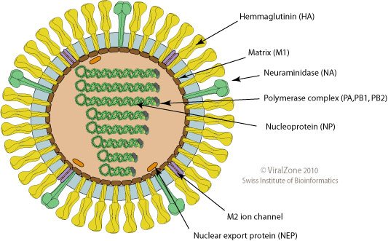
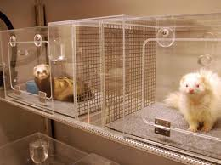
Start of the modern controversy: 2011-12
Virus
Sequence and assay phenotypes
Introduce genetic changes expected to
enhance mammalian transmission and/or select
for transmission via serial passage in mammals
repeat

Slide 12
Biosafety and externalities
Vast majority of research on dangerous pathogens | Potential pandemic pathogens: novel, virulent, transmissible
90+% of NIAID budget including >200 influenza projects | smallpox + <=12 current projects that may enhance transmissibility of antigenically novel flu strains
Occupational health: protect lab workers and immediate surroundings | Public health: risk affects broader, potentially global public
Individual risk: Occupational health | Externality: Public health
Accept some accident rate for sake of scientific progress | Same accident rate may be unacceptable given much larger number affected
Activities that threaten public health should face more stringent restrictions

Slide 13
Illustrative calculations: risk of lab-acquired infection / BSL-3 lab-year
US Select Agent labs 2004-10
>4 LAI / 2044 BSL3-lab-years = 0.2%/lab-yr
NIAID intramural labs:
3 LAI / 317 BSL3-worker-years
= 1%/ full-time BSL3-worker-year
2004-10 Henkel et al.
Applied Biosafety 2012
U.S. Department of Homeland Security, National Bio and
Agro-Defense Facility, Final Environmental Impact
Statement, Appendix B (2007); www.dhs.gov/xlibrary/
assets/nbaf_feis_appendix_b.pdf

Slide 14
Pandemic probability
Probability of pandemic from one “unit” of GOF research
0.2%/ BSL-3 lab-year x pandemic risk per LAI with contagious novel flu: 5-60% =
Pandemic probability 1/1000-1/10,000 / BSL-3 lab year working on contagious novel flu

Slide 15
Pandemic death toll
20 million (SARS-CoV-2) – 1.6 billion (infect 3.2 billion ~ 1/3 of the planet, 50% lethal comparable to avian H5N1 in known human cases)

Slide 16
Risk = probability x consequence
Low estimate: 20m deaths x 1/10,000
= 2000 expected fatalities per BSL3 lab-year

Slide 17
Dueling numbers

Slide 18
Recall: we AVOID experiments that
Cause undue stigma to tens of persons
Involve chimpanzees
Cause unnecessary suffering to tens of animals
In the US: place tens of consenting volunteers at 1/1000 mortality risk (no human challenge studies of SARS-CoV-2 in US)
Involve smallpox virus (outside 2 labs in the world)

Slide 19
summary
Laboratory-associated infections occur with surprising frequency, including in the highest-containment laboratories
For 90+% of virology, and a much higher proportion of biology, the risks are to lab workers – occupational health
In some specific types of research, involving pathogens with virulence and human-to-human transmissibility, the risk extends beyond the laboratory to the public and, for novel, transmissible pathogens, to the globe
Public health benefits of these studies are limited and can typically be accomplished with safer approaches
We need to improve oversight of this limited class of studies to reduce the risk of an accidental pandemic

Slide 20
Alternative ways to study and defeat influenza
Approach | Risk to life | Cost | Throughput | Generalizability
PPP | High | $$$ | - | -
Defective viruses in vitro | ~0 | $ | +++ | ++
Analysis of natural bird vs. human strains | Low | $$ | + | +
Universal vaccine | ~0 | $$ | ++ | +++
Accelerate vaccine production | ~0 | $$ | ++ | +++
Host-targeted therapeutics | ~0 | $$$ | ? | +++
More complete list w citations at Lipsitch & Galvani PLoS Med 2014

Slide 21
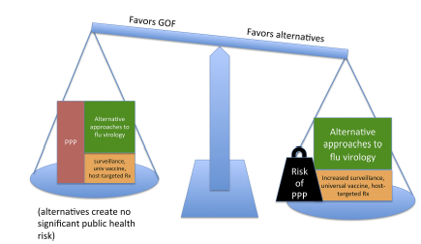
Purported benefits of proposed gofroc should be…
Public health benefits (not solely scientific benefits)
Relative to equal-expenditure portfolio of alternatives
Specific and subject to scrutiny
Lipsitch & Inglesby, mBio 2014

Slide 22
For example
2011-3 H5N1 studies identified no new mutations associated with transmission, facilitated misleading inference due to context dependence.

Slide 23
Must be precise About the specific contribution of the risky study
Needed epidemiology from 2009, did not require full 1918 virus
Needed HA crystal structure, not full virus
Needed genome sequence, not full virus
Scientific knowledge; public health benefit not shown
Needed HA, not full virus
Needed autopsy specimens, not full virus
Scientific knowledge; public health benefit not shown

Slide 24
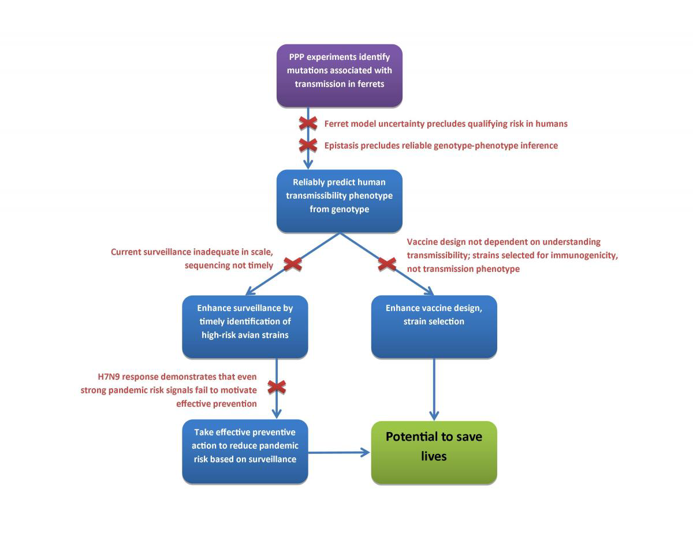
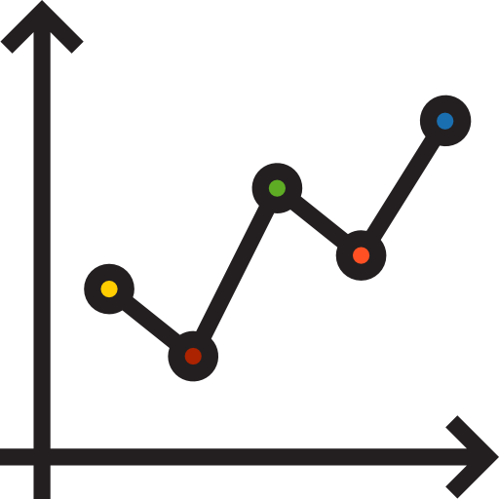
Public health Benefits of transmission enhancement unclear

Slide 25
summary
Laboratory-associated infections occur with surprising frequency, including in the highest-containment laboratories
For 90+% of virology, and a much higher proportion of biology, the risks are to lab workers – occupational health
In some specific types of research, involving pathogens with virulence and human-to-human transmissibility, the risk extends beyond the laboratory to the public and, for novel, transmissible pathogens, to the globe
Public health benefits of these studies are limited and can typically be accomplished with safer approaches
We need to improve oversight of this limited class of studies to reduce the risk of an accidental pandemic

Slide 26
Policy History
2001: IL-4 mousepox recombinant raises biosecurity fears
2003-4: SARS-CoV-1 accidental infections in 3 different labs
2005: 1918 H1N1 reconstructed by US CDC+NIH, published in Science
2007: Pirbright laboratory-associated FMDV outbreak
2011: Controversy over H5N1 enhancement papers, published 2012; debate continues
2014: Cambridge Working Group formed, adds emphasis on biosafety to existing biosecurity concerns

Slide 27
Recent Policy History (US focus)
2014: US government funding pause on research that enhances pathogenicity or droplet spread, deliberative process
2017: Funding pause lifted, P3CO guidance in place: “reasonably anticipated” language
2019: COVID-19 pandemic interrupts policy development process
2021: US HHS states that 3 projects have been subjected to review
2022: US NSABB resumes discussion of regulatory stance
2023 US NSABB final report on oversight framework

Slide 28
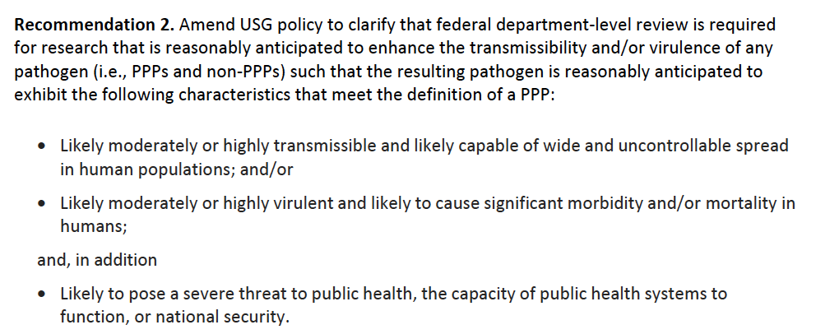
The us is moving toward an pretty good definition of gofroc requiring enhanced review – on paper
Not perfectly sensitive (will miss some risky research)
But pretty good – if applied will reduce risk
US NSABB Final report, January 2023

Slide 29
GOFROC is slipping through the cracks
Three projects reviewed in the special HHS process from 2014 to September 2021
NOT REVIEWED:
Wuhan Institute of Virology bat CoV recombination experiments
Immune escape selection experiments on SARS-CoV-2
Monkeypox recombination experiments (at NIAID)
SARS-CoV-2 recombination experiments (the Boston University controversy)
Construction of a measles virus that escapes vaccine immunity (Cell Reports, 2021)

Slide 30
Gaps in the US Process
US reviews only HHS-sponsored research
Review is at the time of proposal, doesn’t keep up with changing aims*
Funder incentives appear to favor finding ways to keep proposed work out of the system – extensive discretion about what gets reviewed
For now, must reasonably anticipate high virulence and transmissibility*
* Jan 2023 recommendations from NSABB address this issue
Infection control in the 1918 influenza pandemic

Slide 31
All gofroc should be reviewed but some should then proceed
Risk-benefit weighing is hard, but not impossible
Risks are smaller, and benefits larger, when dealing with a current threat rather than a potential one
In particular, laboratory selection for immune escape in SARS-CoV-2 is potentially risky, should be reviewed, but has many potential and actual benefits and is important to pursue
Similarly, I advocated removing the SARS-1 and MERS mouse adaptation experiments from the 2014 funding pause as less risky and more beneficial for countermeasure development vs. proven threats
Transparency not “transparency”
US “transparency statement” cites candor, confidentiality as reasons for hiding the names and content of deliberations
These are unconvincing – we hold civil and criminal trials in public!
https://www.nih.gov/about-nih/who-we-are/nih-director/statements/nih-commitment-transparency-research-involving-potential-pandemic-pathogens

Slide 32
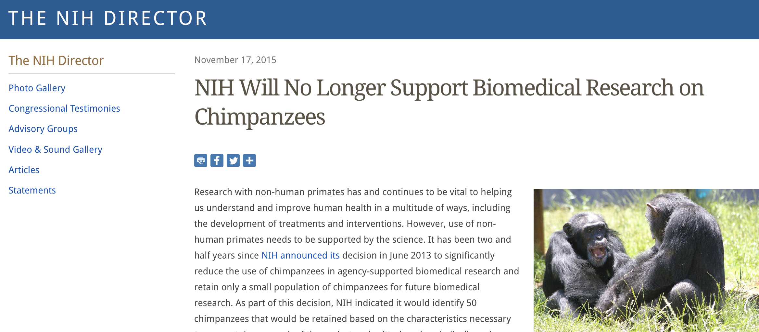
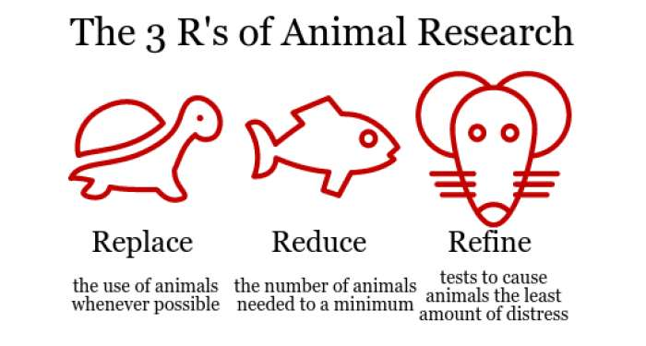
pandemic Risk concerns should be on par with other concerns that constrain research
Human subjects
Animal protection
Money

Slide 33
GOFROC collides with incentives, habits, biases, COI
Academic/scientific freedom
Notion that science may have enormous, unpredictable benefits
The urge to act against a threat, even when it’s not wise to do so (HT: Nir Eyal and Adam Lerner, Rutgers)

Slide 34
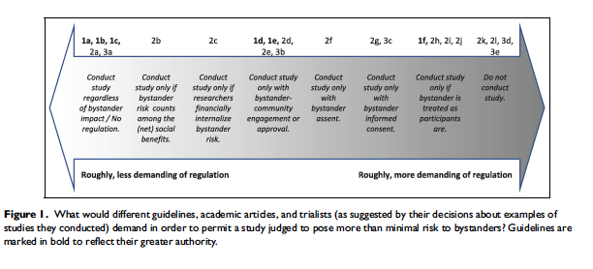
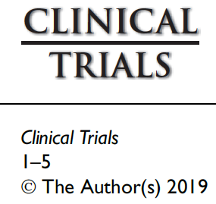
GOFROC collides with incentives, habits, biases, COI
Unfamiliarity of regulating research risks to nonparticipants
PNAS 2018

Slide 35
GOFROC collides with incentives, habits, biases, COI
Funder/institutional/investigator incentives to do/fund/publish high-profile research in synergy with:
Entrenched positions and false entanglement with other issues eg COVID-origins
Tendency to underestimate small probabilities
Incentives to take inadequate care of small probabilities

Slide 36
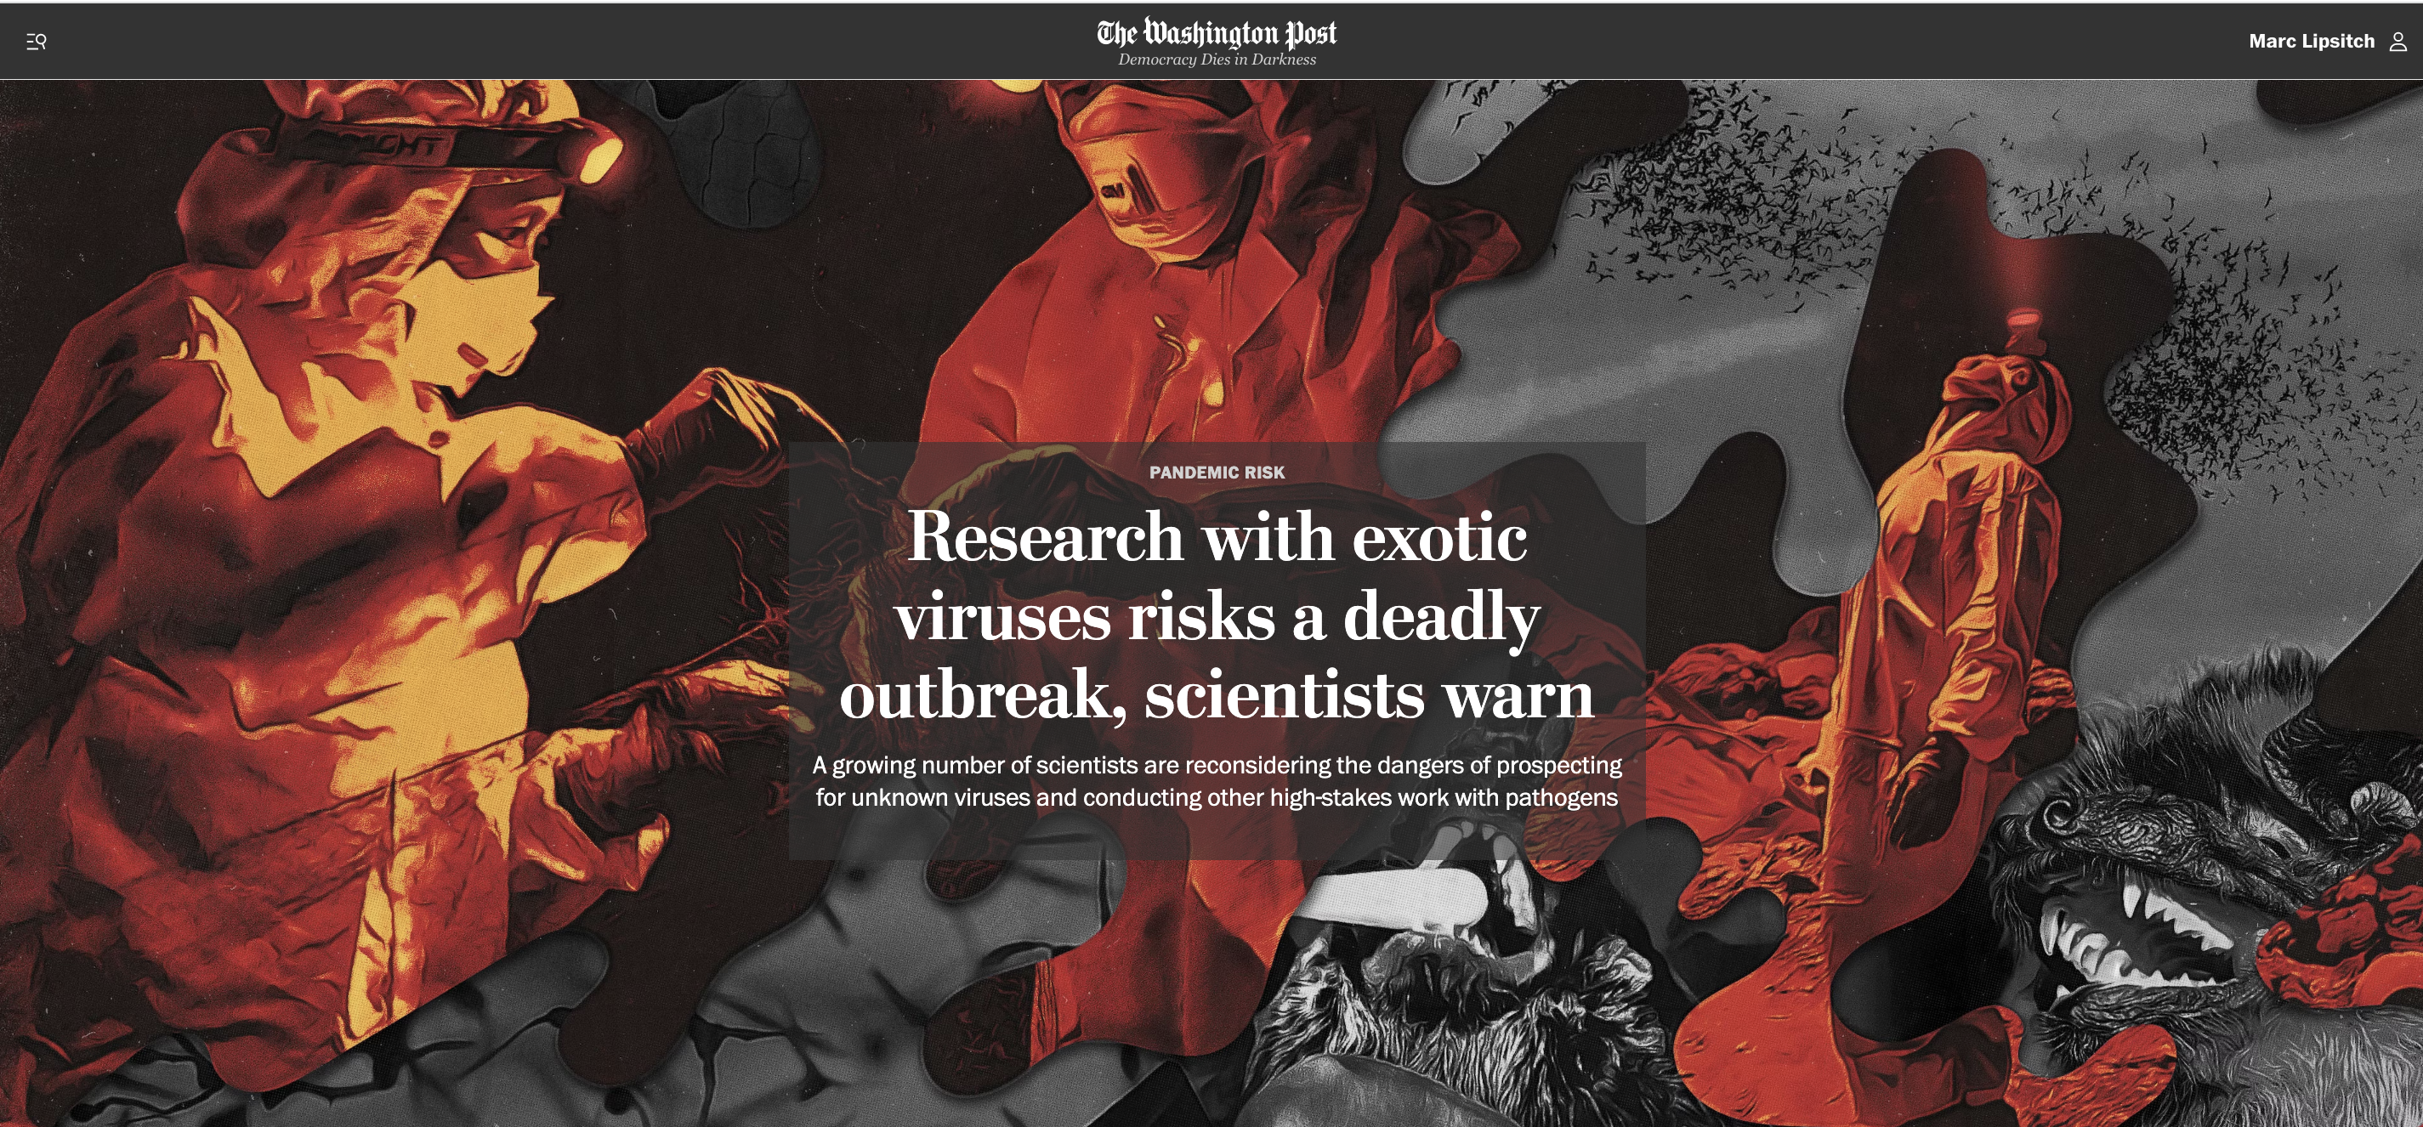
Hard questions lurk over the horizon
Most controversies to date have concerned
Known, named pathogens
Expensive, government-funded studies in universities or government labs
Limited profit motive: public goods vs. public risks
Alteration experiments, not prospecting, surveillance
Many or all of these could change and some already are, reducing our leverage and complicating the considerations

Slide 37
Journals can play a Critical role
Ability to publish (in a prestigious place) is a major motivator for scientists
Irrespective of funding, we cannot publish anywhere respectable if we don’t have human subjects approval
Increasingly, same is true about making data and code available
Journals’ insistence on certification of proper review of biosafety and biosecurity would be a huge incentive to do so. Not perfect, but better
Would have effects globally and irrespective of funders
Journal policies would help to educate about the issue

Slide 38
Global cooperation is key, AND local action helps
Action by research-leading countries will set a global example
This is a hard problem (getting harder) and we’ll need wisdom from around the globe to solve it
Those affected are literally everywhere, irrespective of where the work is being done or funded
Funding crosses borders
This is not about the North/West teaching the South/East – it’s a new challenge for everyone
Still, action in one country reduces risk – don’t wait for perfection

Slide 39
Concluding thoughts
COVID-19 brings new salience to the need to prevent accidental pandemics
This meeting has assembled a “reasonable middle” that needs to take the leading role in shaping policy
Numerous research projects continue that have little or no public health benefit and create risks of accidental outbreaks or pandemics
Yet must preserve a a way to do experiments with real public health benefits while minimizing risks is critical too
There are many loopholes to close in the US rules and – as this meeting exemplifies – an opportunity and a need for concerted international action.
Risk-benefit weighing is hard but not impossible: defining how should be one of our key tasks
Much more thought/analysis needed about viral discovery risks and benefits
Now is the time to act

