Slide 1
IMF Views on Fiscal Policy
Prakash Loungani
Assistant Director, IMF, Independent Evaluation Office (IEO)
January 13, 2021
Views expressed are those of the presenter and should not be attributed to the IMF or the IEO.
This presentation and talk are not part of an ongoing IEO evaluation.

Slide 2
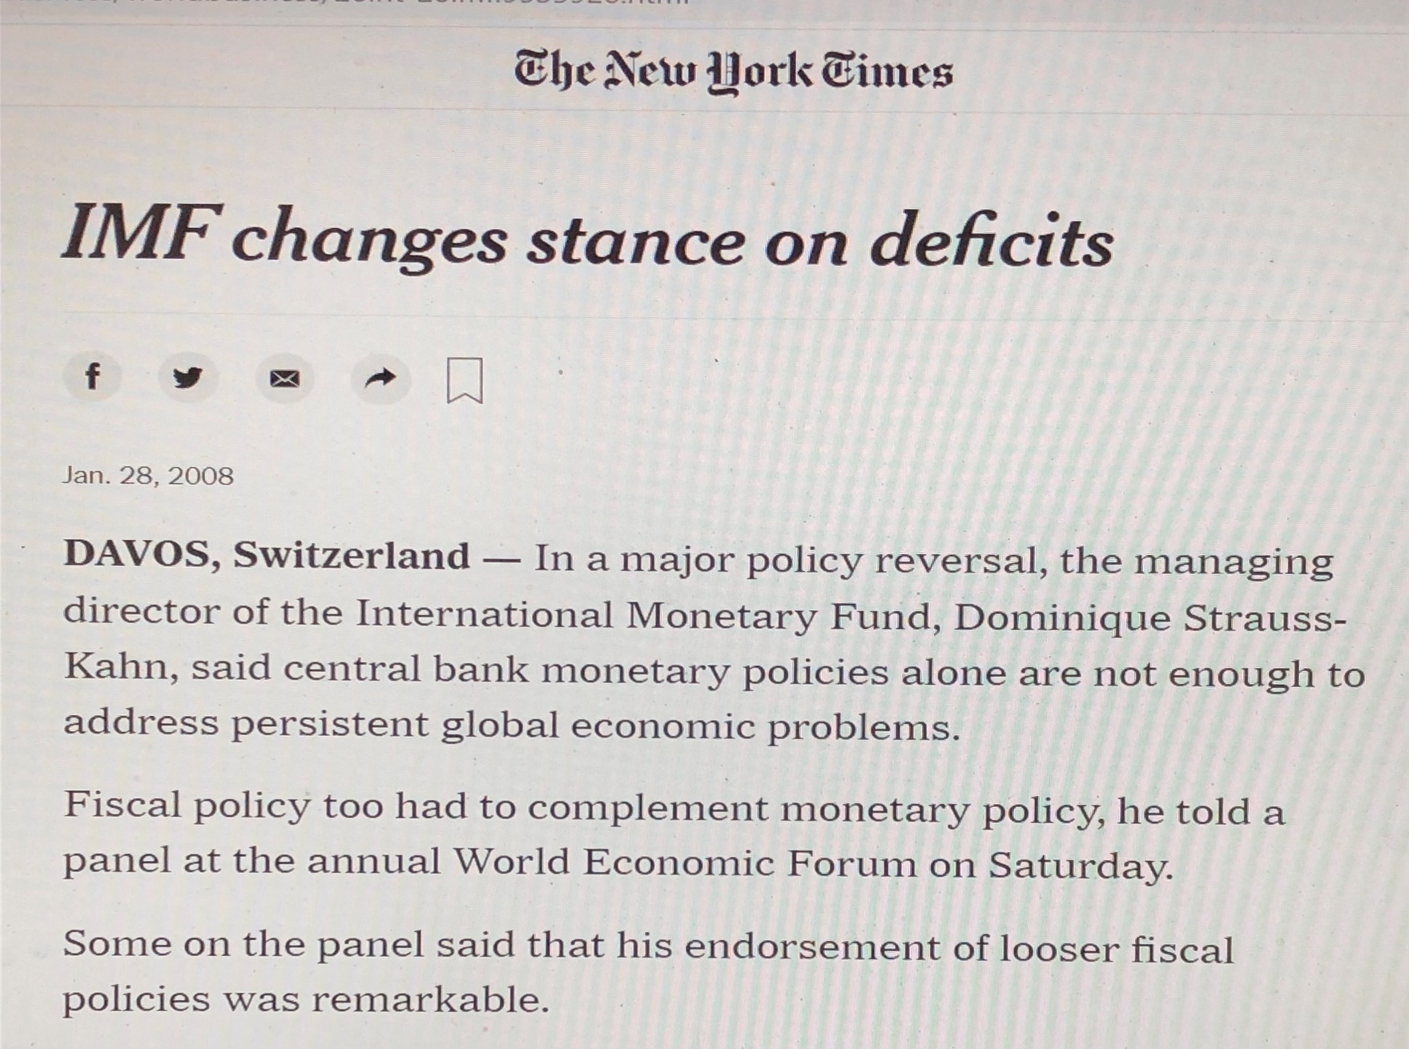

Slide 3
“Turn, turn, turn”:
IMF fiscal policy advice
Source: Fiebiger and Lavoie (2017), “The IMF and the New Fiscalism: was there a U-turn?, European Journal of Economics and Economic Policies: Intervention.

Slide 4
Timing of the turns
“New Fiscalism”: 2008: “the IMF moved towards stimulus” as a way to combat the Global Financial Crisis.
“New Austerity”: around summer of 2010: the IMF reverted back towards its more traditional stance, although not completely”
New Balance: 2013: the IMF moved back “to become a prudent advocate of fiscal stimulus policies”
Source: Fiebiger and Lavoie (2017)

Slide 5
Summary of IMF stance
New Fiscalism: “Our analysis shows that there was not a complete 180-degree turnabout in 2008 – which would have been a move from full austerity to all-out stimulus – but rather something like a 150-degree change in the views held by the IMF, with a prudent move to advocating fiscal stimulus.”
New Austerity: “Similarly, the retrenchment away from fiscal stimulus policies that was observed in 2010 was not a full obliteration of its previous position, despite its support of policies based on so-called expansionary fiscal consolidation in the eurozone.”
New Balance: “there was another cautious reversal of policy advice from around the beginning of 2013, first when the IMF realized that austerity policies were not providing the expected positive effects and that the eurozone was in danger of implosion, and then when the IMF acknowledged that they had underestimated the value of fiscal multipliers in recessions.”
(Fiebiger and Lovoie (2017)

Slide 6
IEO (2014) assessment of IMF fiscal policy response to the Global Financial Crisis
The IMF’s “calls for global fiscal stimulus in 2008-09 were timely and influential,
but its endorsement of in 2010-11 of a shift to consolidation in some of the largest advanced economies was premature …
As time progressed and the growth outlook worsened, the IMF showed flexibility in reconsidering its fiscal policy advice and called for a more moderate pace of fiscal consolidation.”
  Executive Summary, IEO (2014)

Slide 7
IMF Support for Global Fiscal Stimulus
New Fiscalism
“ For the first time in a quarter century the managing director of the IMF has called for an increase in budget deficits and fiscal stimulus."
Larry Summers at Davos, Jan. 2008
“The optimal fiscal package should be timely, large, lasting, diversified, contingent, collective, and sustainable”
Spilimbergo, Symansky, Blanchard and Cottarelli,
Dec. 2008, Staff Position Note.

Slide 8
IMF Staff Views in 2009
New Fiscalism
“[fiscal support] will need to be at least sustained, if not increased, in 2010”
WEO, April 2009
“Notwithstanding already large deficits rising public debt in many countries, fiscal stimulus needs to be sustained until the recovery is on a firmer footing and may even need to be amplified or extended beyond current plans if downside risks to growth materialize”
WEO, Oct. 2009

Slide 9
Views changed over the course of 2010
New Austerity
“Green shoots” of recovery in many economies
  though situation in euro area crisis countries remained difficult
G20 views
  advanced economies “have committed to fiscal plans that will at least halve deficits by 2013 …” (Toronto, June 2010)
  “countries with serious fiscal challenges need to accelerate the pace of consolidation” (Seoul, October 2010)
Views of key European policymakers
  “There is only course of action: all members must return to adherence to the stability and growth pact as rapidly as possible” (Schäuble)
  The “idea that austerity measures could trigger stagnation is incorrect” (Trichet)

Slide 10
IMF Staff Views in 2010
New Austerity
“Fiscal strategies should aim at gradually -- but steadily and significantly -- reducing public debt ratios, rather than just stabilizing them at their elevated post-crisis levels”
Inaugural issue of the Fiscal Monitor, May 2010
“Immediate action is needed to establish fiscal sustainability”
Article IV Euro Area Consultation, July 2010
“What is essential is not so much phasing out fiscal stimulus now, but offering credible medium-term plans for debt stabilization and, eventually, debt reduction.”
WEO, October 2010
“Fiscal consolidation typically has a contractionary effect on output. A fiscal consolidation equal to 1 percent of GDP typically reduces GDP by about 0.5 percent within two years.”
WEO, October 2010, Chapter 3, “Will it Hurt?”

Slide 11
Recalibration in 2011-12
the slowdown in advanced economies was “a development we largely failed to perceive as it was happening”
  WEO, Sep. 2011
markets “react badly when [fiscal] consolidation leads to lower growth”
WEO, Apr. 2012

Slide 12
Perceptions of IMF: 2013 Spring Meetings
New Balance
How the IMF became the friend who wants us to work less and drink more
-- Washington Post
April 16, 2013
“It is to the credit of the economists at the Fund that their recommendations to policymakers have adapted to this strange world we’re living in rather than sticking with their more normal, doctrinaire advocacy of monetary and fiscal restraint.”
IMF Renews Push Against Austerity
-- Wall Street Journal
April 17, 2013
“ … the International Monetary Fund called on countries that can afford it -- including the U.S. and Britain -- to slow the pace of their austerity measures.”

Slide 13
Elements of the IMF’s New Balance (1)
New Balance
Key element: Caution about premature and aggressive withdrawal of fiscal support; realistic fiscal multipliers
“The main finding is that smooth and gradual consolidations are to be preferred to frontloaded or aggressive consolidations, especially for economies in recession facing high risk premia on public debt, because sheltering growth is key to the success of fiscal consolidation in these cases”
Batini, Callegari, Melina (July 2012, IMF Working Paper 12/190)
“in advanced economies, stronger planned fiscal consolidation has been associated with lower growth than expected.”
Blanchard and Leigh (Box in WEO, October 2012)
Gavyn Davies in a FT blog said these three pages could have “a greater effect on global economic policy” than all of the sessions held in Tokyo at the Bank-Fund annual meetings.

Slide 14
Elements of the IMF’s New Balance (2)
New Balance
Drawing out implications of a low interest rate environment
  re-assessing fiscal space and debt sustainability
  calls for increased infrastructure spending
Several elements in common with Furman-Summers (2020)
PLUS:
Views on taxation (avoiding ‘race to bottom’; taxing the rich)
For EMs and LICs: Enhanced debt sustainability frameworks
Concern with distributional consequences of austerity

Slide 15
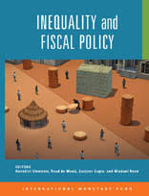
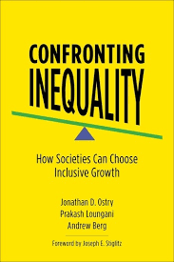
Austerity and inequality
New Balance
SHAMELESS SELF-PROMOTION
Fiscal Affairs Dept. (FAD) book

Slide 16
IMF Staff Views in April 2020
“fiscal policies are at the forefront of responding to the COVID-19 pandemic. Fiscal measures can save lives, protect the most-affected people and firms from the economic impact of the pandemic, and prevent the health crisis from turning into a deep long-lasting slump.”
“Large, temporary and targeted support is urgently needed for affected workers and firms until the emergency abates. As the shutdowns end, broad-based, coordinated fiscal stimulus—where financing conditions permit—will become more effective in fostering the recovery.”
Fiscal Monitor, April 2020

Slide 17
IMF (Oct. 2020) and Furman-Summers (Nov. 2020)
IMF Fiscal Monitor
Furman-Summers
“More than six months into the pandemic, the Fiscal Monitor emphasizes the importance of not pulling the plug of fiscal support too soon, in spite of the high levels of debt prevailing worldwide. It evaluates the difficult policy trade-offs that different countries face. Finally, it makes the case for public investment.”
“the primary worry for policy [in advanced economies] is doing too little to expand the debt, not doing too much.
Low interest rates create more scope and need for expansionary fiscal policy, a reason to reassess views of debt sustainability, and more reason to undertake public investments.”

Slide 18
Perceptions of IMF: 2020 Annual Meetings
IMF: Austerity is not inevitable
-- The Guardian
Oct. 14, 2020
“The IMF “has rubbished the idea that governments should be pushing austerity soon to pay for the cost of COVID-19 … The FT’s Chris Giles says the IMF’s tone is quite different than a decade ago”
IMF says austerity is not inevitable to ease impact on public finances
-- Chris Giles, Financial Times
Oct. 14, 2020
“Most advanced economies that can borrow freely will not need to plan for austerity to restore the health of their public finances after the coronavirus pandemic, the IMF has said in a reversal of its advice a decade ago”

Slide 19
“Different strokes for different folks”
“As economies tentatively reopen, but uncertainty about the course of the pandemic remains, governments should ensure that fiscal support is not withdrawn too rapidly.”
“Emerging market and low-income economies facing tight financing constraints will need to deliver more with less, by reprioritizing spending and enhancing its efficiency. Some may need further official financial support and debt relief.”
“Governments should also adopt measures to improve tax compliance and consider higher taxes for the more affluent groups and highly profitable firms. The ensuing revenues would help pay for critical services … during a crisis that has disproportionately hurt the poorer segments of society.”
Vitor Gaspar and others
IMF Blog, Oct. 14, 2020

Slide 20
IEO (20xx) assessment of IMF fiscal policy response to the COVID-19 pandemic
WATCH THIS SPACE!

