Slide 1
How Monetary Policy Got Behind the Curve— and How to Get Back to Rules-Based Policy
John B. Taylor
Stanford University
Prepared for Presentation At
The Independent Evaluation Office Seminar Series
International Monetary Fund
February 28, 2023

Slide 2
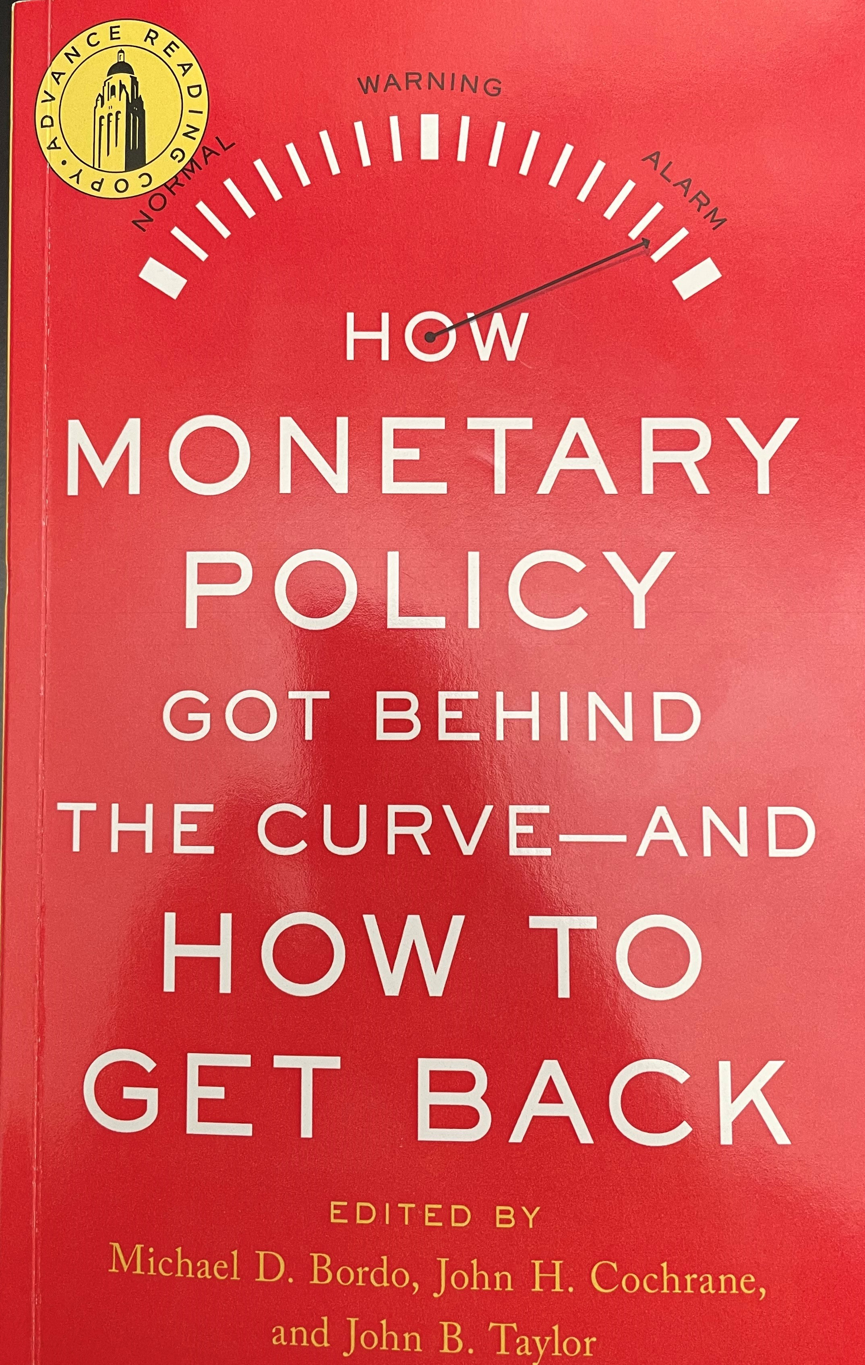

Slide 3
Opening Remarks
Condoleezza Rice
What Monetary Policy Rules and Strategies Say
Richard Clarida, Lawrence Summers, John Taylor
Fiscal Policy and Other Explanations
John Cochrane, Tyler Goodspeed, Beth Hammack
The Fed’s Delayed Exits from Monetary Ease
Michael Bordo and Mickey Levy
Jennifer Burns
Kevin Warsh
Inflation Risks
Ricardo Reis
Volker Wieland
Arvind Krishnamurthy
Three World Wars: Fiscal-Monetary Consequences
George Hall and Thomas Sargent
Ellen McGrattan
John Lipsky
Toward a Monetary Policy Strategy
James Bullard, Randal Quarles, Christopher Waller
Joshua Rauh
Inflation Blues: The 40th Anniversary Reissue?
Monika Piazzesi

Slide 4
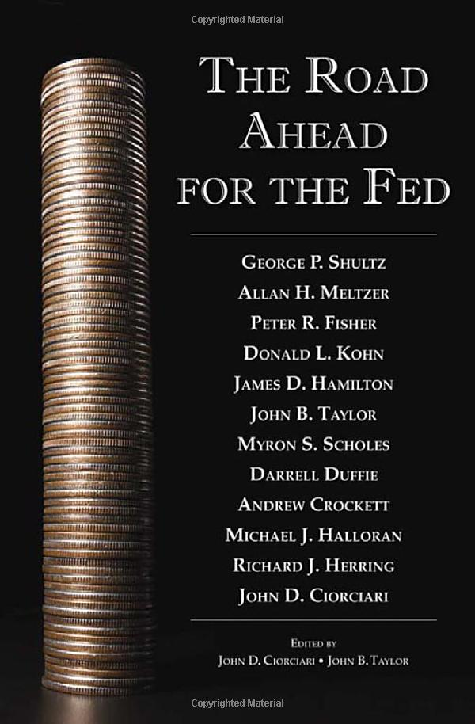

Slide 5
The Basic Story
Move to monetary policy rules was proceeding, until pandemic hit:
  Jay Powell, Fed Chair: “I find these rule prescriptions helpful”
  Mario Draghi, President of the ECB: “we would all clearly benefit from…improving communication over our reaction functions…”
  Raghu Rajan, Governor, Reserve Bank of India: “what we need are monetary rules,”
Move was interrupted when pandemic hit in early 2020. Rules were out!
But by Feb 2021, rules were back in Fed’s Monetary Policy Report
But rules were out again in the Feb 25, 2022 Report.
Jay Powell said on March 3 that rules would be back in
And the Monetary Policy Report, released on June 17, 2022,
policy rules were back in, including the Taylor rule as number 1 on the list
But at first only small changes were seen in actual monetary policy
  A gap still exists between rule-based policy and policy actions
  At Fed and at other central banks
Thus, we are still living in a high inflation era unless monetary policy actions are taken.
Events in Ukraine recently raised inflation, but not the basic story

Slide 6
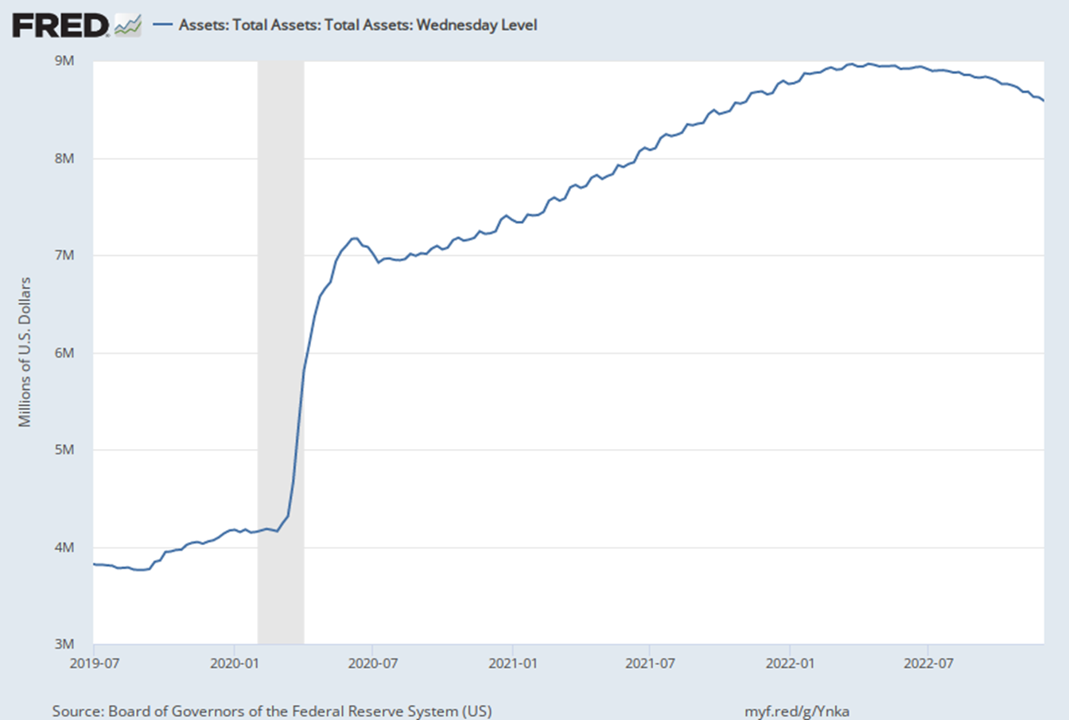
January 5, 2022

Slide 7
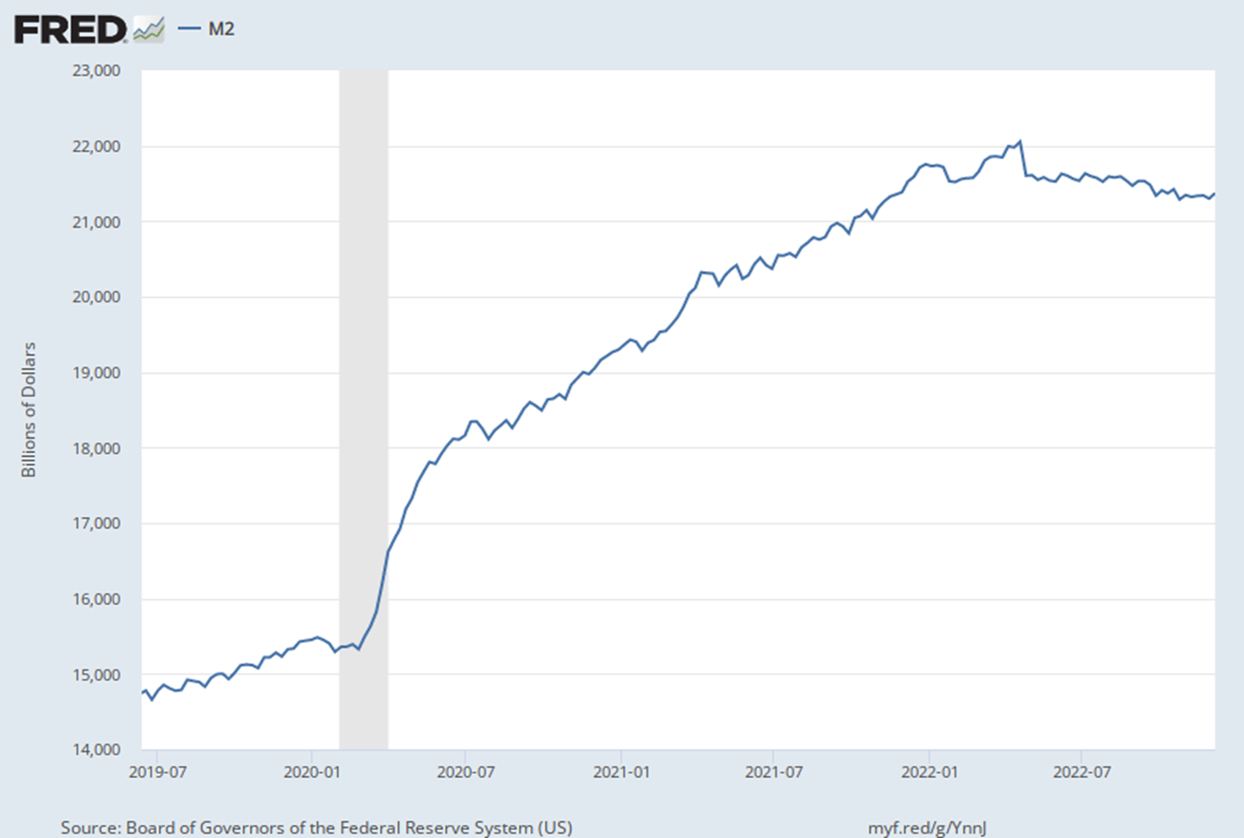
January 3, 2022

Slide 8
The Fed’s Monetary Policy Report, July 9, 2021

Slide 9
The Fed’s Monetary Policy Report, June 17, 2022, page 47

Slide 10
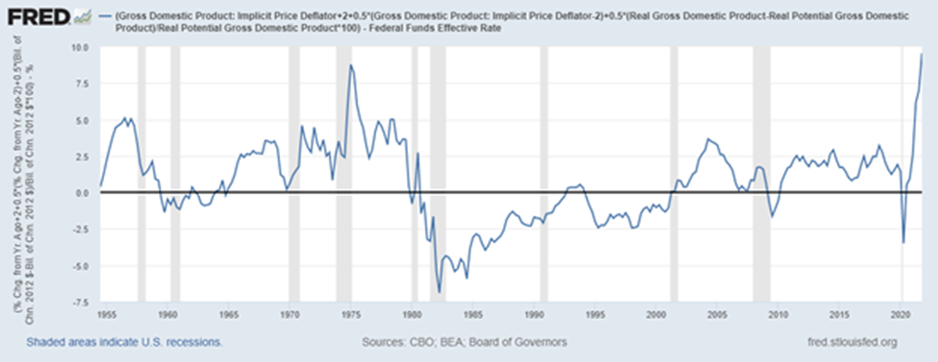
Financial Press Reacts:
Wall Street Journal, March 15, p. A18: “…keeping rates too low for too long was ignored—except by monetary economist John Taylor and on these pages.”
Money & Markets, March 25, Amber Hestla
“Taylor Rule Shows the Fed Hasn’t Messed Up This Much in Decades” https://moneyandmarkets.com/taylor-rule-shows-the-fed-hasnt-messed-up-this-much-in-decades/
Seeking Alpha, March 27, John Mason, “The Stock Market: Is Fed Really Tightening?”
https://seekingalpha.com/article/4497993-stock-market-fed-really-tightening
Market Watch, March 30, Vivien Lou Chen,
“Fed’s projected rate hikes ‘won’t sufficiently tame’ inflation, Credit Suisse says,”
https://www.marketwatch.com/story/federal-reserves-projected-rate-hikes-wont-sufficiently-tame-inflation-credit-suisse-says-11648672116
The Exchange, CNBC, March 31, Kelly Evans: “The Street is getting more anxious about the Fed”
https://www.cnbc.com/2022/03/31/kelly-evans-the-street-is-getting-more-anxious-about-the-fed.html

Slide 11
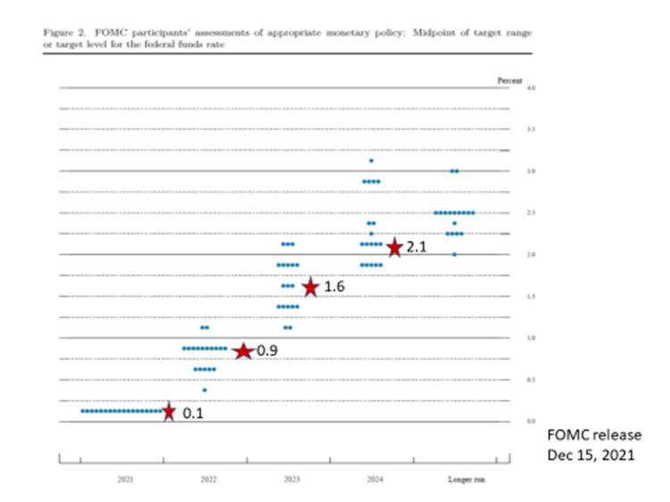

Slide 12
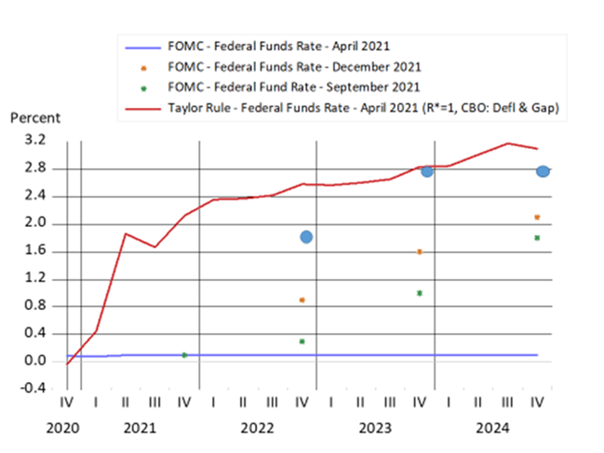

Slide 13
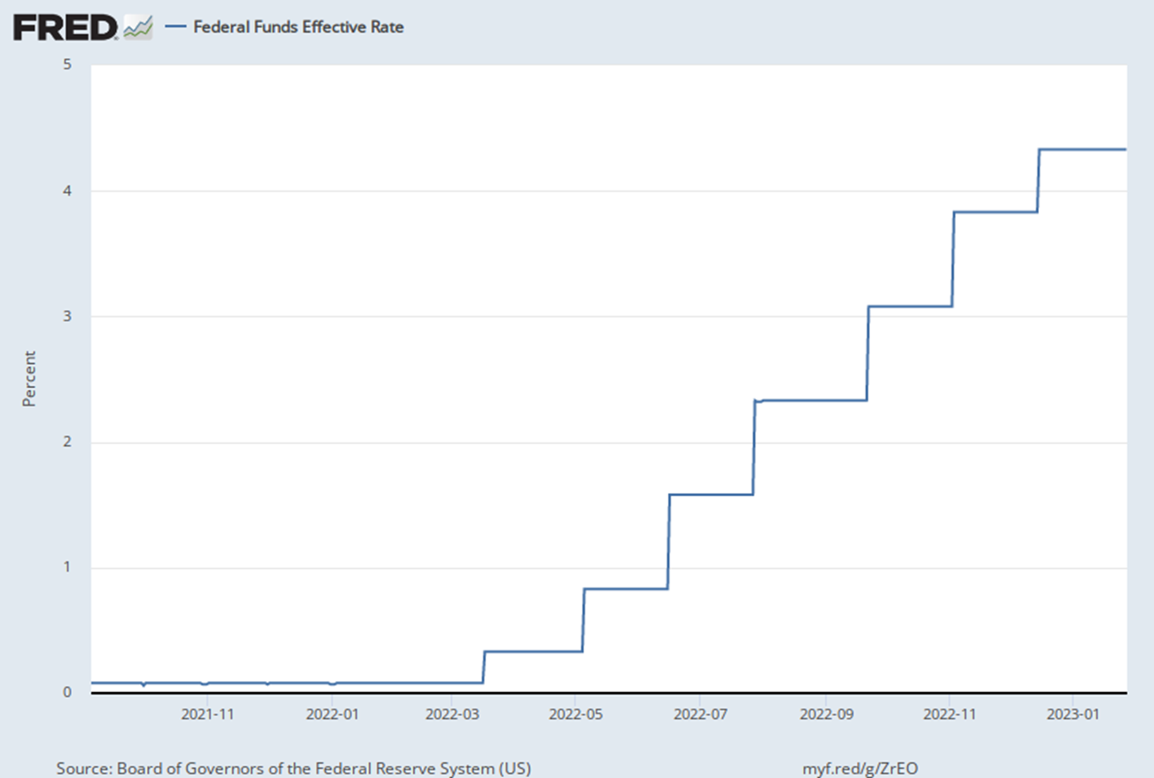

Slide 14
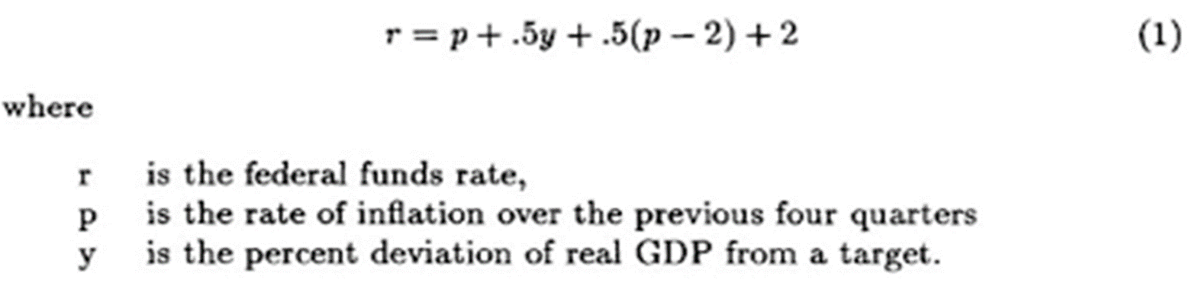
From “Discretion versus Policy Rules in Practice,” Prepared for the November 1992 Carnegie-Rochester Conference on Public Policy, Carnegie Mellon University, Pittsburgh, Pennsylvania
Using this rule:
2+2= 4
1+2 = 3
1+ 3 + .5(3-2) = 4.5
1+4+ .5(4-2) = 6
Using the June 17, 2023, Monetary Policy Report “Taylor rule,” and plug in:
an inflation rate over the past four quarters of 4%,
a target inflation rate of 2%,
an equilibrium interest rate of 1%,
a gap between GDP and its potential of about 0%,
you get a federal funds rate of 6%.

Slide 15
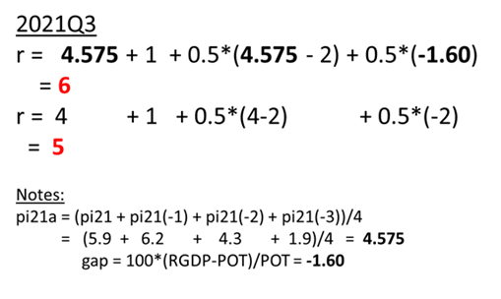

Slide 16
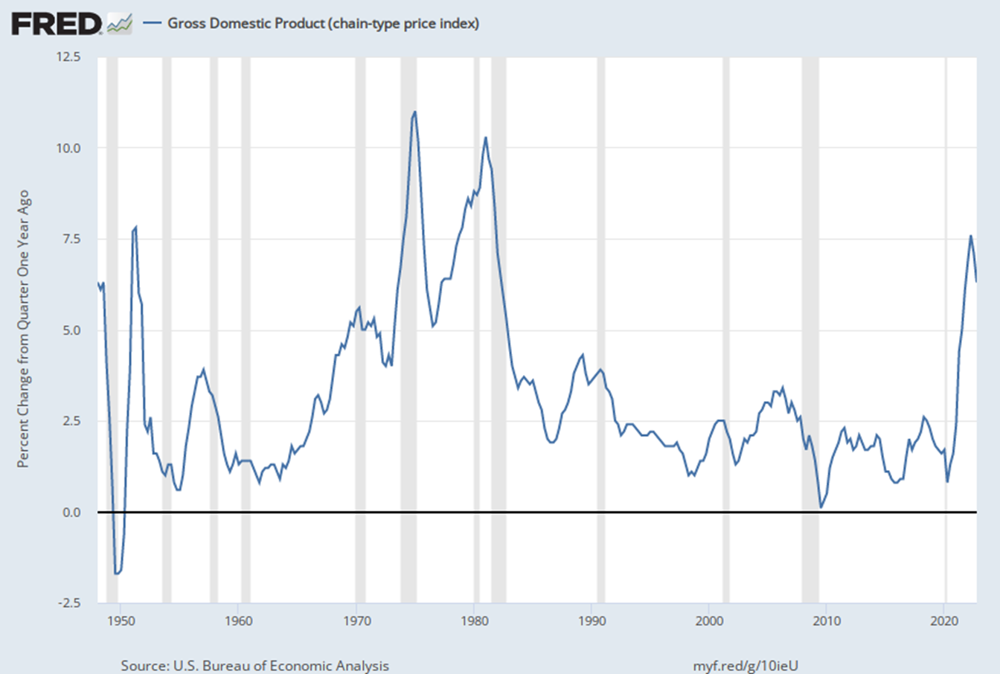

Slide 17
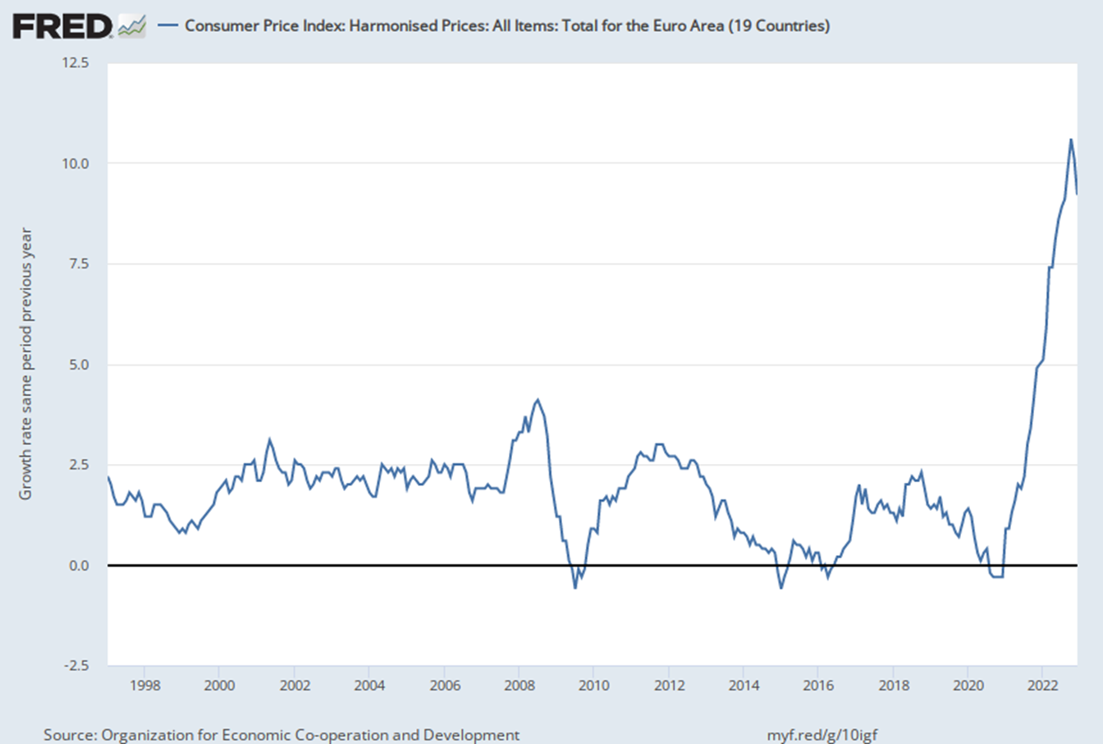

Slide 18
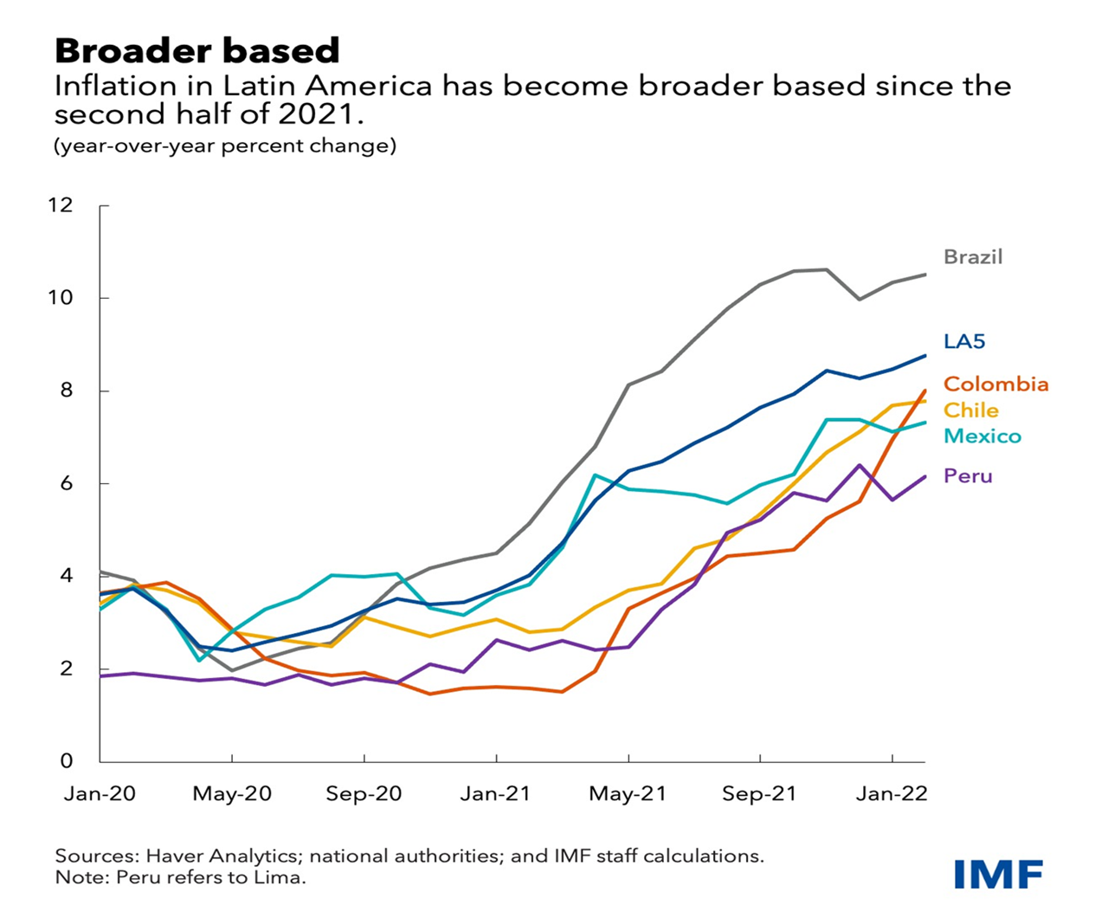

Slide 19
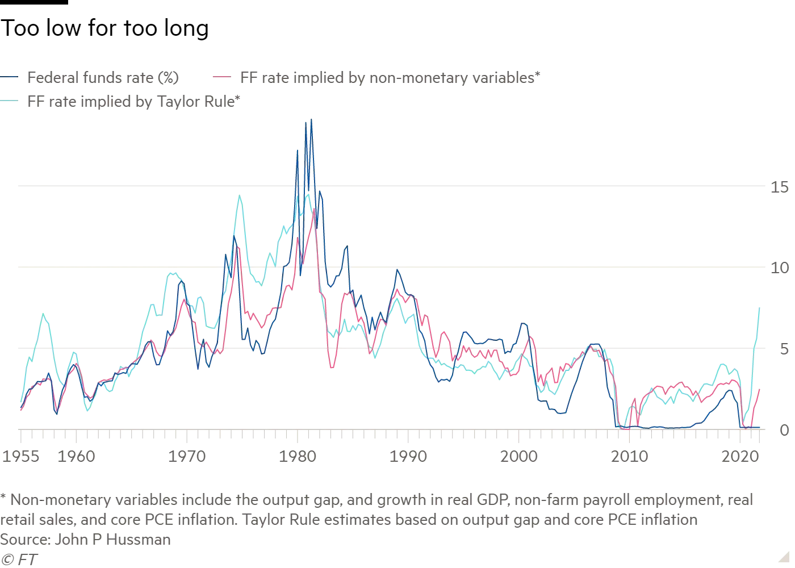
See also “Overruling Mr. Taylor,” pp 10-11, Grant’s Interest Rate Observer, Vol. 40, No. 3, Feb. 18 2022

Slide 20
So, The Key Question:
Are We Entering a New Era of High Inflation?
YES, unless monetary policy makers change policy:
More reasons now for central banks to be guided by a rules-based policy
Here I outlined a method to do so.
  Central banks should start now on rules that markets understand
  The policy interest rate would increase if inflation rises, as is now happening
It would of course be a contingency plan, as are all rules.
Would greatly reduce chances of a large damaging change later.

