Slide 1
The Climate Crisis after COP27
Noah Gordon, Carnegie Endowment
For the IMF IEO
December 2022

Slide 2
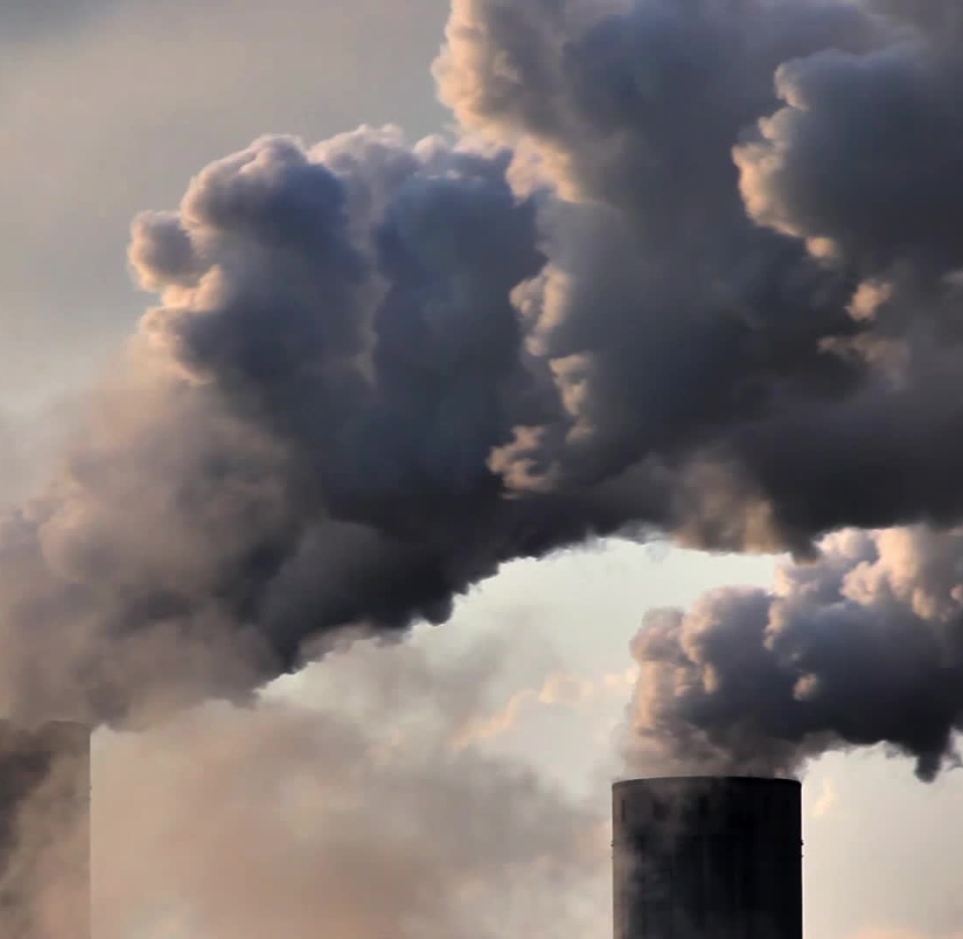
The Big Picture: Temperature Targets & Emissions

Slide 3
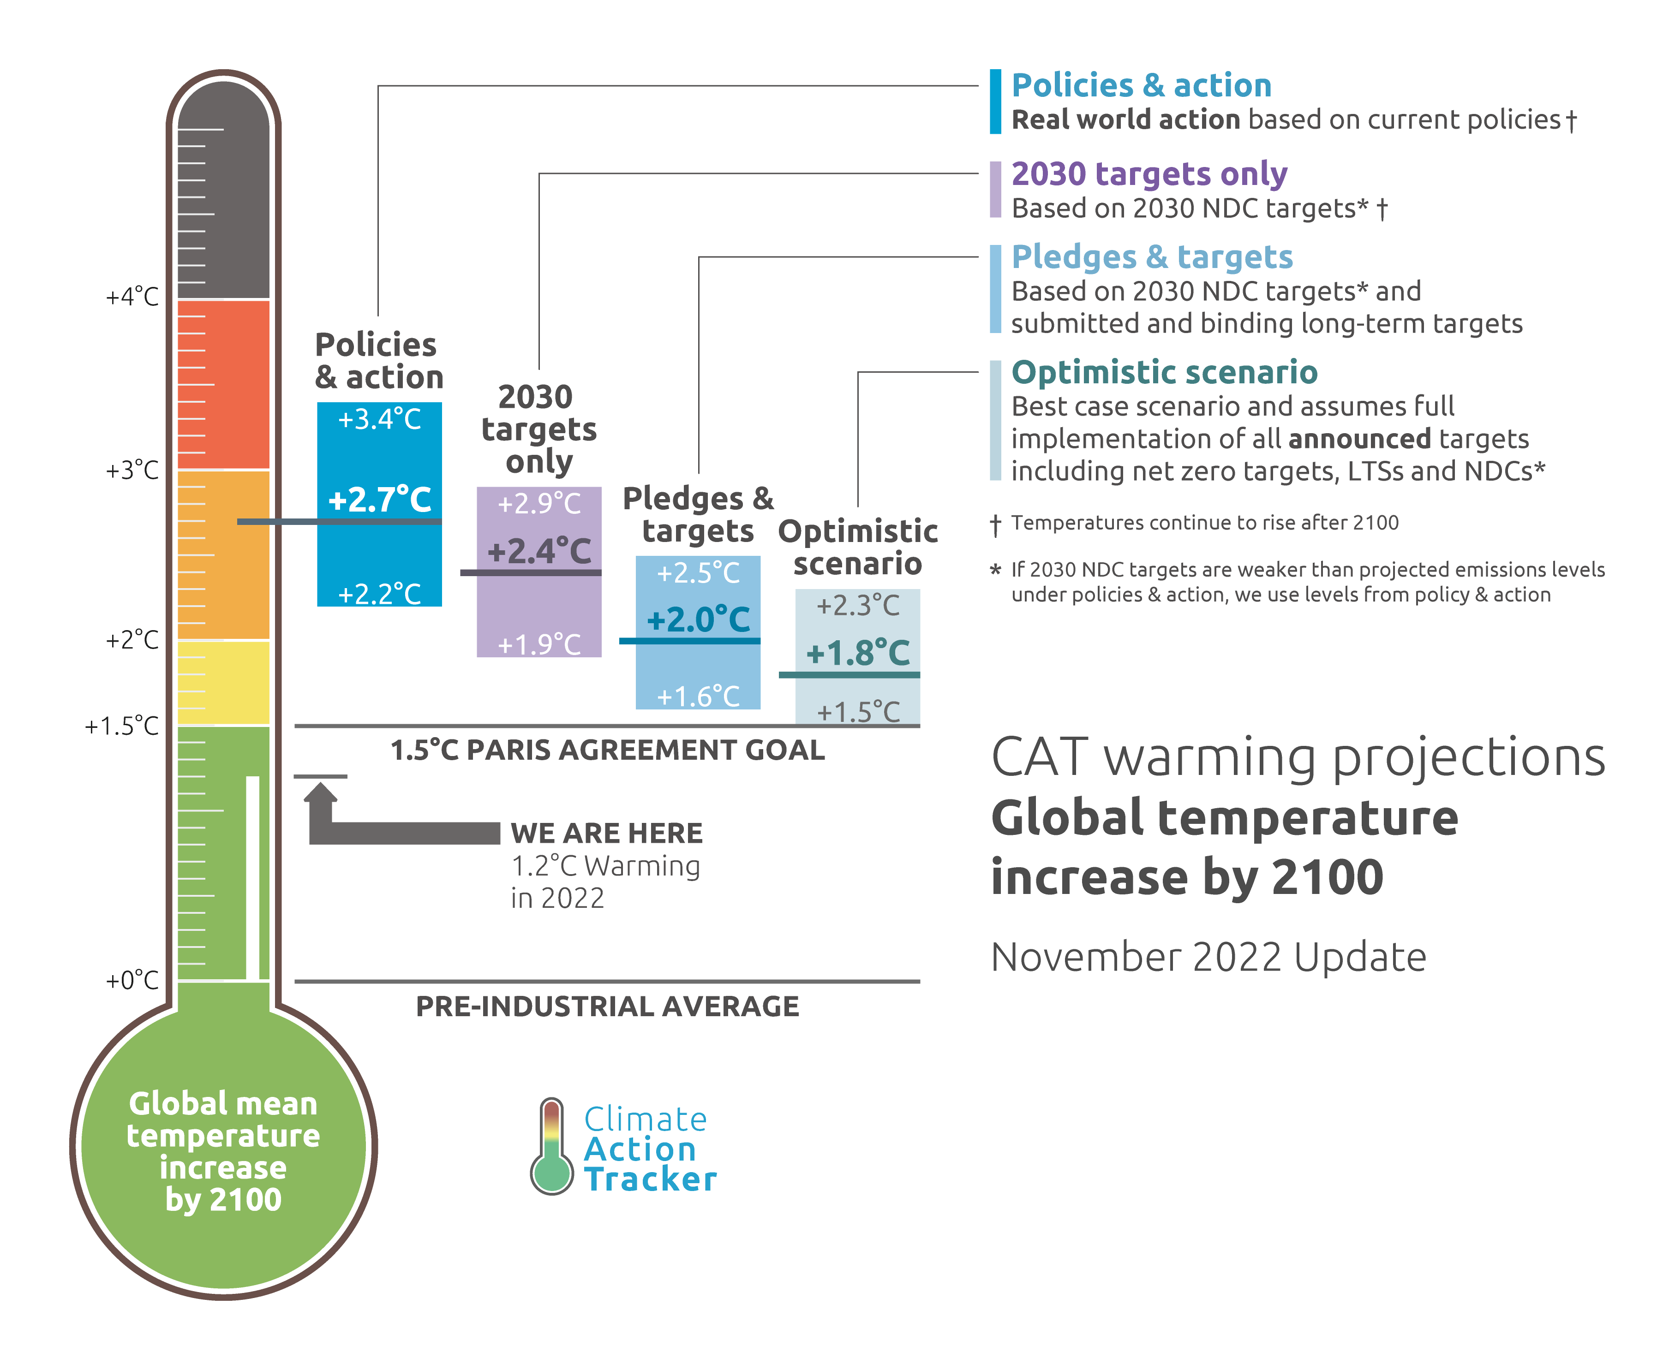
1.5˚C likely gone

Slide 4
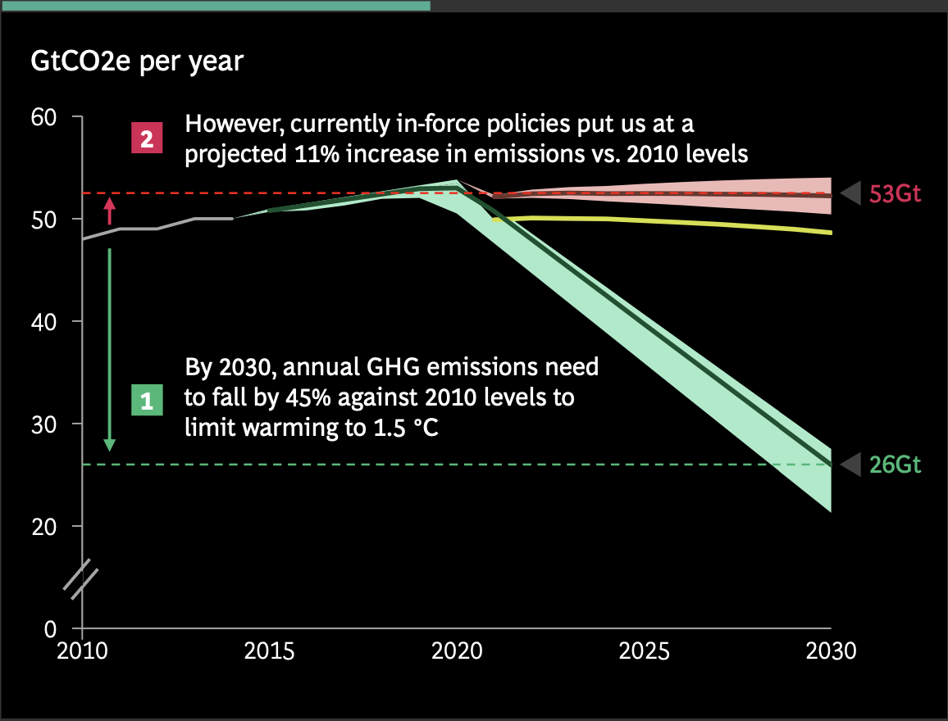
Emissions rising, not falling
Source: BCG COP27 presentation

Slide 5
But so is 4-5˚C

Slide 6
Thanks to policies & pledges

Slide 7
and technology
Source: Stephen Hall, WEF, 2022

Slide 8
A long journey

Slide 9
Energy additions, not transitions

Slide 10
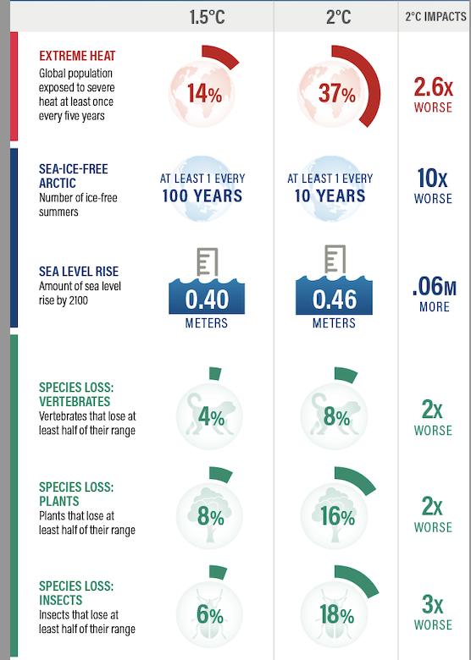
Climate impacts: 1.5˚C vs 2˚C
Source: WRI and IPCC,
Special Report on 1.5C warming, 2018

Slide 11
Tipping points
Source: Mckay et al, Science, 2022

Slide 12
Messy Climate Geopolitics

Slide 13
Emissions from one place…

Slide 14
A US Fridge vs a Kenyan person

Slide 15
Historical Responsibility

Slide 16
... And impacts in another
Source: IPCC 6th assessment report working group 2

Slide 17
The missing $ 100 billion
Source: Jocelyn Timperly, Nature, 2021

Slide 18
And much bigger total needs…
Source: WRI, State of Climate Action 2021

Slide 19
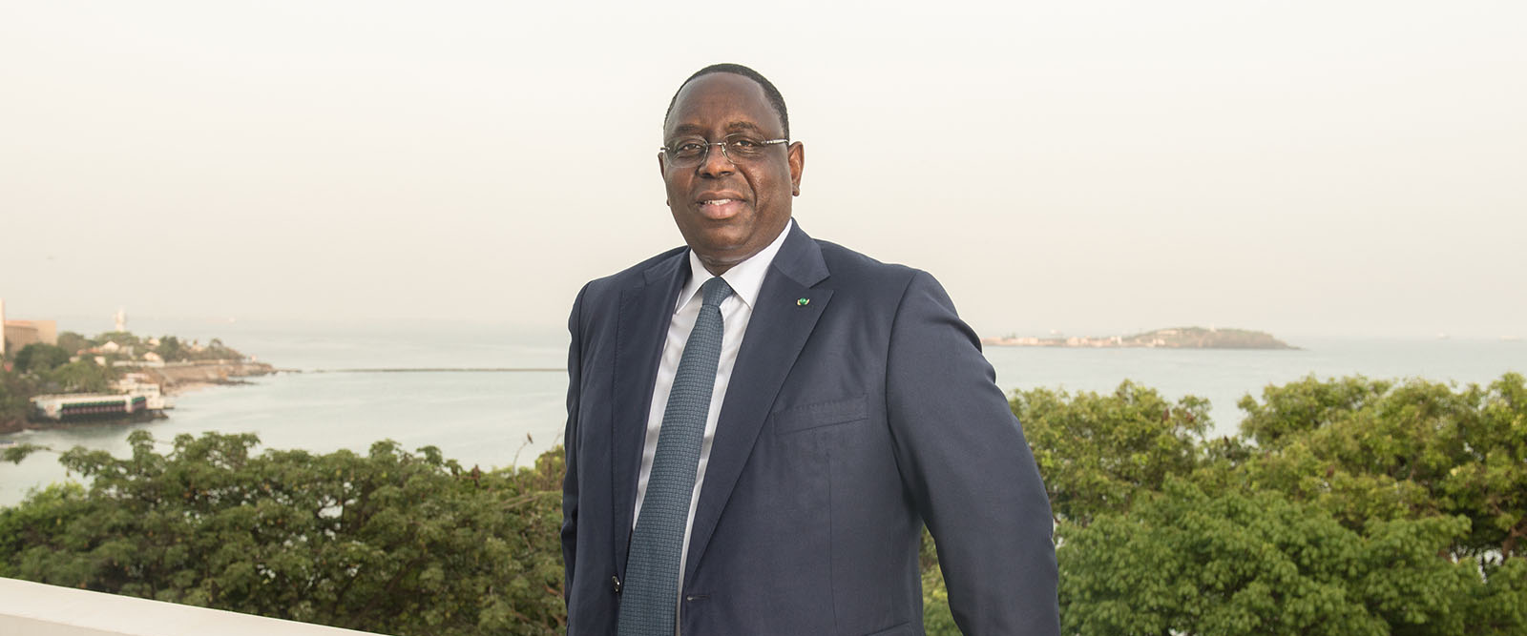
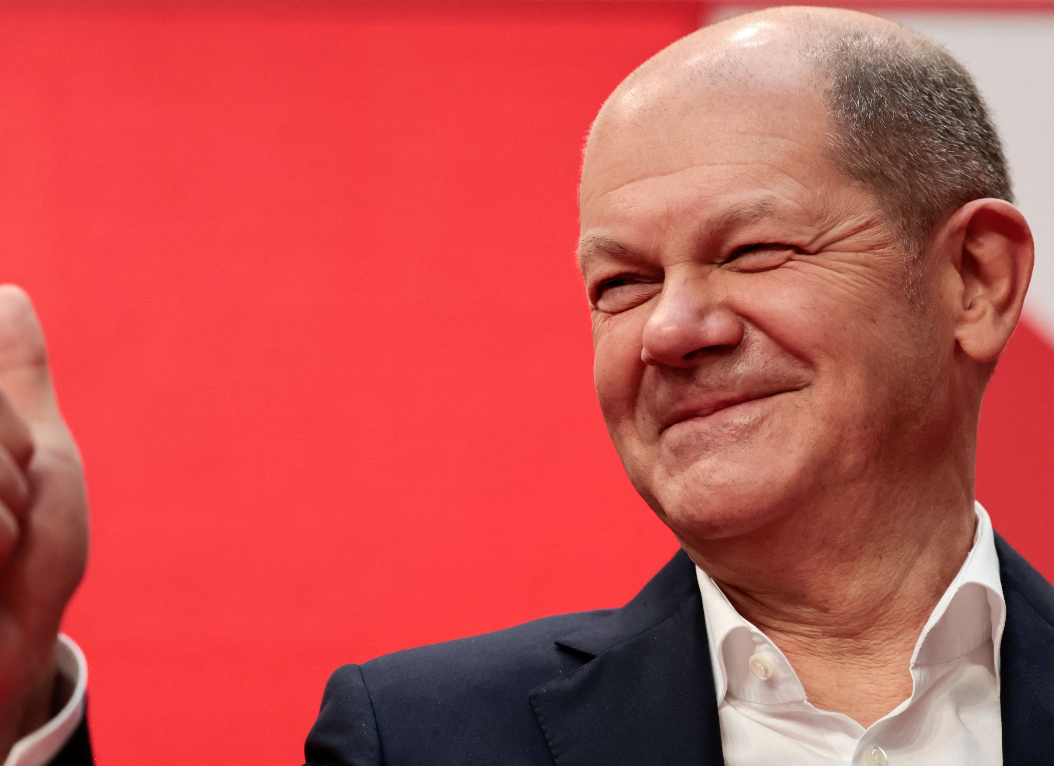
Climate, sovereignty, & hypocrisy

Slide 20
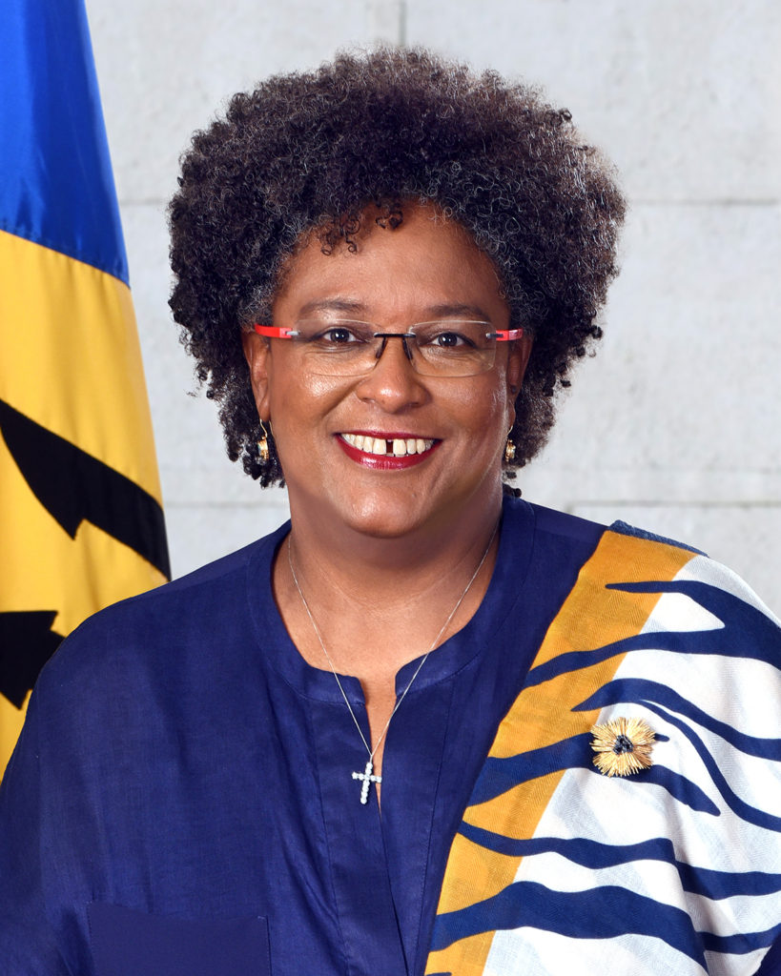
Climate, sovereignty, & hypocrisy

Slide 21
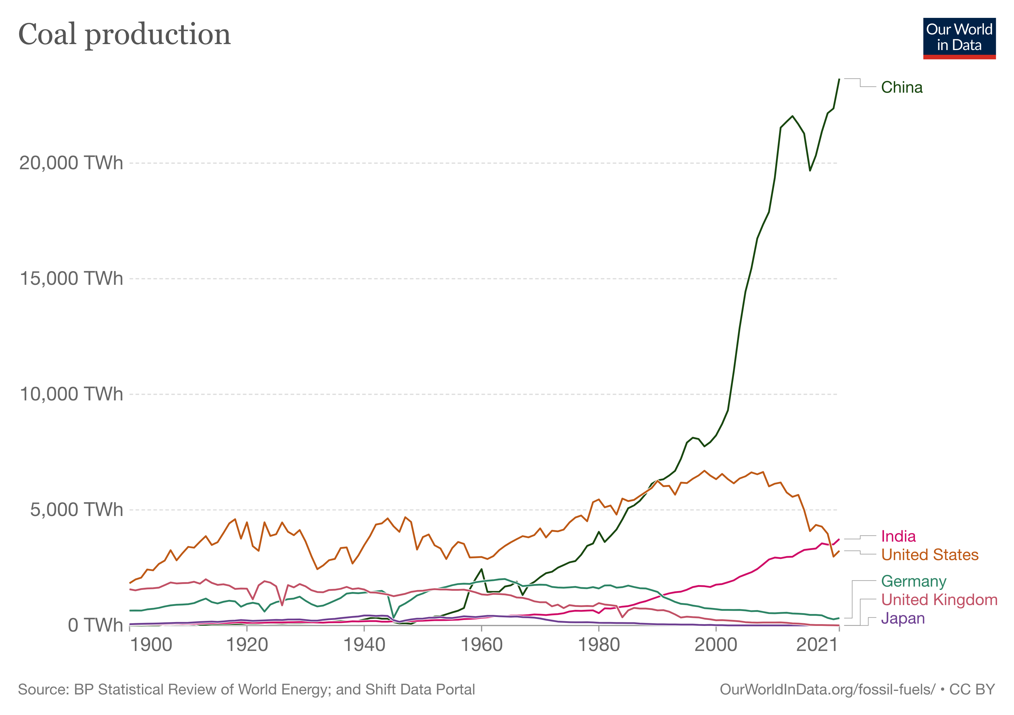
Winners and losers, coal:

Slide 22
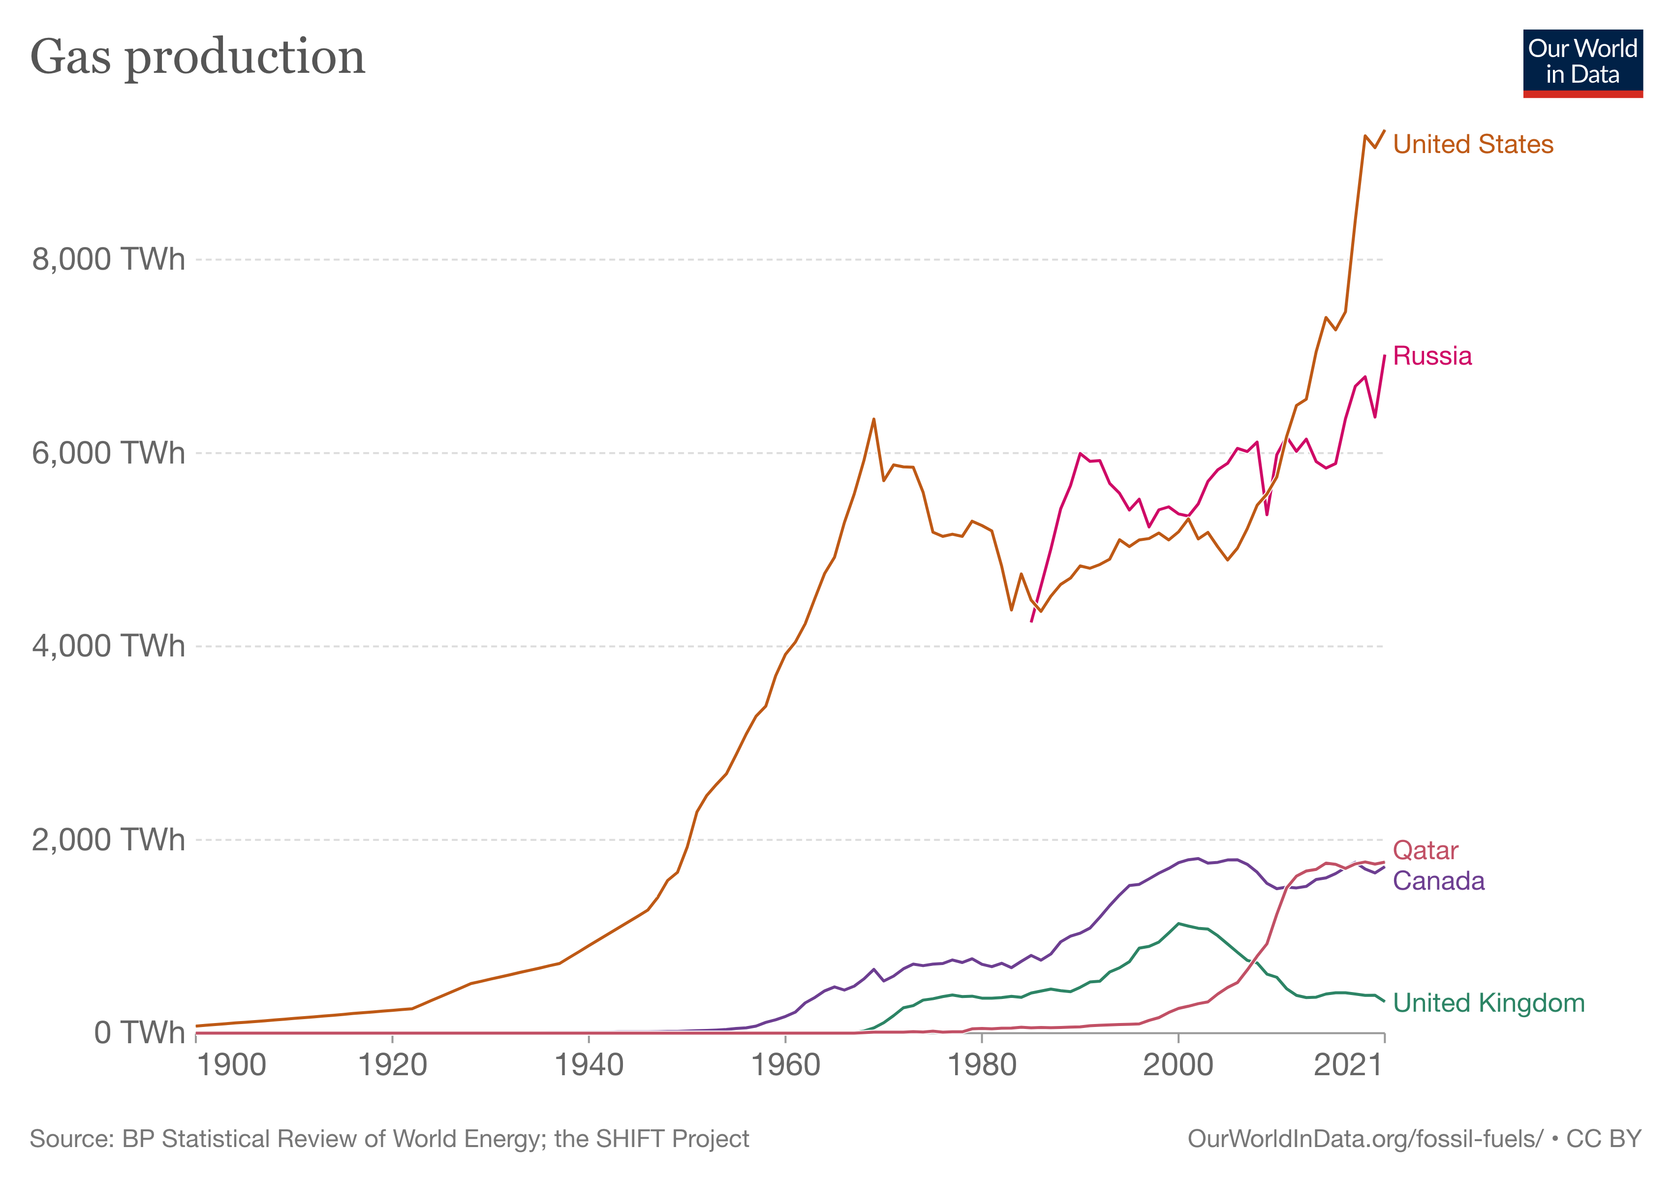
Winners and losers, gas:

Slide 23
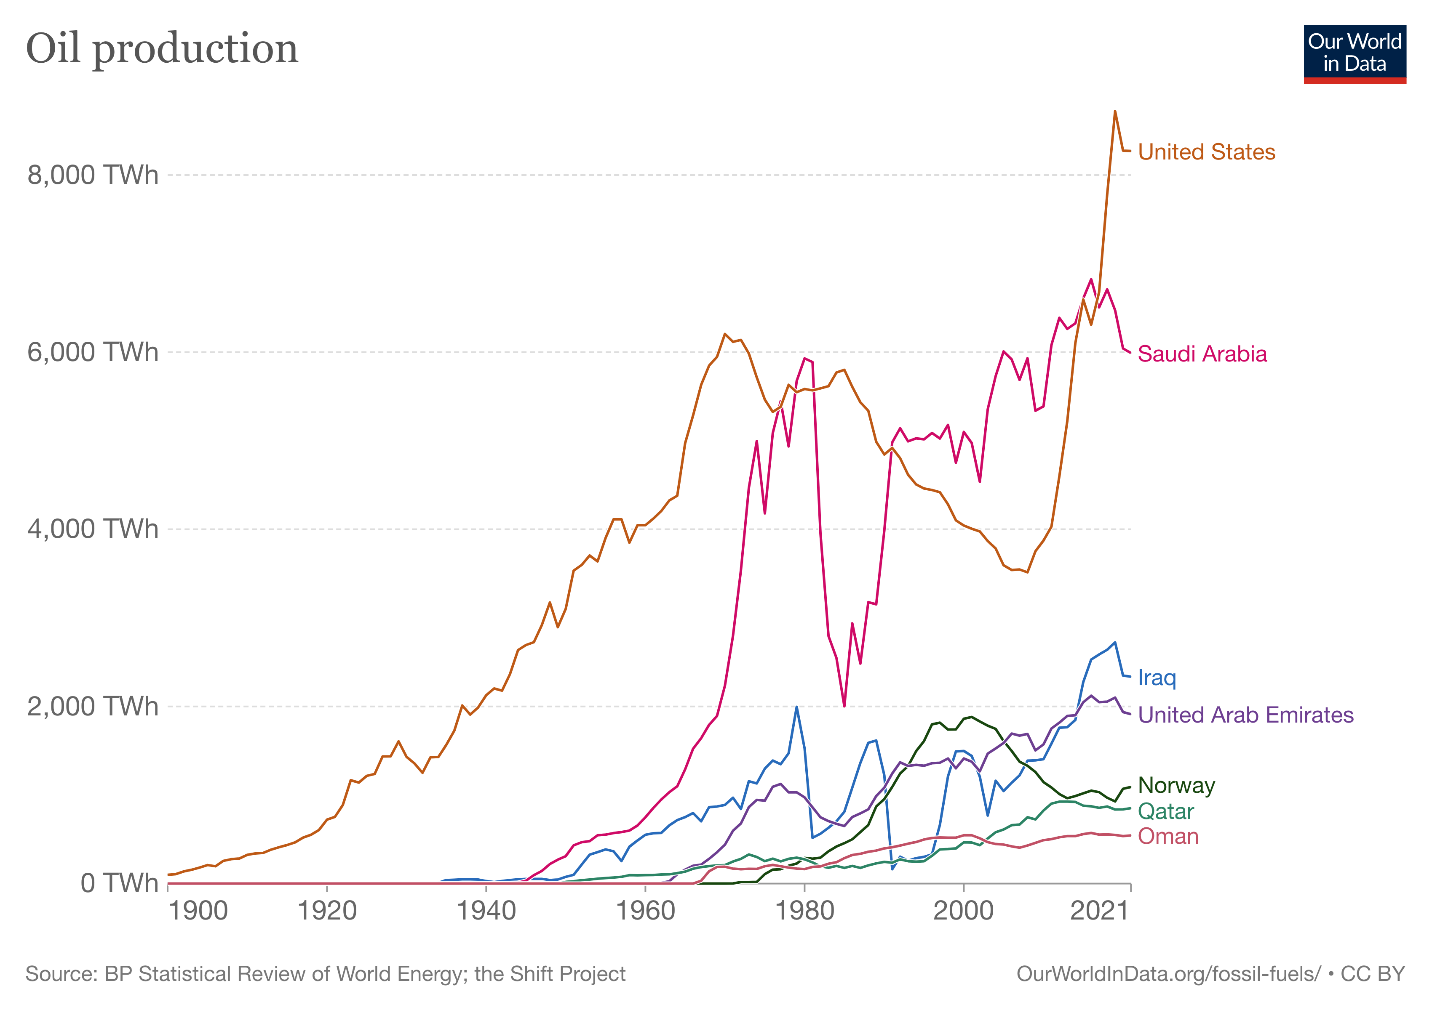
Winners and losers, oil:

Slide 24
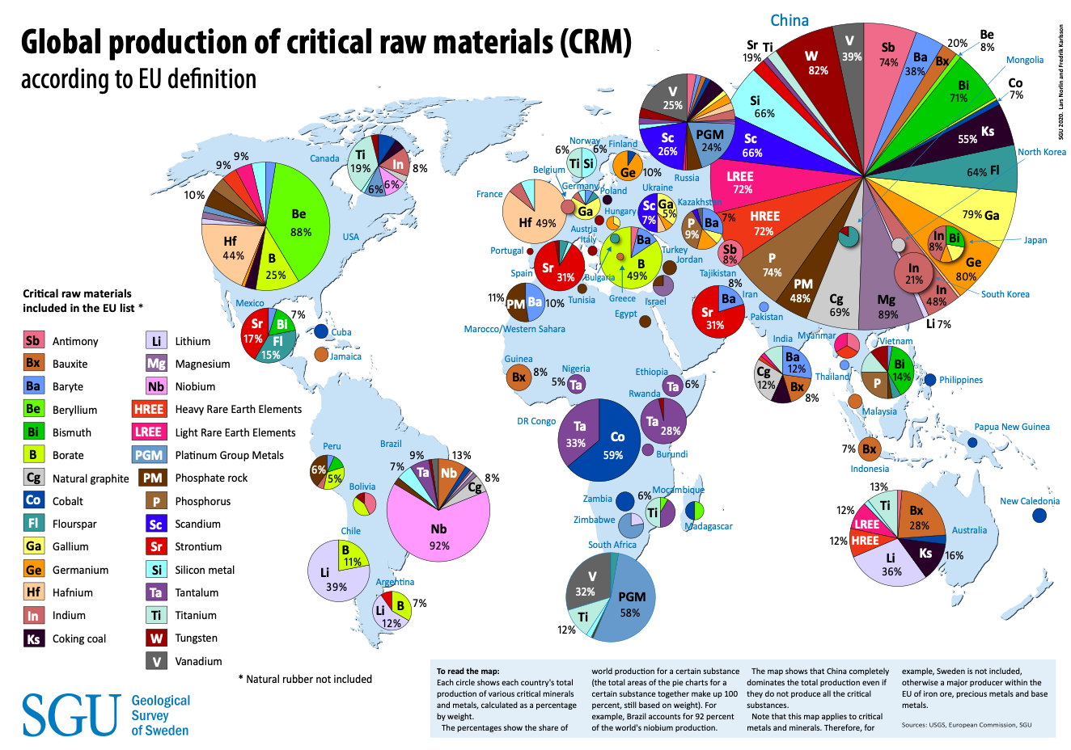
Winners and losers, critical raw materials:

Slide 25
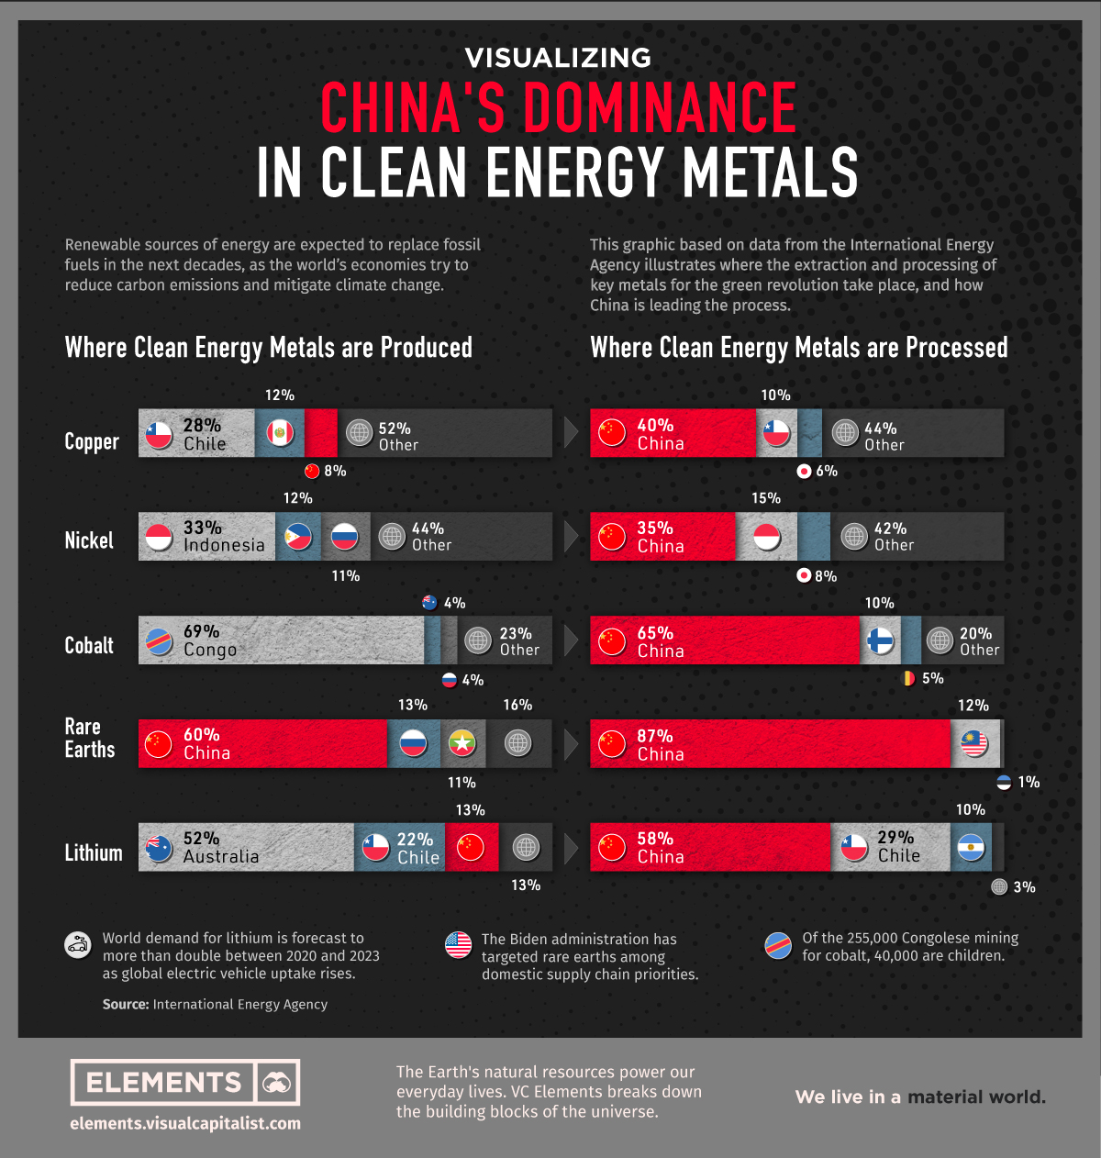
Winners and losers, metal processing

Slide 26
Winners and losers, finance
Source: Semieniuk et al, Nature, 2022

Slide 27
Winners and losers, meat
Source: Atlasbig, FAO

Slide 28
Carbon tunnel vision?
Source: SEI

