Slide 1
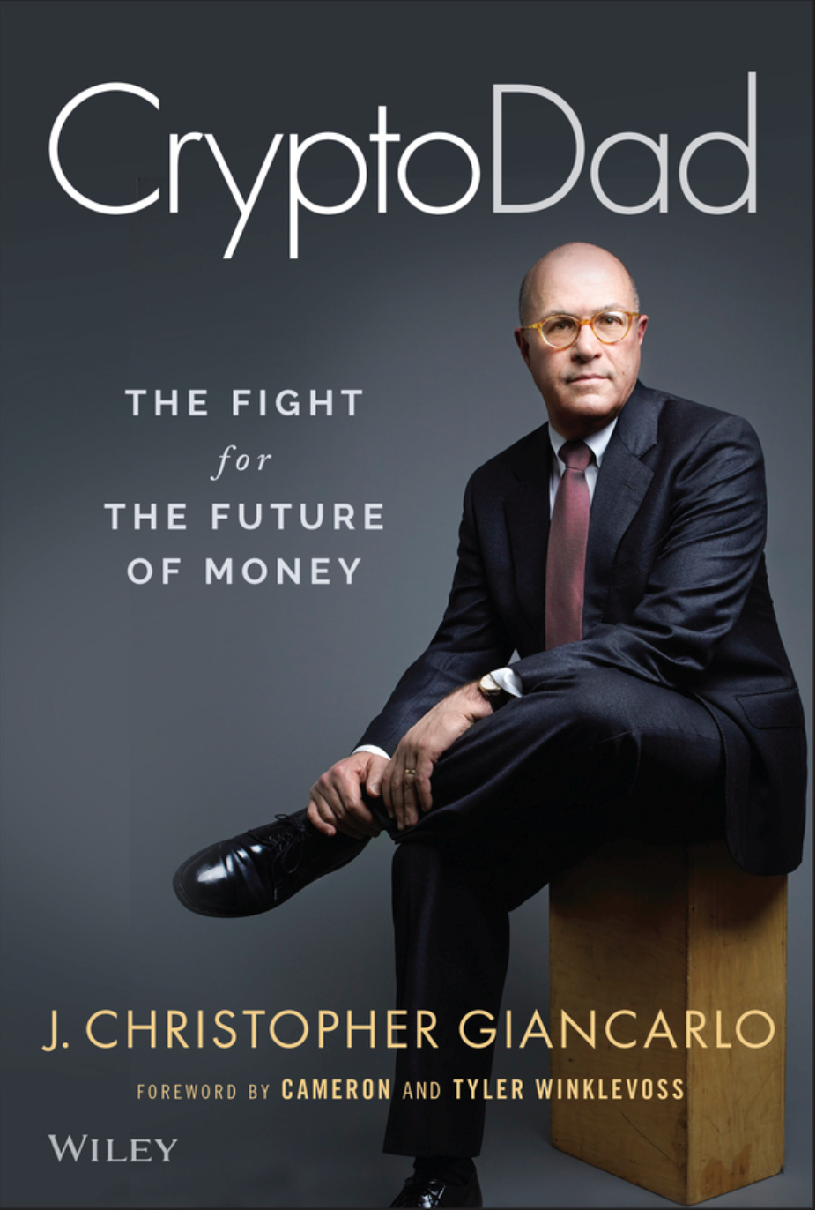
CRYPTO:
A New Architecture of Finance
IMF Independent Evaluation Office
Seminar Series
January 20, 2023
Hon. J. Christopher Giancarlo Senior Counsel, Willkie Farr & Gallagher LLP Fr. Chairman, Commodity Futures Trading Commission
Twitter: GiancarloMKTS

Slide 2
What is Crypto?
A new, highly speculative tradable asset class
A faster & more efficient means of payment
Digital Gold
A scam to defraud naïve investors
All of the above

Slide 3
ANSWER: Crypto is...
A series of algorithmic protocols on digital networks to record and confirm the holding and transfer of things of value, including money itself.

Slide 4
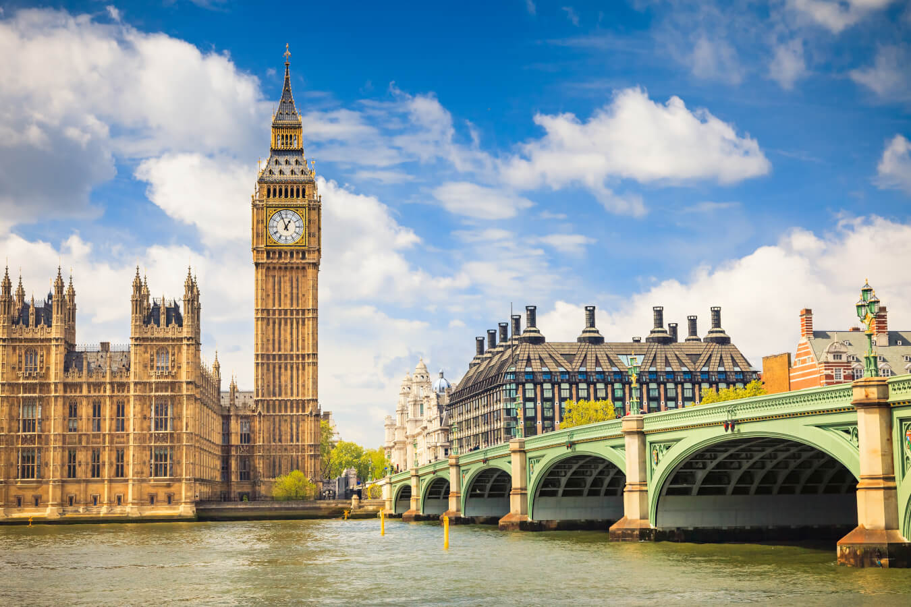
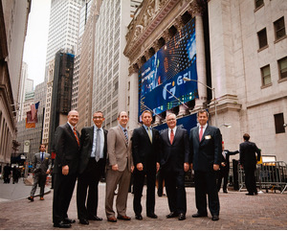
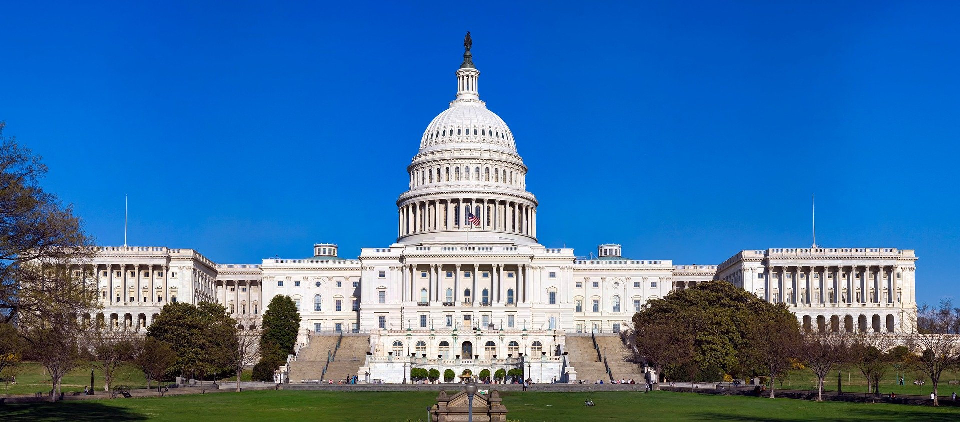
My story: Lawyer, Entrepreneur, Regulator, Author…

Slide 5
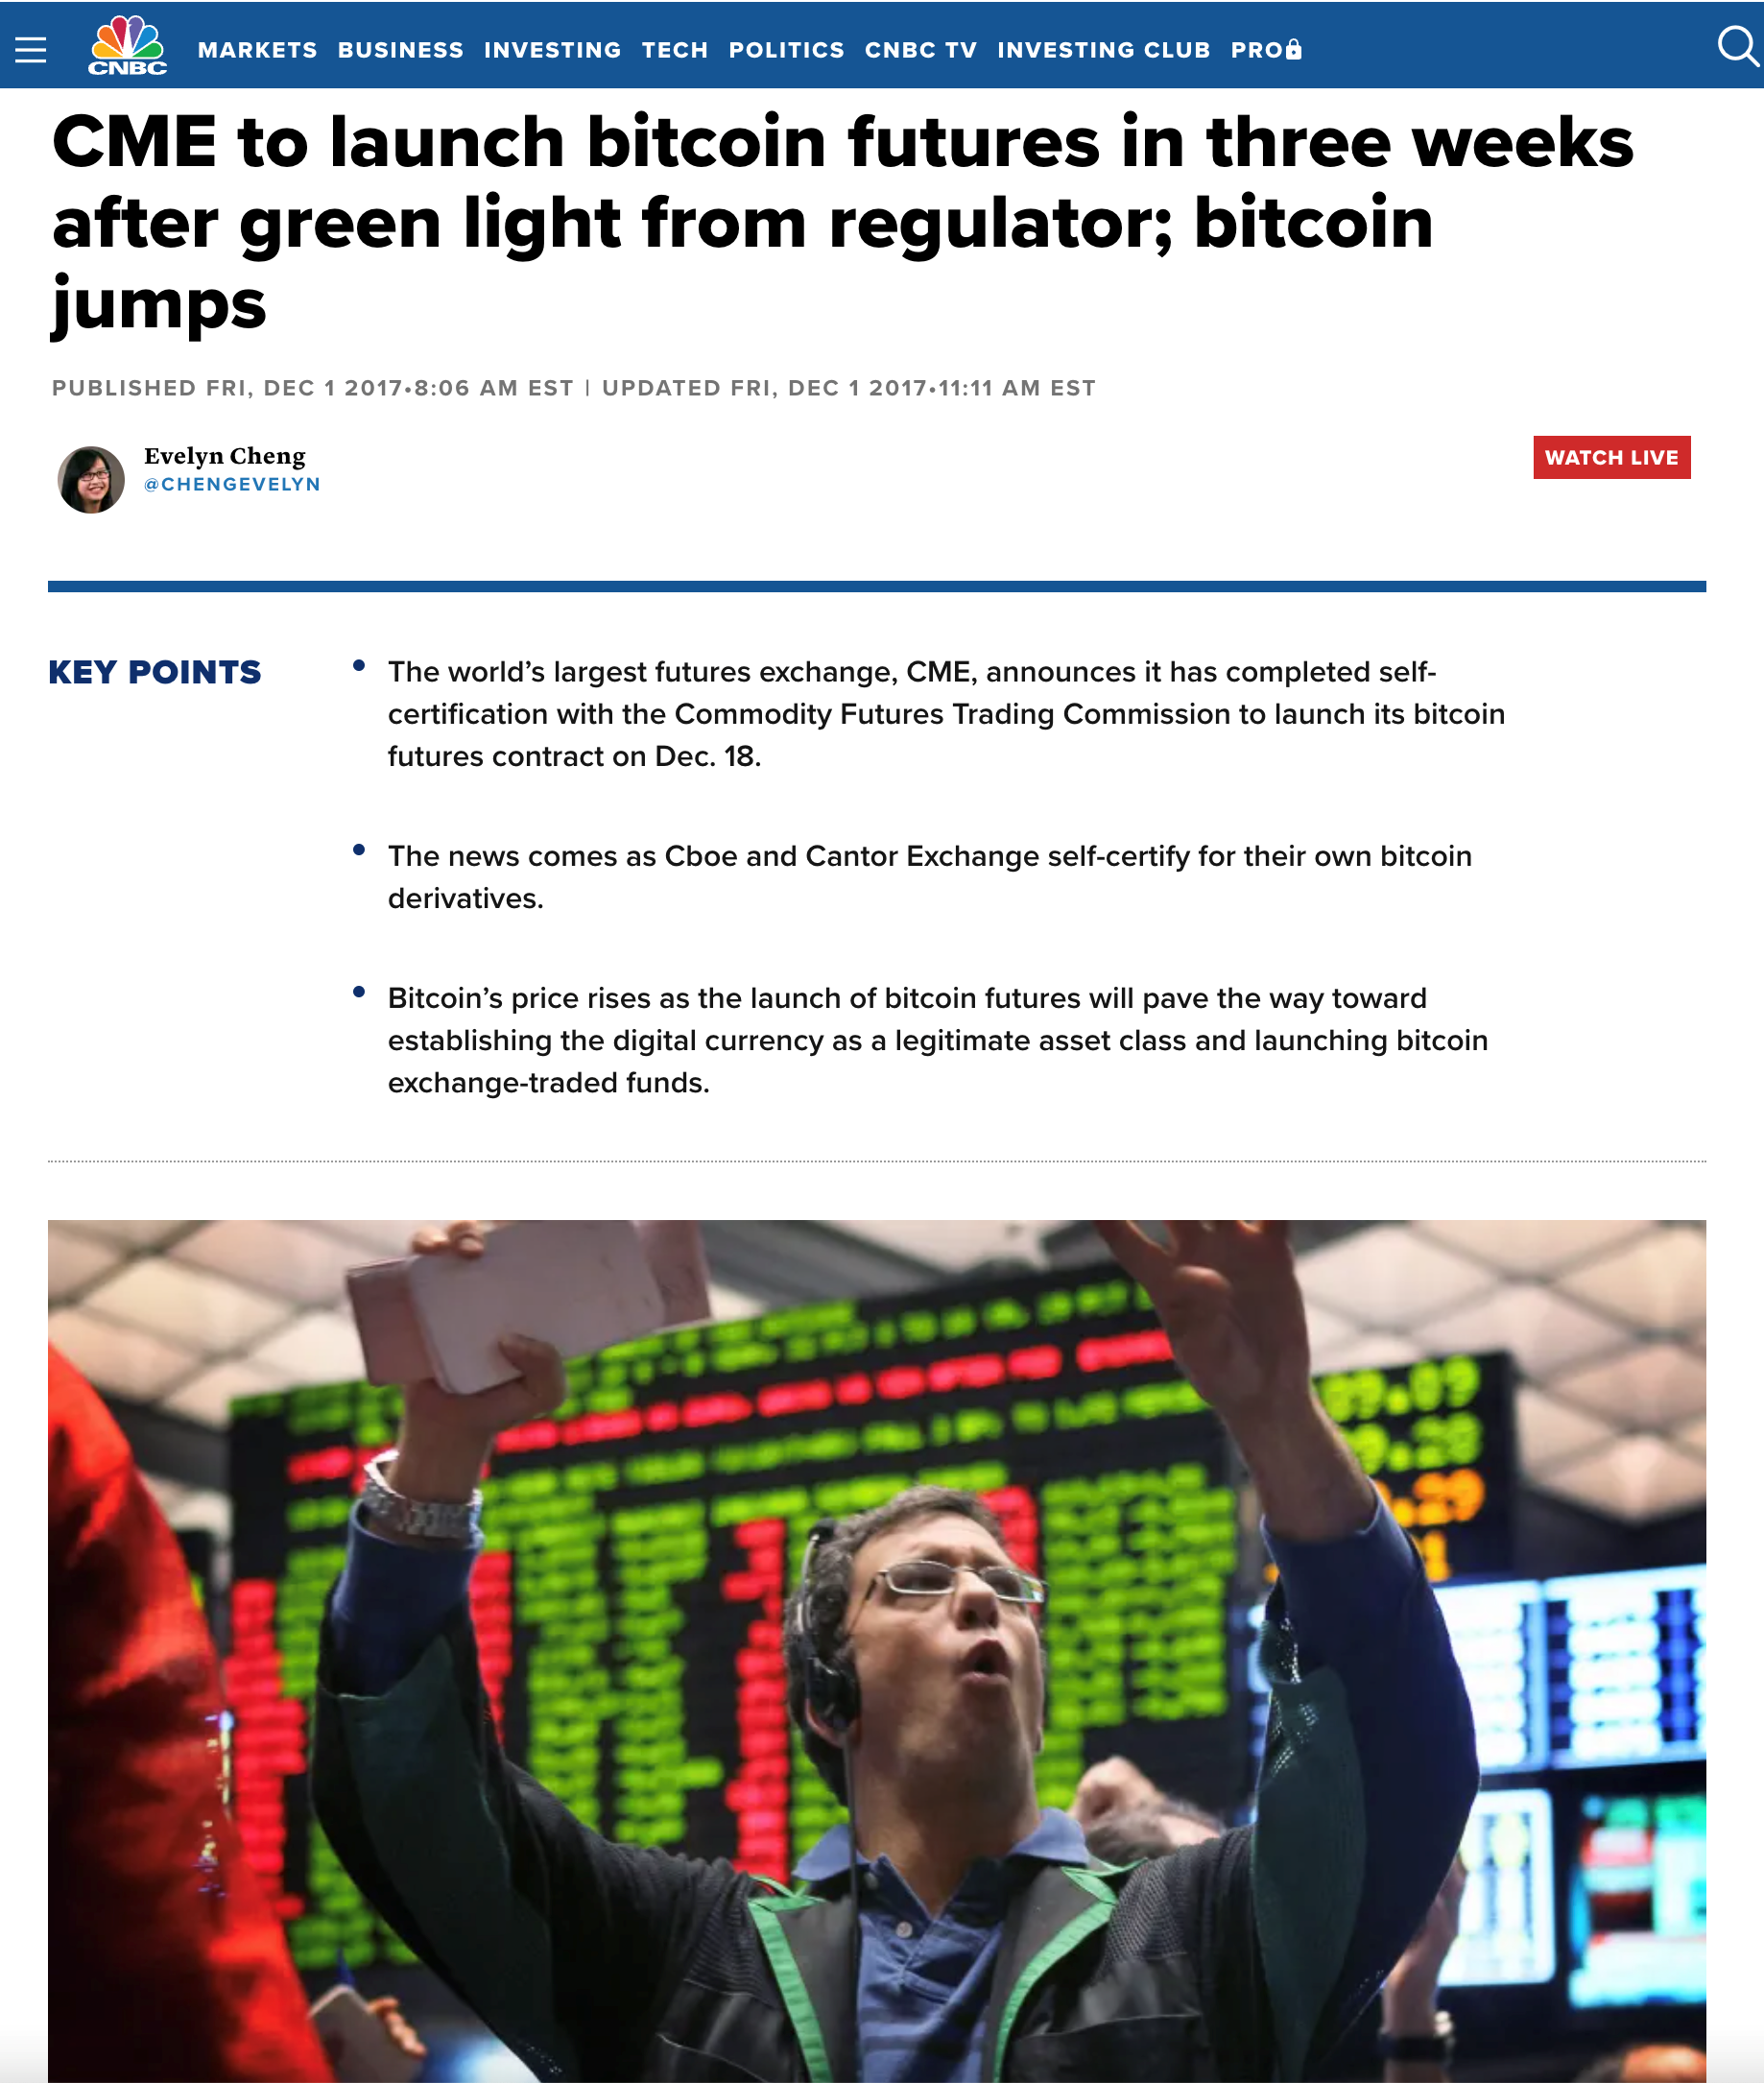
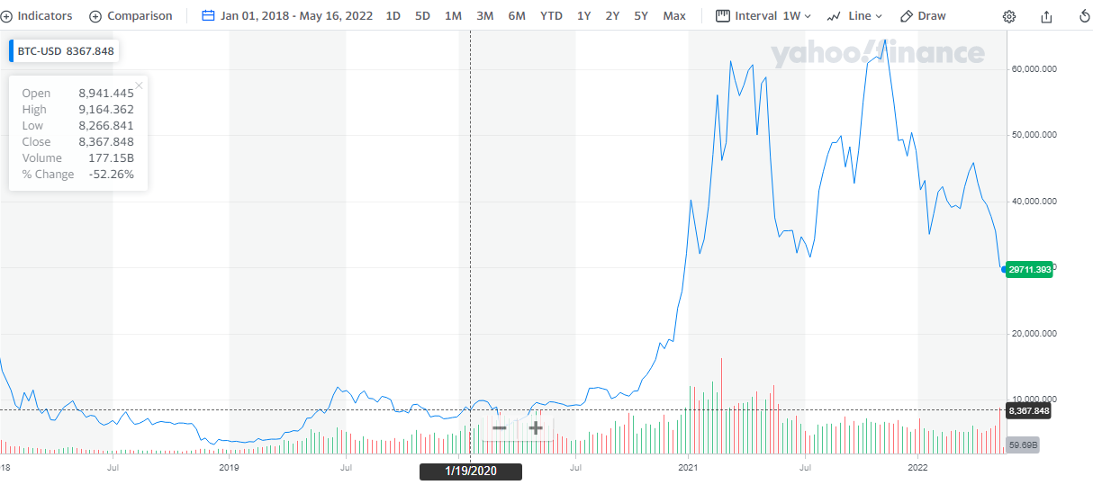
A Wave of Value Grows

Slide 6
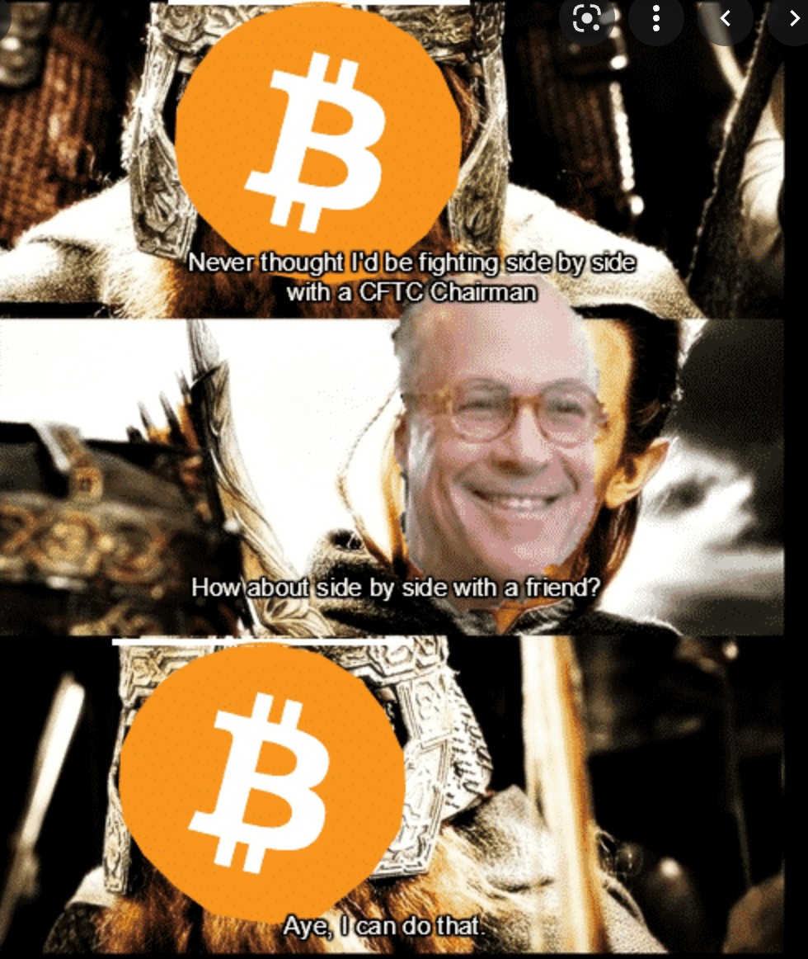
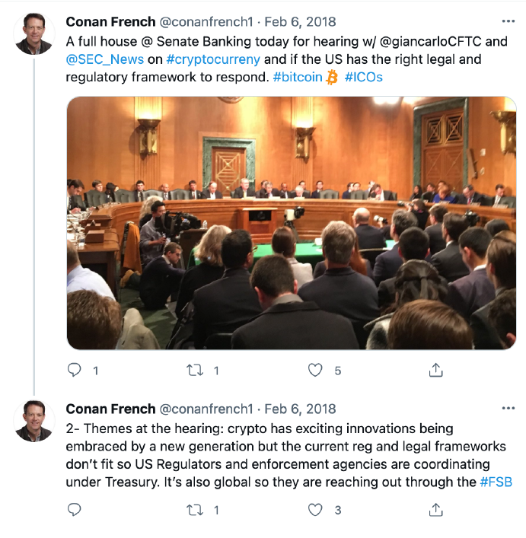
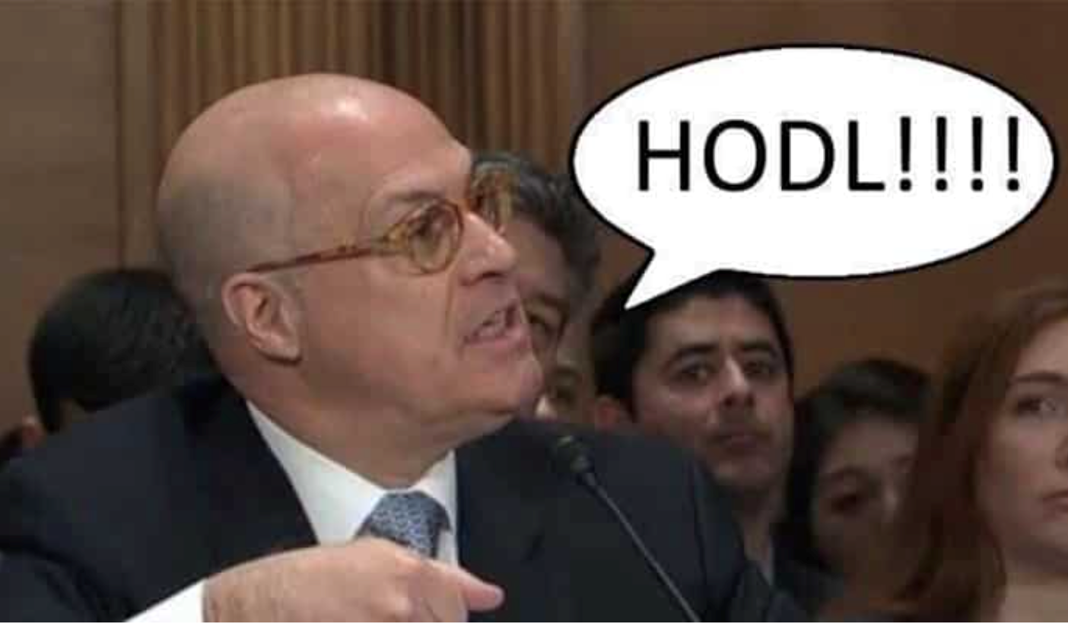

Slide 7
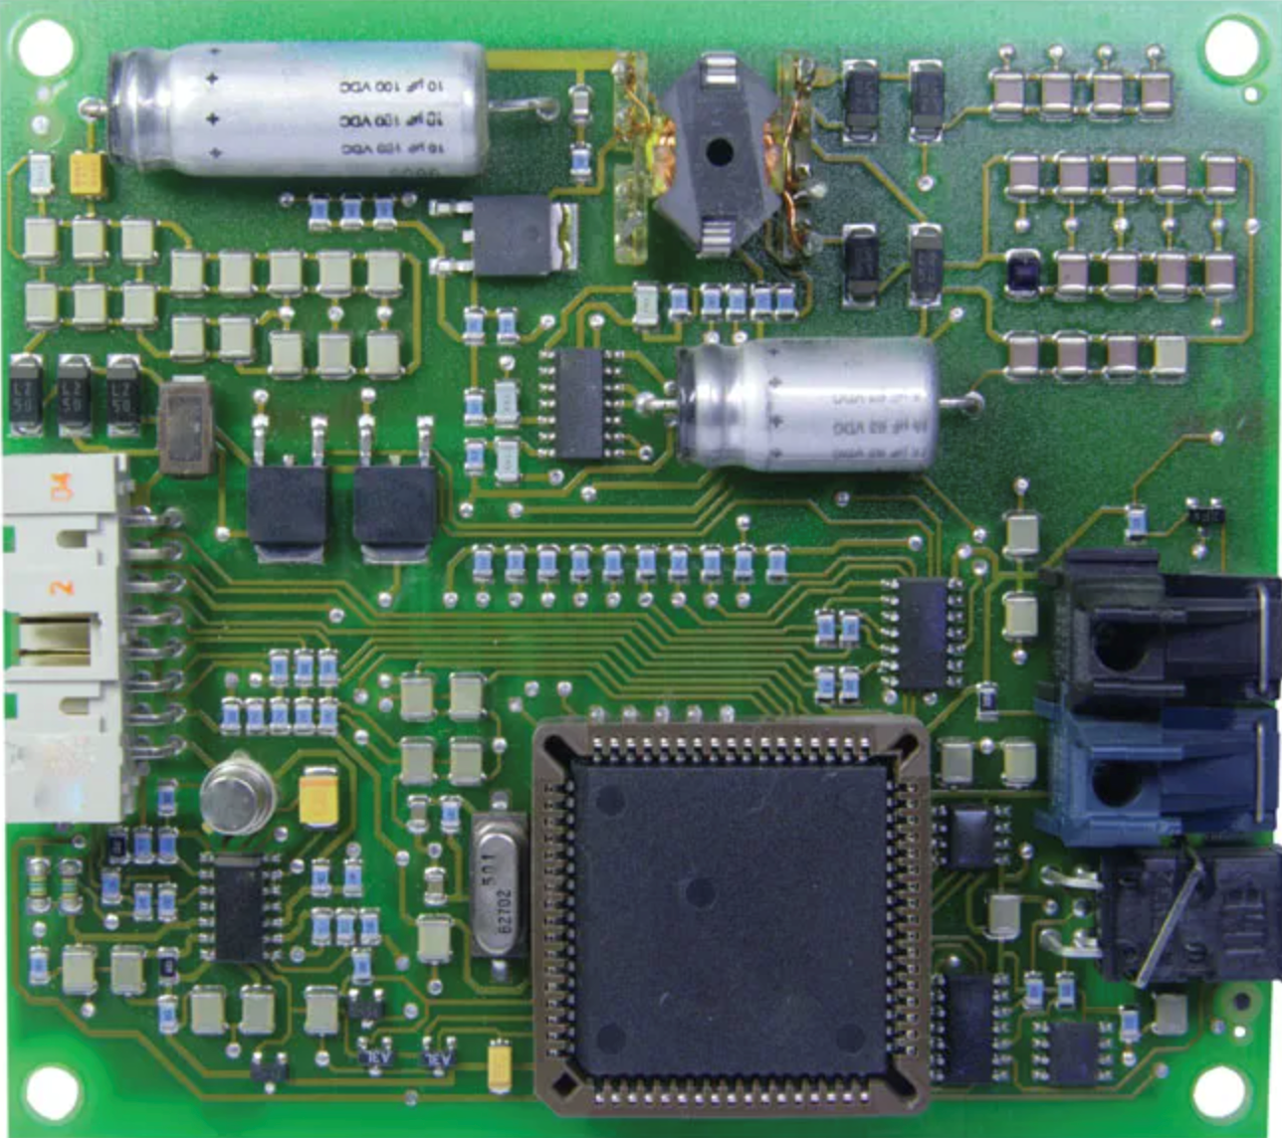
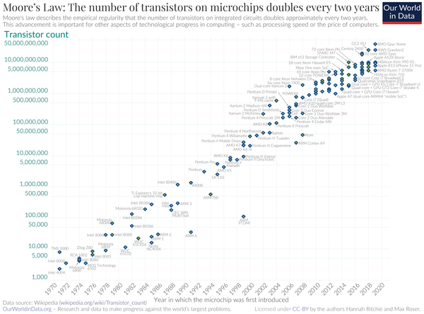
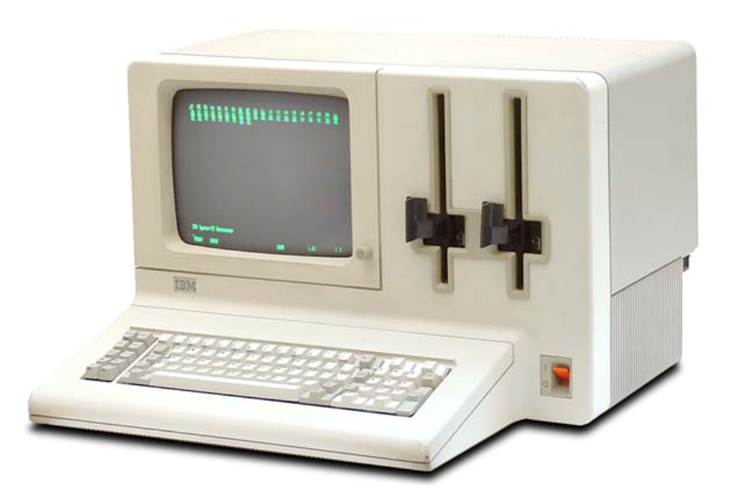
First Wave: Internet of Information 1970s-2000s
Key protocols:
TCP/IP
FCP/IP
TFTP
HTTP

Slide 8
Transformed: All Manner of Information Sharing
Music (Pandora and Spotify)
Television (YouTube and Netflix),
Retail shopping (Amazon and eBay)
Local transportation (Uber and Lyft)
Travel and leisure (Expedia and Travelocity)
Video/Photography (Flicker and TicToc)
Communications (Twitter and FaceTime)
Social networking (Facebook and LinkedIn)
Business meetings (Zoom and Teams)

Slide 9
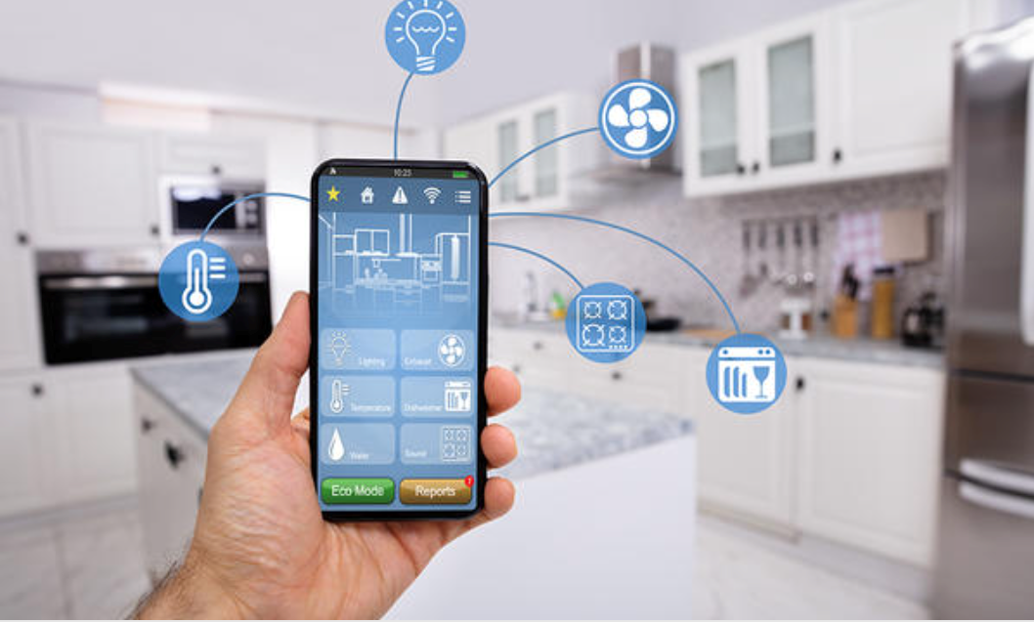
Second Wave: Internet of Things 2000s-2020s
Key protocols:
CoAP
SNMP
MQTT
WiFi
Bluetooth

Slide 10
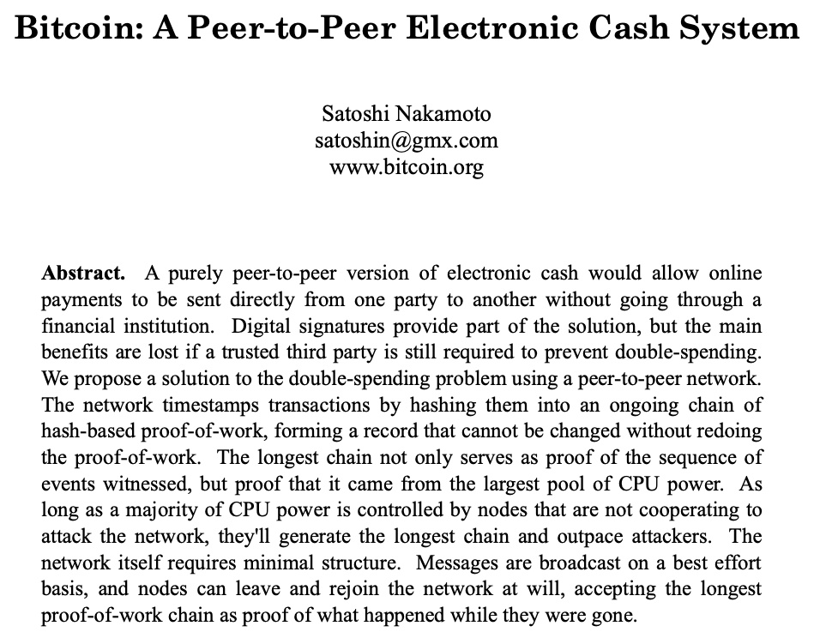
Third Wave: Internet of Value - Now -
Key Protocols:
BTC (Bitcoin)
ETH (Ethereum)
SOL (Solana)
USDC (Circle Coin)

Slide 11
Crypto = computer protocols using distributed ledger technology and cryptography to record ownership and transfer of value on the Internet…

Slide 12
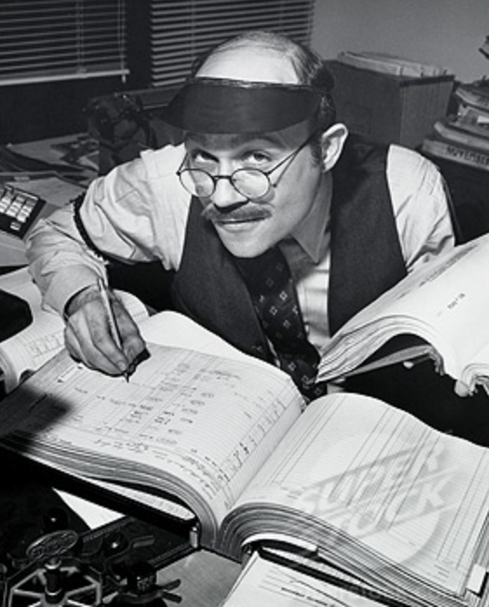
…rather than as assets and liabilities on proprietary balance sheets of +7,000 commercial financial institutions

Slide 13
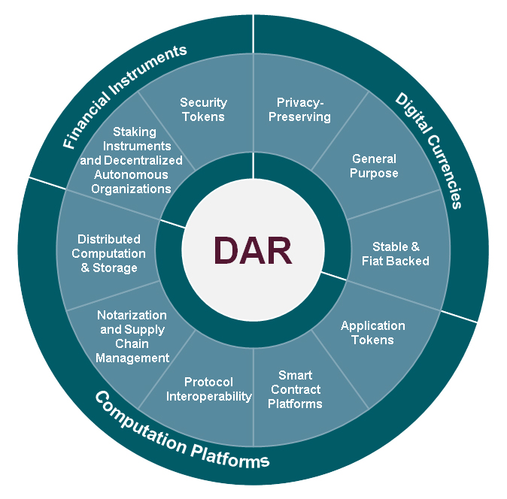
Crypto: A Rapidly Evolving, digital network-based Architecture for Recording Value Taxonomy
Cryptocurrencies
Digital Commodities
Digital Securities
Stablecoins
Decentralized Autonomous Organizations (DAOs)
Computing protocols
Decentralized Finance (Defi)
Smart Contract Platforms
Non-Fungible Tokens (NFTs)

Slide 14
Public Sector Response to Private Sector Innovation of Crypto: cautious indifference ➡️ regulatory accommodation ➡️ regulatory hostility
The Private Sector
Bitcoin in 2008
Ethereum in 2013
1,000s of crypto since
Stablecoins, NFTs, DAOs, etc
Investors & traders worldwide
$1-2 Trillion in value
Many Central Banks
China’s Digital Yuan in 2014
+100 CBDCs in development
Digital EUR, USD coming
Some Market Regulators
2013: Dig. asset (Norway)
2014: Payments (Spain)
2017: Bitcoin Futures (US)
Payments (Spain)
National Legislation
EU MICA crypto legislation in 2022
US legislation in 2023

Slide 15
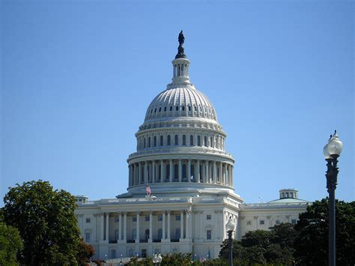
U.S. Legislative Process is Underway
Comprehensive frameworks:
Digital Commodities Consumer Protection Act (Aug. 2022) Stabenow-Boozman
Responsible Financial Innovation Act (June 2022) Lummis-Gillibrand
Digital Commodity Exchange Act (Apr. 2022) Khanna-Thompson-Emmer-Soto
Targeted:
Stablecoin Trust Act (Aug 2022) Toomey
Blockchain Regulatory Certainty Act (Aug. 2021)
Keep Innovation in America Act (Nov. 2021)
Virtual Currency Consumer Protection Act (Aug. 2021)
U.S. Virtual Currency Market and Regulatory Competitiveness Act (Aug. 2021)

Slide 16
THE FTX FIASCO
FTX Business Model: Prop Trading Firm + Trade Execution + Broker
Financial Regulation: (almost) none
Transparency: (almost) none
Conflicts of Interest: rampant
Historic Analogy: Enron + Nick Leeson + Madoff
Old fashioned crime: Appropriated the promise of transparent, decentralized (internet) finance and conducted it through an opaque, conflicted & centralized platform.
Reverberation: FTX Fiasco will have continuing political & social effects

Slide 17
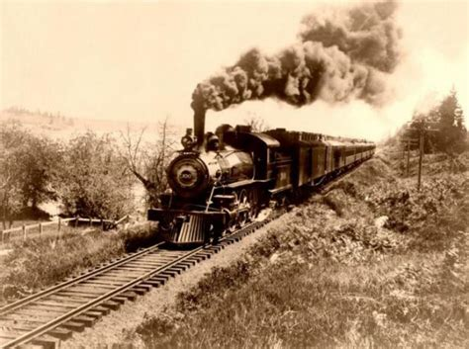
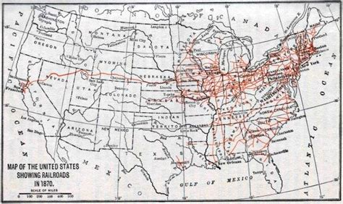
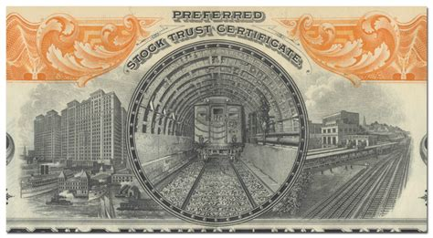
Analogy: 19th Century Railroad development
Distinguish:
Fraudulent sales of early railroad shares
Fundamental transformation of US economy by 19th century steam engine railroad develpment

Slide 18
The current “Crypto Winter”
The promise (and valuation) of Internet-based value transfer got ahead of:
End of QE & beginning of new, QT global credit cycle
State of development of underlying infrastructure
Legacy financial systems & regulatory frameworks
Generational status quo bias & technology anxiety
(especially by finance ministries & central banks)
Kids (and crooks) playing with too much money without adult supervision
Smiley, A. H., & Fisher, M. (2022). The Golden Age Is Behind Us: How the Status Quo Impacts the Evaluation of Technology. Psychological Science, 33(9), 1605–1614. https://doi.org/10.1177/09567976221102868.

Slide 19
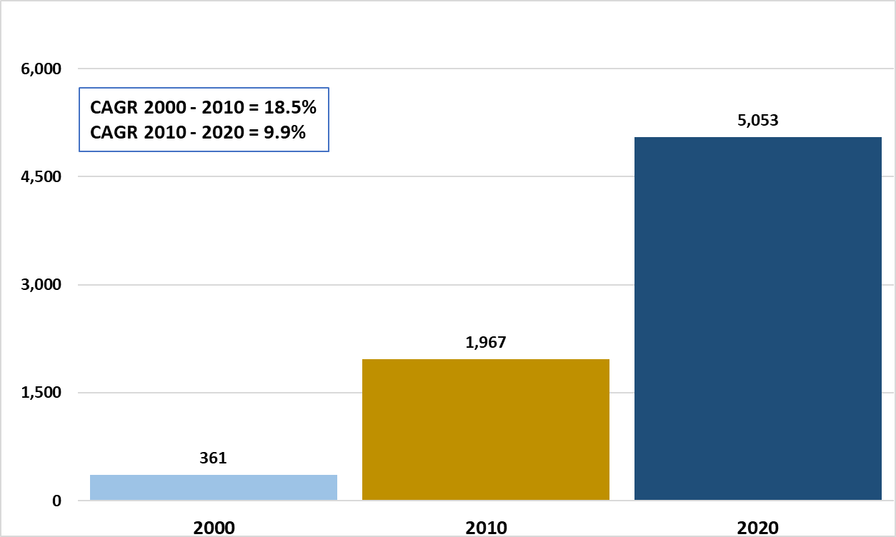
Analogy: 2000 Dot-Com Bust
Failure of Pets.com was not because consumers did not want to purchase pet supplies online.
Failure of Pets.com was because consumers did not want to do so on dial-up modems with two weeks for delivery and invest at high valuations.
Today, on-line commerce is firmly established in society.
Worldwide Internet Usage

Slide 20
Institutional & Corporate interest in Crypto Continues to Grow
…despite aggressive enforcement, regulatory uncertainty and declining crypto prices.
Flight to Quality: A shift is underway from crypto speculation
to real world usage in trading, payments & investment
Institutional-grade service provision is expanding:
Execution, Prime Brokerage & back office:
BNY Mellon
Nasdaq
Portfolio Investment:
Fidelity
BlackRock
State Street
Corporate expansion of retail usage
Paypal, Visa & Mastercard, Nike, Coca-Cola, Google, Microsoft

Slide 21
Enormous interest in Crypto by Finance Ministries and Central Bankers
As means of payment:
Faster, cheaper and more programmable way to move money
annual transaction volume (stablecoins = $16T vs USD = $25T)
Potential to reduce cost to offset slowing global economic growth.
As store of value:
Algorithmic scarcity (Bitcoin) as a rebuke to fiscal profligacy and monetary depreciation
Potential for greater financial inclusion (verifying token itself)
As unit of account:
Historically, sovereign currencies peg value to commodities: gold and silver, not fiat
For more effective regulation:
Potential for quantitative market regulation, not anecdotal

Slide 22
Public Sector Response: Central Bank Digital Currency
Digital Currency issued by a central bank
backed by the full faith and credit of a sovereign government
that trades at par to paper money.

Slide 23
Central Bank Digital Currency or “CBDC”
Over 100 of the world’s central banks have engaged in research or experimentation toward developing CBDC.
CBDC FRAMEWORKS
SNB SBDC
Banque de France
Bank of International Settlements & Swiss National Bank
PROJECT JASPER
E-KRONA
Central Bank of Canada
Central Bank of Sweden
ECCB CBDC PILOT
DIGITAL YUAN
Eastern Caribbean Central Bank
The People’s Bank of China
ECB CBDC
PROJECT STELLA
European Central Bank
Bank of Japan
PROJECT KHOKHA
BOK CBDC Pilot System
South African Reserve Bank
Bank of Korea
PROJECT ABER
PROJECT UBIN
Saudi Arabian Monetary Authority
and United Arab Emirates Central Bank
Monetary Authority of Singapore
NON-EXHAUSTIVE
Source: The Digital Dollar Project

Slide 24
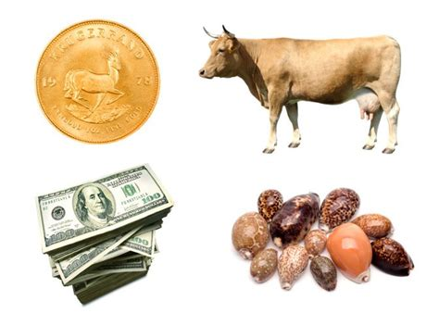
A (very) Brief History of Money:
Tokens go back to the dawn of human history
Tokens require verification only of the token itself, not personal identity
Tokens are fast, cheap & inclusive
Token shortcoming: limited to local usage

Slide 25
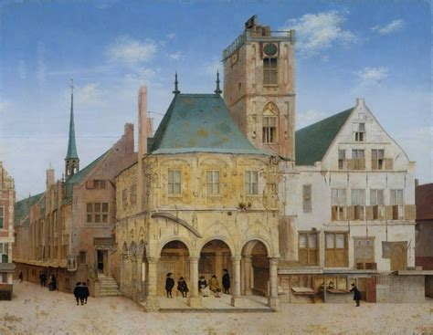
Brief History of Money (continued):
Established depositor accounts
Issued bank receipts
Allowed for safer & more convenient movement of value around the globe
Financed: “Age of Discovery”
Bank of Amsterdam
(est. 1609)

Slide 26
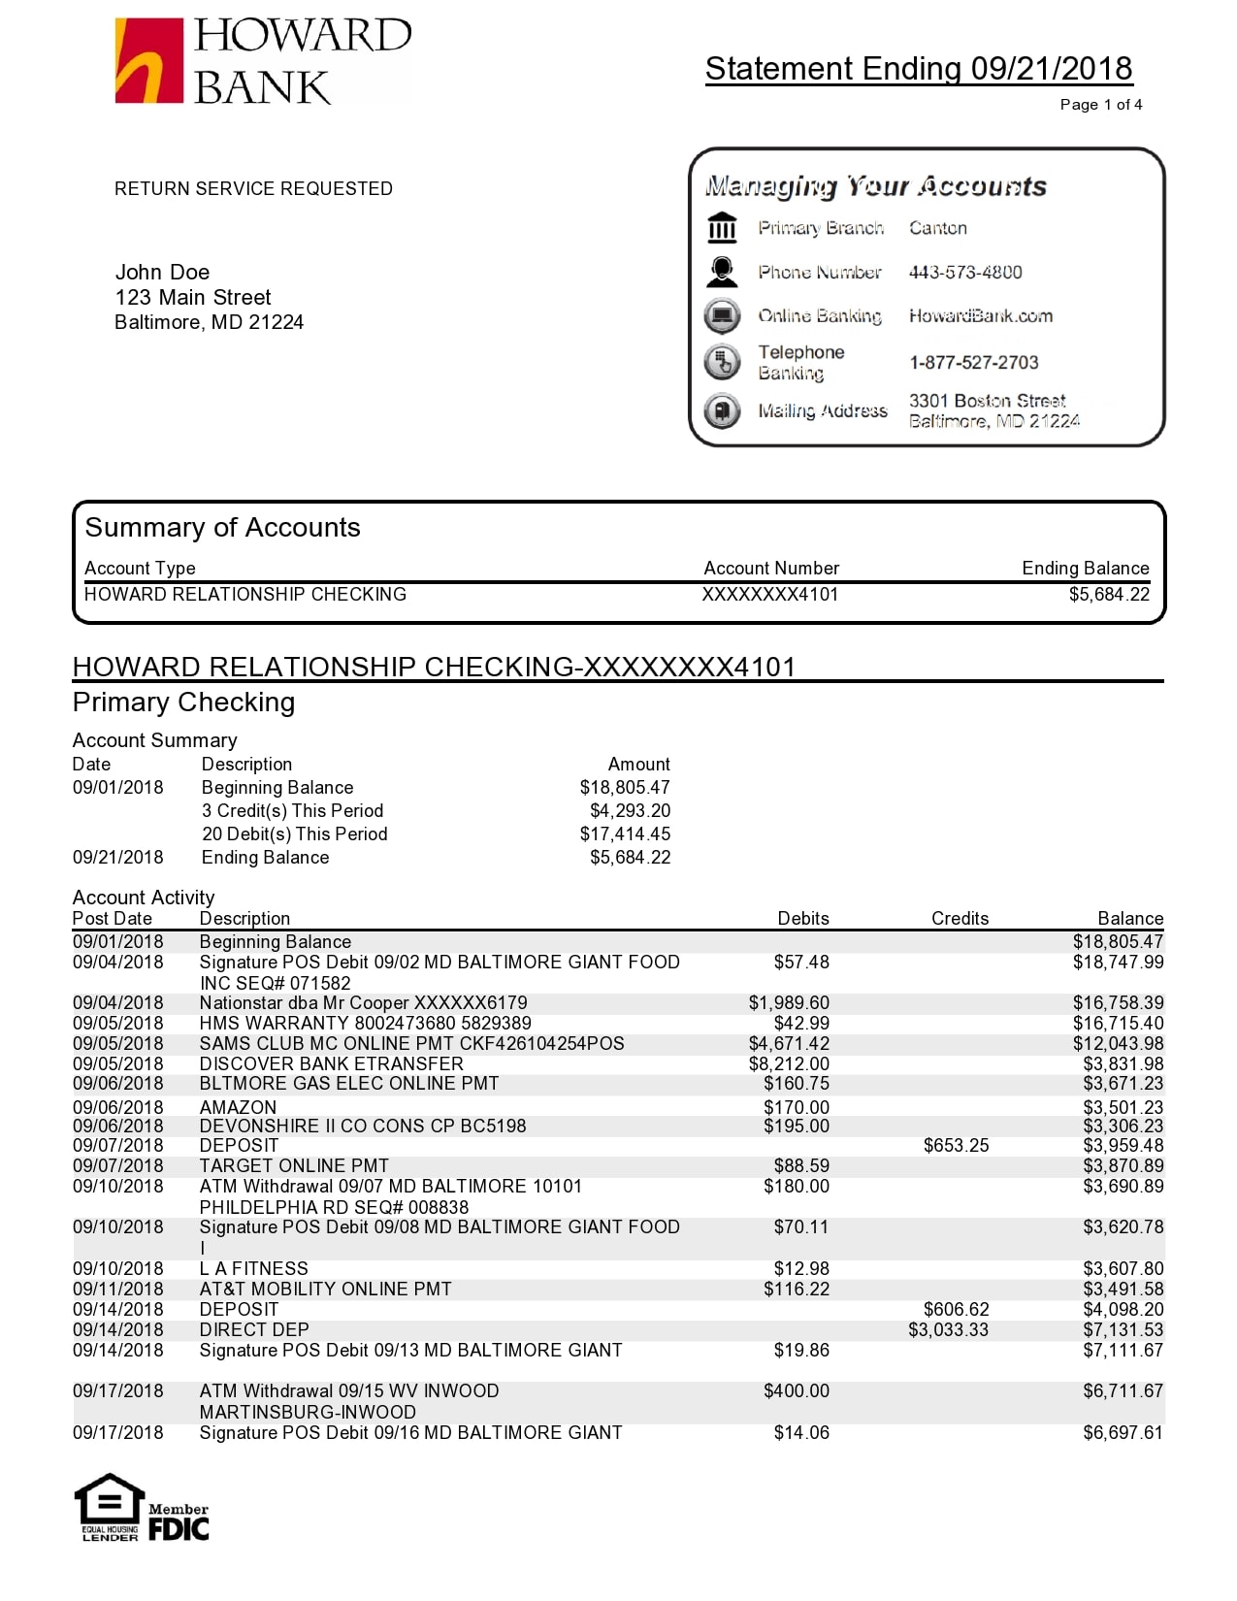
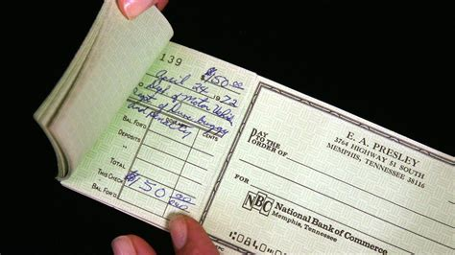
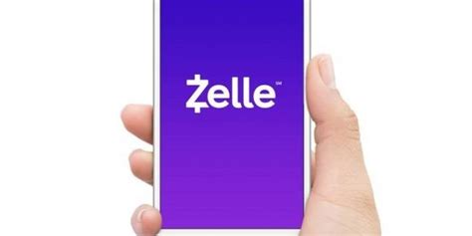
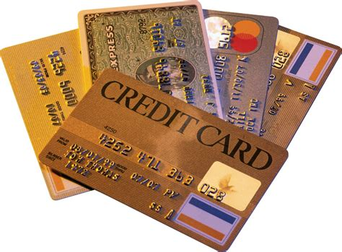
Brief History of Money (continued):
Today: bank money = @90% of money in use worldwide
Bank money exists as assets & liabilities @ 7,000 banks worldwide
Bank money requires verification of account holders
Bank money is globally accepted
Shortcoming: Bank money is slow, expensive & exclusive

Slide 27
Brief History of Money (concluded):
What new technology is available?
To make value less local and more global than under the “token money” system?
To make access to and transfer of value faster, cheaper and inclusive than the current “bank money” system?
To enable value (for the 1st time in human history) to move efficiently across both space and maybe even time?

Slide 28
Seven Factors Driving Central Bank Interest in CBDC
DATA CAPTURE
INFRASTRUCTURE UPGRADE
INCLUSION (FINANCIAL)
PRECISION MONETARY & SOCIAL POLICY
RISE OF STABLECOINS
INFLUENCE (GEOPOLITICAL)
KARMA
First AliPay, then FaceBook
Financial centers starting in Singapore
Developing World leading the way
Lessons of Covid-19
Competition against central banks control of institutional money transfer
China’s eCNY & the Digital Euro
Surveillance Coin vs. Freedom Coin

Slide 29
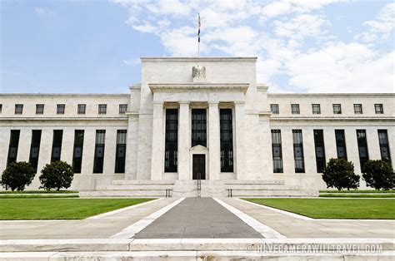
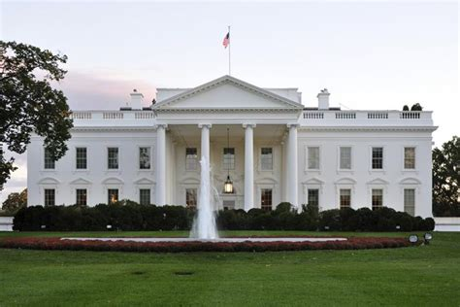
A “Digital Dollar”
Digital Bearer Instrument with Full Faith & Credit of the US Government
January 2020
March 2022
June 2022
Digital Dollar Project calls for the Federal Reserve to explore a US “Digital Dollar”
FRB Chairman Powell:
Digital Dollar Could help maintain Dollar’s International Standing.
Biden Executive Order:
CBDC Research and Development is of ‘Highest Urgency’

Slide 30
Digital Dollar Value Proposition
A centralized CBDC enables a common currency platform across possible use cases
DDP Pilot Initiatives:
The DDP is working with participants in various industries to explore how a CBDC impacts or benefits different markets
Un and Underbanked Consumers Use Case
Mobile wallets could be more cost effective, secure, and inclusive than account-based systems for those who don’t live near banks or can’t afford to have a bank account
Financial Market Infrastructure Use Case
CBDC could enable direct monetary relations between financial institutions regardless of pre-existing relationships
Banked Consumers Use Case
CBDC could serve as a complementary and novel offering to enhance existing account-based systems at a national banking level
Value of a Fed CBDC
Deeper and more liquid markets than fractionalized Stablecoin networks
Consistent & publicly available
A CBDC is legal tender and trusted unit in case of an economic panic
Government Benefits Use Case:
CBDC could improve government benefit distribution by improving efficiency and reducing fraud.
Federal Reserve
Small , Medium, Multi-National Businesses Use Case
CBDC could offer small/medium businesses treasury management benefits and digital payment efficiencies, and multinational businesses cross border efficiencies.
Source: The Digital Dollar Project
Notes:
Fractionalizing the liquidity versus one deep liquid pool such as USD

Slide 31
First Digital Dollar Pilot
Test Utility with Real World Pilot Projects
Pilot test by Digital Dollar Project and Depository Trust Clearing Corp of use of Digital Dollar in the clearing & settlement of securities.
FIRST pilot in history to test a U.S. CBDC.
FIRST pilot in history to test CBDC of any denomination that is entirely private sector led, not initiated by a central bank.
Earlier this week, the Digital Dollar Project released an updated version of its white paper, "Exploring a U.S. CBDC," with recommendations for US leadership in global CBDC development.

Slide 32
Conclusion: What is to come
Naïve to believe that the Internet will not do to finance and money what it has done to other human activities: increase efficiency, lower cost, increase inclusion and overturn traditional market structures.
As a pre-Internet generation of policy-makers give way to a networked generation, the Internet of value will be second-nature.
An Internet of Value has already started…and will continue, despite the FTX scandal and its reverberations.

Slide 33
Conclusion: How to Prepare
Anticipate direction of innovation towards Internet-based architecture of value
Understand crypto as “software” (as well as securities, commodities or currencies)
Repurpose regulatory frameworks to function with new digital architecture
Advise policymakers in developing well suited legal & regulatory frameworks
Do not be afraid.

Slide 34
Questions & Dialogue

