Slide 1
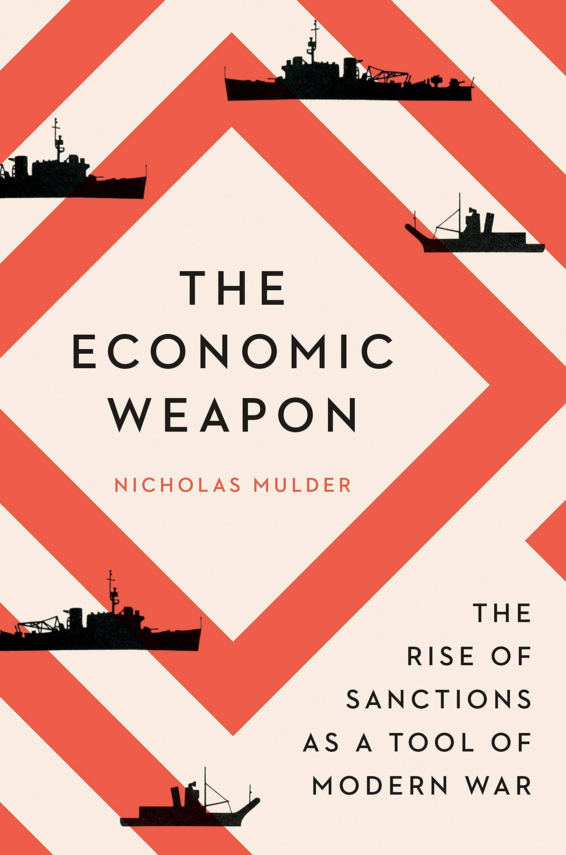
The Economic Weapon: The Rise of Sanctions as a Tool of Modern War
Nicholas Mulder
Assistant Professor of History
Department of History, Cornell University
nicholas.mulder@cornell.edu
Independent Evaluation Office Seminar
International Monetary Fund
Tuesday 17 May 2022

Slide 2
Overview
I. From blockade to sanctions
II. The League of Nations and deterrence in the 1920s
III. Sanctions during the crisis of globalization in the 1930s
IV. Finance and aid: the positive economic weapon
VI. Sanctions and the world economy today: comparisons and contrasts

Slide 3
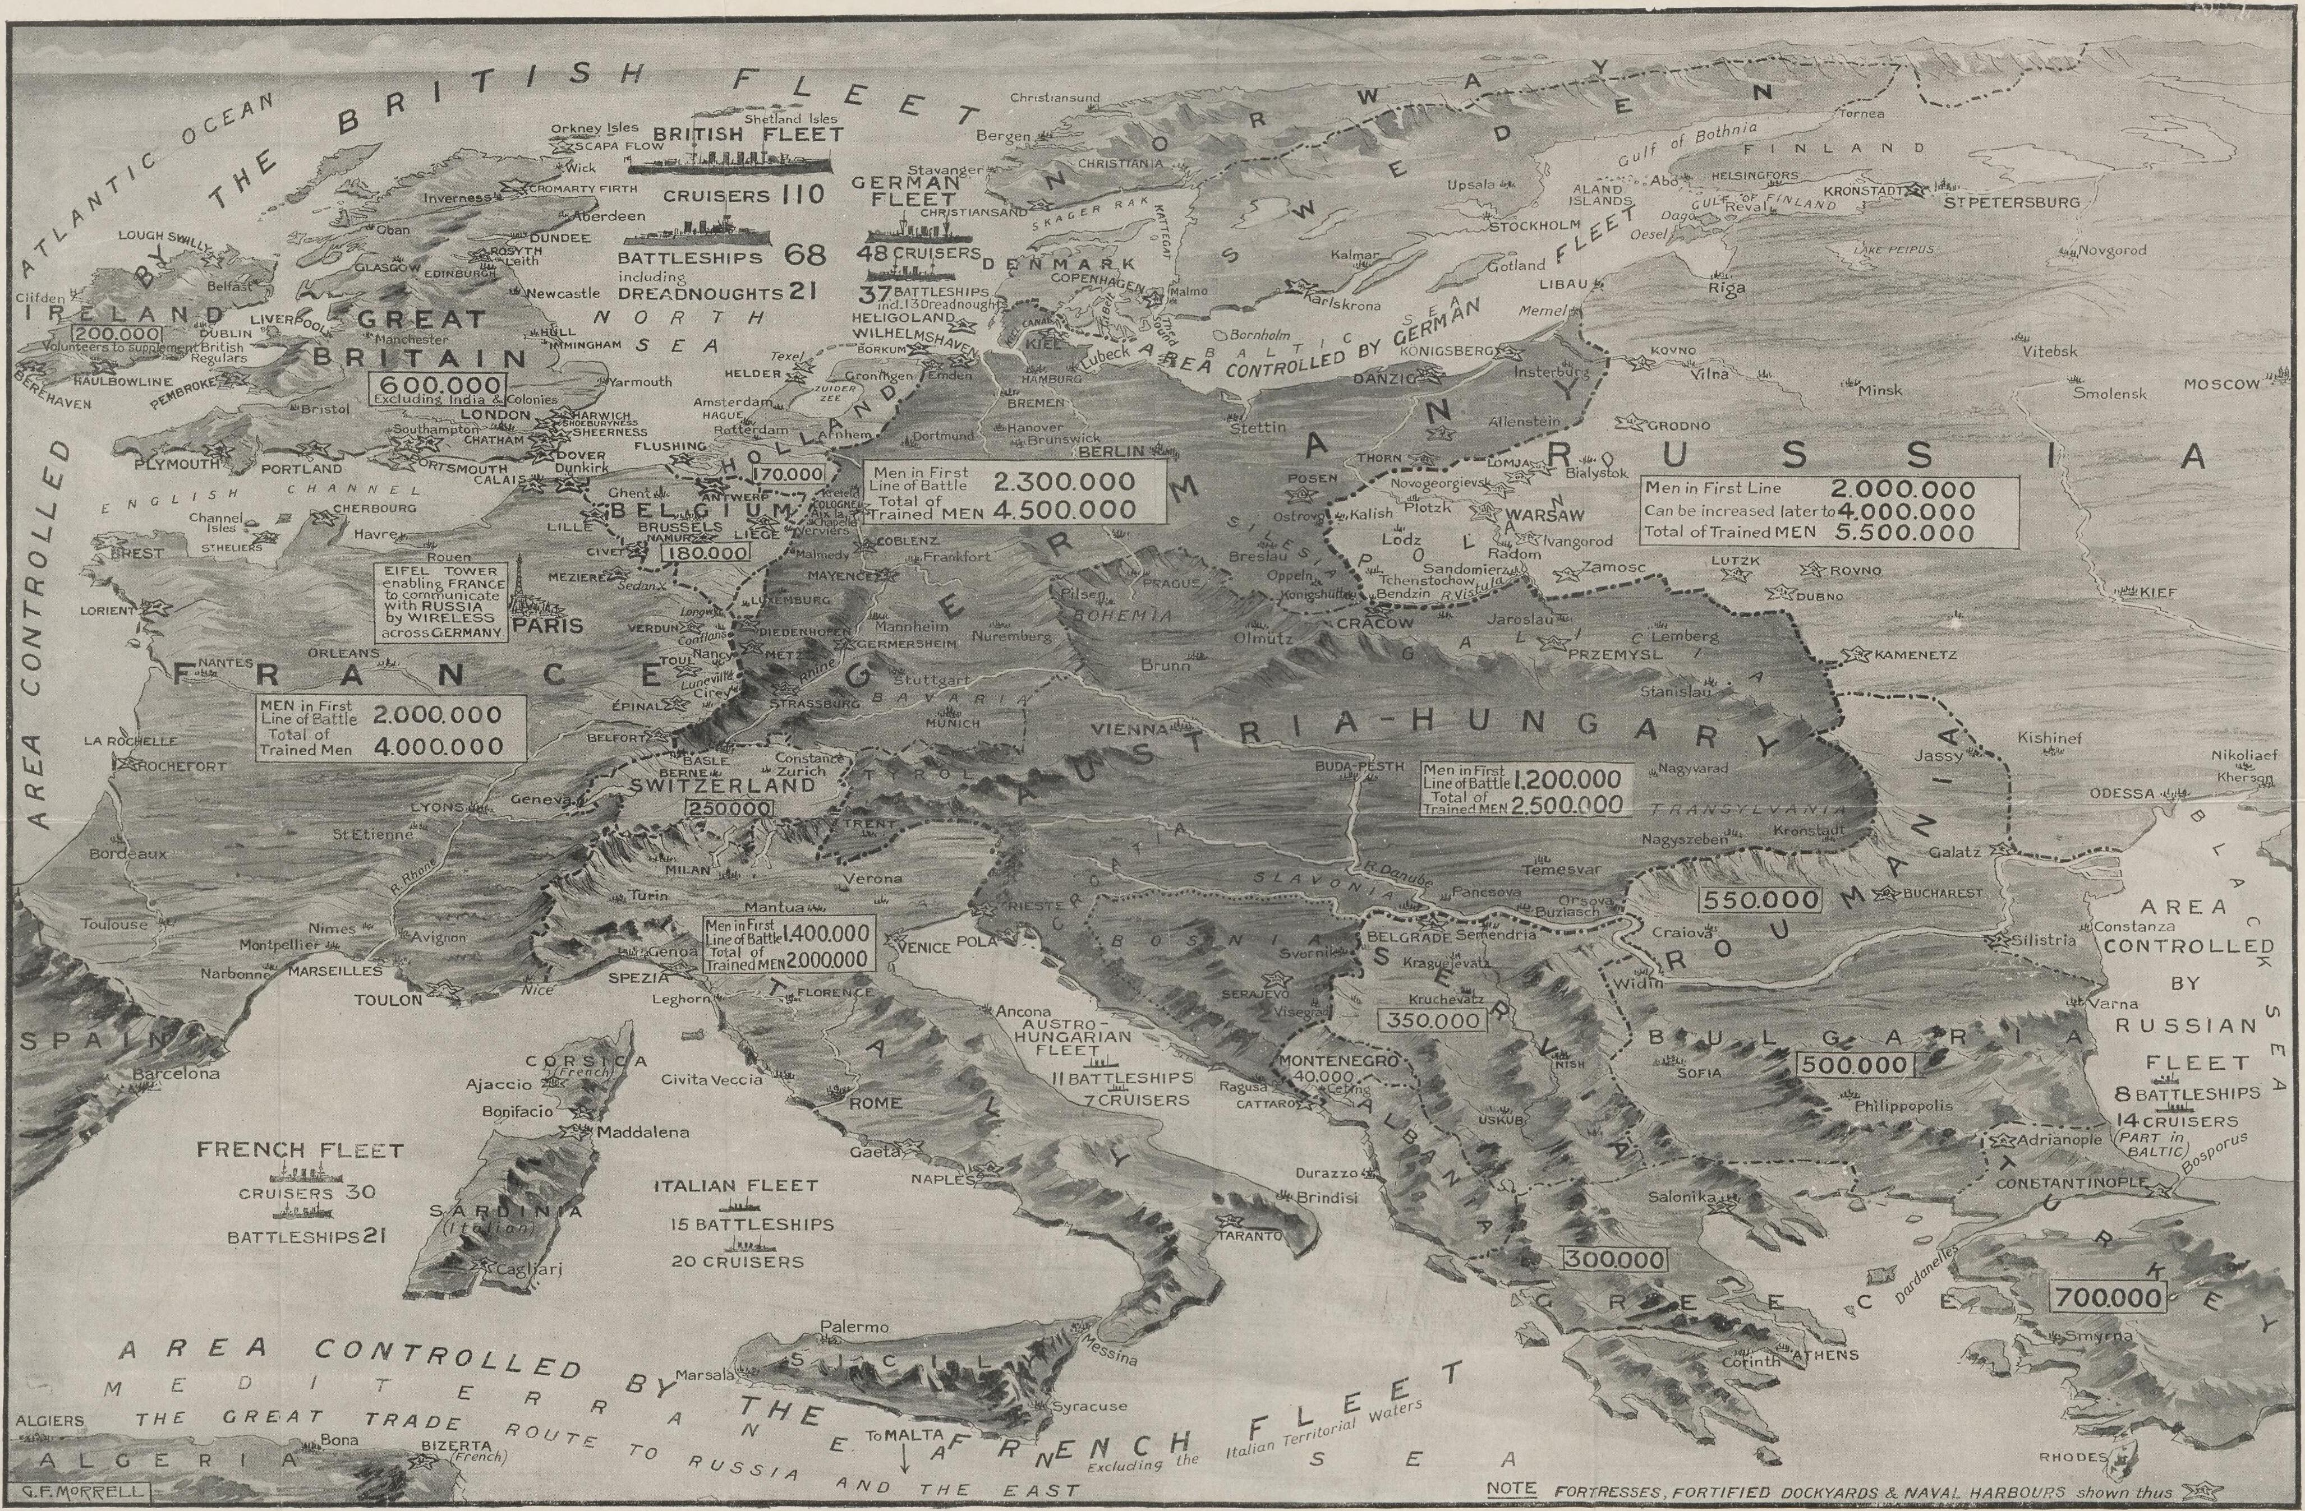
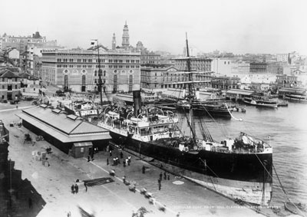
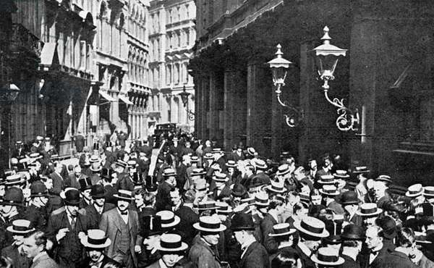
The First World War: blockade in a globalized world economy

Slide 4
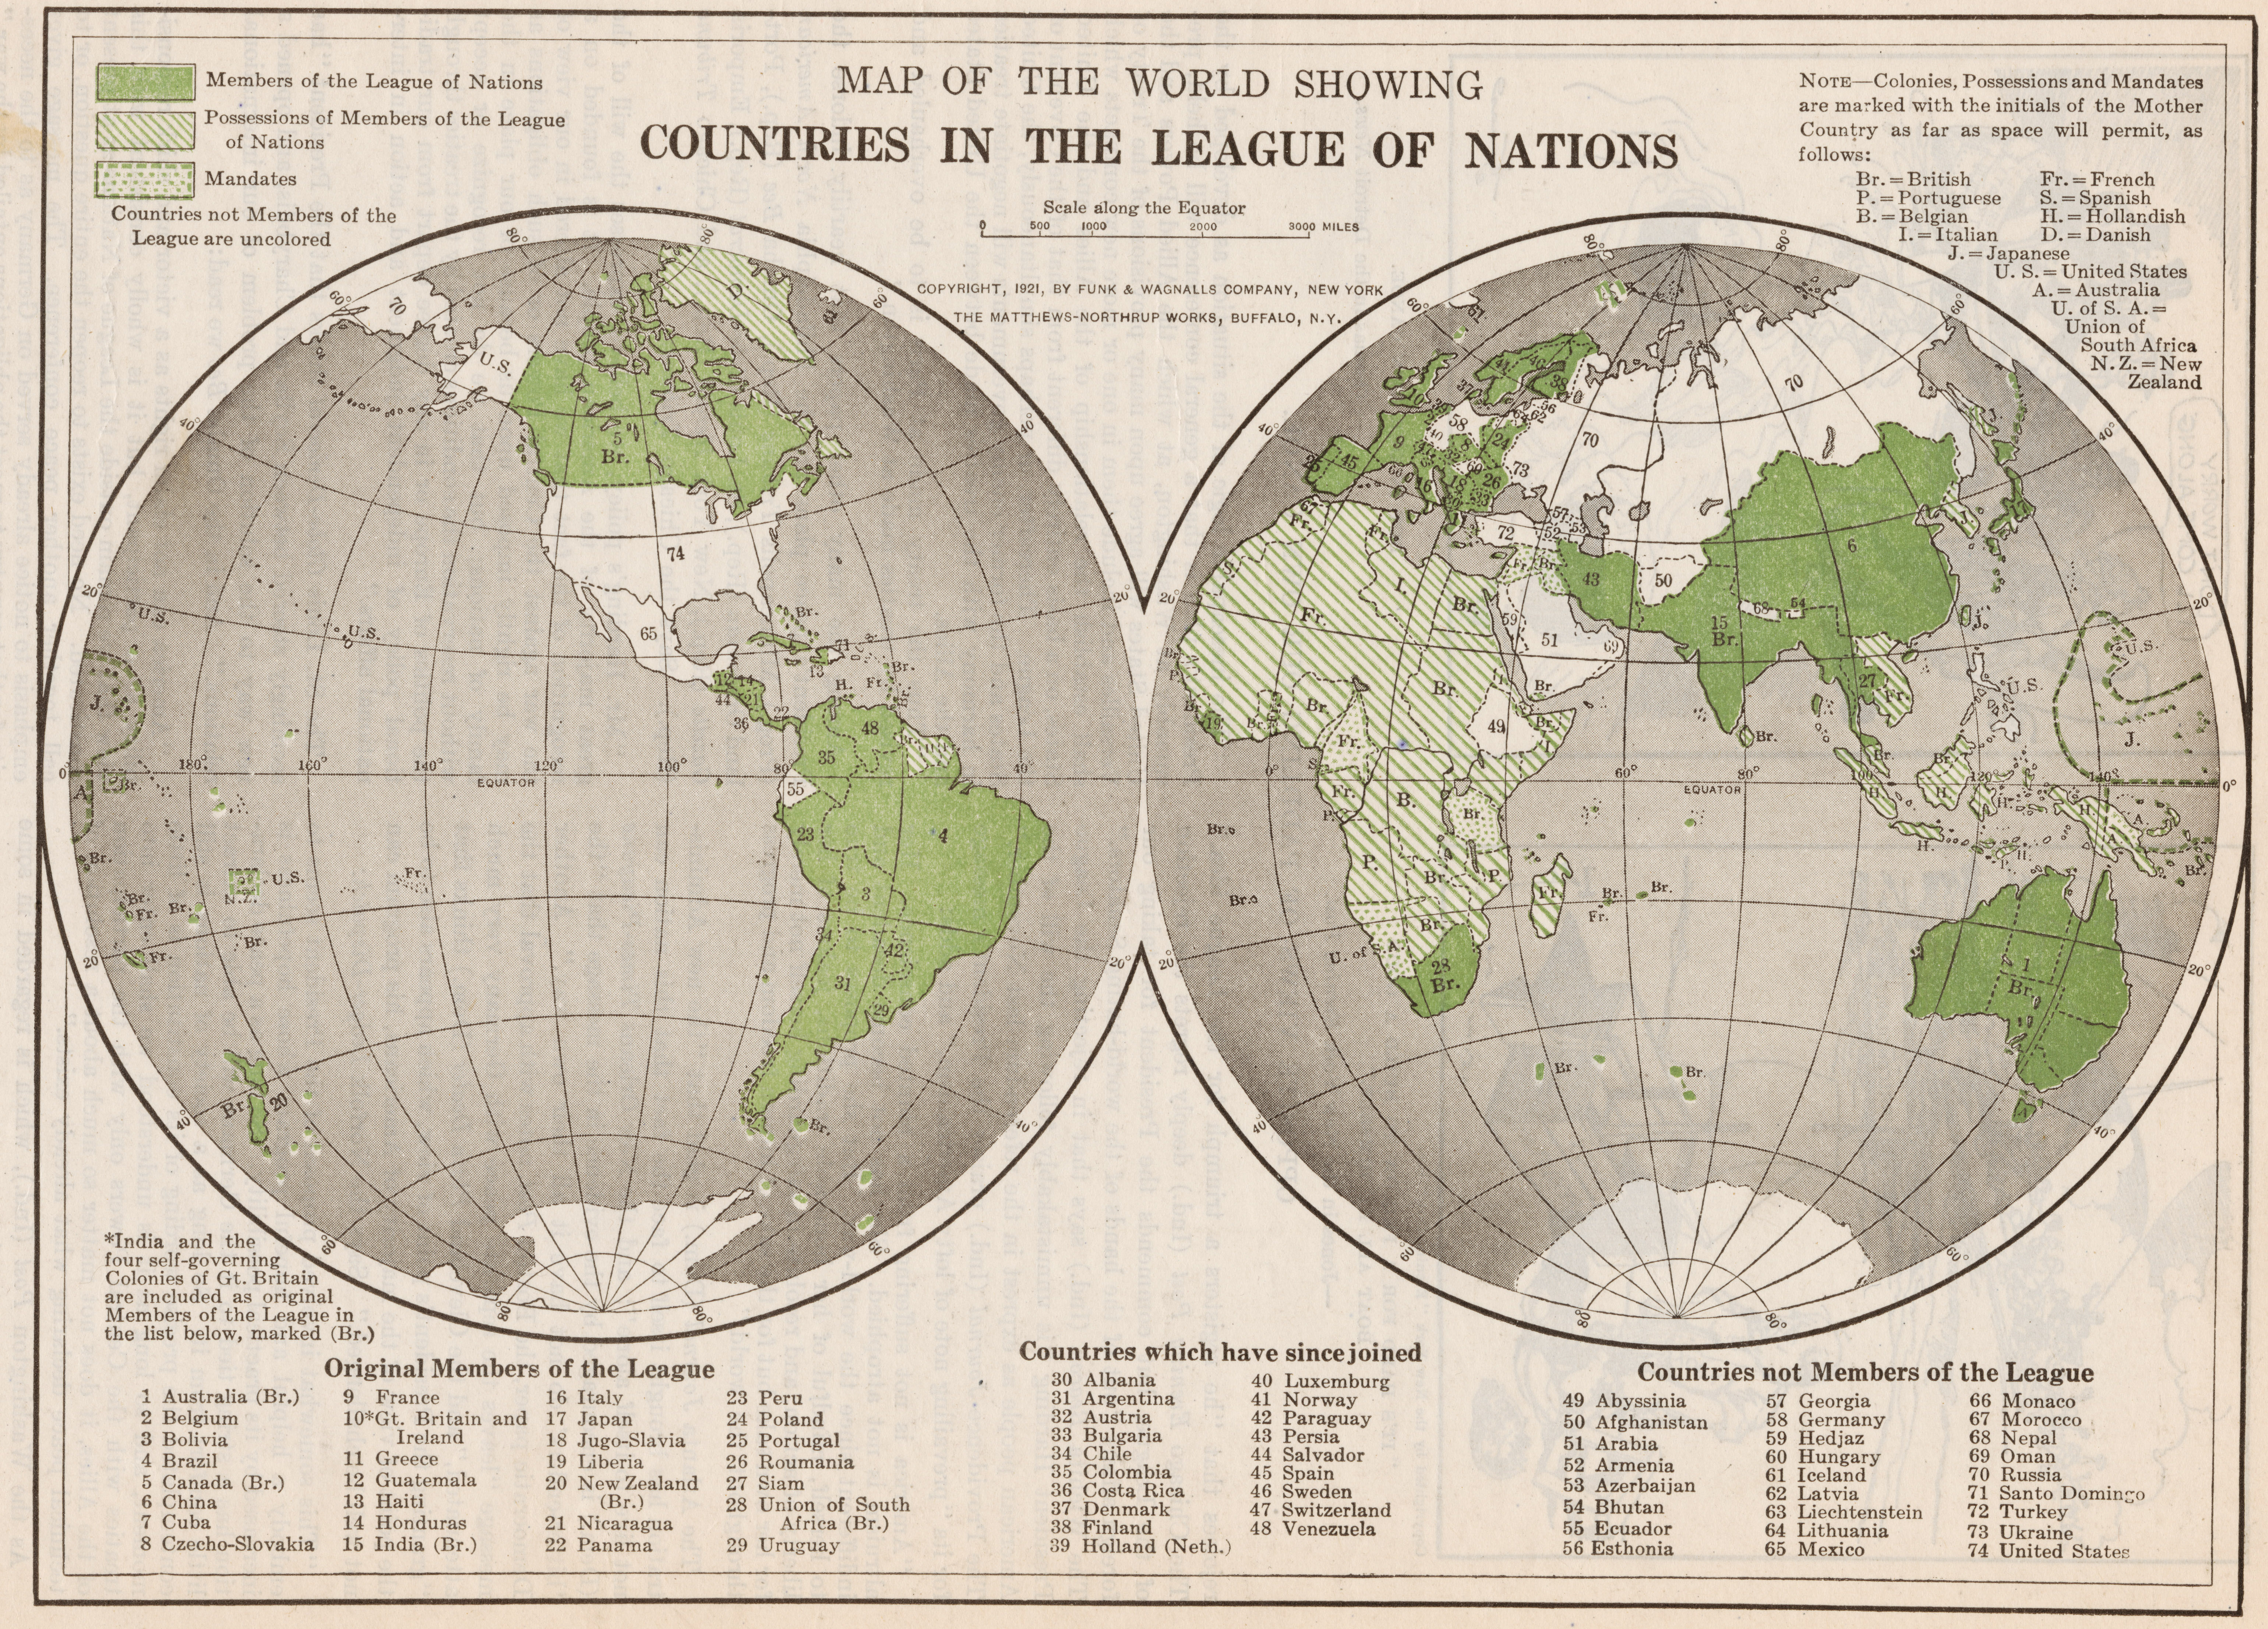
From blockade to sanctions
Article 16 of League of Nations Covenant (1919)
  Negative economic weapon: Sanctions procedure against aggressor
  Positive economic weapon: financial and logistical aid to victims of aggression
Sanctions require national and international coordination
  Administrators in member states (esp. Britain & France)
  Officials in League of Nations Economic & Financial Organization (EFO)
  Statistics as economic information v. strategic intelligence

Slide 5
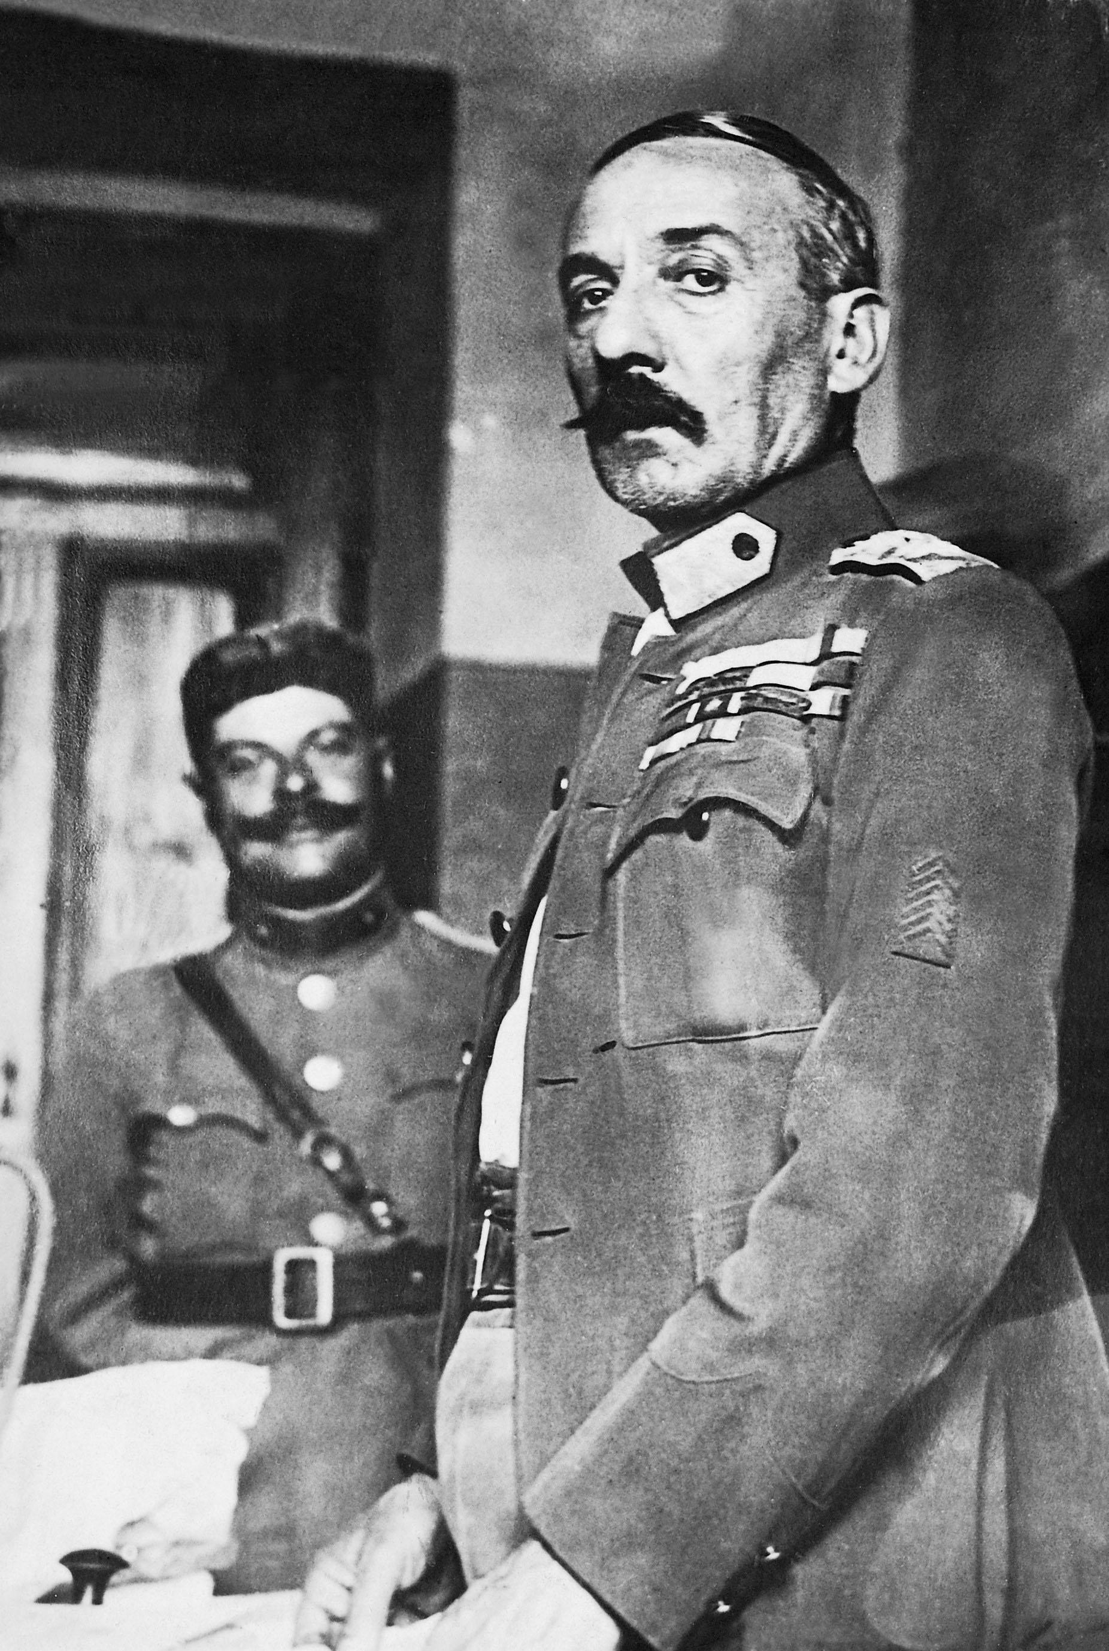
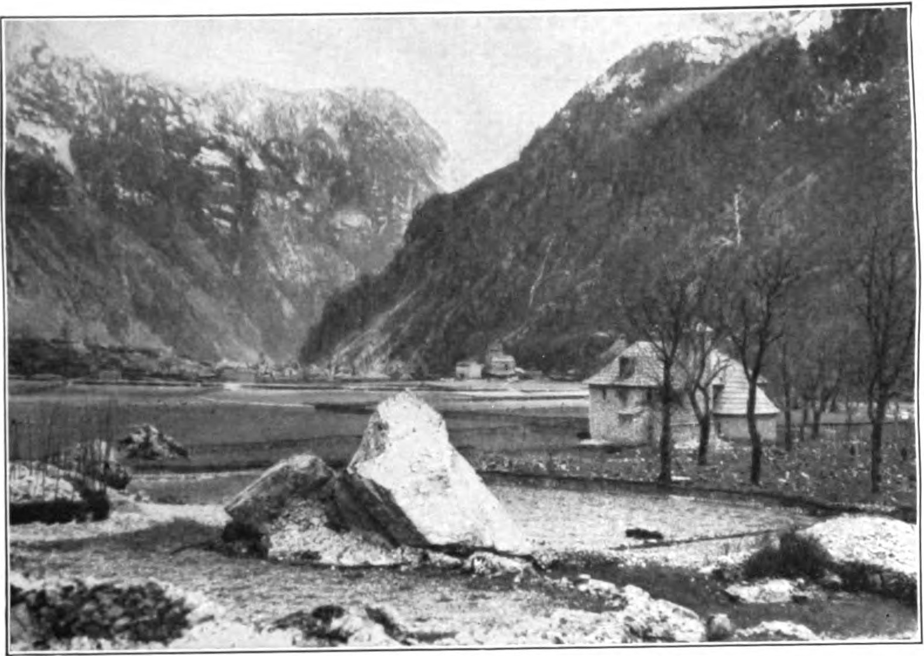
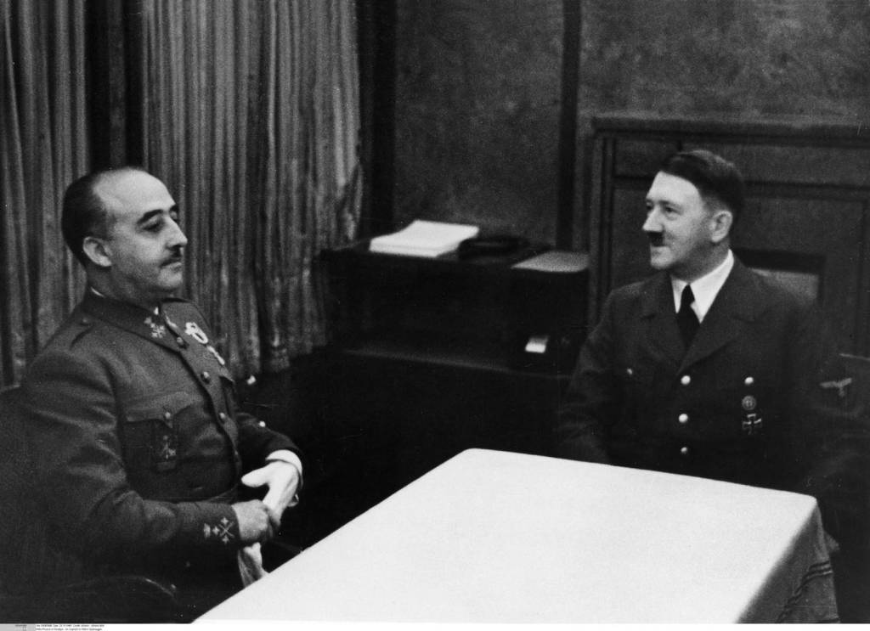
Sanctions as a deterrent: some successes against smaller economies
1.Yugoslavia (November 1921)
2. Greece (October 1925)
3. Spain (August 1940)

Slide 6
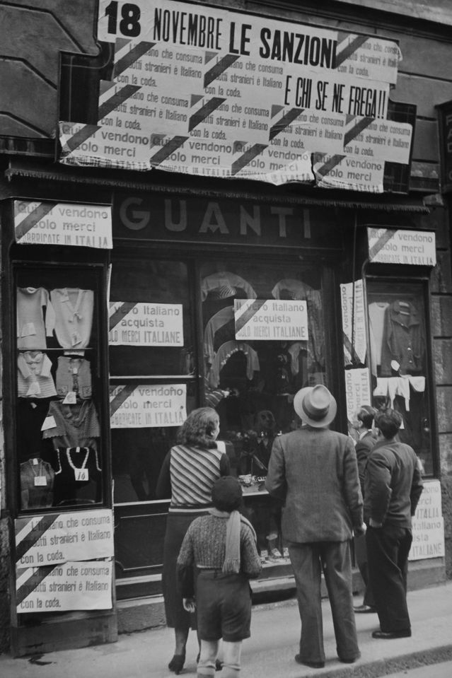
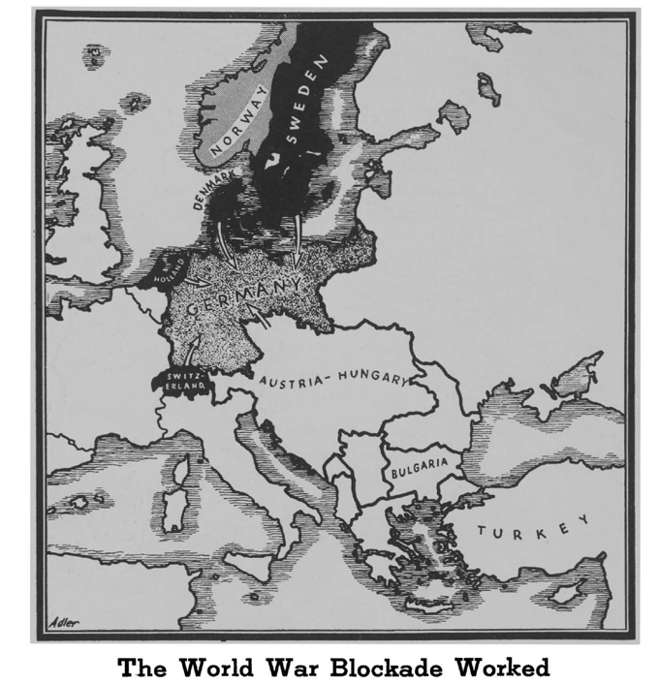
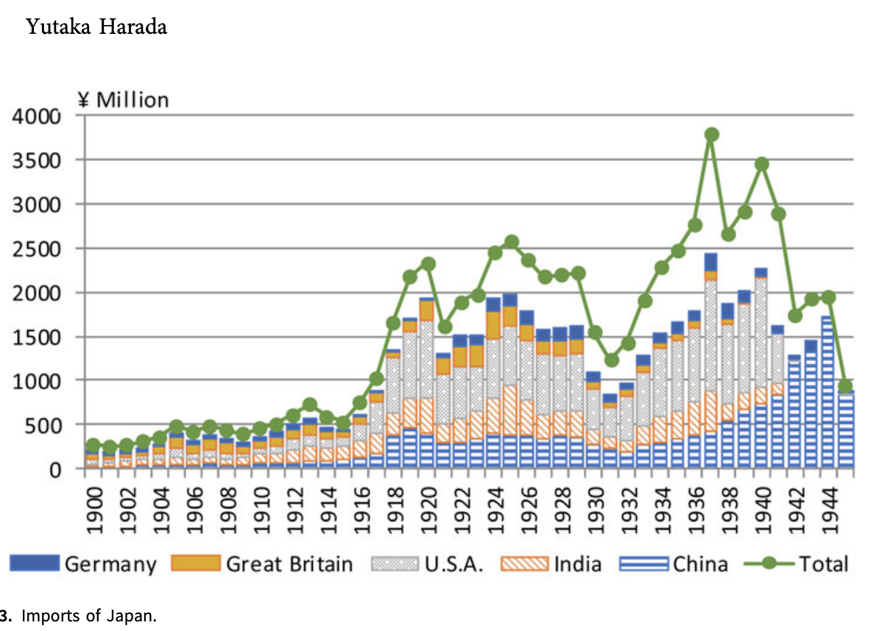
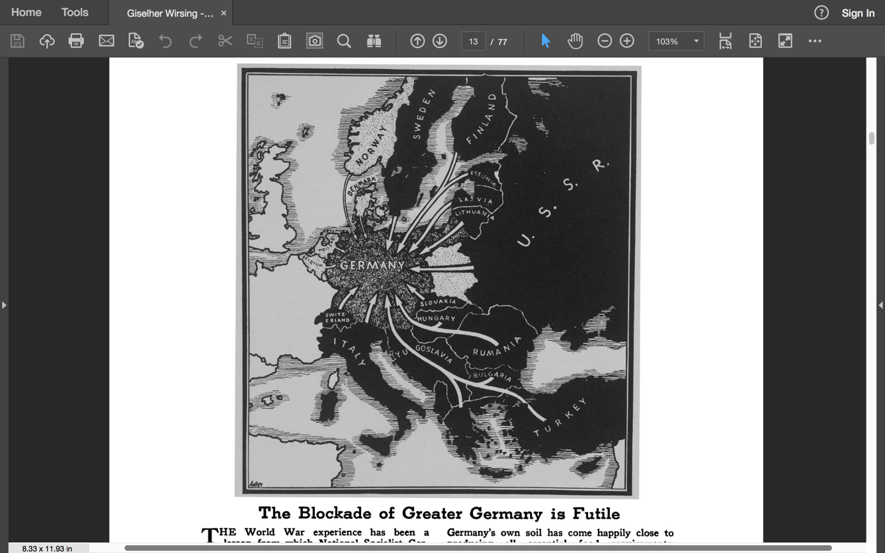
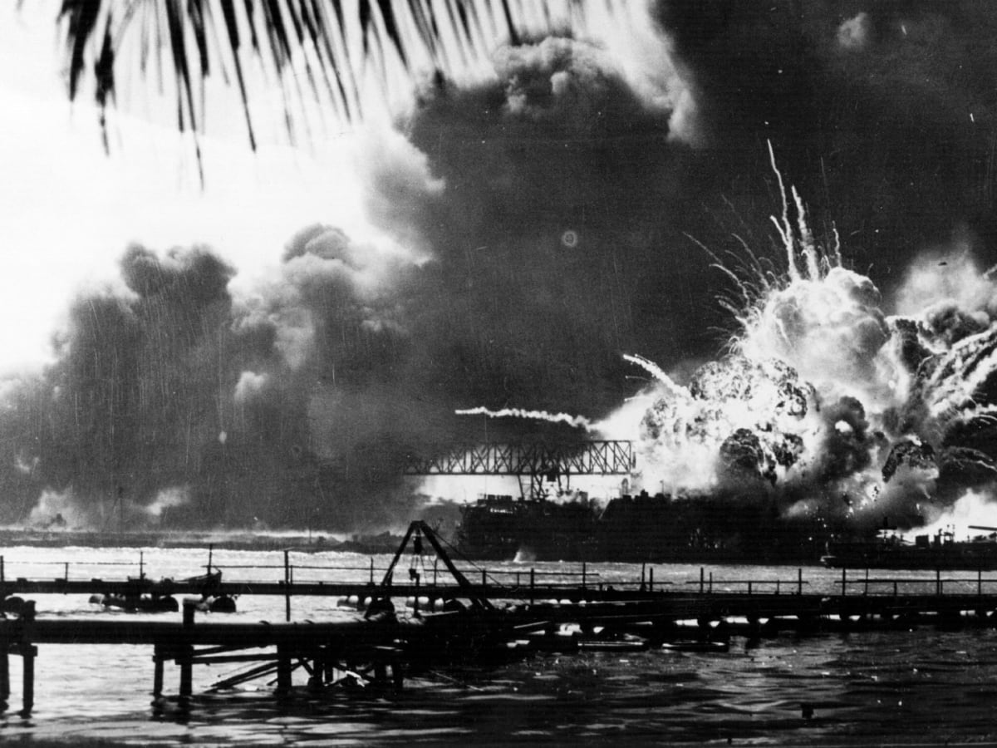
Sanctions in the 1930s: failures & sanctions-autarky spiral
Failure: League sanctions against Italy (8th largest economy in the world) during Italo-Ethiopian War (1935-1936)
Escalation: Nazi Germany (3rd largest economy) accelerates path to autarky (Four-Year Plan)
Backfire: Western sanctions against Japan (7th largest economy) from 1939 onward end with 1941 Japanese attack in SEA-Pacific
(2018)

Slide 7
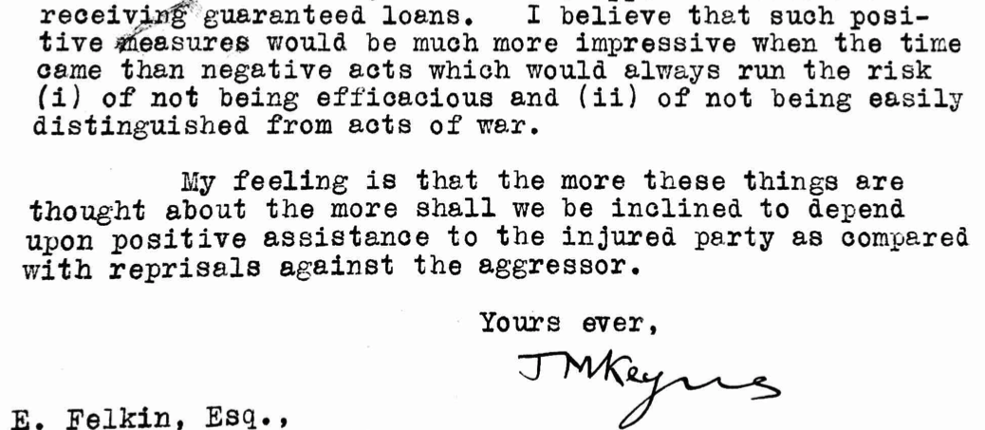
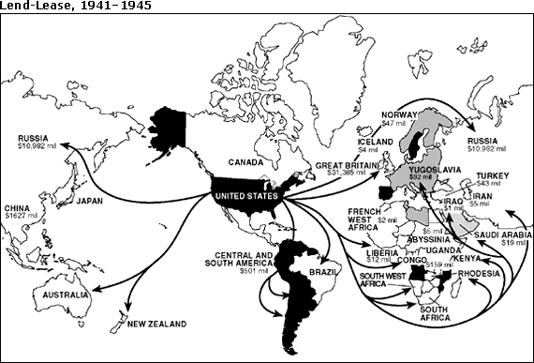
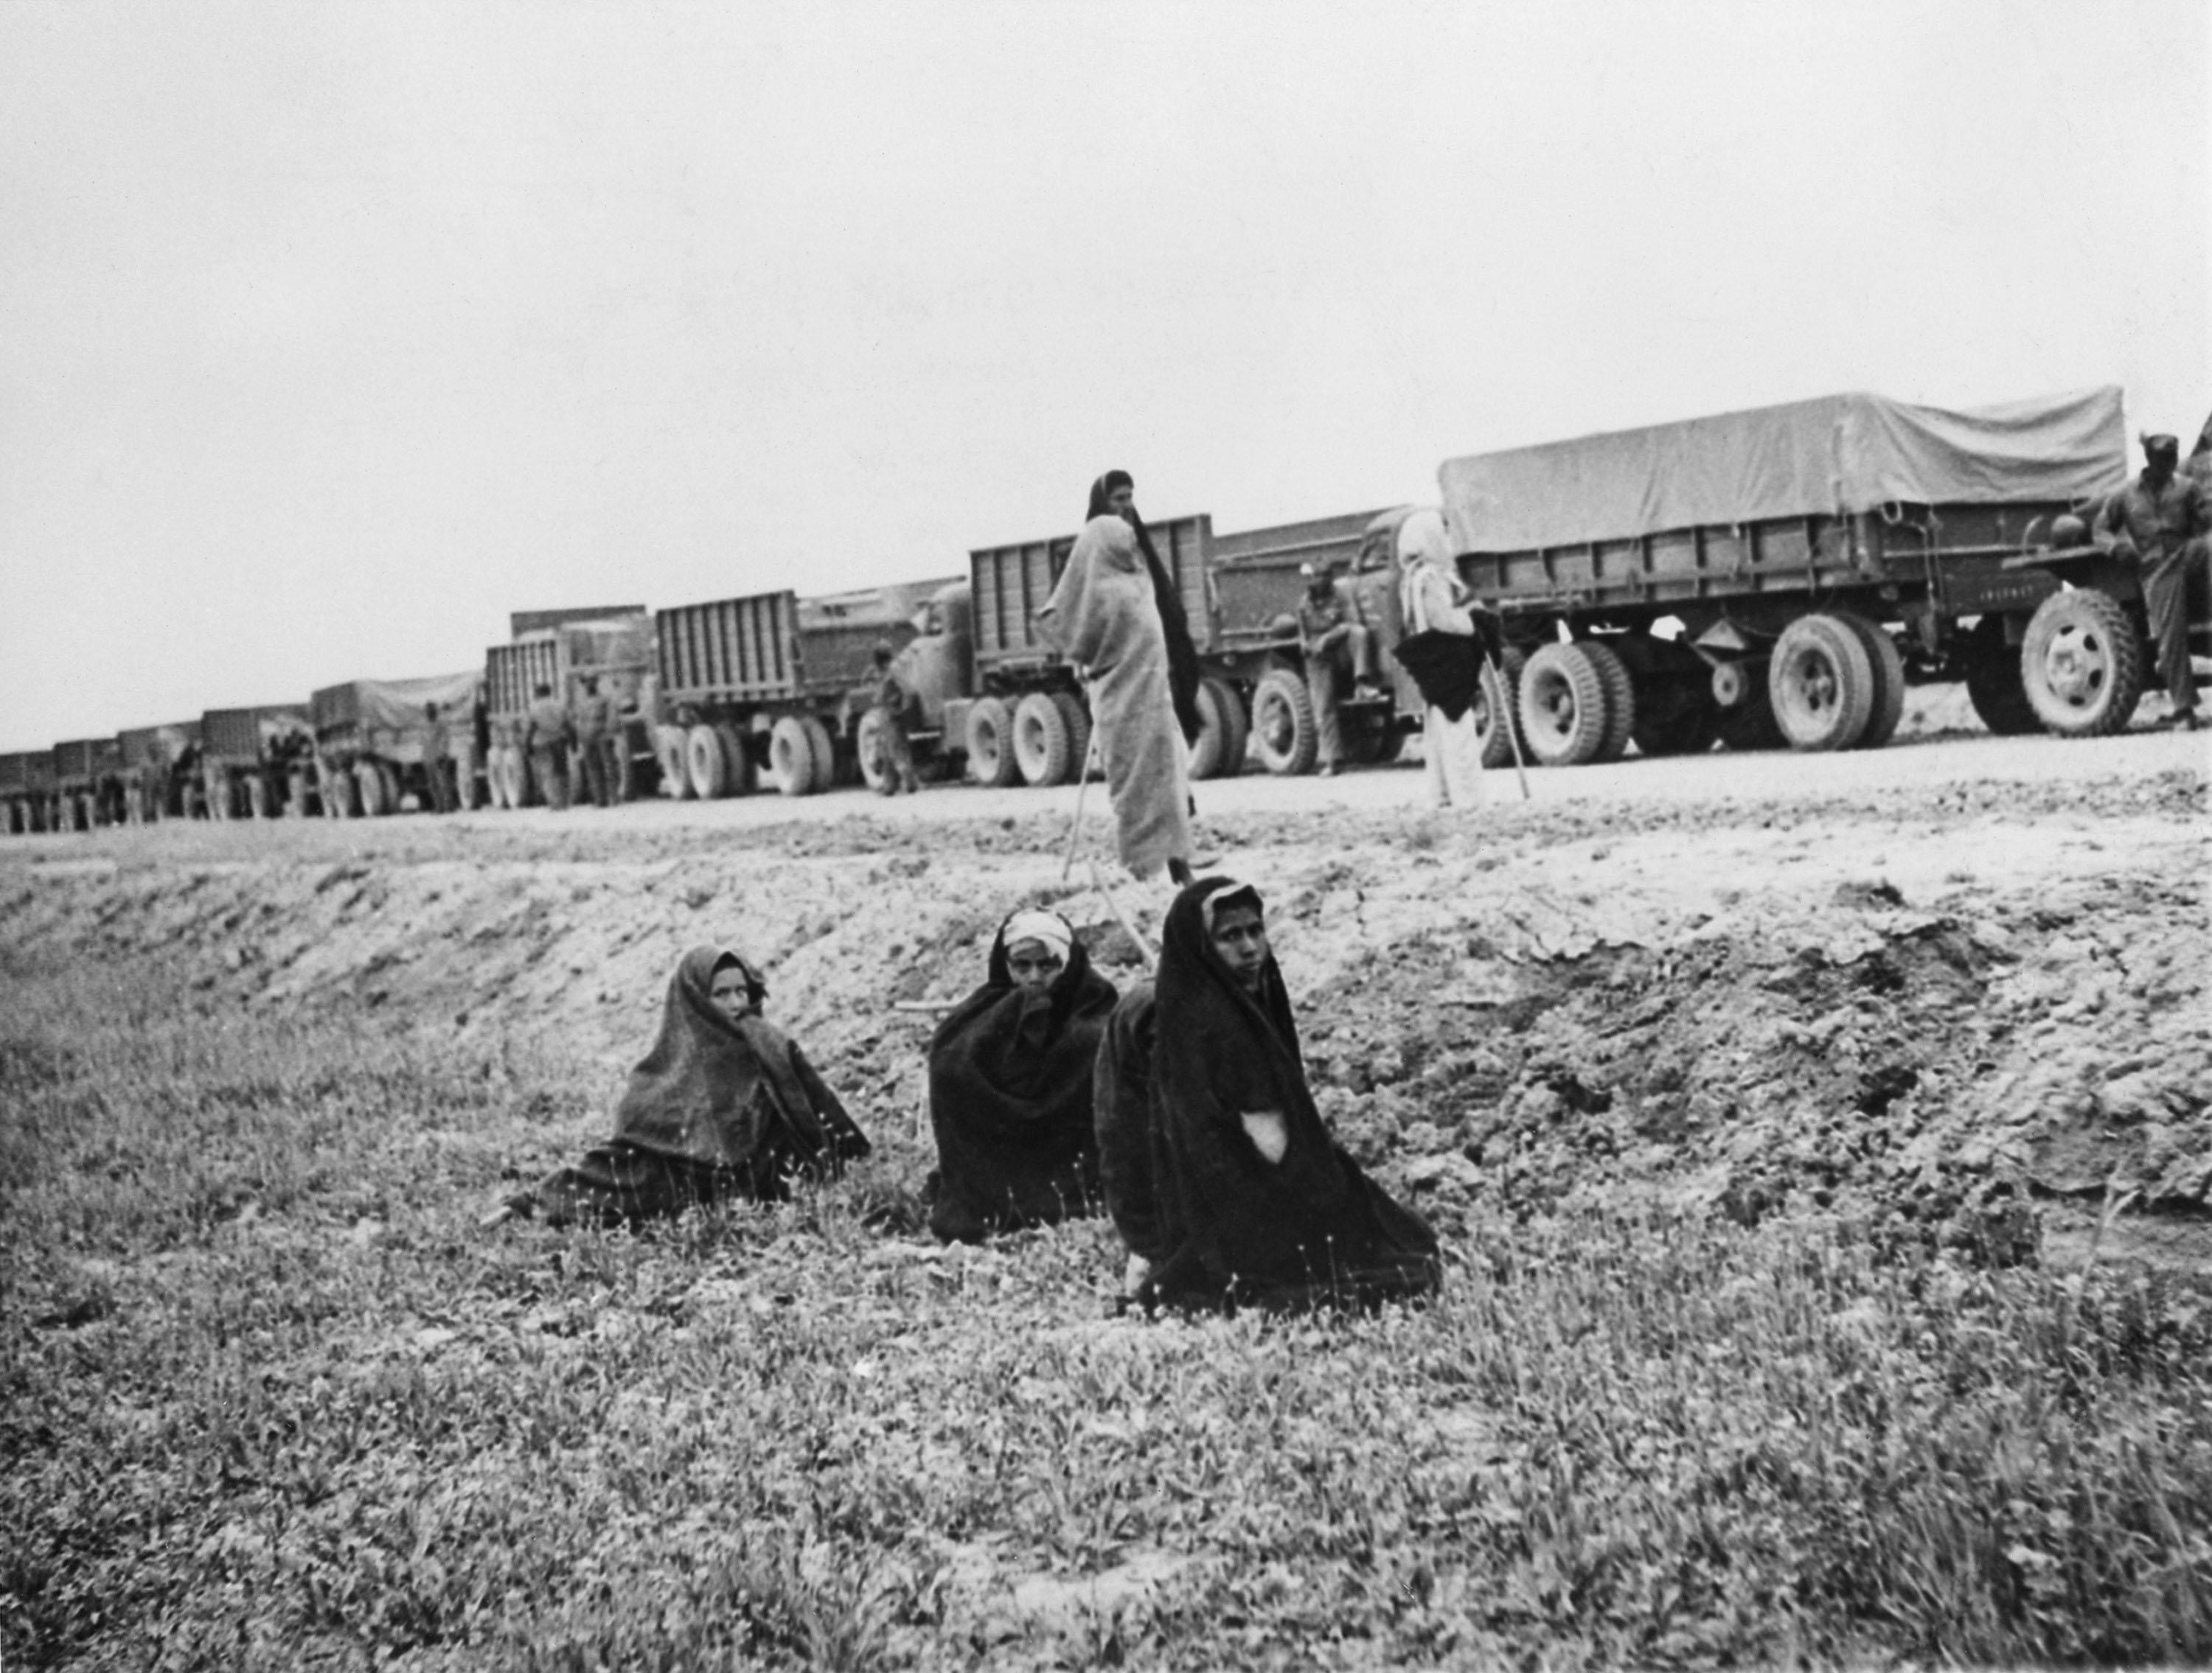
The positive economic weapon
Positive economic weapon (loans, aid and supplies) balance out effects of negative sanctions weapon on the world economy
John Maynard Keynes in 1924: positive assistance to victims better than punishment of aggressors
1930-1932: League’s Convention on Financial Assistance fails due to Depression and budgetary orthodoxy
World War II: $50.1bn (2022: $985bn) Lend-Lease aid provides massive goods, raw materials and services for world economy

Slide 8
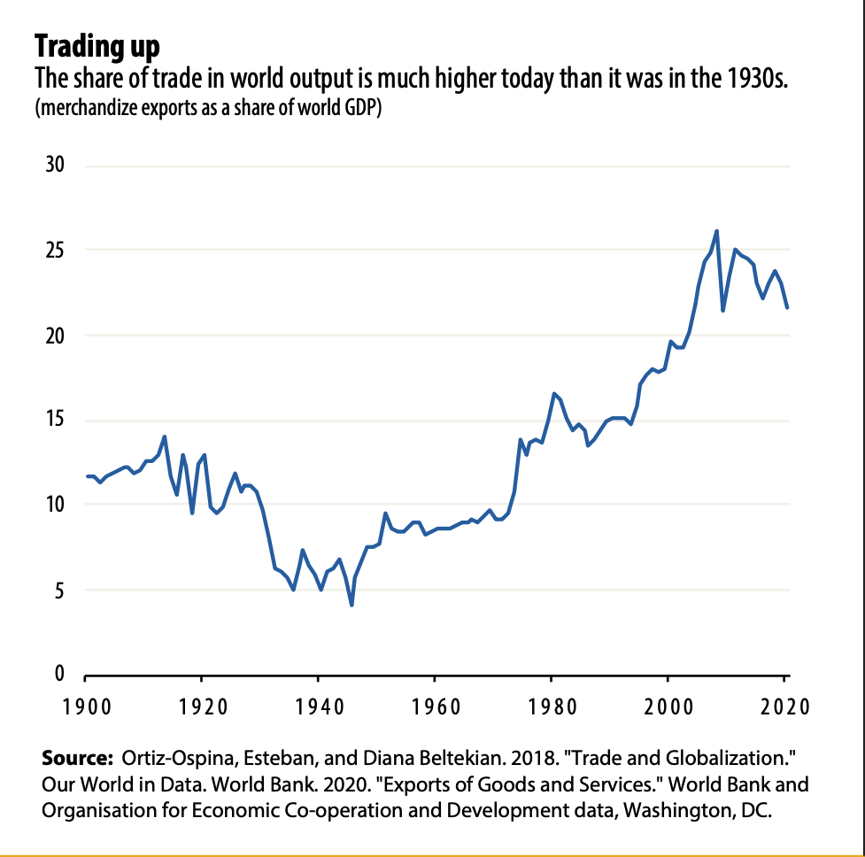
Sanctions and the world economy today
Present-day sanctions against large economies such as Russia unseen in scale since 1930s
Military escalation risks probably somewhat lower
But spillover effects today are larger than before because of increased interdependence & higher trade/GDP ratios
Sanctions interact with the economic conjuncture – timing can enhance or weaken effects:
i) today’s mix of pandemic-caused disruptions, supply-chain fragilities caused by underinvestment in AE, a reversion in the global financial cycle, and EMDE BoP+debt problems make sanctions on 11th-largest economy in the world a major macro shock
ii) commodity price shock
iii) private-sector panic (‘self-sanctioning’) and sanctions hysteresis effects:
a. negative multiplier effect of corporate withdrawal from sectors, transactions potentially under sanctions → short-term shock to global GDP and trade caused by sanctions likely overshoots the scope of official government restrictions
b. medium-term adjustment of sanctions-imposing economies & target economies as trade diversion sets in
c. long-term damage: missed growth, living standards, foreign investors’ fear of re-investment

Slide 9
A positive economic weapon for today?
What kinds of constructive policy exist to offset damage that sanctions do to the world economy?
  1. Supply-side infrastructure investment by advanced economies
  2. Demand-side support for emerging markets and developing economies
  3. SDR expansion to avert EMDE balance-of-payments and debt crises
  4. Food and energy demand management: international coordination through diplomacy better than demand destruction through rapid interest rate hikes
  5. Humanitarian aid channels for food and medicine
  6. Reconstruction for Ukraine + support for Russia after possible sanctions lifting
Large-scale sanctions are a form of economic war, so post-sanctions (world) economy(ies) require support akin to post-war reconstruction: aid and finance

