Slide 1
Comments on Furman and Summers
Charles Wyplosz
The Graduate Institute, Geneva
IMF/IEO webinar on:
“The End of Austerity? Evolution of Views on Fiscal Policy as a Counter-Cyclical Tool”
January 13, 2021

Slide 2
Two sets of comments
The theory
Applicability to the Eurozone
In short
  Thought-provoking paper
  But easily misleading

Slide 3
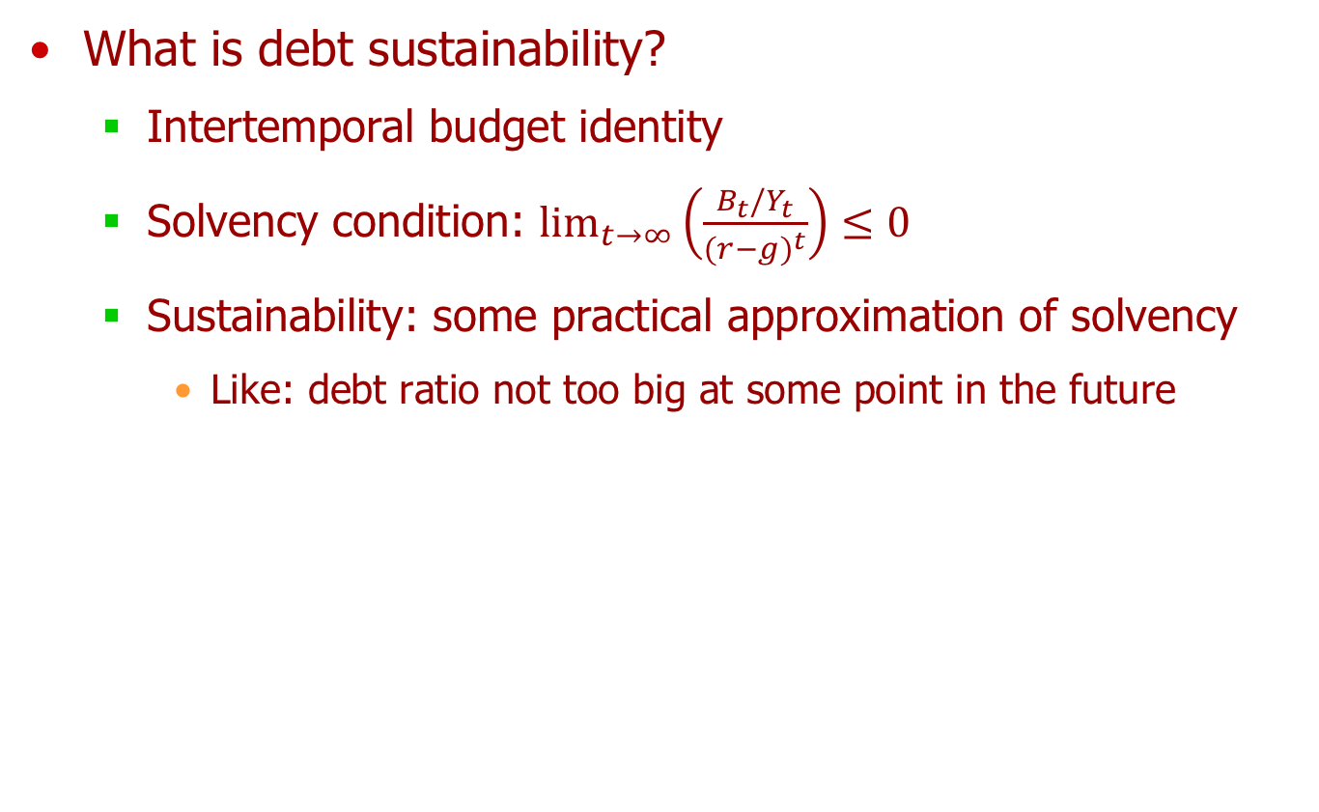
A strange theory: selected observations
What is debt sustainability?
  Intertemporal budget identity
  Solvency condition: $\lim_{t→∞}{{\left(\frac{B_{t}/Y_{t}}{{(r−g)}^{t}}\right)≤0}^{}}$
  Sustainability: some practical approximation of solvency
    Like: debt ratio not too big at some point in the future

Slide 4
Not to big at some point in time?
NC, not SC: not increasing forever

Slide 5
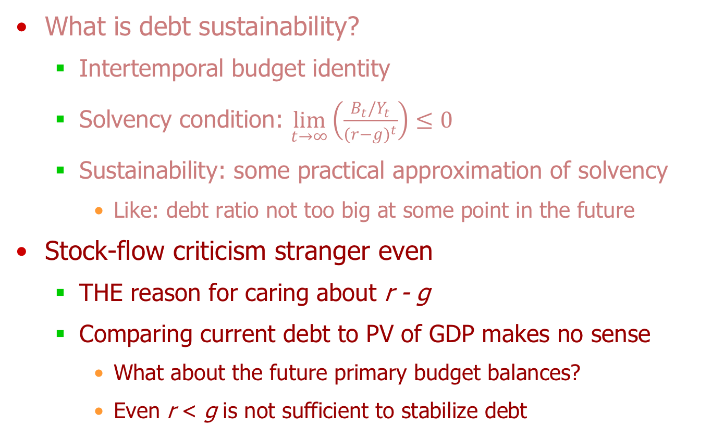
A strange theory: selected observations
What is debt sustainability?
  Intertemporal budget identity
  Solvency condition: $\lim_{t→∞}{{\left(\frac{B_{t}/Y_{t}}{{(r−g)}^{t}}\right)≤0}^{}}$
  Sustainability: some practical approximation of solvency
    Like: debt ratio not too big at some point in the future
Stock-flow criticism stranger even
  THE reason for caring about r - g
  Comparing current debt to PV of GDP makes no sense
    What about the future primary budget balances?
    Even r < g is not sufficient to stabilize debt

Slide 6
The irrelevance of r < g
Not to mention caution with measurement (Reis, 2020; Galbraith, 2020)

Slide 7
Relevance for Eurozone
Agree that now is not the time to worry about sustainability
  But we know that, at some point in time, markets will worry
  We have been there in 2010-11, ECB is not Fed
Stability Pact suspended until end of 2021
  Either it is fixed by then, or we are back with deeply flawed rule
  Time to explain what a good rule looks like

Slide 8
What a good rule looks like
US experience/reasoning irrelevant
  Extremely poor experience at Federal level, including PAYGO (Auerbach, 2008)
  Extremely poor rules at State level: no stabilization
What’s wrong with Stability Pact
  Complex mix of arbitrary and largely incompatible rules
  Result: procyclical fiscal policies and debt crisis
Key principles
  One target: debt ratio in the long run (cf CBO)
  One instrument: path of primary budget balances
  Enforcement (not discussed here)

Slide 9
This paper will not help
Promising r – g < 0 is wrong starting point
  No empirical basis
  Just a few years of r – g > 0 can trigger bad equilibrium
5% probability to be here
Markets won’t wait

Slide 10
This paper will not help
Promising r – g < 0 is wrong starting point
  No empirical basis
  Just a few years of r – g > 0 can trigger bad equilibrium
Adding interest payment “guidepost” to existing rules will make it worse
  Without going into details of proposed computation
“Golden” rule will make every item of public spending a profitable investment

